Slide 1
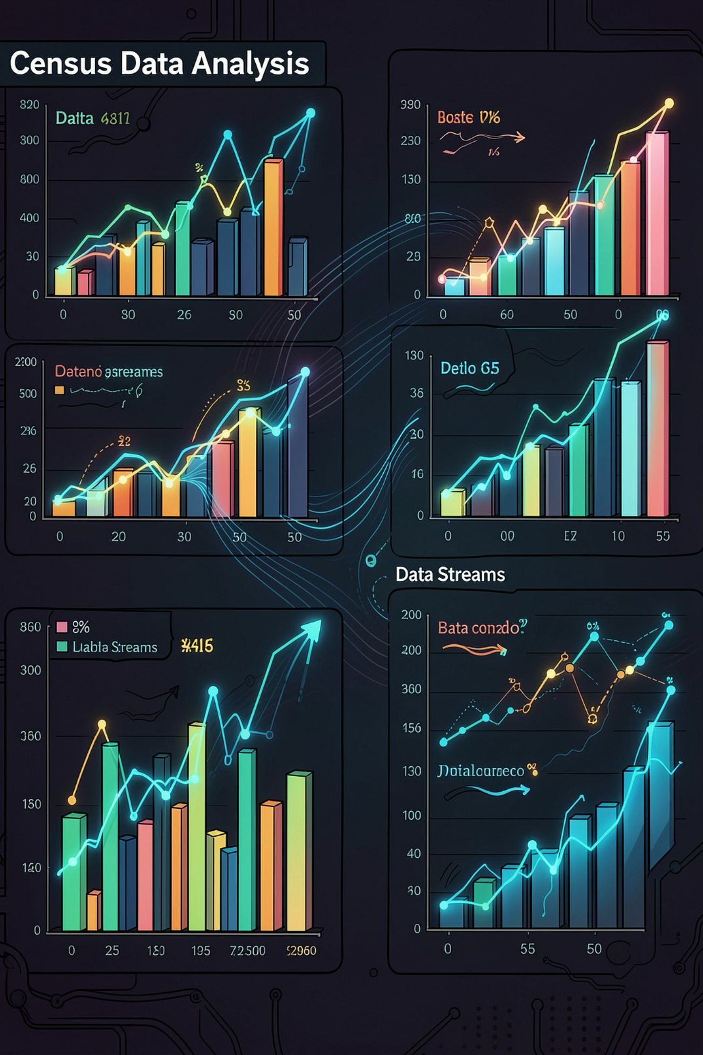
Adult Census Income Analysis
Data Analytics Project
COURSE: BCA
SUBJECT: DATA ANALYTICS

Slide 2

Introduction
The Adult Census Income dataset contains demographic and employment data for individuals.
Key variables include age, education, occupation, workclass, gender, working hours, capital gain, capital loss, and income.
The target variable classifies income as <=50K or >50K annually.
32,561
32,537
Initial Rows
Final Rows
Before data cleaning
After cleaning
15
Columns
Variables per record

Slide 3

Business Problem
Income levels can vary depending on factors such as education, occupation, age, workclass, and working hours. Understanding these factors can help identify patterns in income levels and differences between people earning <=50K and >50K annually.
"To analyze the Adult Census Income dataset and identify patterns and factors associated with whether an individual earns <=50K or >50K annually."

Slide 4
Objective & Expected Outcome
Project Objectives
Expected Outcome
To identify the key factors that are associated with income levels and understand the patterns between individuals earning <=50K and >50K annually. The analysis will provide clear insights through charts and visualizations.
Analyze the Adult Census Income dataset.
Understand income distribution across categories.
Study the relationship between education and income.
Analyze the relationship of age, occupation, workclass, gender, and working hours with income.
Identify key patterns using visualizations.

Slide 5

Data Cleaning
Raw Dataset
Missing Value Handling
Duplicate Removal
Data Verification
The cleaning pipeline addressed missing values, duplicates, and data type verification to produce a reliable dataset for analysis.
Missing Values
Duplicate Removal
Verification
Replaced "?" with NaN. Filled categorical columns using mode: workclass → Private, occupation →
Prof-specialty, native.country → United-States
Found and removed 24 duplicate rows to
ensure each record is unique
Checked data types and used describe() for a
numerical summary of all columns
Before cleaning: 32,561 rows
24 duplicate rows removed
After Cleaning: 32,537rows

Slide 6




Exploratory Data Analysis
EDA helps uncover patterns, distributions, and relationships within the cleaned dataset before drawing conclusions. Visualizations were used throughout to make findings easier to interpret.
Distribution Analysis
Working Hours
Income, age, workclass, education, gender, and occupation distributions
Hours worked per week across the dataset
Education vs Income
Correlation & Outliers
Relationship between education levels and income categories
Correlation analysis and age outlier detection

Slide 7
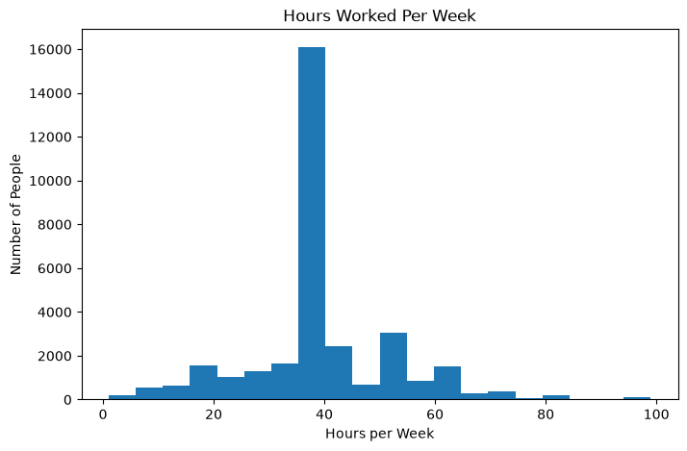
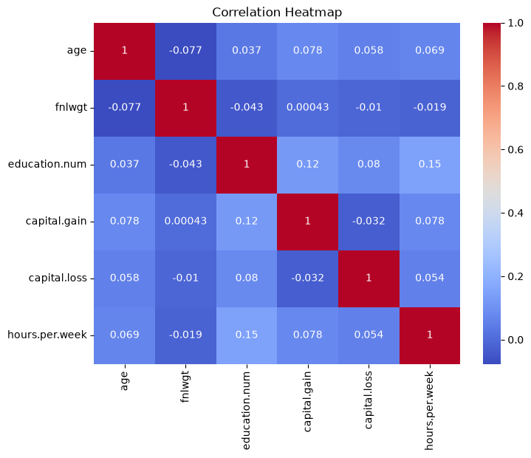
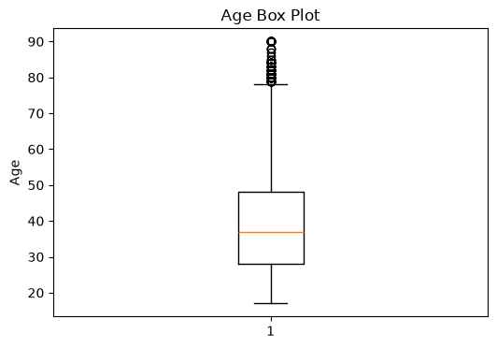
Numerical Analysis
Hours per Week
Correlation Heatmap
Age Box Plot
Observation: Most individuals work around 40 hours per week. The distribution shows that 40 hours is the most common working time.
Observation: The heatmap shows the relationships between numerical variables. Education level and hours worked have a positive relationship, while most other variables have relatively weak correlations.
Observation: The median age is around 37 years. The box plot also shows some higher-age values as outliers,
mainly around 80–90 years.

Slide 8
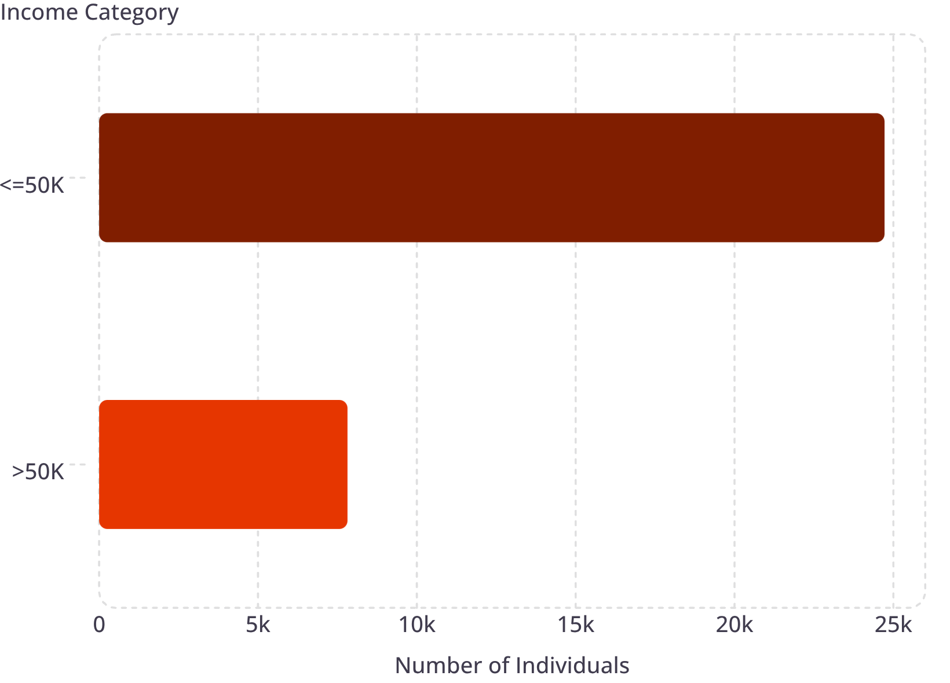

Income Distribution
Key Finding
Most individuals belong to the <=50K income category, while a smaller proportion earns >50K annually.
Approximately 76% of individuals earn <=50K, while 24% earn >50K.

Slide 9
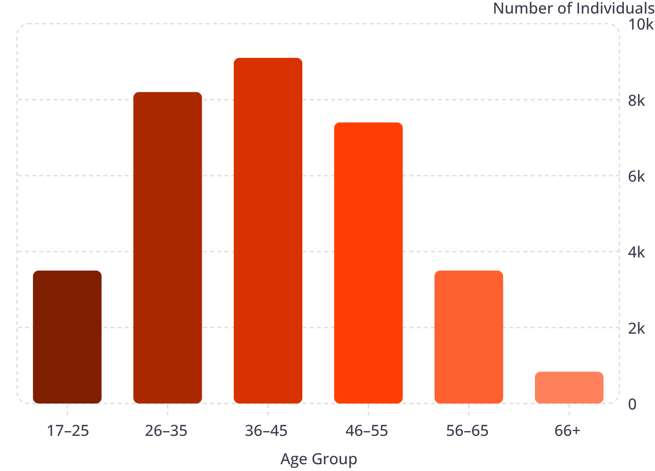
Age and Working Hours Analysis
Key Findings
Individuals range from 17 to 90 years old
The largest groups are in the 36–45 and 26–35 age brackets
Most people work around 40 hours per week
Age distribution reflects a predominantly working-age population

Slide 10
Workclass Distribution
Private is the largest workclass.
Government workclasses have smaller counts.
Without-pay and Never-worked contain very few records.

Slide 11
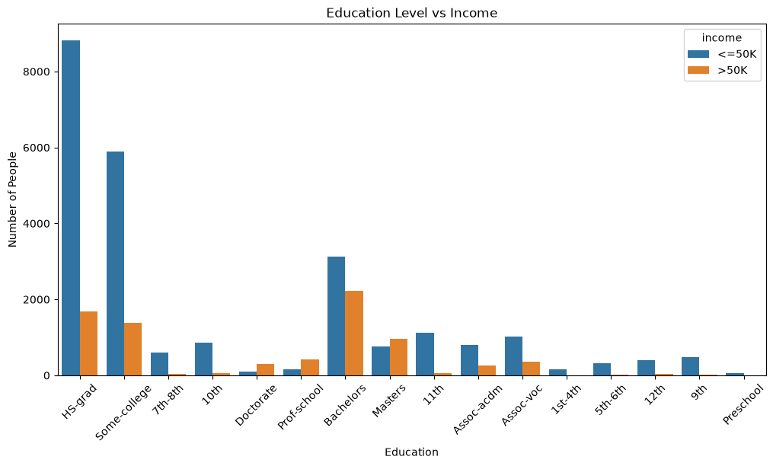
Education Distribution & Income
Key Findings
HS-grad is the most common education level in the dataset
Some-college and Bachelors are also well-represented
Higher education levels generally have more individuals in the >50K income category.
Education level appears to be related to income

Slide 12
EDA Questions & Key Findings
Questions explored:
1. What is the income distribution?
→ Most individuals earn <=50K, while a smaller group earns >50K.
2. Which workclass has the most individuals?
→ Private is the largest workclass.
3. What is the age distribution?
→ Individuals range from 17 to 90 years, with most in the working-age groups.
4. How many hours do people usually work?
→ Around 40 hours per week is the most common.
5. Does education relate to income?
→ The analysis shows that education level appears to be related to income, with higher education levels generally having more individuals in the >50K category.
6. Are there unusual age values Why used nan?
→ The box plot shows some higher-age values around 80–90 years as outliers.
7. Why did you replace ‘?’ with NaN ?
→. ‘?’ was used to represent missing values. I replaced NaN so pandas could identify and handle those missing values properly.
12

Slide 13
Suggestions
Based on the analysis, the following suggestions can be made:
Focus on education: Higher education appears to be associated with higher income, so skill development and higher education may improve earning opportunities.
Improve job skills: Professional and technical skills can help individuals access better-paying occupations.
Career planning: Students and job seekers can consider occupations and education paths associated with higher income levels.
Use data for workforce planning: Organizations can use demographic and employment data to understand income patterns.
Further analysis: Future analysis can examine income using additional factors such as occupation, age, workclass, gender and working hours together.
13

Slide 14
Conclusion
The Adult Census Income dataset was successfully cleaned and analyzed.
24 duplicate rows were removed and missing values were handled.
EDA and visualizations helped identify important income-related patterns.
Most individuals belong to the <=50K income category.
Private is the largest workclass.
Education level appears to be related to income.
Overall, the project demonstrates how data cleaning, EDA and visualization can be used to understand income patterns.
14

