Slide 1


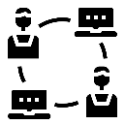

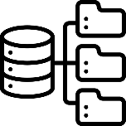

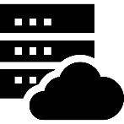

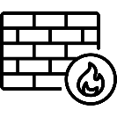

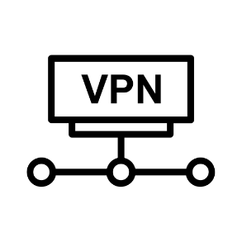

DMZ
Intranet
Private Network
Router
Workstation
Portable Device
Access Control
Database Server
IDS/IPS
Portable Device
Access Control
File Server
Workstation
Router
Application Server
Firewall
Internal Firewall
Internal Firewall
Web Server
Application Server
Database Server
Workstation
Application Server
Layer 1
(Asset value = 500)
Layer 2
(Asset value = 1000)
Layer 3
(Asset value = 1500)

