Slide 1
VIT CHENNAI • DBMS PROJECT REVIEW I
Database Users & Roles Simulator
and Trigger Visualizer
Simulating dynamic Role-Based Access Control and autonomous trigger-driven workflows for a secure core banking system
TEAM
STUDENT
GUIDE
MICHAEL
M. Sakthi Sundar (25BCE1244)
Dr. Swaminathan A

Slide 2
THE CHALLENGE
02
Problem Statement
Managing secure, granular access control and enforcing strict financial workflows in modern banking systems is highly complex.
01
RBAC Isolation
Dynamic Role-Based Access Control securely isolates sensitive banking data by role.
This project addresses that challenge on two fronts: visualizing how Role-Based Access Control isolates sensitive data, and demonstrating how invisible database triggers enforce compliance in real time.
02
Autonomous Triggers
Database triggers enforce compliance, prevent fraud, and maintain audit trails without front-end logic.
Database Users & Roles Simulator and Trigger Visualizer | Project Review I

Slide 3
GOALS
03
Project Objectives
Simulate a highly secure Core Banking environment using dynamic Role-Based Access Control (RBAC).
Develop real-time UI components to visualize background trigger executions and their impact on data.
1
4
Enforce financial rules and state-machine workflows, such as loan approvals, strictly at the database level.
Deploy the secure simulator on a public cloud platform for live demonstration.
2
5
Dynamically query and visualize database privileges directly from PostgreSQL system catalogs.
3
Database Users & Roles Simulator and Trigger Visualizer | Project Review I

Slide 4
DESIGN
04
System Architecture
Frontend — UI / UX Routing
Streamlit (Python) drives dynamic user interaction and visualizes execution paths.
Backend — Data & Security
PostgreSQL (Neon Serverless) handles data storage, constraint enforcement, and business logic.
Security Layer
Python intercepts invalid inputs pre-transmission; PostgreSQL strictly enforces table/column-level grants.
Workflow Engine
Database triggers act as an invisible, tamper-proof state machine validating every transaction.
Database Users & Roles Simulator and Trigger Visualizer | Project Review I

Slide 5





SCHEMA
05
Database Design — Core Banking Tables
customer_profiles
customer_accounts
daily_transactions
Manages KYC and personal information.
Tracks account statuses and current balances.
Records financial transfers between accounts.
fraud_alerts
loan_applications
audit_log
Logs suspicious activities and investigation statuses.
Manages loan requests and underwriting pipelines.
Tamper-proof history of critical system actions.
Database Users & Roles Simulator and Trigger Visualizer | Project Review I

Slide 6
ACCESS CONTROL
06
Role Hierarchy — Operational Roles
Bank Teller
Branch Manager
Fraud Analyst
BASIC ACCESS
ADMINISTRATIVE
RISK INVESTIGATION
Can INSERT new accounts and UPDATE balances during deposits and withdrawals, but lacks administrative authority.
Granted surgical UPDATE privileges on account_status (freeze/close), fraud alert status, and final loan approval status.
Granted INSERT and SELECT on fraud_alerts, but strictly restricted from freezing accounts or modifying balances.
Database Users & Roles Simulator and Trigger Visualizer | Project Review I

Slide 7
ACCESS CONTROL
07
Role Hierarchy — Specialized Roles
Senior Underwriter
IT Security Admin
Internal Auditor
LOAN VETTING
SYSTEM MONITORING
COMPLIANCE OVERSIGHT
Granular UPDATE access restricted solely to moving a loan application to the underwriting phase.
Exclusively holds SELECT access to the immutable audit_log to track employee actions.
Comprehensive read-only oversight — broad SELECT permissions across all core tables to verify financial compliance.
Database Users & Roles Simulator and Trigger Visualizer | Project Review I

Slide 8
STRATEGY
08
RBAC Implementation Strategy
1
Dynamic Privilege Queries
The Streamlit application does not rely on hardcoded permissions — it actively queries PostgreSQL's information_schema (role_table_grants and role_column_grants).
2
Column-Level Security
Permissions are surgical: Branch Managers can update the account_status column but are blocked by the database from updating the balance column.
3
Defense in Depth
UI options are dynamically rendered (allowed) or disabled (blocked) based exclusively on the active role's verified PostgreSQL privileges.
Database Users & Roles Simulator and Trigger Visualizer | Project Review I

Slide 9
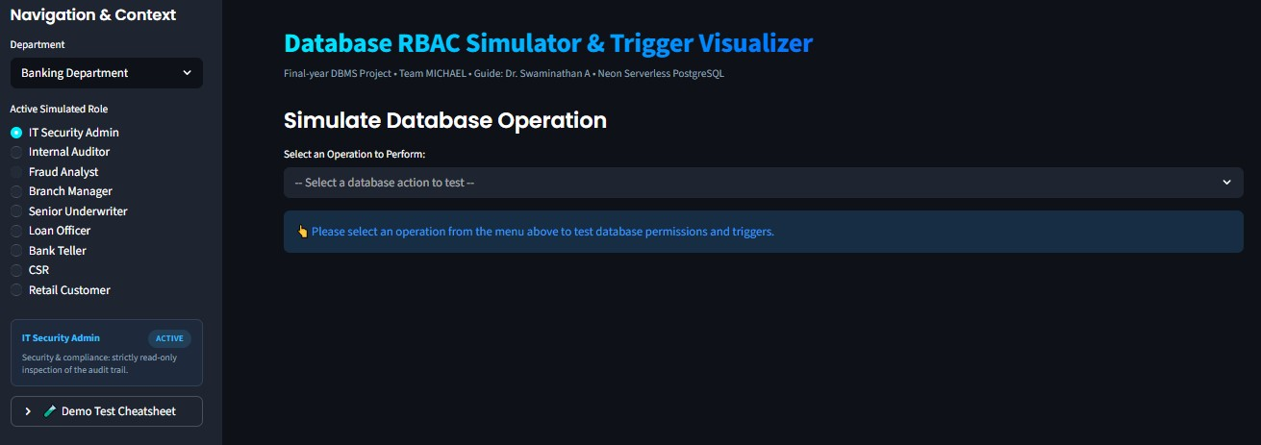
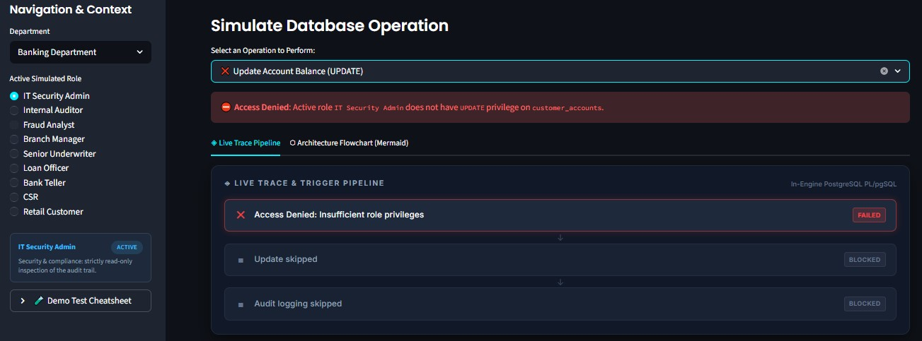
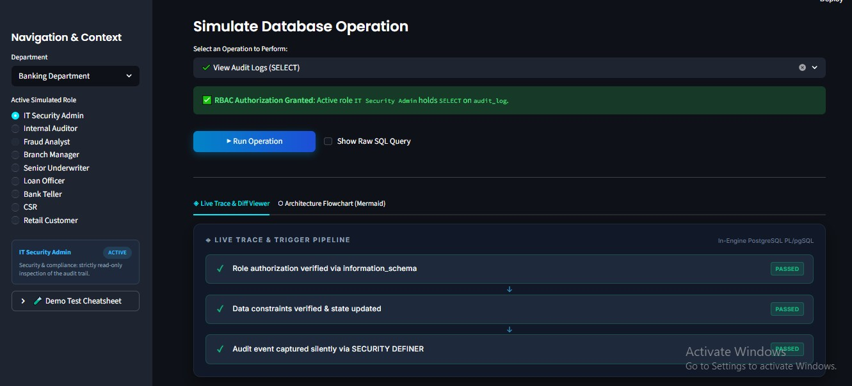
LIVE DEMO
09
Simulator Dashboard
SCREENSHOT
TO BE ADDED
SCREENSHOT
TO BE ADDED
Role-Switching Dashboard
Access Feedback — Allowed vs. Denied
Sidebar lets the reviewer switch between the six operational roles and immediately view the resulting privilege set.
Interface options render as enabled or disabled in real time, based purely on the active role's verified PostgreSQL grants.

Slide 10
10
Database Trigger Design
Transaction Firewall
BEFORE INSERT
Loan Eligibility
BEFORE INSERT
process_transaction
check_loan_eligibility
Validates KYC, checks for frozen accounts, and blocks transfers where fraud alerts exist.
Prevents “loan stacking” and blocks applications from customers with compromised accounts.
Loan State Machine
BEFORE UPDATE
Audit Trail
AFTER UPDATE
enforce_loan_workflow
log_audit_event
Enforces linear, role-based approvals (Submitted → Underwrite → Approved) using SECURITY DEFINER.
Silently records all account and loan status changes into the audit_log.
Database Users & Roles Simulator and Trigger Visualizer | Project Review I

Slide 11
11
Trigger Execution Trace
Because triggers run invisibly in the backend, a dedicated UI module will visualize this hidden execution step-by-step for the user.
LIVE TRACE
✓
KYC verification passed
1
A real-time “Live Trace” checklist in the UI showing each validation step as it runs.
✓
Account status: active (not frozen)
2
Mapping PostgreSQL exception messages directly to visual UI alerts, educating users on exactly which database rule blocked an action.
✕
Fraud check failed — alert on file
■
Transaction blocked before insert
Database Users & Roles Simulator and Trigger Visualizer | Project Review I

Slide 12
12
Data State Diff Viewer
Objective: visually demonstrate the direct impact of complex trigger executions on the underlying database tables.
Implementation: a dynamic UI component captures the data state before an action and contrasts it with the resulting state — e.g. sender and receiver balances updating simultaneously once the process_transaction trigger fires successfully.
BEFORE
AFTER
Sender balance
₹ 42,500
Sender balance
₹ 37,500
Receiver balance
₹ 12,800
Receiver balance
₹ 17,800
Transaction status
Pending
Transaction status
Completed
Database Users & Roles Simulator and Trigger Visualizer | Project Review I

Slide 13
PLANNED WORK
13
Cloud Deployment Plan
1
2
3
Hosting Platform
Database Integration
Security Hardening
Deploy the Python UI to Streamlit Community Cloud for public accessibility and live demonstration.
Maintain connectivity to the Neon Serverless PostgreSQL database for robust, scalable backend operations.
Migrate database credentials from plain text code to Streamlit's encrypted secrets.toml vault to protect administrative access on public GitHub repositories.
Database Users & Roles Simulator and Trigger Visualizer | Project Review I

Slide 14
ROADMAP
14
Expected Project Workflow Timeline
PHASE 1
PHASE 2
PHASE 3
PHASE 4
PHASE 5
COMPLETED
COMPLETED
IN PROGRESS
UPCOMING
UPCOMING
Database Design & Setup
RBAC Implementation
Trigger Engineering
UI Visualizers
Cloud Deployment
ER modeling, Neon Postgres configuration, core table creation.
Role creation, privilege assignment, dynamic UI integration via information_schema.
Developing PL/pgSQL functions for firewalls, state machines, and audit logging.
Developing the Execution Trace and Before/After Diff Viewer.
Streamlit deployment, secrets management, and final documentation.
Database Users & Roles Simulator and Trigger Visualizer | Project Review I

Slide 15
APPENDIX
15
Tech Stack & References
REFERENCES
TECH STACK
Python
PostgreSQL Official Documentation
Core application language
Guidelines on information_schema, PL/pgSQL trigger functions, and Role-Based Access Control.
Streamlit
Frontend / interactive UI
Streamlit Documentation
PostgreSQL (Neon Serverless)
API reference for UI components, session state, and secure secrets management.
Backend database
psycopg2
Industry Standards
Database connector
Database security, Defense-in-Depth, and the Principle of Least Privilege applied to financial systems.
Database Users & Roles Simulator and Trigger Visualizer | Project Review I

