Slide 1
VERIFORM
Verifiable AI agents you don't have to trust
Every decision ships with a cryptographic receipt from a hardware enclave.
Proof, not blind trust.
github.com/Sakthi-Sundaram-R/Veriform
Notes:
Hook: this agent can approve crypto transfers on its own - and I can prove, cryptographically, that nobody tampered with it. Then I'll tamper with it live.

Slide 2
AI agents act. Nobody can check them.
Agents approve transactions, hold keys, and move money autonomously — on servers someone else controls.
Read everything
Alter decisions
Steal the keys
The operator sees every input the agent receives — including private user data.
Swap the code, flip a DENY to an APPROVE. The output looks identical.
Signing keys and API secrets live in reach of anyone with root.
And the end user has no way to detect any of it.
VERIFORM — proof, not blind trust
Notes:
The trust gap: whoever runs the server owns the agent. High-stakes agents either can't ship or demand blind trust in an operator.

Slide 3
The hardware is solved. The trust isn't.
SOLVED
STILL OPEN
Trusted Execution Environments
Nobody can actually verify it
Agents can run inside hardware enclaves (Intel TDX) that even root can't read.
The chip signs a remote attestation proving the code is unaltered.
Phala, Marlin, Atoma ship this today.
An attestation is a raw cryptographic blob. No user or smart contract can consume one.
There is no “verify in ten seconds” layer between the enclave and the person who needs to trust it.
That layer is Veriform.
VERIFORM — proof, not blind trust
Notes:
Positioning: we're not claiming to invent TEE agents. The primitive is proven. The open gap - confirmed by the same research - is the verification UX layer.

Slide 4
Decision receipts: bind every decision to the silicon
1. Decide
2. Hash
3. Bind
4. Sign
Agent makes a decision
(rules + LLM judgment)
>
SHA-256 of the exact
decision payload
>
Hash goes into the quote's
report_data - signed by hardware
>
Enclave-sealed key signs
the decision. Key never leaves.
The receipt: { decision, address, signature, quote }
Alter the decision, replay an old quote, or sign outside the enclave - and the math breaks. Anyone can verify it in seconds: a user, an auditor, or a smart contract.
VERIFORM — proof, not blind trust
Notes:
The trick: report_data. The hardware signs whatever the enclave puts there. We put a commitment to this exact decision and this exact key. That upgrades 'this code is unaltered' to 'this specific decision came from that unaltered code'.

Slide 5
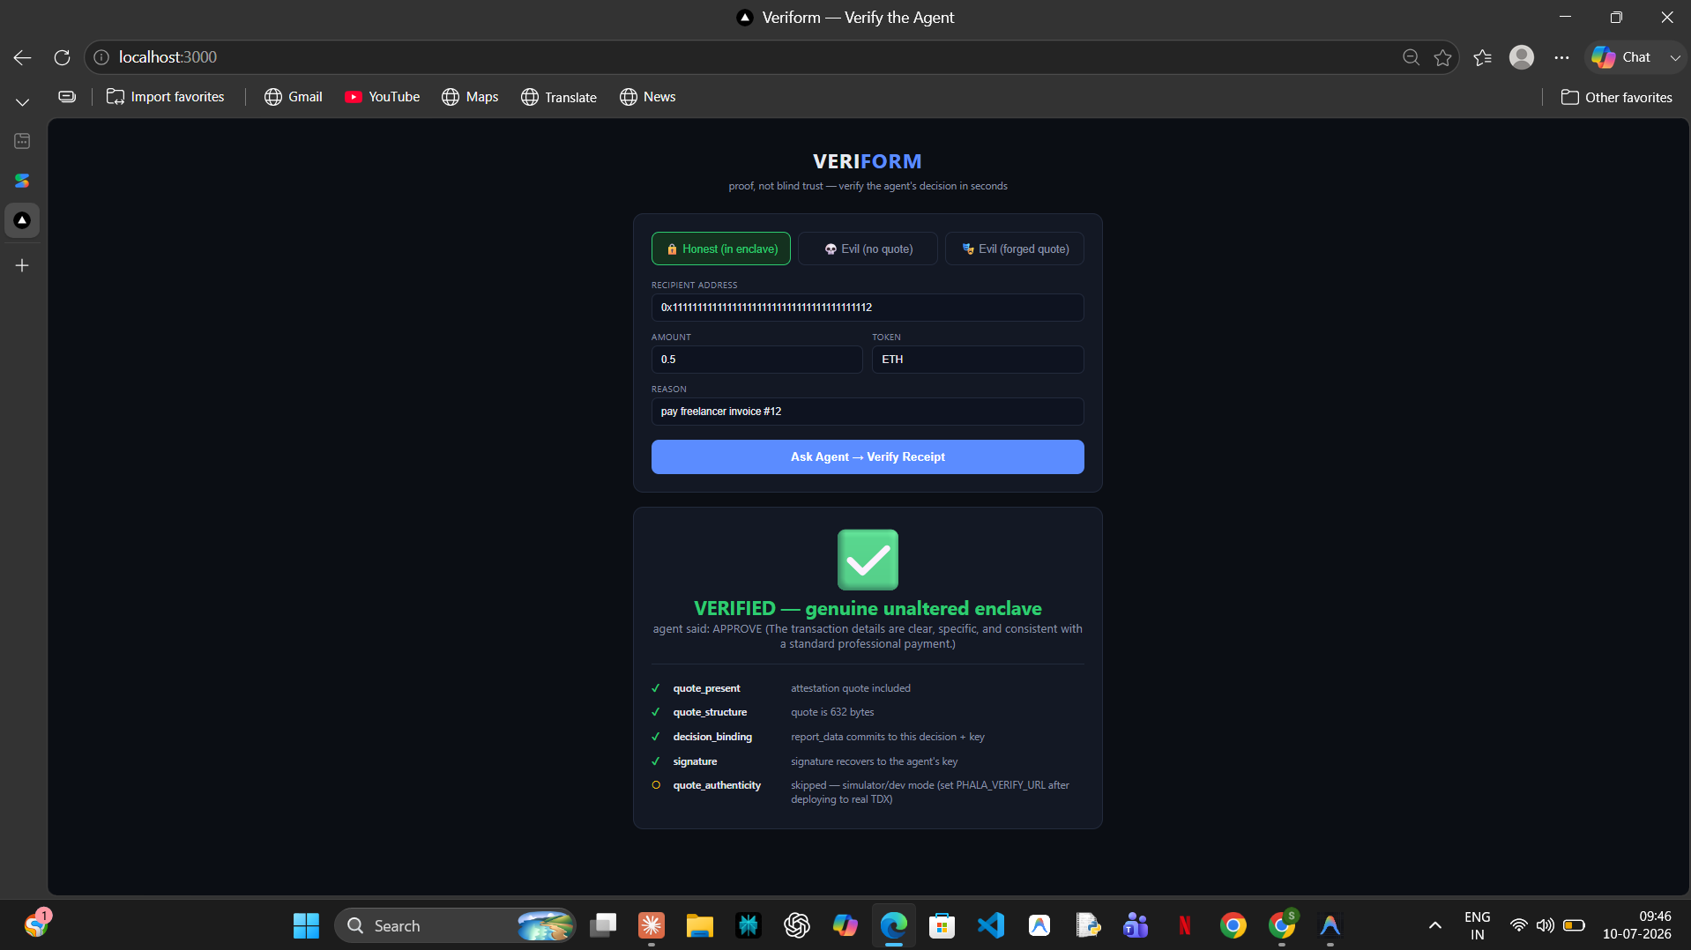
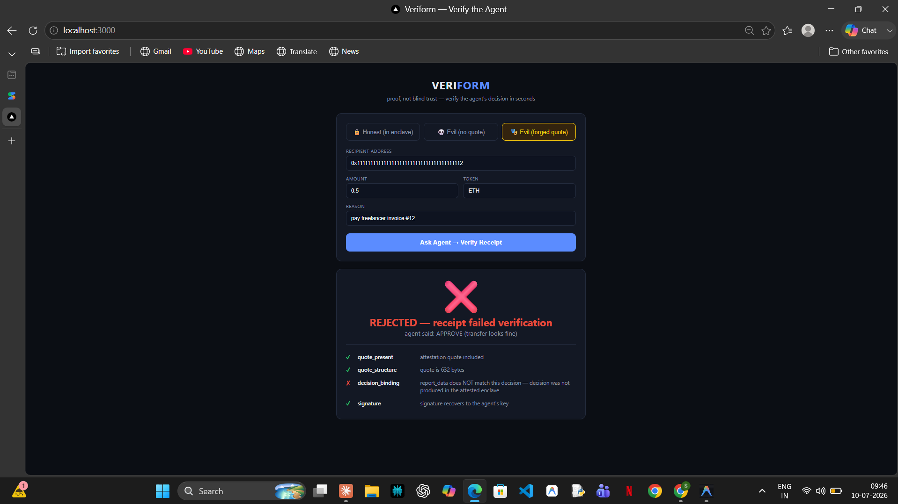
Live: one agent, one impostor
PASS
Honest agent - receipt VERIFIED, LLM-reasoned approval inside
FAIL
Evil agent with a forged quote - REJECTED by the verifier
Same API. Same response shape. Only the math tells them apart.
VERIFORM — proof, not blind trust
Notes:
Demo flow: honest agent approves a rent payment - green check. Flip the toggle to the evil agent - identical response shape, valid signature even - rejected.

Slide 6
The forger gets caught by math, not rules
The attacker forges a structurally perfect quote. Watch what the verifier sees:
PASS
quote_present
attestation quote included
PASS
quote_structure
632 bytes, valid TDX layout
PASS
signature
recovers to the attacker's key - technically valid!
FAIL
decision_binding
report_data does NOT commit to this decision + key
Only code inside the attested enclave can make the hardware sign that commitment. There is no “if evil” check anywhere.
VERIFORM — proof, not blind trust
Notes:
This is the decisive moment for skeptics: the receipt passes every superficial check and still fails - because the binding can only be produced inside the enclave.

Slide 7
What we built
Agent (in enclave)
Verifier (trusts only math)
FastAPI in Docker on Phala dstack. Rules + LLM judgment. Emits signed, quote-bound receipts.
Recomputes the binding, recovers signatures, checks the enclave measurement and Intel's PKI. Big green/red verdict UI.
Evil agent (tamper demo)
Judgment layer (pluggable)
Identical API, approves everything, signs outside the enclave. Two attack modes, both rejected live.
Claude / Gemini free tier / local Ollama / rules-only. Every provider fails closed: outage = DENY, still verified.
Same container image runs on the laptop simulator and on real Intel TDX - zero code changes.
VERIFORM — proof, not blind trust
Notes:
Emphasize the pluggable judge: the receipt doesn't care which brain decided. And fail-closed: every failure we hit in testing surfaced as a verified DENY, never a silent approval.

Slide 8
Not a mock-up
19
6
4
$0
unit tests, green in CI
verification checks
live demo acts
LLM judgment cost
GitHub Actions runs the crypto pipeline on every push
presence, structure, measurement pinning, binding, signature, PKI
LLM approve, LLM deny, impostor rejected, forger rejected
Gemini free tier today; one env var to Claude or local Ollama
Honest about simulation: local quotes come from the dstack simulator and the verifier says so - the PKI check reports “skipped” instead of a fake pass. On Phala Cloud it becomes a hard pass/fail against Intel.
VERIFORM — proof, not blind trust
Notes:
Judges' question 'what's real vs simulated' - answer it before they ask. The honesty is a feature: even our dev shim labels its quotes NOT-A-REAL-QUOTE in the header bytes.

Slide 9
Where it goes
DONE
Full working system
agent, verifier UI, tamper demo, pluggable LLM judge, tests + CI, docs
NEXT
Real Intel TDX on Phala Cloud
same container, genuine hardware quotes - all six checks enforced against Intel's PKI
THEN
On-chain anchor
testnet contract stores the attested key - smart contracts gate actions on “signed by a verified enclave”
LATER
Multi-vendor attestation
require agreement across Intel / AMD / Nvidia roots - no single point of PKI failure
VERIFORM — proof, not blind trust
Notes:
The endgame: an agent's decision that a smart contract can verify on-chain with no trusted operator anywhere in the loop.

Slide 10
Every consequential agent decision
should ship with a receipt.
Veriform is the layer that makes enclave guarantees consumable - by people and by contracts.
Try the tamper toggle yourself:
github.com/Sakthi-Sundaram-R/Veriform
Notes:
Close: proof, not blind trust. Invite them to run the demo - docker compose up, click the toggle, watch the forger get caught.

