Slide 1
Employee Data Analysis using Excel
STUDENT NAME:SAKTHI.M
REGISTER NO:F655CEEOB3D347B8F5B4F2C87055DA51 / 312208763
DEPARTMENT: B.com ( general )
COLLEGE : MEENAKSHI COLLEGE FOR WOMEN

Slide 2
PROJECT TITLE
Employee Performance Analysis using employee gender , Department and FTE in excel

Slide 3
AGENDA
Problem Statement
Project Overview
End Users
Our Solution and Proposition
Dataset Description
Modelling Approach
Results and Discussion
Conclusion
3/21/2024 Annual Review

Slide 4
PROBLEM STATEMENT
The purpose to analysis the employees data for , to know there working hours in the company, of both men and women employees

Slide 5
PROJECT OVERVIEW
The project aims to analyse FTE (Full-time employee) on both men and women employees at various departments . The full time and part time employees to identify and address under the table. By conducting this analysis the company came to who are the employees working more hours and less hours in the compacompany

Slide 6
WHO ARE THE END USERS?
HUMAN RESOURCE DEPARTMENTS
BUSINESS ANALYSTS
MARKETING DEPARTMENT
SALES DEPARTMENT
ENGINEERING DEPARTMENT
EMPLOYEES
MANAGEMENT AND LEADERSHIP

Slide 7
OUR SOLUTION AND ITS VALUE PROPOSITION
FILTERING- REMOVE VALUES
PIVOT TABLE - SUMMARY OF EMPLOYEE PERFORMANCE
BAR DIAGRAM - FINAL REPORT

Slide 8
Dataset Description
EMPLOYEE DATA SET- NAN MUDHALVAN PORTAL
9FEATURES IN EXCEL:
EMPLOYEE ID- ALPHANUMERIC(TEXT)
NAME- ALPHABETICAL(TEXT)
GENDER- ALPHABETICAL(TEXT)
DEPARTMENT - ALPHABETICAL(TEXT)
SALARY - NUMERICAL
START DATE - ALPHANUMERIC(TEXT)
FTE- NUMERICAL
EMPLOYEE TYPE- ALPHABETICAL(TEXT)
EMPLOYEE LOCATION- ALPHABETICAL(TEXT)
3FEATURES USED:DEPARTMENT - ALPHABETICAL(TEXT)
FTE- NUMERICAL
EMPLOYEE TYPE- ALPHABETICAL(TEXT)

Slide 9
THE "WOW" IN OUR SOLUTION
Effective data visualization makes it easier to present complex data in an engaging and understandable way.
3/21/2024 Annual Review
9

Slide 10
MODELLING
Open employee data set and download it
Then open the employee dataset in excel
select all the data in excel
Then click the insert and open pivot table
Drag the need data and create a pivot table
Select the pivot table and click on insert
Now click on the chart that you want,
The chart is created.
10

Slide 11
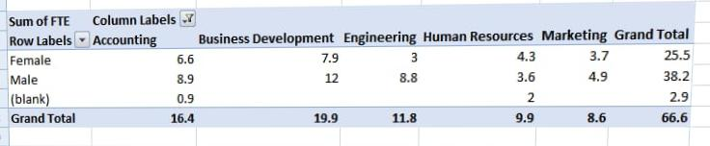
RESULTS
1 Table
11

Slide 12
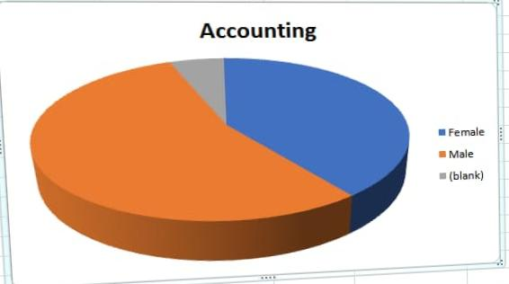
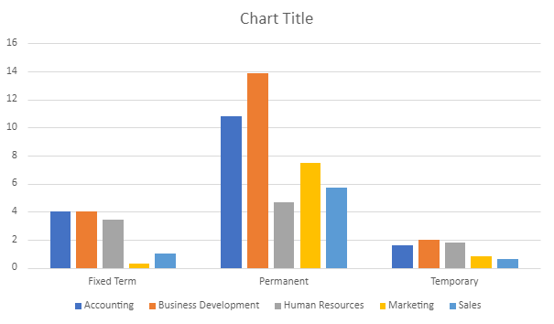
2 Bar diagram

Slide 13
conclusion
The dataset reveals the overall composition of the workforce, including demographics such as gender, salary, employee type and work location This information is crucial for understanding the diversity and experience level within the organization.

