Slide 1

Synthetic data generation in microwave networks
NETWORK DATA ANALYSIS LAB - Project 17

Slide 2
WHAT IS A MICROWAVE NETWORK?

Slide 3

WHY FAILURE MANAGEMENT MATTERS IN MICROWAVE NETWORKS?
Microwave links carry critical telecom traffic.
Failures reduce service quality and availability.
Manual diagnosis is time-consuming.
Machine learning can identify hardware-failure patterns from alarm data.
Faster diagnosis helps reduce downtime and maintenance effort.

Slide 4




HOW DO FAILURES APPEAR IN THE NETWORK?
Hardware fault
Alarm generation
NMS recording
Failure identification
IDU failure
ODU failure
Cable failure
Power failure
The network devices produce alarm signals related to the fault.
For each 15-minute window, the system records how long each of the 164 alarms was active.
The complete alarm pattern is analysed to classify the hardware failure.

Slide 5
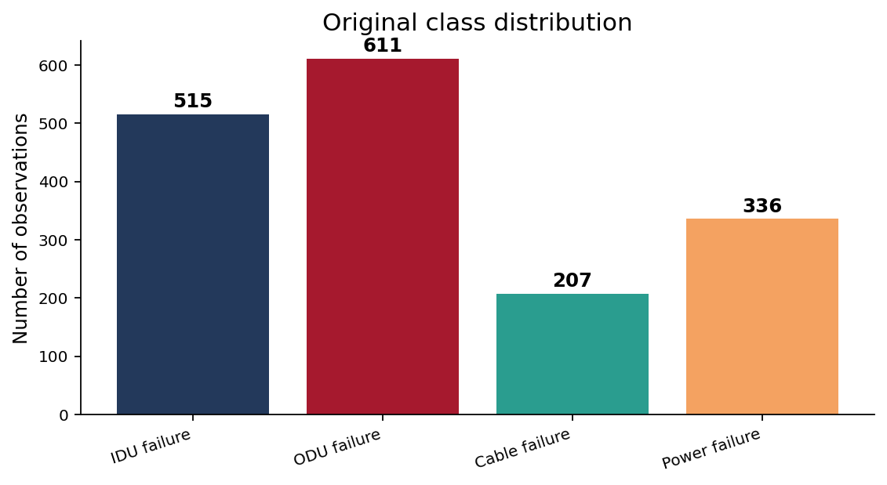
Dataset overview
Every observation captures the alarm activity of a microwave link during a 15-minute period. The model studies the combined pattern of 164 alarms to identify the most likely hardware failure.
Cable failure is the smallest class, so it is the most affected by class imbalance
This imbalance motivates the use of synthetic data generation.

Slide 6
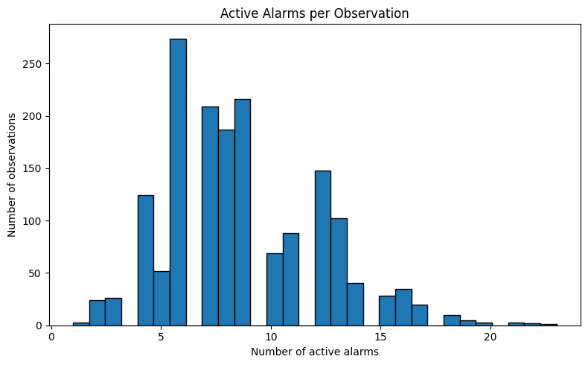
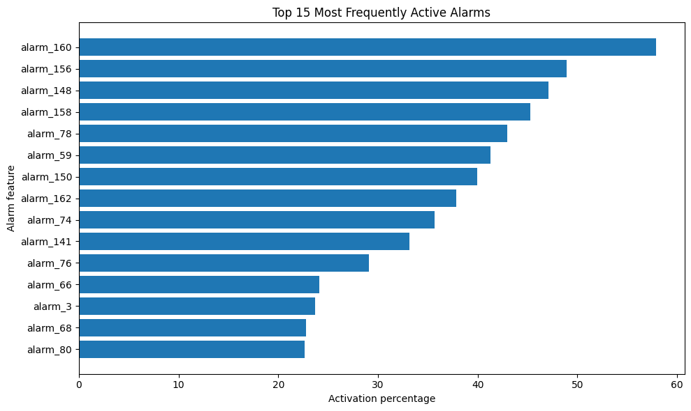
RAW DATA ANALYSIS AND VISUALIZATION
One row represents one hardware-failure observation.
Each observation covers a 15-minute window.
Each alarm column records how many seconds the alarm was active.
0 seconds means inactive.
900 seconds means active for the full window.
The label shows the diagnosed failure class.

Slide 7
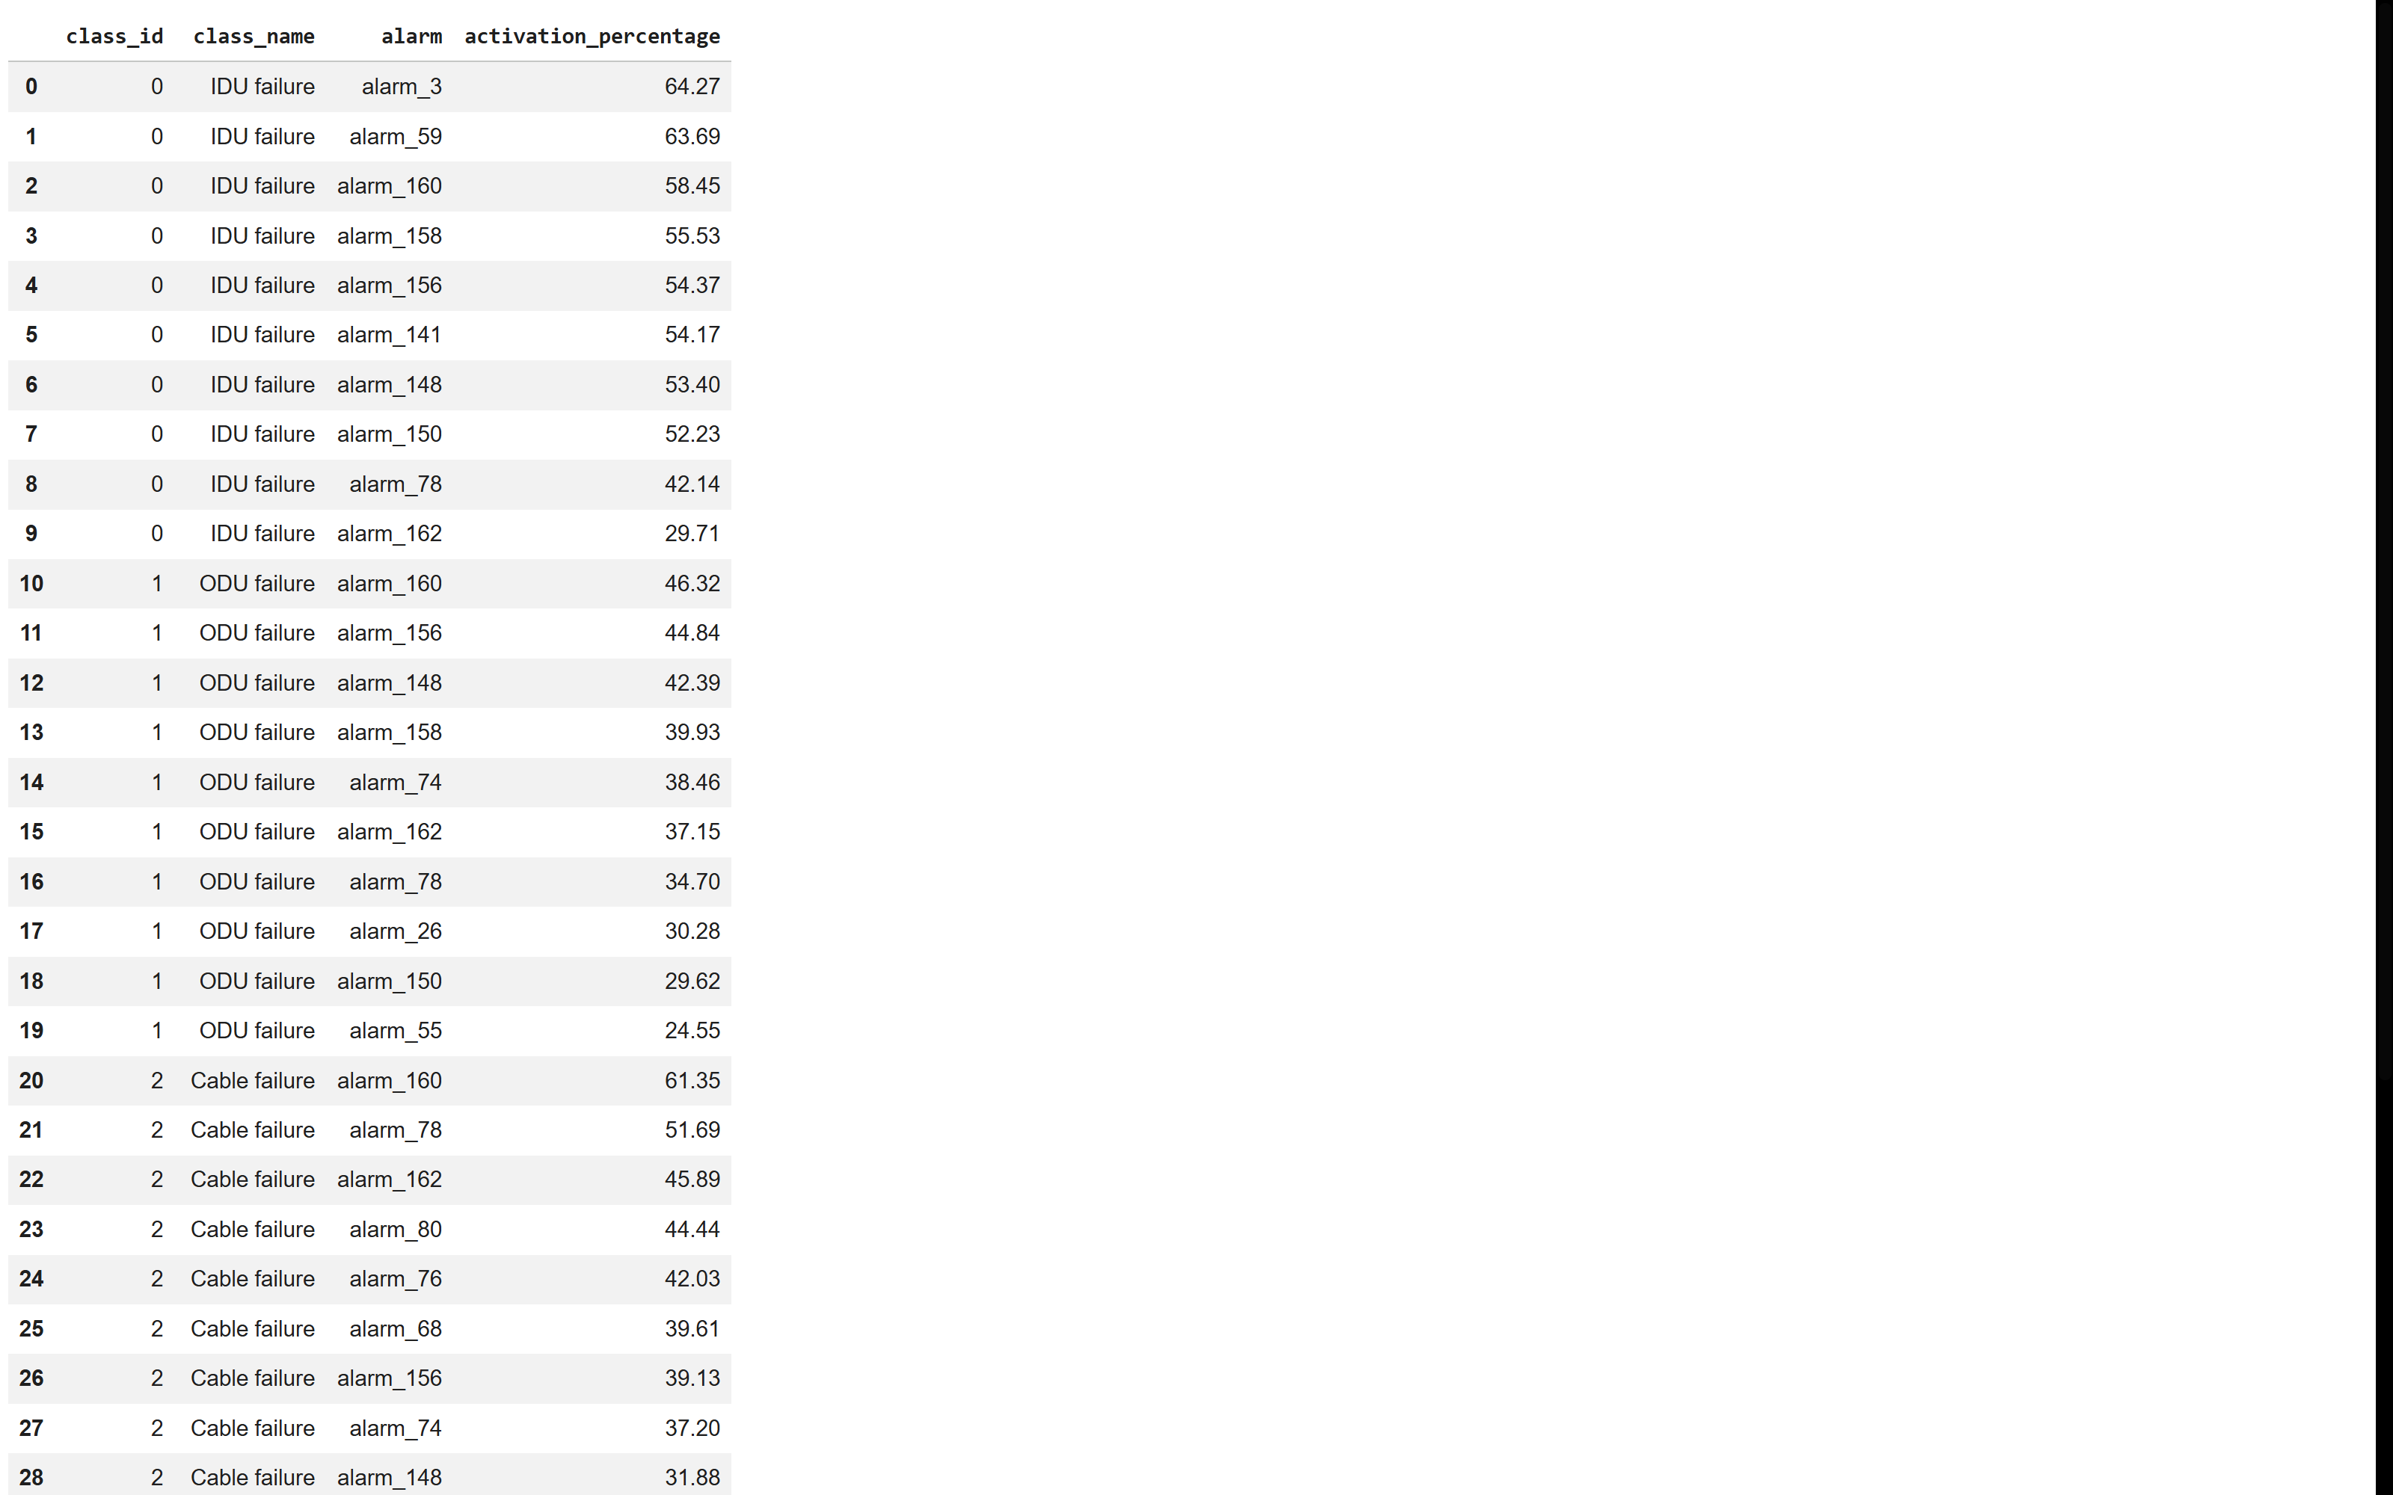
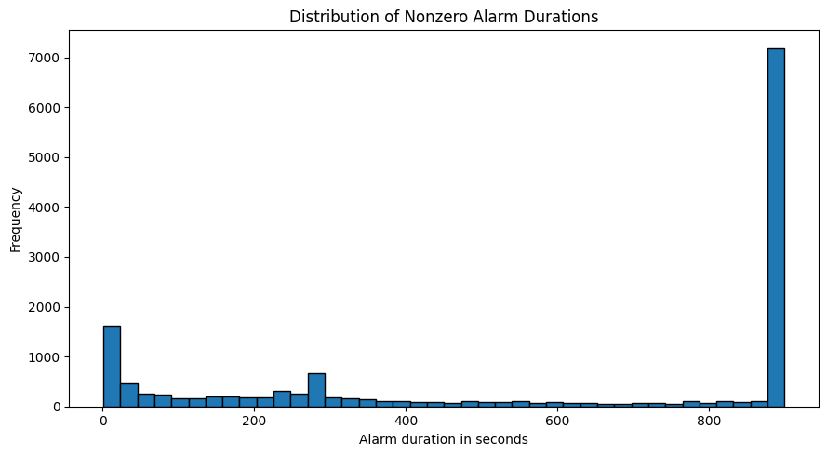

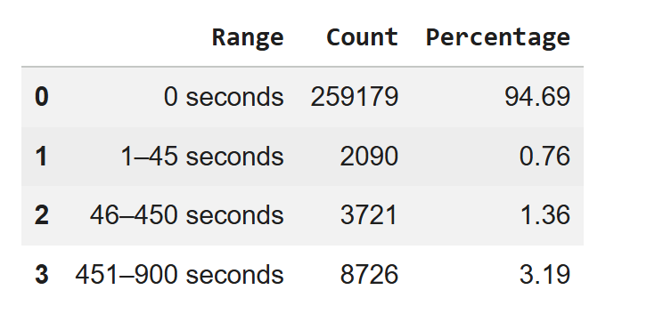
ALARM DURATION AND FAILURE PATTERNS
The dataset is highly sparse because most alarms are inactive
Some alarms appear in multiple failure classes, so one alarm alone cannot identify the failure

Slide 8
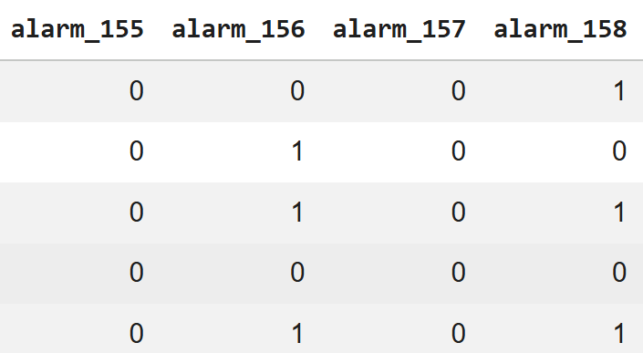
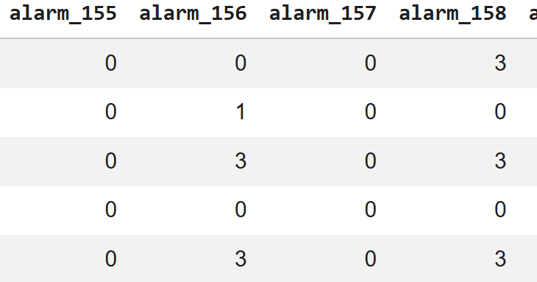
Feature preprocessing: two representations
Binary features
Categorical features
If alarm value > 0 → 1
If alarm value = 0 → 0
Captures alarm occurrence only
Simple and robust for sparse data
0 seconds → 0
1–45 seconds → 1
46–450 seconds → 2
451–900 seconds → 3
Captures alarm duration severity
We compare both because binary features reduce noise, while categorical features preserve more information.

Slide 9
TRAIN-TEST SPLIT AND PATTERN OVERLAP
70 / 30 STRATIFIED SPLIT
Original dataset: 1,669 real observations
Split preserves the four failure-class proportions
Full dataset
1,669
Training set
1,168 (70%)
Test set
501 (30%)
CLASS DISTRIBUTION AFTER SPLIT
RESULT
CLASS | FAILURE TYPE | TRAIN | TEST
0 | IDU failure | 360 | 155
1 | ODU failure | 428 | 183
2 | Cable | 145 | 62
3 | Power | 235 | 101
TOTAL |  | 1168 | 501
ITEM | VALUE
Test observations | 501
Test patterns also in train | 186
Pattern overlap | 37.13%

Slide 10
MODEL EVALUATION METRICS AND RANDOM FOREST CONFIGURATION
BINARY RANDOM FOREST BEST CONFIGURATION
PARAMETERS | SELECTED VALUE
n_estimators | 400
max_depth | None
min_samples_split | 2
min_samples_leaf | 1
class_weight | balanced
EVALUATION METRICS USED FOR EVERY FINAL MODEL:
Accuracy
Macro Precision
Macro recall
Macro F1 - score
Weighted F1 - score
OPTIMIZATION FLOW
Training data (1168 observations)
5 –fold stratified CV
GridSearchCV parameter test
Best model by Macro F1
Real test set (501 observations)

Slide 11
DATAGEN-1 : BALANCING THE TRAINING DATASET
STARTING POINT – REAL IMBALANCED TRAINING DATASET
After the 70/30 split, only the training data is used for data generation. The test set remains real and unchanged.
BEFORE DATAGEN-1
TARGET AFTER DATAGEN-1
IDU
360
IDU
428
ODU
428
ODU
428
Cable
145
Cable
428
Power
235
Power
428

Slide 12
SYNTHETIC TRAINING DATA CREATION
GENERATION WORKFLOW
Real training set
Choose generator
Mixed train set
Real test set
1,168 observations
Class counts: 360 / 428 / 145 / 235
SMOTEN or CVAE
Generate missing rows per class
Real + synthetic
1,712 total observations
501 unchanged real observations
Used only for final scoring
SYNTHETIC METHOD 1 - SMOTEN
SYNTHETIC METHOD 2 - CVAE
Nearest Neighbour idea – SMOTEN creates new discrete samples by looking at nearest observations from the same minority class. It preserves valid binary/categorical values
Class-conditioned generator – The CVAE learns alarm patterns using an encoder-decoder neural network. The requested class labels guides the generator
We chose SMOTEN instead of SMOTE because our feature values are discrete : binary (0,1) and categorical (0,1,2,3). SMOTEN keeps generated values inside these valid categories

Slide 13
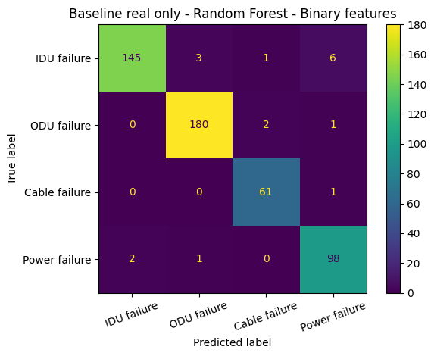

RANDOM FOREST BASELINE OUTPUTS
We first trained Random Forest using real training data only.
RF BASELINE | ACCURACY | MACRO F1
Binary | 0.9661 | 0.9641
Categorical | 0.9581 | 0.9567

Slide 14
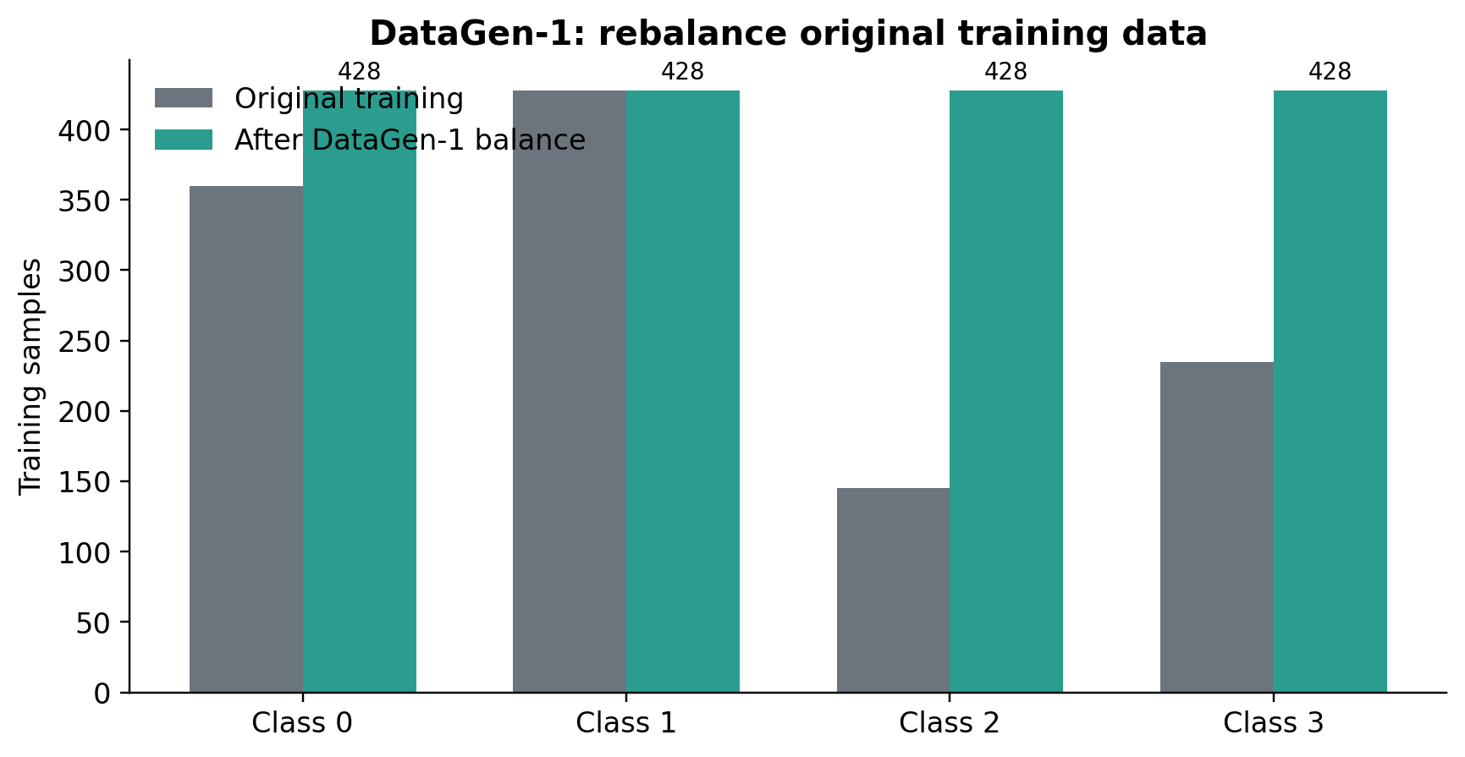
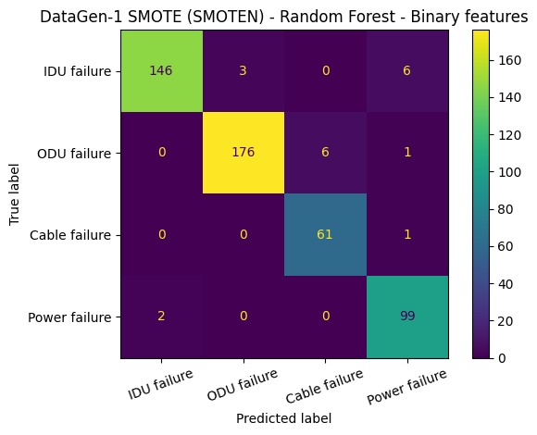
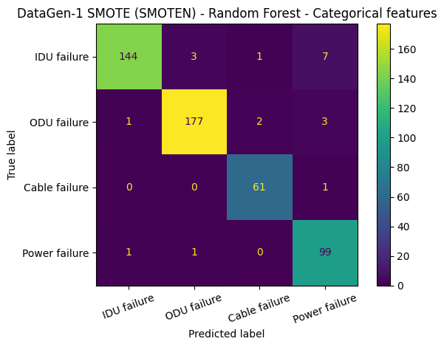
DataGen-1 SMOTEN WITH RANDOM FOREST
Both binary and categorical DataGen-1 SMOTEN experiments were evaluated.
RF DataGen-1 | TRAINING | ACCURACY | MACRO F1
Binary base | Real only | 0.9661 | 0.9641
Binary SMOTEN | Real + synthetic | 0.9621 | 0.9584
Categorical base | Real only | 0.9581 | 0.9567
Categorical SMOTEN | Real + synthetic | 0.9601 | 0.9590
Notes:
Task 5 DataGen-1: emphasize that we did not test only categorical. Binary SMOTEN and categorical SMOTEN were both generated and evaluated with Random Forest. DataGen-1 balances the original training data to 428 samples per class.

Slide 15
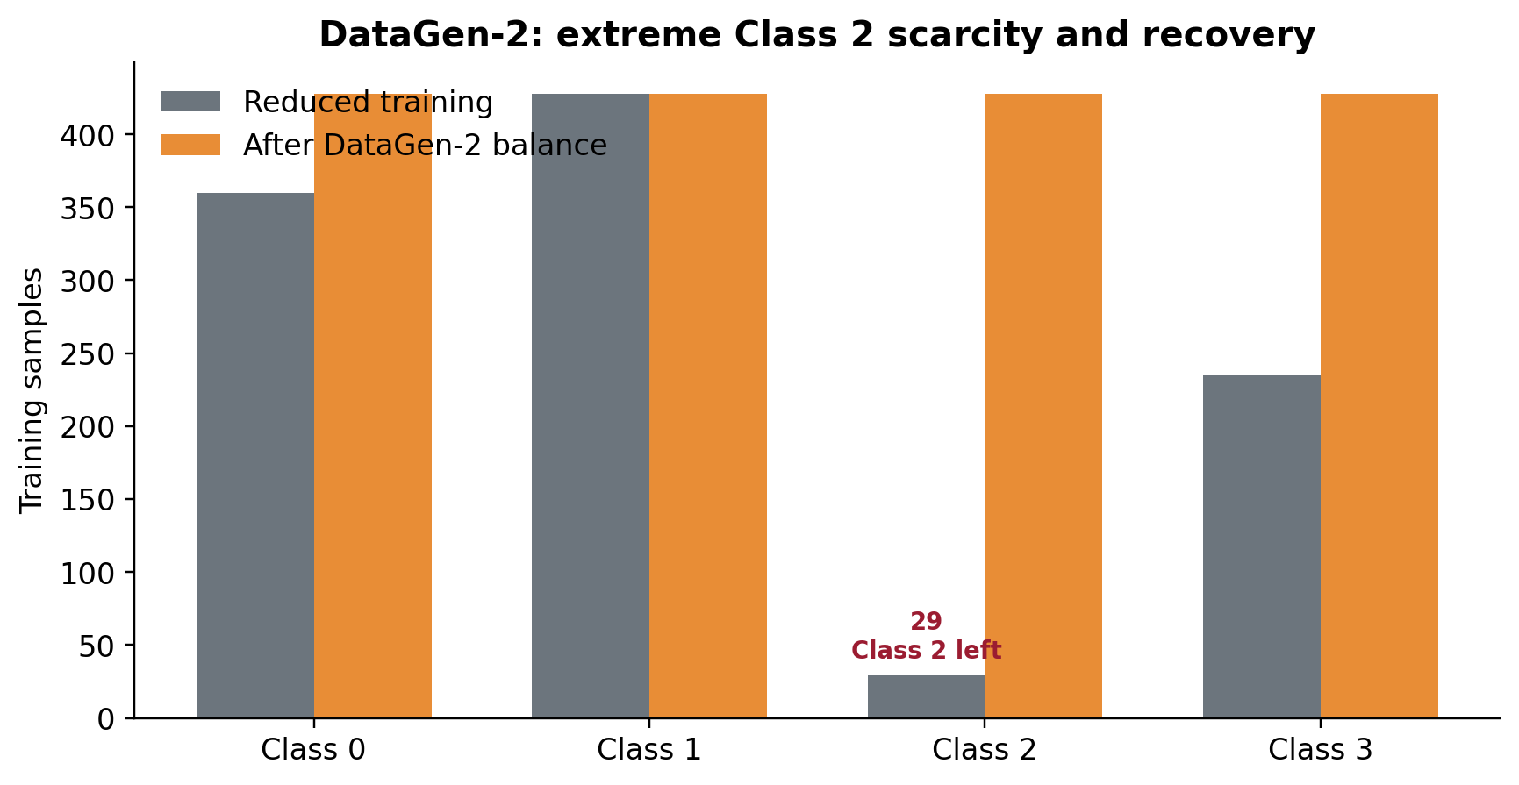

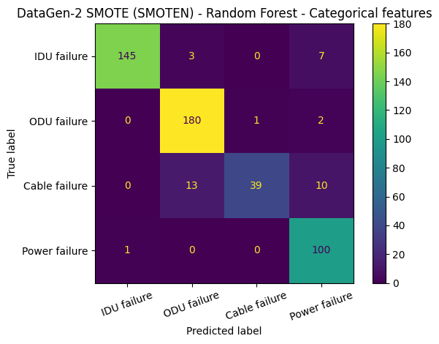
DataGen-2 SMOTEN WITH RANDOM FOREST
Both binary and categorical DataGen-2 SMOTEN experiments were evaluated after reducing Class 2.
RF DataGen-2 | TRAINING | ACCURACY | MACRO F1
Binary base | Reduced real only | 0.9202 | 0.8889
Binary SMOTEN | Real + synthetic | 0.9381 | 0.9220
Categorical base | Reduced real only | 0.9242 | 0.9013
Categorical SMOTEN | Real + synthetic | 0.9261 | 0.8968
Notes:
Task 5 DataGen-2: explicitly mention that categorical DataGen-2 was also tested. It is important because it proves that all combinations were covered. The result is also useful because it shows synthetic data does not automatically improve every setting.

Slide 16
CVAE INPUT PREPARATION
Before building the generator, the notebook prepared TensorFlow inputs for binary and categorical data.
Training features
Convert to NumPy
float32 arrays
Failure labels
One-hot class vectors
Ready for CVAE
INPUTS PREPARED :
Binary alarm matrix (Used by the binary CVAE)
Categorical alarm matrix (Used by the categorical CVAE)
Class Labels (Tells the CVAE which failure class each row belongs to)
One-hot encoding (Represents IDU, ODU, Cable and Power as neural network inputs)
Separate DG1/DG2 inputs
The CVAE is not just given alarm values. It also receives the failure class, so it can learn class-specific alarm patterns.
Notes:
Explain Task 6 simply: TensorFlow needs numeric arrays, and class labels must be converted into a format the neural network can use. The CVAE is conditional because it receives the class label as input.

Slide 17
CVAE ARCHITECTURE AND SAMPLE GENERATION
Real alarm row + class label
Encoder
Latent vector z
Decoder + class label
Synthetic alarm
PARTS :
Encoder – Compresses the alarm pattern into a hidden representation
Sampling layer – Adds controlled randomness
Decoder – Rebuilds an alarm row from the hidden vector
Class condition – Guides the generator towards IDU, ODU, Cable or Power
Post processing – Rounds outputs to valid binary or categorical values
Notes:
Task 6 architecture: avoid too much mathematics. Say encoder compresses, latent vector stores hidden information, decoder generates. The class label is supplied to both encoder and decoder so we can ask for a specific failure class such as Cable.

Slide 18


DataGen-1 CVAE WITH RANDOM FOREST
Both binary and categorical CVAE DataGen-1 outputs were evaluated with Random Forest.
RF + CVAE DataGen-1
ACCURACY
MACRO F1
Binary
0.9521
0.9450
Categorical
0.9541
0.9490
Notes:
Task 7 DataGen-1: mention both binary and categorical CVAE. The important message is that the CVAE generated valid samples, but Random Forest did not improve compared with the strong real-only baseline.

Slide 19


DataGen-2 CVAE WITH RANDOM FOREST
Both binary and categorical CVAE DataGen-2 outputs were evaluated after reducing Class 2.
RF DataGen-2
BASE MACRO F1
CVAE MACRO F1
CHANGE
Binary
0.8889
0.9088
Improved
Categorical
0.9013
0.9180
Improved
Notes:
Task 7 DataGen-2: this slide is important because it shows CVAE can help when the Cable class is severely reduced. It improved both binary and categorical Random Forest compared with the reduced real-only baseline.

Slide 20
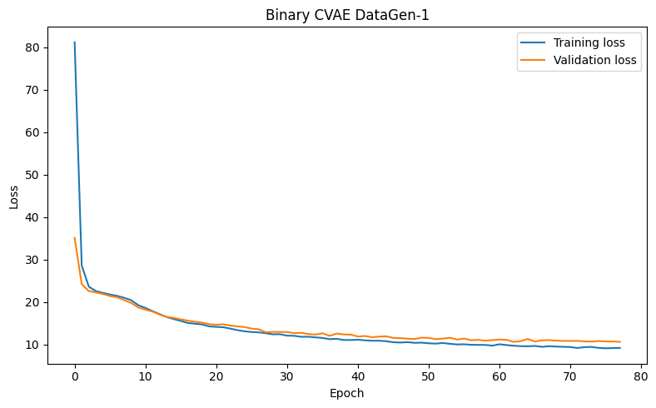
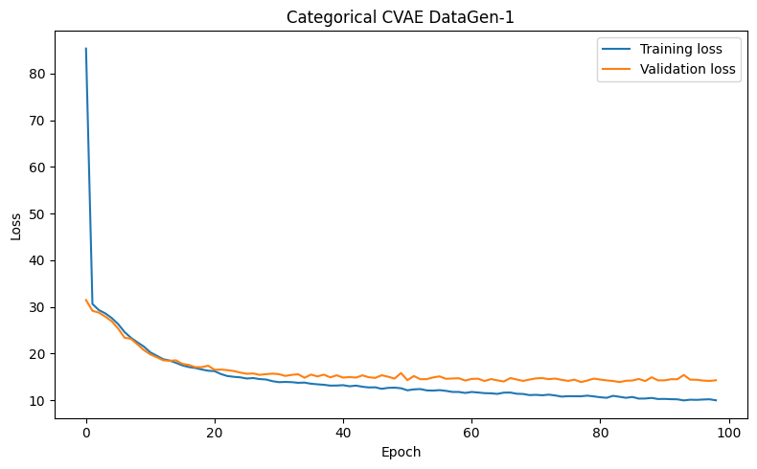
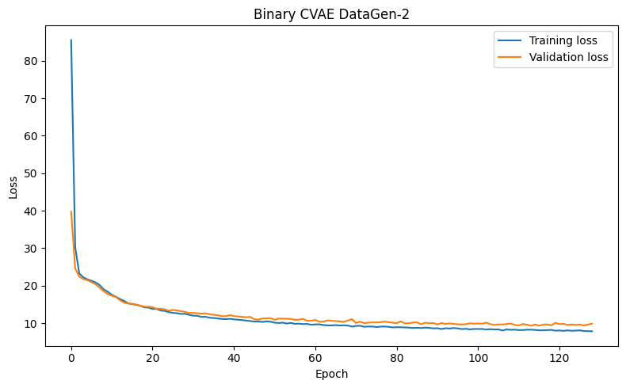
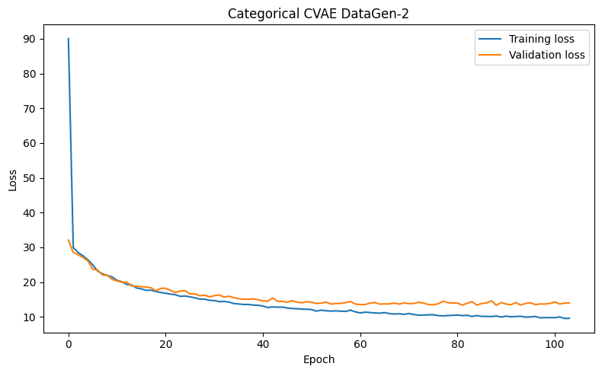
CVAE Training Histories
The notebook plotted training and validation losses for all four CVAEs.
CVAE model
Training time
Binary DataGen-1
17.26 s
Categorical DataGen-1
37.78 s
Binary DataGen-2
27.70 s
Categorical DataGen-2
36.86 s
Notes:
Use this slide only briefly. Say the loss curves confirm that the four CVAE generators were trained successfully. Mention that categorical and DataGen-2 models take longer because the task is harder.

Slide 21


XGBoost TUNING AND BASELINE OUTPUTS
We optimized XGBoost and evaluated real-only baseline models.
XGBoost BASELINE
ACCURACY
MACRO F1
Binary
0.9601
0.9570
Categorical
0.9701
0.9690

Slide 22


XGBoost WITH SMOTEN
We evaluated SMOTEN-generated mixed training data using XGBoost.
XGBoost + SMOTEN
Accuracy
Macro F1
DG1 Categorical
0.9641
0.9624
DG2 Binary
0.9561
0.9494
DG2 Categorical
0.9601
0.9516
DG1 Binary
0.9641
0.9614

Slide 23


XGBoost with CVAE
We evaluated CVAE-generated mixed training data using XGBoost.
XGBoost + CVAE
ACCURACY
MACRO F1
DG1 Binary
0.9561
0.9510
DG1 Categorical
0.9701
0.9684
DG2 Binary
0.9421
0.9306
DG2 Categorical
0.9461
0.9325

Slide 24
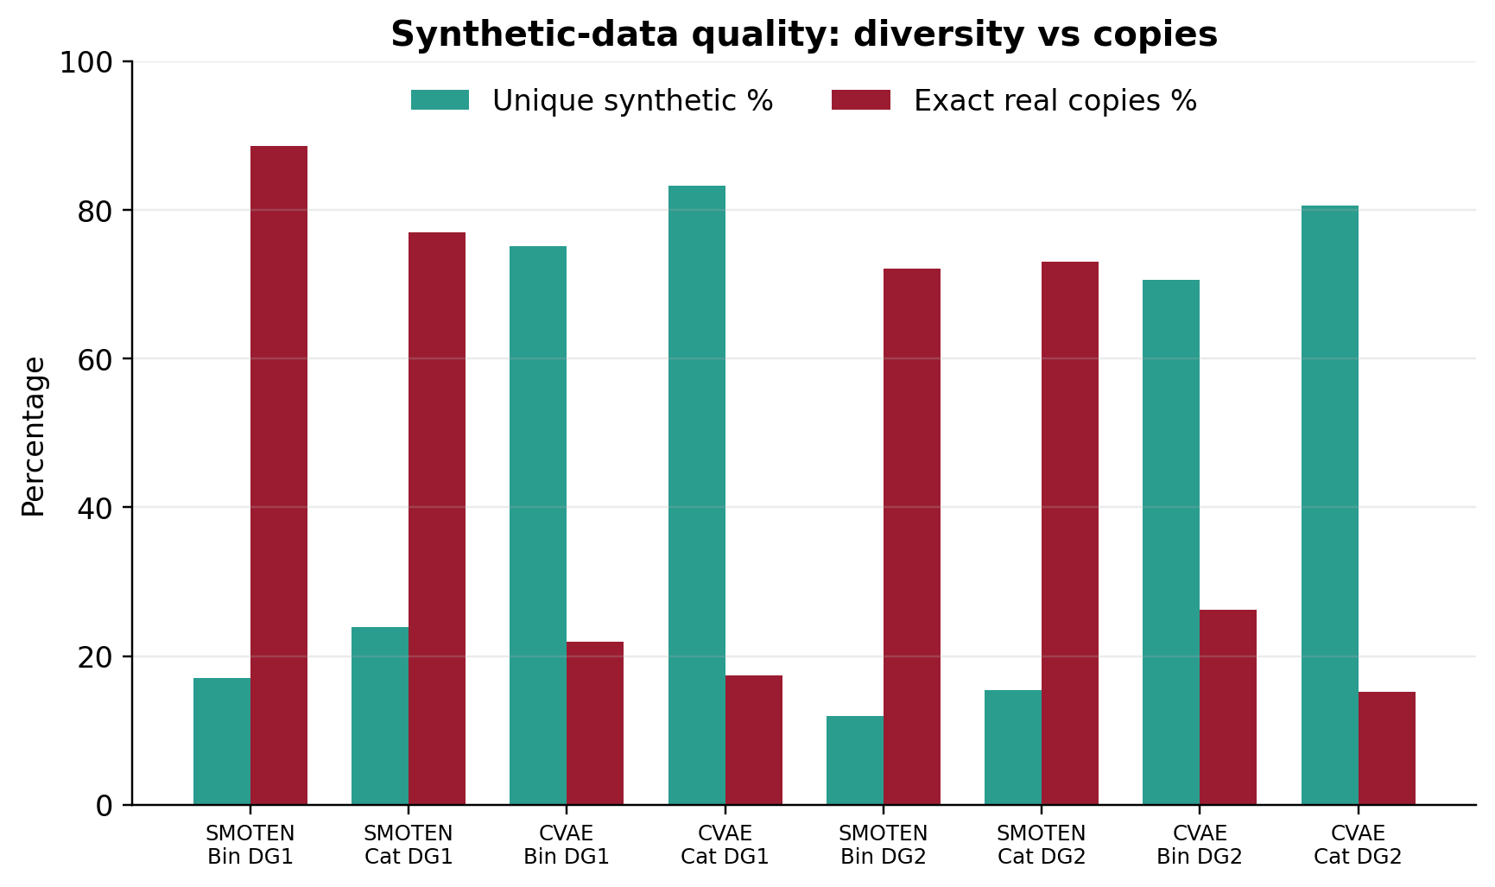
SYNTHETIC DATA QUALITY CHECKS
We checked validity, diversity, duplicates and exact real-data copies.
Valid values
Generated features stay within {0,1} or {0,1,2,3}
Unique samples
How many different synthetic rows were created
Duplicate rows
Repeated synthetic rows
Exact real copies
Synthetic rows identical to real training rows
Average active alarms
Whether generated rows have realistic sparsity
CVAE tends to be more diverse; SMOTEN is faster but often creates copy-like rows

Slide 25
PER CLASS AND CABLE FAILURE ANALYSIS
CLASS | FAILURE | SUPPORT | RECALL | F1 | PRECISION
0 | IDU | 0.99 | 0.94 | 0.97 | 155
1 | ODU | 0.98 | 0.98 | 0.98 | 183
2 | Cable | 0.97 | 0.98 | 0.98 | 62
3 | Power | 0.92 | 0.99 | 0.95 | 101
Best overall model: XGBoost + categorical + DG1 Base. Cable failure performs well in the best overall model: precision 0.97, recall 0.98, F1 0.98.
DG2 BINARY MODEL | CLASS 2 RECALL | CLASS 2 F1
RF Base | 0.6290 | 0.7647
RF SMOTEN | 0.7581 | 0.8545
RF CVAE | 0.8548 | 0.8154
XGB Base | 0.8065 | 0.8772
XGB SMOTEN | 0.8871 | 0.9244
XGB CVAE | 0.9516 | 0.8741
In DataGen-2, the best Cable F1 is XGBoost + SMOTEN = 0.9244. The best Cable recall is XGBoost + CVAE = 0.9516.

Slide 26
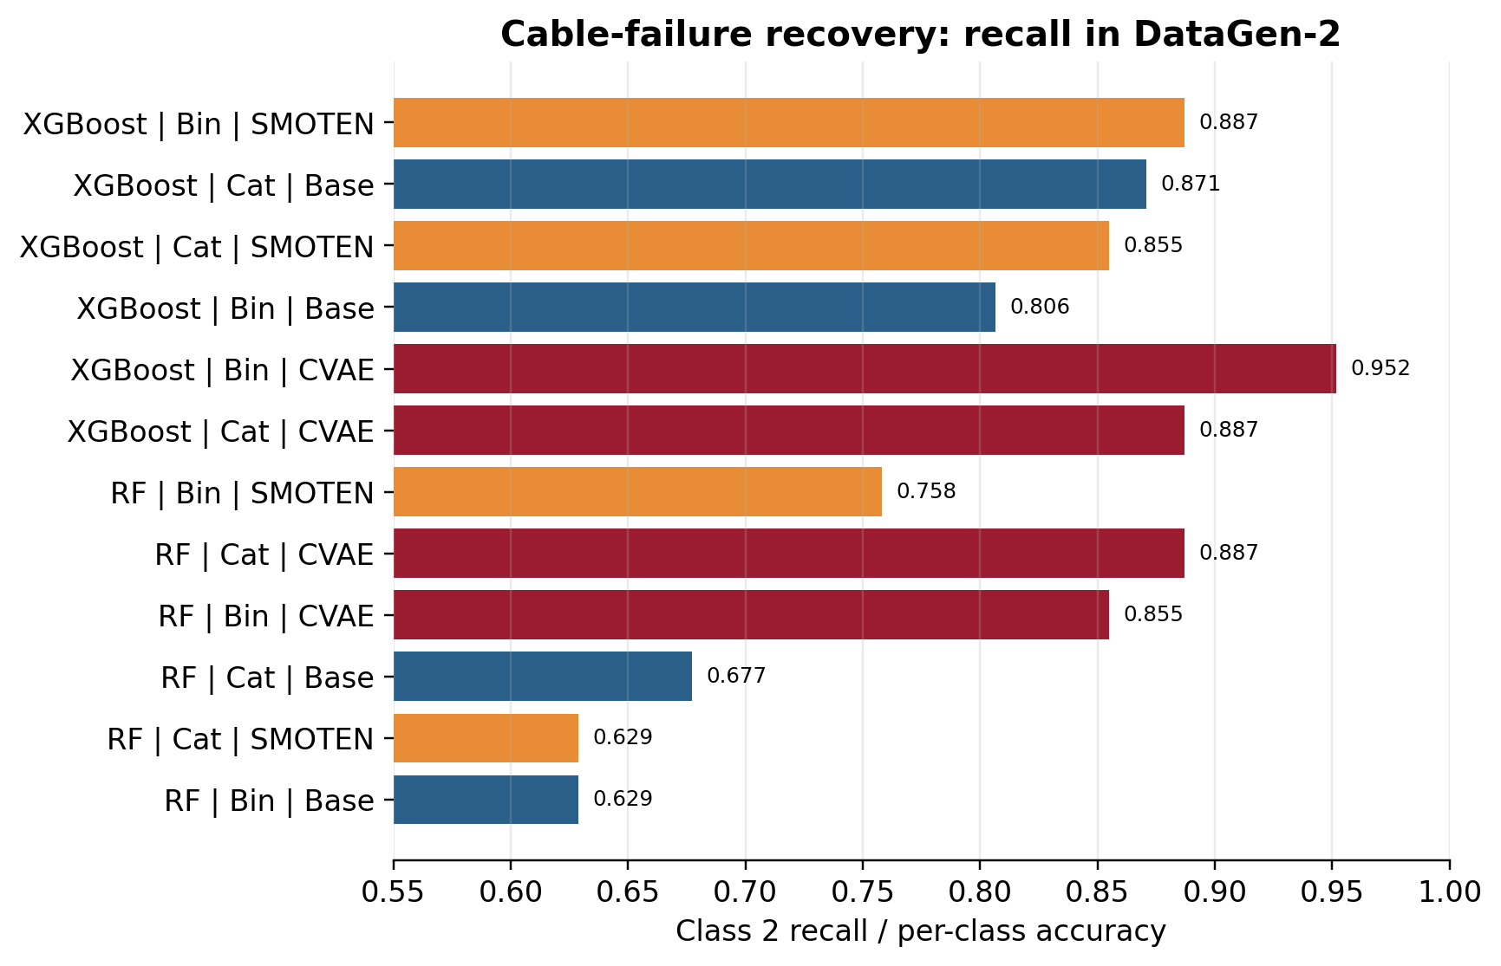
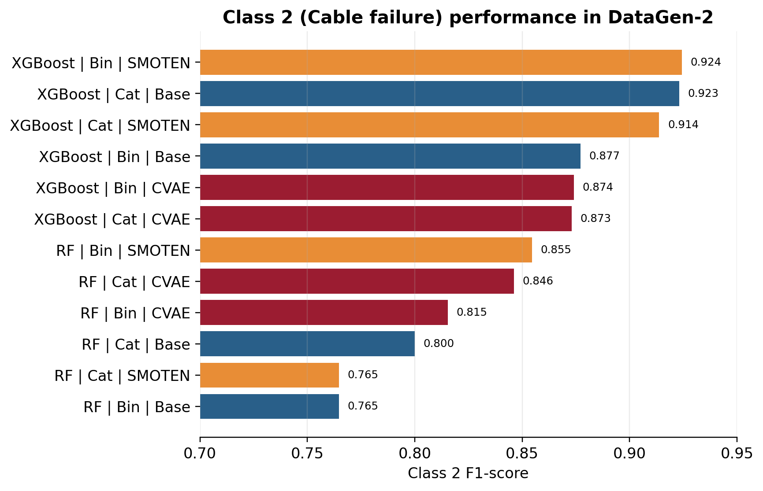
CLASS 2 CABLE FAILURE RECOVERY
Class 2 is the minority class and the target of DataGen-2.
Under DataGen-2, synthetic data improves Cable recovery in several configurations, especially XGBoost + Binary + SMOTEN for Class-2 F1

Slide 27
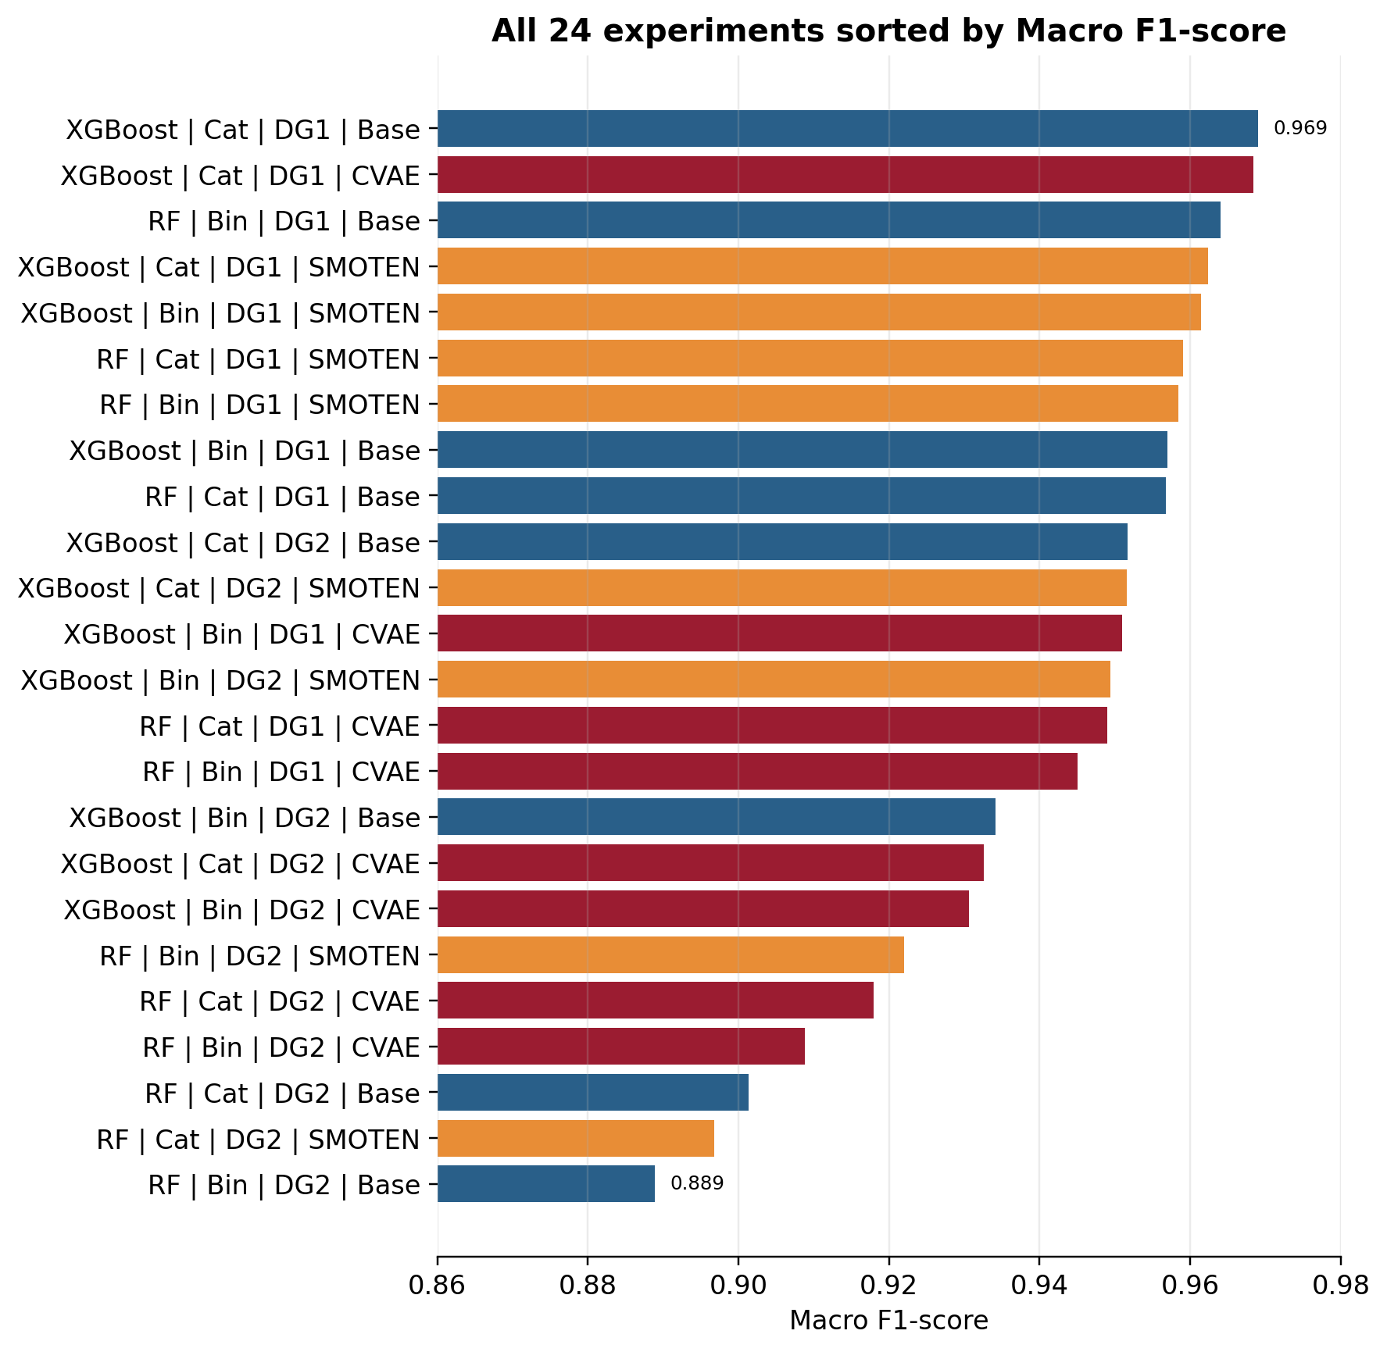
OVERALL RESULT VISUALIZATION
Main result:
Best Macro F1 = 0.9690
XGBoost |Categorical | DataGen-1 |Base
Best synthetic:
Macro F1 = 0.9684
XGBoost |Categorical |DataGen-1 | CVAE
.
Synthetic data was useful in some imbalance scenarios, but not always better than a strong real-only baseline

Slide 28
FINAL INTERPRETATIONS AND LIMITATIONS
We summarized what the results mean and reported limitations below
Finding
Interpretation
Limitation
How we handled it
Best overall
XGBoost + categorical + DG1 Base, Macro F1 0.9690
Train–test pattern overlap
Reported 37.13% overlap
Best synthetic
XGBoost + categorical + DG1 CVAE, Macro F1 0.9684
SMOTEN vs standard SMOTE
Explained as SMOTE-family method for discrete features
DataGen-2
Harder scenario; synthetic data helps some models
Repeated patterns
Same split used for all methods
CVAE vs SMOTEN
CVAE more diverse; SMOTEN faster and simpler
Main lesson
More generated data is not automatically better
Optional advanced task
Not claimed as XAI/TL/FL

Slide 29
SUMMARY
We achieved the following
24
complete experiments
96
per-class rows
8
synthetic-quality rows
0.9690
best Macro F1
0.9684
best synthetic Macro F1
Completed raw-data analysis, preprocessing, model tuning, generation scenarios and final validation.
Compared SMOTEN and CVAE under DataGen-1 and DataGen-2.
Evaluated Random Forest and XGBoost on a fixed real test set.
Found that synthetic data helps mainly under scarcity, but strong Base models can already perform very well.

Slide 30
THANK YOU

