Slide 1
keyloggers
Presented By:
P. Sakthi Lakshmi-Holycross Engineering College-CSE Dep
Reg No:950921104031

Slide 2
Outline
What is Keylogger
Types of Keylogger
Protect yourself from keyloggers
Legal vs Illegal Keylogger Users
Example of Keyloggers
How to Remove Keyloggers

Slide 3

What is keylogger?
A keylogger is a type of software or hardware device used to covertly monitor and record the keystrokes made by a user on a computer keyboard.
Keyloggers operate silently in the background, capturing every keystroke typed by the user without their knowledge. This includes all text input, including usernames, passwords, messages, and other sensitive information.
Keyloggers come in different forms, including software-based and hardware-based variants. Software keyloggers are typically installed on a computer system like any other program, while hardware keyloggers are physical devices inserted between the keyboard and the computer or integrated within the keyboard itself.

Slide 4
Keyloggers can record a wide range of keystrokes, including letters, numbers, symbols, function keys, and special keystrokes like Ctrl, Alt, and Shift combinations. Some advanced keyloggers may also capture screenshots, track mouse movements, or record clipboard activity.
While keyloggers can have legitimate uses such as parental control, employee monitoring, or law enforcement investigations, they are also commonly employed for malicious purposes. Cybercriminals use keyloggers to steal sensitive information such as login credentials, financial data, personal information, and intellectual property for identity theft, fraud, espionage, or sabotage.

Slide 5
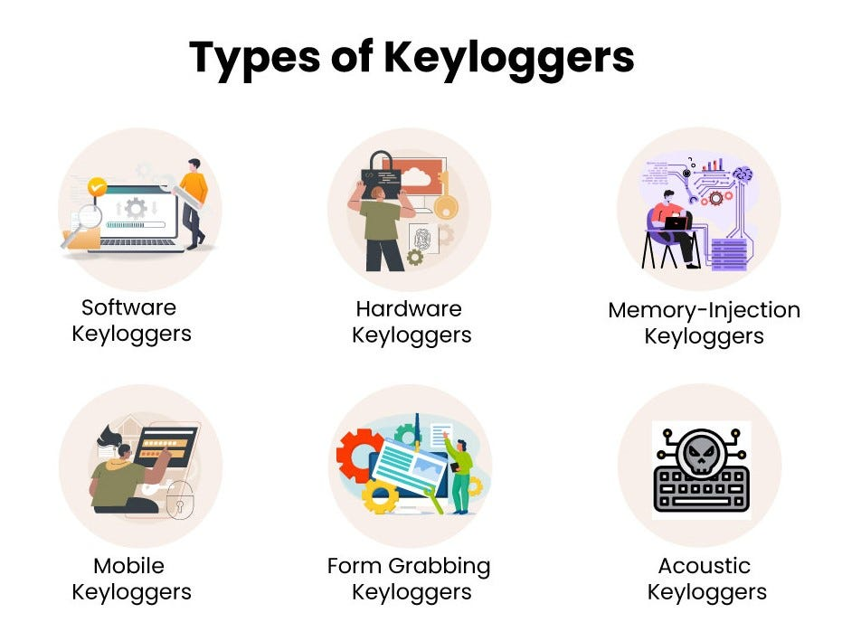

Slide 6
Software Keyloggers
Software keyloggers are covert programs installed on computer systems to secretly monitor and record keystrokes made by users. They operate silently in the background, capturing all text input including passwords, usernames, messages, and other sensitive information without the user's knowledge. Software keyloggers come in various forms, from standalone applications to malicious code embedded in legitimate software. They pose a significant security risk as they can be used by cybercriminals to steal personal and confidential information for identity theft, fraud, or espionage. Detecting and preventing software keyloggers typically requires the use of antivirus software and security best practices.

Slide 7
Hardware Keyloggers
Hardware keyloggers are small devices inserted between a keyboard and a computer, discreetly recording keystrokes. They can be installed by physical access or remotely via compromised USB ports. Unlike software-based keyloggers, they function independently of operating systems and security software, making them difficult to detect. Once installed, they silently capture keystrokes, including sensitive information like passwords, credit card numbers, and personal messages. Some advanced models even feature Wi-Fi connectivity for remote access to logged data. Due to their covert nature and effectiveness, hardware keyloggers pose a significant threat to cybersecurity, requiring vigilance and thorough security measures to defend against.

Slide 9
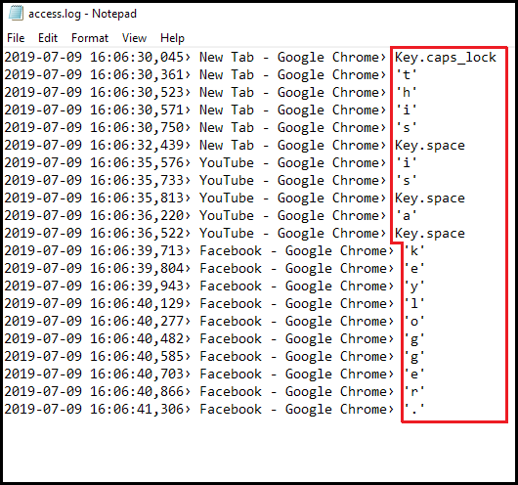
result
Attack tactics and social engineering are
some of the common ways keyloggers are installed in
a malicious scenario. But there is another way this
software can find its way to your computer. Imagine a
scenario where you make your way to a file-sharing site
or software marketplace and choose a software download.
While doing so, you get something extra – your software
comes bundled with a keylogger. This way, a keylogger
can infiltrate your "safe" computer.

Slide 10
PROTECT YOURSELF FROM KEYLOGGERS
Use Antivirus Software: Employ reputable antivirus software with real-time protection to detect and block keyloggers.
Update Regularly: Keep your operating system, software, and antivirus up to date to patch security vulnerabilities.
Avoid Suspicious Links: Refrain from clicking on links or downloading attachments from unknown or suspicious sources.
Use Virtual Keyboards: Utilize virtual keyboards for sensitive tasks like online banking to bypass physical keyloggers.
Two-Factor Authentication (2FA): Enable 2FA wherever possible to add an extra layer of security.
Secure Wi-Fi: Protect your Wi-Fi network with a strong password to prevent unauthorized access.
Monitor Account Activity: Regularly check your accounts for any unusual or unauthorized activity.
Educate Yourself: Stay informed about the latest cybersecurity threats and best practices for prevention.

Slide 11
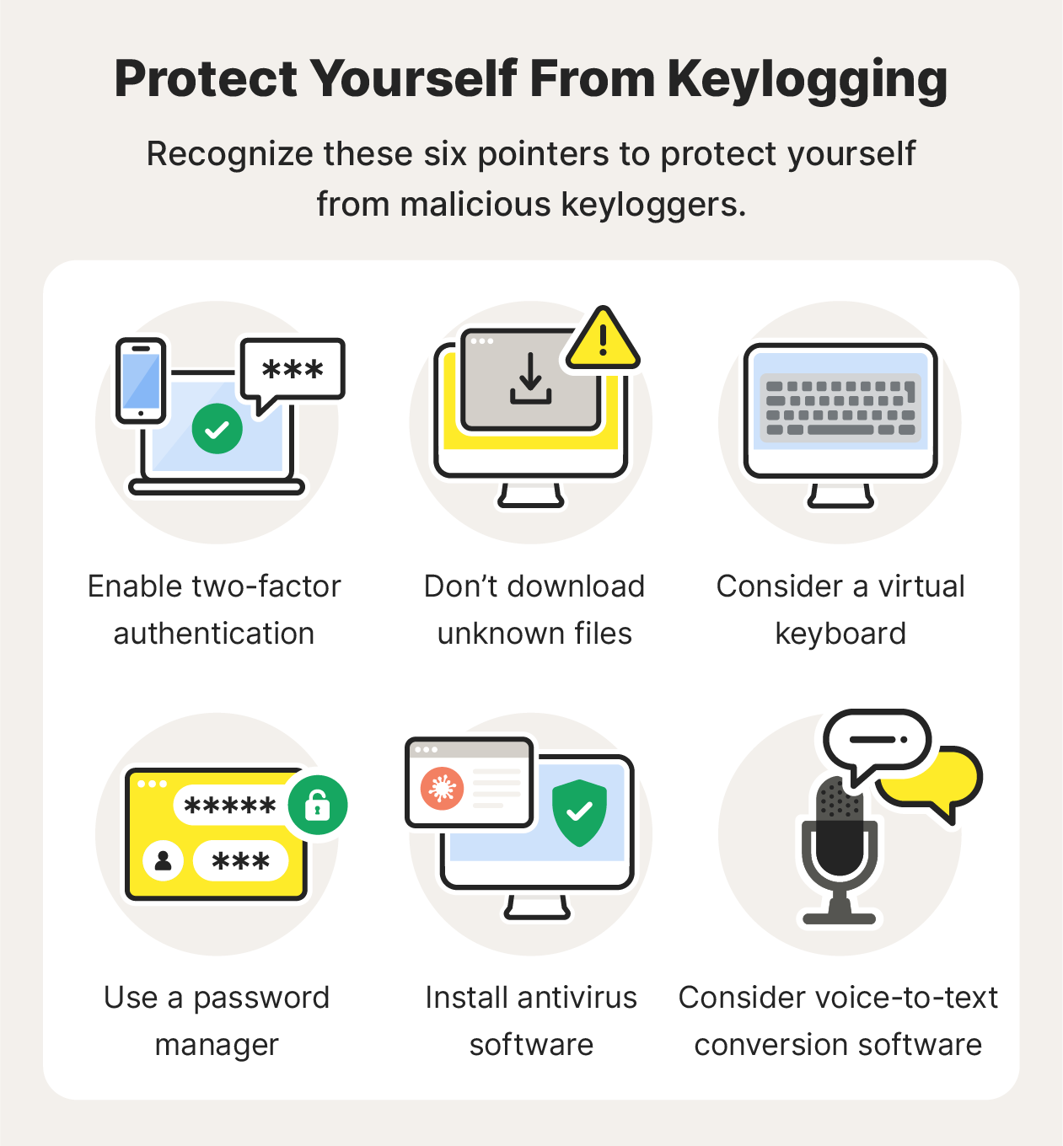

Slide 12
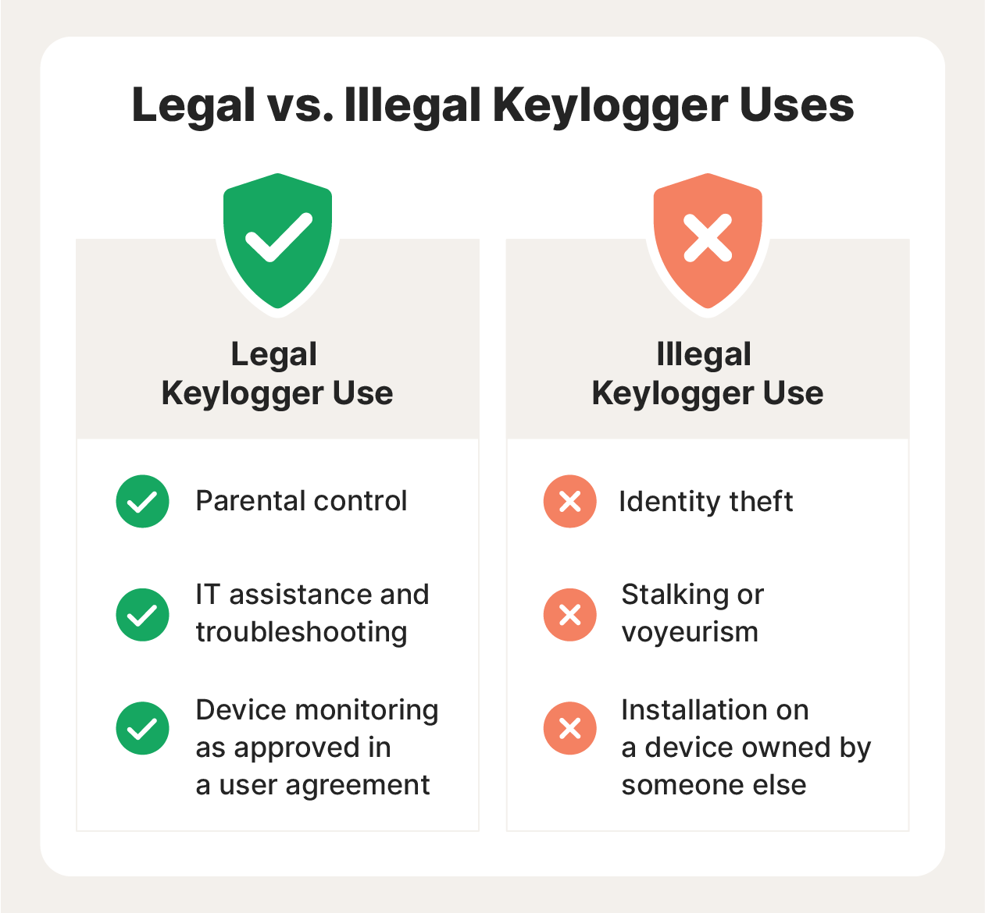

Slide 13
EXAMPLE OF KEYLOGGERS
Keyloggers come in various forms, ranging from software-based to hardware-based, each with its own methods of capturing keystrokes. Here are examples:
Software Keyloggers Examples include:
Spyrix Personal Monitor
REFOG Keylogger
Ardamax Keylogger
Hardware Keyloggers Examples include:
KeyGrabber USB Keylogger
Keyllama USB Premium Keylogger

Slide 14
How to remove keyloggers
Update Your Security Software: Make sure your antivirus and anti-malware software is up-to-date. Run a full system scan to detect and remove any malicious software, including keyloggers.
Use Anti-Malware Tools: Consider using reputable anti-malware tools specifically designed to detect and remove keyloggers. There are many options available, both free and paid, such as Malwarebytes, Spybot - Search & Destroy, or Kaspersky Anti-Virus.
Disconnect from the Internet: Disconnect your device from the internet to prevent the keylogger from sending captured data to its source. This can help contain the damage and prevent further information theft.
Boot into Safe Mode: Boot your computer into Safe Mode to prevent the keylogger from running alongside other startup programs. In Safe Mode, only essential system processes and drivers are loaded, which can make it easier to remove the keylogger.

Slide 15
Review your list of installed programs and remove any unfamiliar or suspicious ones that you don't remember installing. Keyloggers often disguise themselves as legitimate programs, so be thorough in your examination.
Reset Your Passwords: If you suspect that sensitive information has been compromised, such as passwords or financial details, change your passwords immediately. Choose strong, unique passwords for each account to prevent further unauthorized access.
Monitor Your System: After removing the keylogger, keep a close eye on your system for any unusual behavior or signs of re-infection. Regularly scan your computer for malware and practice good cybersecurity habits to prevent future infections.
Consider Professional Help: If you're unsure about removing the keylogger yourself or if the infection seems particularly stubborn, consider seeking assistance from a professional computer technician or cybersecurity expert.

Slide 16
Thank you

