Slide 1
AI ENGINEER INTERNSHIP CASE STUDY
Document Intelligence Platform
End-to-end extraction, validation and reconciliation for financial documents
Live application
document-intelligence-platform-kace.onrender.com
FastAPI | Gemini vision | Evidence-backed JSON
01

Slide 2
CASE-STUDY REQUIREMENTS
Objective and scope
A reviewable pipeline for turning mixed financial documents into traceable, validated data.
4 document types
Safe inputs
Traceable output
Arithmetic checks
Invoice, balance sheet, profit and loss, and cash-flow statement.
PDF, JPG/JPEG and PNG; validated from bytes with a three-page limit.
Fields, table values, source snippets and page evidence.
Document-type formulas with tolerance and explicit statuses.
Design principles
• Do not hallucinate: absent or unreadable values stay null.
• Reject invalid files before OCR or paid AI work.
• Keep asynchronous processing visible to the user.
• Expose the same structured result through the dashboard and API.
02 | DOCUMENT INTELLIGENCE PLATFORM

Slide 3
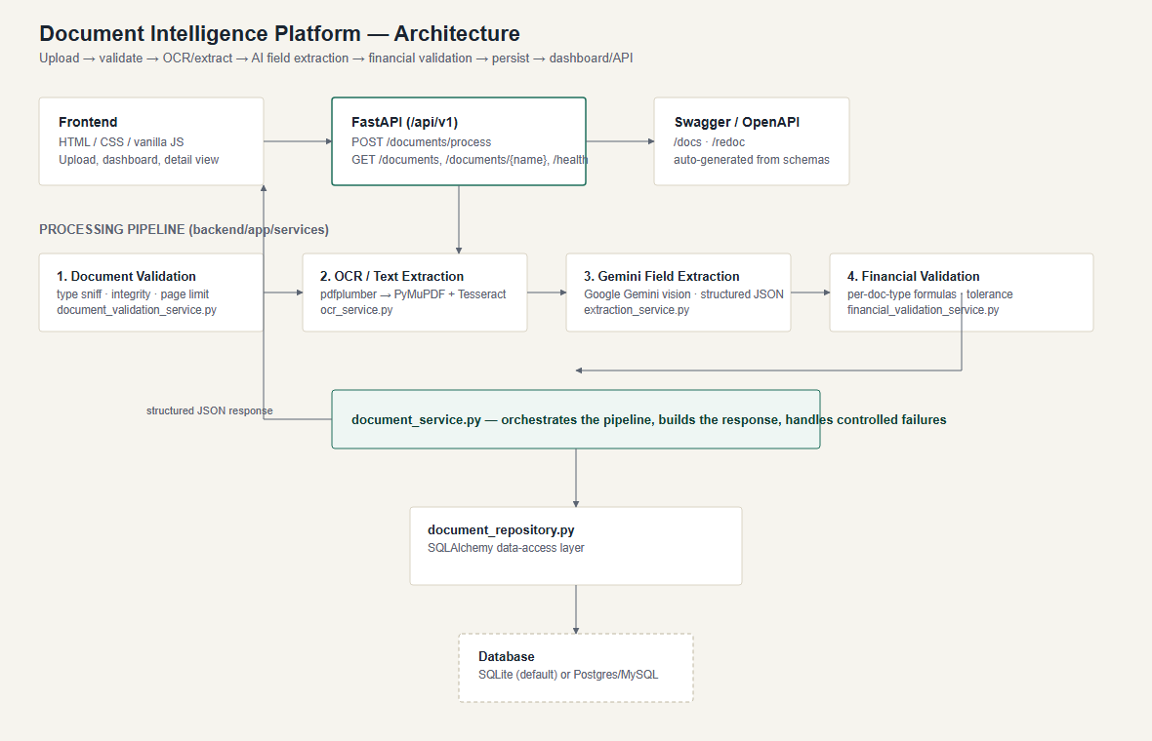
MODULAR PROCESSING PIPELINE
System architecture
Request flow
Browser dashboard
-> FastAPI REST API
-> validation and OCR
-> Gemini vision extraction
-> financial validation
-> repository and database
-> dashboard / API response
Service boundaries
• document_validation_service.py
• ocr_service.py and extraction_service.py
• financial_validation_service.py
• document_repository.py
03 | DOCUMENT INTELLIGENCE PLATFORM

Slide 4
BEFORE THE AI CALL
Validation, OCR and input safety
1. Validate bytes
2. Extract text
3. Preserve evidence
Detect file signatures, MIME/type, integrity, readability, page count and size.
Use PDF text when available; rasterize scanned pages with PyMuPDF and Tesseract.
Normalize page-tagged text and images so every field can point back to a page.
Rejected early
Supported upload contract
• Unsupported extensions or content types
• Empty, corrupt or unreadable files
• Documents above 15 MB or more than 3 pages
• Invalid PDF/image content before OCR begins
PDF | JPG / JPEG | PNG
Maximum 3 pages | Maximum 15 MB
Processing states: PROCESSING -> PASS / FAILED
Page number and source snippet per extracted field
04 | DOCUMENT INTELLIGENCE PLATFORM

Slide 5
CURRENT GEMINI IMPLEMENTATION
Evidence-backed AI extraction
The model is used for reading and structuring the document, not for inventing accounting data.
Structured contract
Vision + text context
Resilient responses
google-genai SDK with a stable extracted_data envelope, line items, evidence and confidence.
Normalized page images plus page-tagged OCR/text are supplied for layout-aware extraction.
Handles current response variants, empty output, JSON fences, retry and model fallback.
Guardrails
• Missing or unreadable values return null.
• Evidence includes source_text and page_number.
• Comparative periods use explicit field__period keys.
• Runtime key is configured through GEMINI_API_KEY and never committed.
05 | DOCUMENT INTELLIGENCE PLATFORM

Slide 6
TRANSPARENT ARITHMETIC
Financial validation engine
Each check records its operands, formula, calculated value, reported value, variance and status.
Invoice
subtotal + tax - discount = total
Balance sheet
liabilities + equity = assets
Profit and loss
revenue - cost of sales = gross profit
Cash flow
operating + investing + financing + FX = net change
Status policy
PASS within rounding tolerance | FAIL when operands disagree | NOT_APPLICABLE when inputs are missing
06 | DOCUMENT INTELLIGENCE PLATFORM

Slide 7
REVIEWABLE BY A HUMAN
Product experience and API
Ledger dashboard
Document workspace
Async visibility
Responsive upload workflow, search, filters, statistics and refresh control.
Centered detail view with Fields, Validation and Raw JSON tabs; missing and low-confidence values are marked.
POST returns a processing record; the browser polls until PASS or FAILED and shows the exact failure.
Mandatory endpoints
One response model
POST /api/v1/documents/process
GET /api/v1/documents/{document_name}
GET /api/v1/documents
GET /api/v1/health
GET /docs and /redoc
The API and UI share the same persisted document, extracted fields, line items, validation checks and raw JSON.
07 | DOCUMENT INTELLIGENCE PLATFORM

Slide 8
EVIDENCE OF COMPLETION
Verification and deployment
25
43
6
PASS
AUTOMATED TESTS PASS
LIVE FIELDS EXTRACTED
LIVE LINE ITEMS
FRESH LIVE INVOICE TEST
Deployment checks
Repository
• Public Render frontend is live.
• /api/v1/health reports service status and Gemini configuration.
• Swagger/OpenAPI is available at /docs.
• Fresh live invoice verification returned file validation PASS and processing PASS.
• Sample JSON fixtures cover all four document types and failure paths.
github.com/SakthiPriyaR/ document-intelligence-platform
No secrets committed; runtime key is supplied by the deployment environment.
08 | DOCUMENT INTELLIGENCE PLATFORM

Slide 9
READY TO SUBMIT
Deployment and submission links
Use these live links in the internship submission form and during your presentation.
Deployed Backend API (health)
Deployed Frontend URL
https://document-intelligence-platform-kace.onrender.com/api/v1/health
https://document-intelligence-platform-kace.onrender.com/
Open working API endpoint
Open live frontend
Deployment platform used
Public GitHub repository
Render - Docker web service on the Free plan
github.com/SakthiPriyaR/document-intelligence-platform
Open public repository
PPT sharing
Download the version-controlled PPTX from GitHub
Google Drive submission: upload this PPTX to your Drive, set General access to 'Anyone with the link - Viewer', then paste that share URL into the form.
09 | DOCUMENT INTELLIGENCE PLATFORM

Slide 10
WHAT CHANGES BEYOND EVALUATION
Limitations and production plan
The evaluation deployment is intentionally small; the seams for production hardening are explicit.
Current limitations
Production changes
Render Free local SQLite storage is ephemeral. No authentication or rate limiting. Large dense documents may need chunked extraction. Model confidence is not independently calibrated.
Managed Postgres and object storage. Durable worker queue and observability. Authentication, tenant isolation and quotas. Golden-document evaluations and reconciliation expansion.
Important distinction
The current live extraction flow works; durable history requires a persistent database plan.
10 | DOCUMENT INTELLIGENCE PLATFORM

Slide 11
ENGINEERING DISCIPLINE
Delivery quality and submission materials
Delivery quality
Included in the repository
Modular service boundaries, controlled failures, environment-based configuration and automated tests keep the system maintainable. Gemini is used at runtime only for evidence-backed field extraction after explicit configuration.
Public GitHub source Live frontend, API and Swagger README with setup and limitations Architecture source plus PNG/PDF exports This solution presentation in PPTX/PDF/Markdown Sample fixtures and automated tests
Thank you
Live app: document-intelligence-platform-kace.onrender.com
11 | DOCUMENT INTELLIGENCE PLATFORM

Slide 12
SIX-MINUTE WALKTHROUGH
How to present the live demo
01
Open the live Ledger dashboard
State the problem: financial documents are unstructured and hard to review.
02
Choose a document type and upload
Point out PDF/JPG/PNG support, page limit and validation before AI.
03
Explain the processing path
Validation -> OCR -> Gemini extraction -> financial reconciliation -> persisted result.
04
Open the processed document
Show fields, evidence, line items, validation checks and raw JSON.
05
Close with assurance
Mention live deployment, API docs, 25 tests, known limits and the production roadmap.
Tip: do the upload before your interview starts so the completed record is already available to open.
12 | DOCUMENT INTELLIGENCE PLATFORM

