Slide 1
BUSINESS-CRITICAL TICKET MONITORING
Business-Critical Watcher
An automatic assistant that watches most important BC tickets,
summarizes what changed, next actions periodically and emails the team - so nobody has to chase for updates.

Slide 2
THE PROBLEM
Keeping track of critical tickets was manual and slow
1
Constant follow-ups
Teams across the business spend a lot of time following up with developers just to get the current status.
2
Scattered projects
Critical issues were spread across many Jira projects. No single place to see them all.
3
Easy to miss
A new comment or status change could sit unnoticed for hours or days.
4
Slow to explain
When something broke, writing up what happened and why took time and effort.
5
Heavy documentation
Long technical write-ups, stack traces and multi-paragraph comments take real time just to read.
Jira Business-Critical Watcher
2

Slide 3
WHY THIS IS DIFFERENT
Not another ticket feed - one clear AI summary
This is not a copy of Jira and not a raw stream of comments. For each critical issue the AI reads everything and writes one final, consolidated summary - the current status and what's next - so everyone stays updated without digging. Engineers update the ticket in one place - like a status page - and that single update reaches everyone automatically.
The usual way
With the Watcher
- Scroll through long comment threads
+ AI-written current status
- Piece the story together yourself
+ Only what matters: status + what's next
- Ask developers for the latest status
+ Updates reach everyone by email, automatically
- Different tickets in different projects
+ Every critical ticket, all in one place
Jira Business-Critical Watcher

Slide 4
THE SOLUTION
One dashboard that watches everything for you
The Watcher checks your business-critical tickets on a schedule, understands what changed using AI, and shows it all on one clean screen. It can also email the team automatically.
All in one place
Reads the updates for you
Emails automatically
Every critical ticket across every project on a single dashboard.
AI writes a short, plain-language status and what is likely next.
New updates and end-of-day summaries are sent without anyone asking.
Jira Business-Critical Watcher
3

Slide 5
HOW IT WORKS
Four simple steps, running quietly in the background
1
2
3
4
>
>
>
Scan
Understand
Show
Notify
Fetches the latest business-critical tickets and their comments from Jira.
Groq AI reads each ticket and writes a short status and what is next.
Displays everything on the live dashboard, grouped and filterable.
Emails real-time updates and an end-of-day summary to the team.
Jira Business-Critical Watcher
4

Slide 6
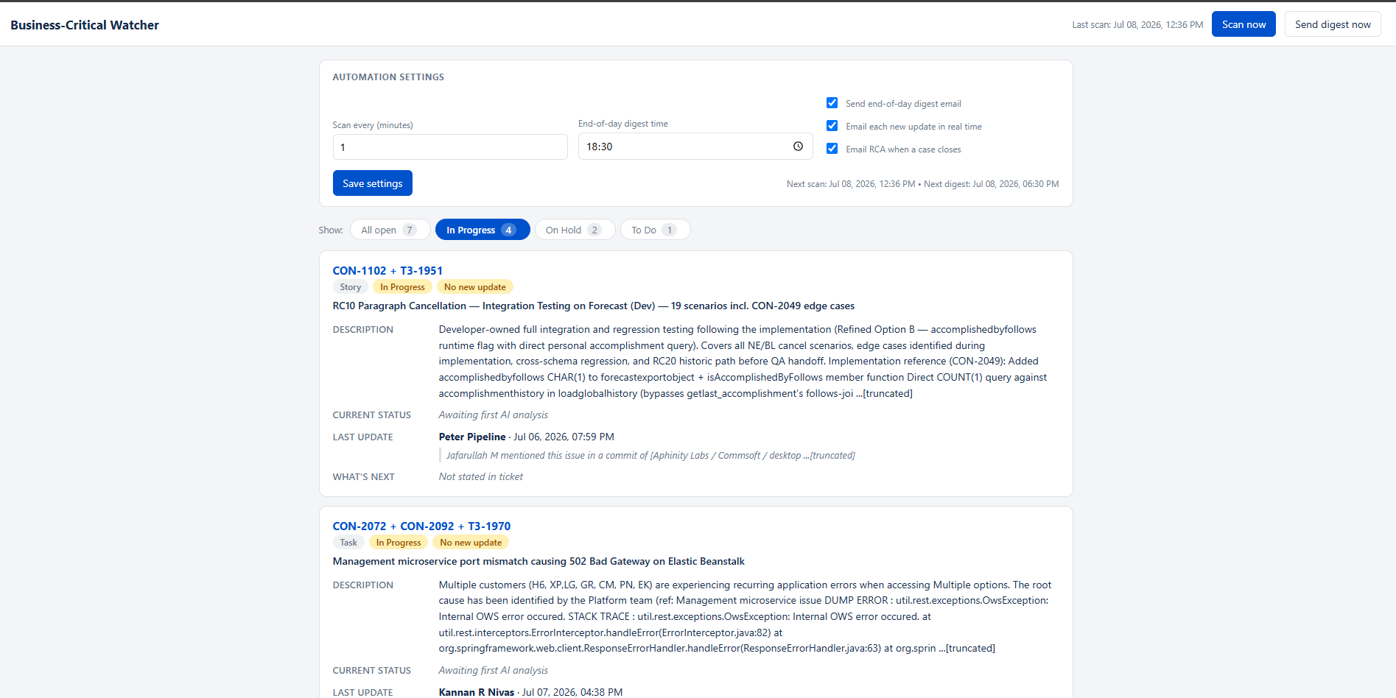
THE DASHBOARD
Every critical ticket, one screen
Filter tabs
Switch between In Progress, On Hold and To Do in one click.
Live counts
See how many tickets are in each state at a glance.
Clean cards
Description, current status, last update and what's next per ticket.
Auto refresh
The screen updates itself after each scan.
Jira Business-Critical Watcher
5

Slide 7
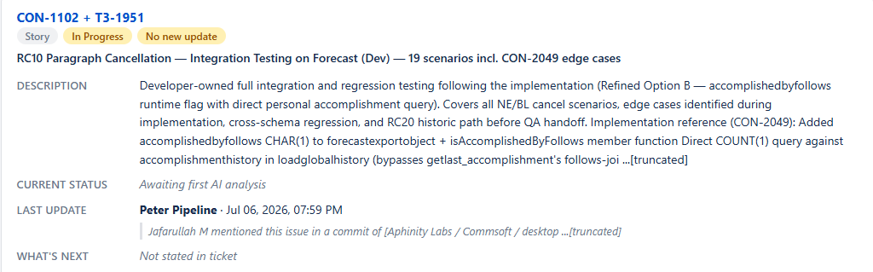
AI STATUS & PREDICTION
Plain-language updates, written automatically
Current status
A short summary of where the ticket stands right now.
What's next
The AI's best guess at the likely next step.
No update label
In-progress tickets with no change are clearly marked 'No update'.
Clean text
Jira formatting and @mentions are stripped for easy reading.
Jira Business-Critical Watcher
6

Slide 8
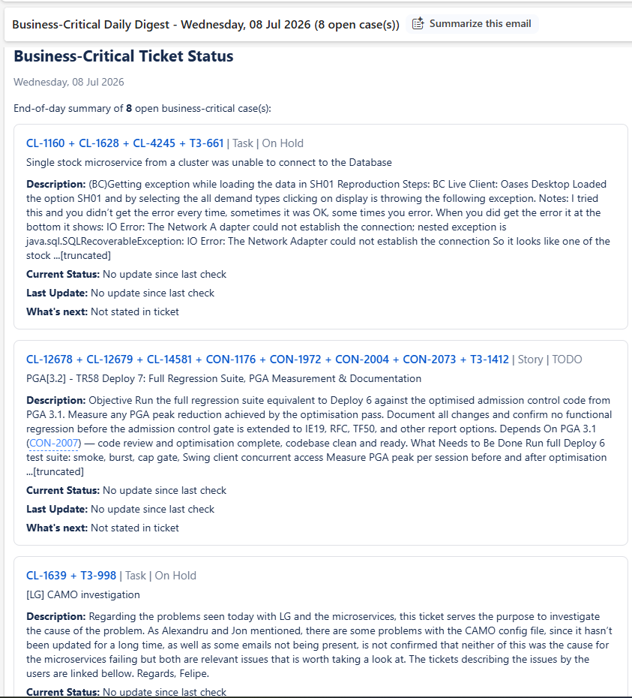
AUTOMATIC EMAILS & RCA
Updates land in the inbox without anyone asking
Real-time updates
When a ticket gets a new comment, an email goes out.
End-of-day digest
One tidy summary of all open critical tickets, sent daily.
RCA emails
Root-cause summaries are drafted automatically for incidents.
Consistent format
Description, current status, last update and next step - every time.
Jira Business-Critical Watcher
7

Slide 9
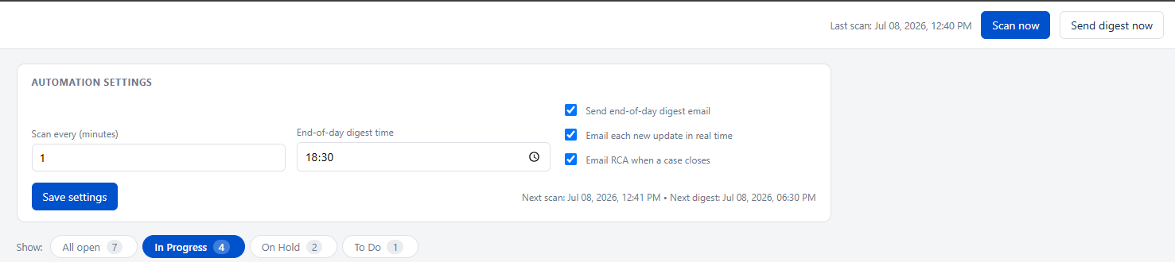
SET IT AND FORGET IT
You control the timing from the dashboard
Choose the interval
Scan every 5, 10 or 30 minutes - whatever suits the team.
Pick the digest time
Set the end-of-day summary to arrive when you want it.
Turn features on/off
Enable or disable real-time emails and the digest.
Runs on its own
Starts automatically and keeps watching in the background.
Jira Business-Critical Watcher
8

Slide 10
THE BENEFITS
Why this matters day to day
Saves developer time
No more being interrupted for status updates - the app answers for them.
Nobody chases anymore
Managers see live status without pinging anyone.
Nothing slips through
Every new comment and status change is caught automatically.
All projects in one place
Critical issues across all projects, tracked together.
Faster incident write-ups
AI drafts root-cause summaries in seconds.
Easy to follow
Simple, plain-language cards anyone can understand.
Jira Business-Critical Watcher
9

Slide 11
TOOLS USED
Built with modern AI and Jira's own platform
Cursor AI
Groq Inference – Grok 4.3
Used to design and build the whole application quickly, from idea to working tool.
Reads each ticket and writes the plain-language status, next step and RCA summaries.
Jira Rovo
Jira REST API
Atlassian's AI layer that helps surface and understand ticket context.
Pulls live ticket details, comments and links straight from Jira.
Jira Business-Critical Watcher
10

Slide 12
WHAT'S NEXT
Where this app can grow
Trend & prediction
Predict which tickets are at risk of slipping their deadline.
Slack / Teams alerts
Push updates to chat channels, not just email.
+
+
SLA & priority scoring
Automatically flag tickets breaching agreed response times.
Team workload view
See who is handling what and spot bottlenecks early.
+
+
Custom reports
One-click weekly and monthly summaries for leadership.
More AI depth
Suggested fixes and links to similar past incidents.
+
+
Jira Business-Critical Watcher
11

Slide 13
Watch less. Know more.
One AI summary keeps everyone updated.
Jira Business-Critical Watcher
Cursor - Groq / Grok 4.3 model - Jira Rovo & REST API

