Slide 1


CRIME DETECTION IN CREDIT CARD FRAUD
SUPERVISOR Mr.A.Malarmannan,M.E., AP/CSE.
PRESENTED BY
2303811710422135 – SAKTHI SWATHI.M

Slide 2

PRESENTATION OVERVIEW
Objective
Project Introduction
Problem Statement
Methodologies (Programming concepts relevant to problem statement)
Architecture of the proposed system
List of Modules
7. Merits
8. Results and Discussion
9. Queries

Slide 3
OBJECTIVE
Credential Validation: To securely validate credit card numbers and PINs by comparing them with predefined valid credentials to ensure only authorized users gain access.
Fraud Detection: To monitor and track multiple incorrect login attempts, raising fraud alerts when the maximum allowed attempts are exceeded to prevent unauthorized access.
User Security: To enhance the security of credit card usage by providing real-time feedback on successful or failed attempts and alerting users to potential risks.

Slide 4
PROJECT INTRODUCTION
This project aims to simulate a basic fraud detection system for credit cards. It ensures the security of credit card transactions by verifying card numbers and PINs against a predefined database of valid credentials.
The system tracks the number of failed attempts and triggers a fraud alert when the maximum allowed attempts are exceeded.
The implementation is in Java using an interactive graphical user interface (GUI), making it user-friendly for real-world applications.

Slide 5
PROBLEM STATEMENT
Credit card fraud is a growing concern in digital transactions, posing significant financial risks to users and financial institutions. This project addresses:
Validation of user credentials.
Prevention of unauthorized access.
Alert generation in case of repeated failed login attempts.
The goal is to ensure security and provide a mechanism to detect and prevent fraudulent activities.

Slide 6
Methodologies (Programming concepts relevant to problem statement)
Classes and Objects
Abstract Window Toolkit(AWT)
Event Handling
Array Handling
Control Flow
Error Handling

Slide 7
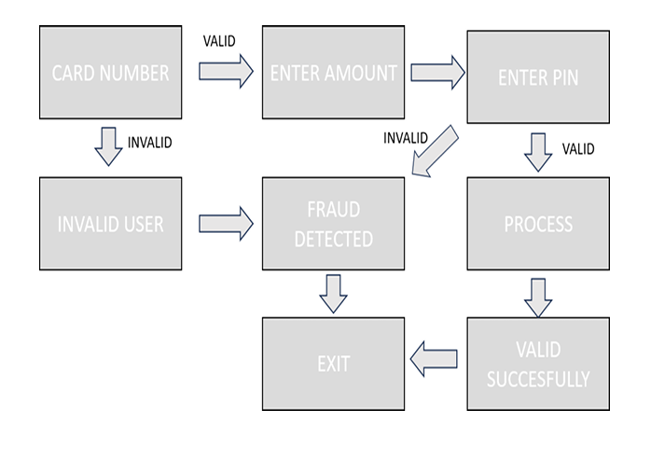
FLOW DIAGRAM

Slide 8
MODULE DESCRIPTION
User Input Module
Validation Module
Attempt Tracking Module
Alert Module
GUI Module

Slide 9
MERITS
Enhanced Security:
Prevents unauthorized access to the system.
User-Friendly Interface:
Simplifies interaction with clear instructions and alerts.
Fraud Detection:
Identifies and raises alerts for suspicious activities.
Scalability:
Can be expanded with more advanced fraud detection algorithms.
Immediate Feedback:
Provides real-time responses to user actions.

Slide 10
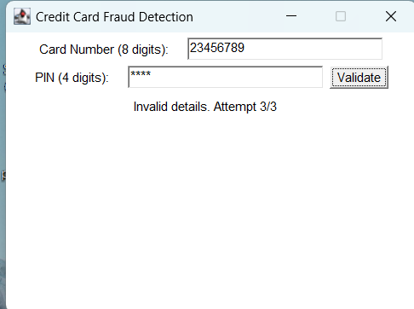
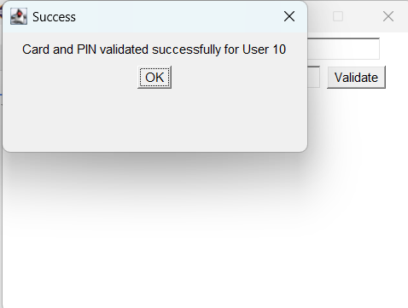
RESULT AND DISCUSSION

Slide 11
ANY QUERIES ?

Slide 12
THANK YOU

