Slide 1
Interactive dashboard
Mini python project by
Name:Sakthi eswaran.D
Intern ID number:STB03-T0017

Slide 2
Introduction
An interactive dashboard is more than a collection of visualizations; it's a dynamic interface that responds to user input, providing a personalized and immersive experience.
Interactive dashboards empower users to actively engage with data, unraveling insights with a simple click or touch.

Slide 3
Objective
Create a platform that facilitates in-depth exploration of our dataset.
Allowing users to dig into various aspects and uncover valuable insights.

Slide 4
Technologies Used
Python
Dash
Plotly
pandas

Slide 5

Algorithm for creating Interactive Dashboard
Import Required Libraries:
Import Dash and the necessary components from Dash and Plotly.
Create Dataframe:
Create the dataframe for the given csv file.

Slide 6
Algorithm for creating Interactive Dashboard
Initialize the App:
Create an instance of the Dash class to initialize the application.
Define the Layout:
Use HTML and Dash components to define the layout of your dashboard.
.

Slide 7

Algorithm for creating Interactive Dashboard
Run the App:
Add the conditional statement to run the app only when the script is executed directly.
Launch the Dashboard:
Run the script, and the dashboard will be accessible through a web browser.

Slide 8
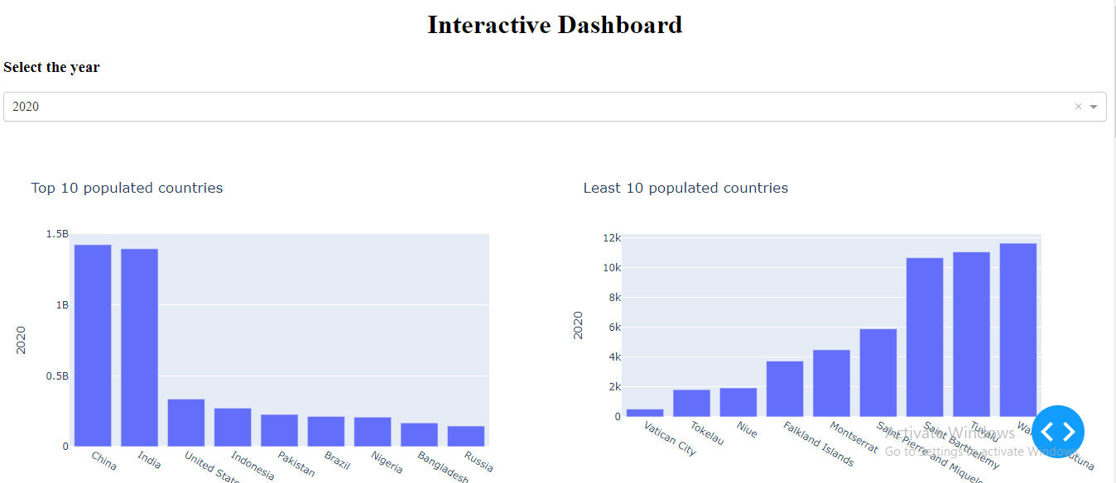
Output

Slide 9
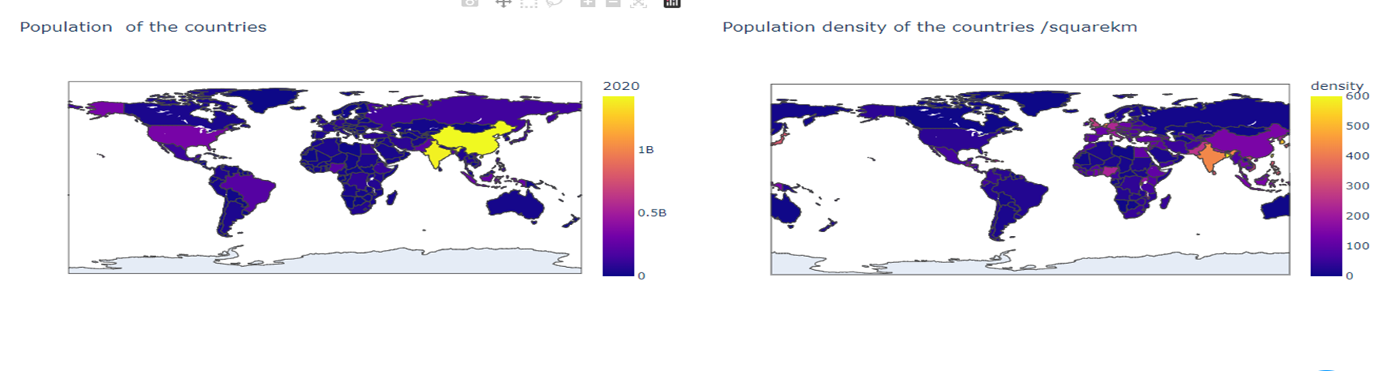

Slide 10
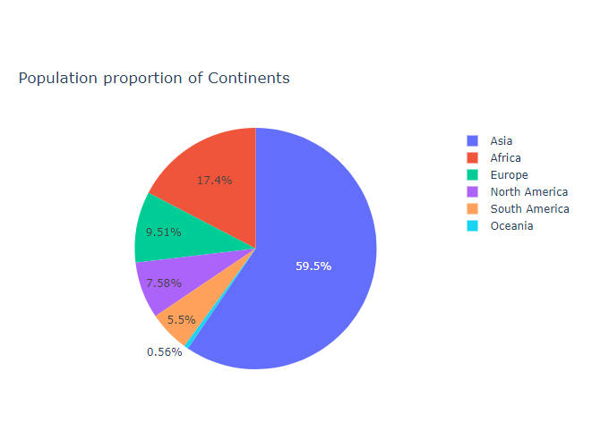
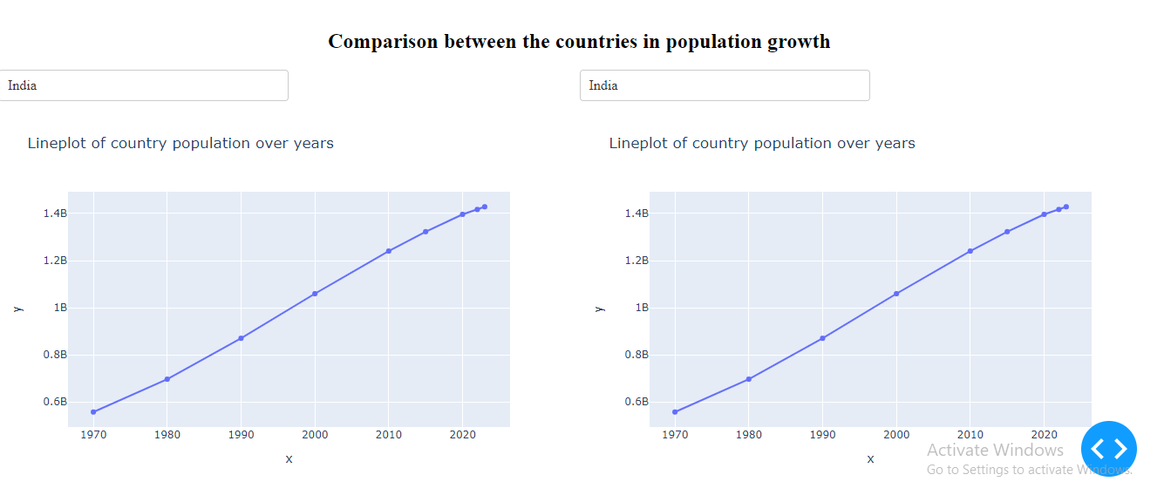
Output

