Slide 1
Image Classification
Mini project by
Name:Sakthi eswaran.D
Intern ID number:STB03-T0017

Slide 2
Introduction
Image classification is a task in that involves categorizing images into predefined classes or categories based on their visual content.
In this project we are going to see how to make a image classification model to classify images.

Slide 3
Objective
The primary objective is to develop a robust image classification system capable of accurately categorizing images into predefined classes or categories using Convolutional Neural Networks (CNNs).

Slide 4
Technologies Used
Python
Tensorflow
Matplotlib

Slide 5
Algorithm for Image classification
Import Required Libraries:
Import Tensorflow and the necessary components from image classification.
Data Preparation:
Define the directories containing training and testing image datasets.
Specify image dimensions and batch size.
Generate batches of training and testing data using ImageDataGenerator.

Slide 6
Algorithm for Image classification
Model Development:
Define the architecture of the CNN model.
Compile the model with an appropriate optimizer, loss function, and evaluation metrics
Model Training:
Train the CNN model using the training dataset.
Specify the number of epochs and batch size for training.
Monitor training progress and performance on the validation dataset.
Adjust hyperparameters if necessary to improve model performance.
.

Slide 7
Algorithm for Image classification
Model Evaluation:
Evaluate the trained CNN model's performance on the testing dataset to assess its accuracy and generalization capabilities.
Calculate test accuracy and loss metrics to measure the model's effectiveness in classifying unseen images.

Slide 8
Algorithm for Image classification
Visualization:
Plot the training and validation loss over epochs to visualize the model's learning progress and identify potential overfitting or underfitting.
Plot the training and validation accuracy over epochs to assess the model's performance improvement during training.

Slide 9
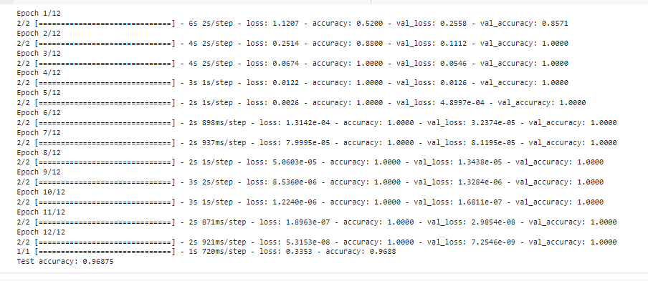
Output

Slide 10
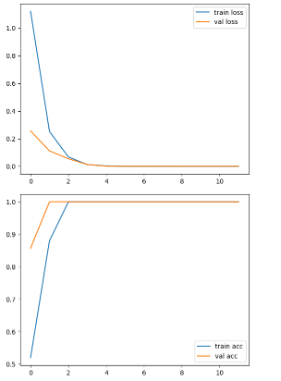
Output

