Slide 1
T Sakthikeerthika
au813821244052
Naan Mudhlvan Project - Semester 6
Generative AI
Saranathan College of Engineering
Year III- CSBS

Slide 2
Binary Text Classification of Yelp Reviews using CNNs.

Slide 3


AGENDA
1.Problem Statement
2.Project Overview
3.Who are the End Users?
4.Your Solution and its Value Proposition
5.The WOW in your Solution
6.Modelling
7.Results

Slide 4

PROBLEM STATEMENT
In the vast sea of online reviews, distinguishing between positive and negative feedback is crucial for businesses to understand customer sentiment and improve services. Manual review classification is time-consuming and prone to errors. How can we automate the process of categorizing Yelp reviews into positive or negative sentiment accurately and efficiently?

Slide 5

PROJECT OVERVIEW
This project aims to leverage Convolutional Neural Networks (CNNs) to build a binary text classification model that automatically classifies Yelp reviews into two categories: positive and negative. By utilizing advanced NLP techniques and deep learning, we seek to create a model that not only improves accuracy over traditional methods but also offers insights into the features driving sentiment in customer reviews

Slide 6
STEPS:
1.Download and Import necessary libraries.
2.Functions
3.Loading Dataset (Yelp Reviews dataset from Kaggle)
4.Shuffeling and splitting the Data
5.Preprocessing and Tokenization
6.Dataset Visualization
7.Sequence Normalization and Encoding Labels
8.Model Preparation and Training (CNN)
9.Visualizing and Evaluating the Results
10.Saving the model

Slide 7
WHO ARE THE END USERS?
Our primary end users are business owners and service managers who rely on customer feedback to make informed decisions. Additionally, data analysts and marketing teams can use our solution to gauge customer sentiment trends over time. The secondary audience includes academic researchers and students interested in applied NLP and sentiment analysis

Slide 8

YOUR SOLUTION AND ITS VALUE PROPOSITION
Solution:
Our solution employs a CNN model trained on a vast dataset of Yelp reviews. It outperforms traditional text classification models by capturing local dependencies and semantic nuances in textual data.
Value Proposition: Automate sentiment analysis with high accuracy, reduce manual review analysis costs, and enable real-time sentiment tracking to swiftly address customer concerns and improve service quality.

Slide 9

THE WOW IN YOUR SOLUTION
What sets my solution apart is its innovative use of CNNs, traditionally used for image processing, in understanding textual content. By adapting these models to NLP, our solution captures complex patterns in text data, achieving remarkable accuracy. Additionally, our model's ability to learn from unstructured text data means it continuously improves, offering scalable and dynamic sentiment analysis.
9

Slide 10
MODELLING
Data Preparation: The modelling process begins with data preprocessing: cleaning text data, tokenization, and vectorization using word embeddings.
Model Architecture: Design a CNN architecture suitable for the sentiment analysis task, considering factors like convolutional layers, pooling layers, and dense layers.
Model Compilation: The model is compiled with binary cross entropy loss and the Adam optimizer.
Model Training: Train the CNN model using the training data, specifying the number of epochs and batch size.
Model Evaluation: Evaluate the trained model using the validation set to assess its performance and adjust hyperparameters if necessary.
Performance Evaluation: Evaluate the model's performance using metrics such as accuracy.
10

Slide 11
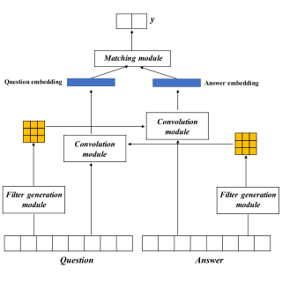
MODELLING

Slide 12
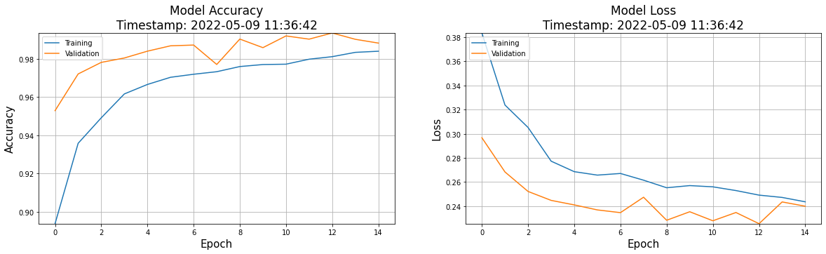
RESULTS
My CNN model achieved an accuracy of 90.68% on the test set.
12

