Slide 1
Walmart
Sales Analysis

Slide 2
Problem Statement
The analysis aims to identify key trends and insights from Walmart's sales data across cities, product categories, payment methods, time periods, and branch performance.
By examining disparities in sales, customer preferences, and ratings, this study seeks to uncover actionable opportunities to enhance market strategies, optimize product offerings, and improve customer satisfaction for sustainable growth

Slide 3
Overview of Walmart Sales Data
Unit Price:
The product unit prices span from $10 to $100, offering a broad spectrum of affordable to mid-range items across different categories.
Quantity per Sale:
On average, each transaction involves the purchase of 1 to 10 units, reflecting varied consumer buying behavior and potential opportunities for bulk purchases.
Total Transaction Value:
The total price per transaction ranges from $10 to approximately $1000, with an average value of $121, indicating that while most sales are modest, there are significant transactions that could represent high-value products or larger orders.
Product Ratings:
The average product rating sits at around 6, suggesting room for improvement in customer satisfaction or potential opportunities for addressing product feedback.
Profit Margins:
The average profit margin across all sales is 0.40, providing a healthy margin that can be leveraged for strategic pricing, cost control, or promotions to enhance profitability.

Slide 4
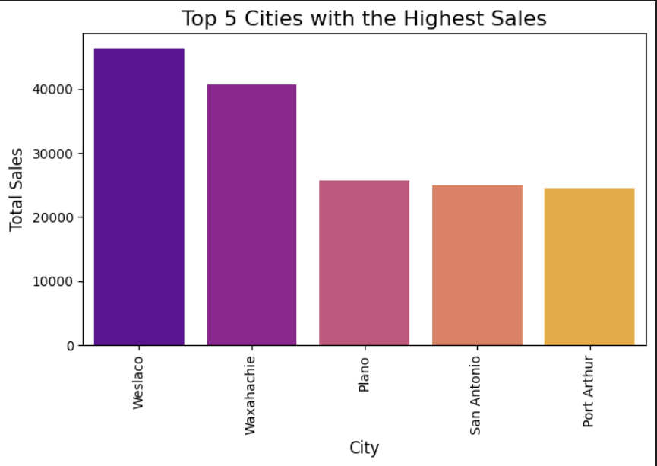
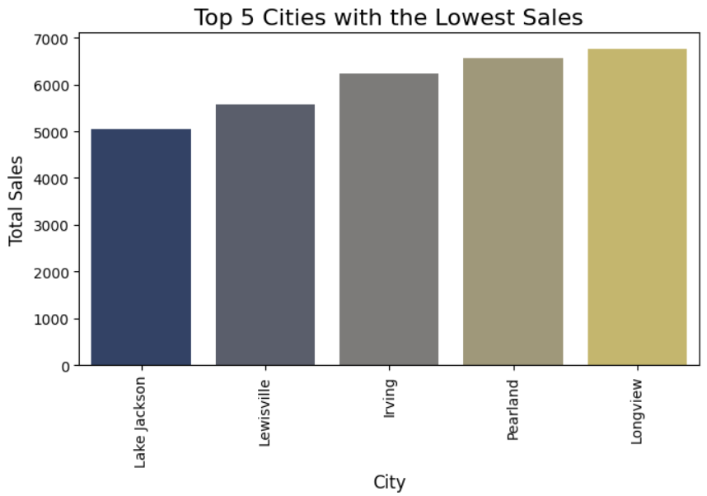
Regional Sales Performance
Among the 98 cities analyzed, Weslaco emerged as the top-performing region, contributing 4% of total sales, showcasing robust consumer engagement and strong market activity.
In contrast, Lake Jackson recorded the lowest sales share at 0.5%, highlighting an area with lower market activity that could benefit from focused strategies to unlock growth potential

Slide 5
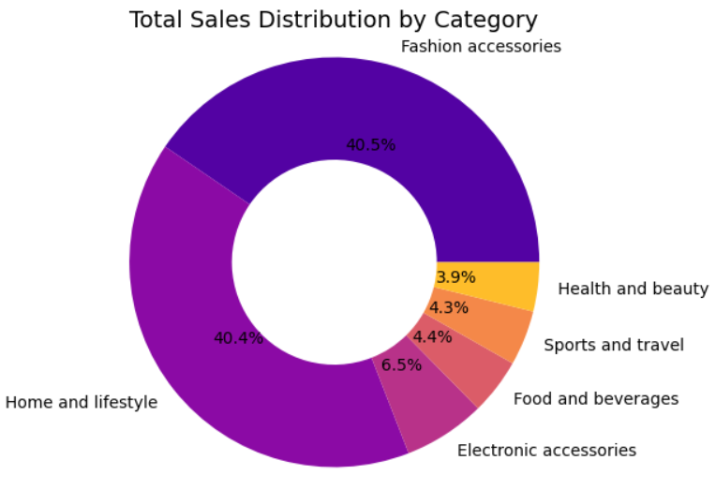
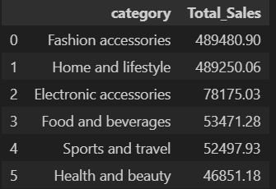
Product Category Trends
The Fashion Accessories and Home & Lifestyle categories account for nearly 80% of total sales, indicating significant customer demand and strong market performance in these segments.
On the other hand, the Health & Beauty category contributes only 4% of total sales, signaling limited customer engagement or untapped potential that could be unlocked through focused strategies to drive growth

Slide 6
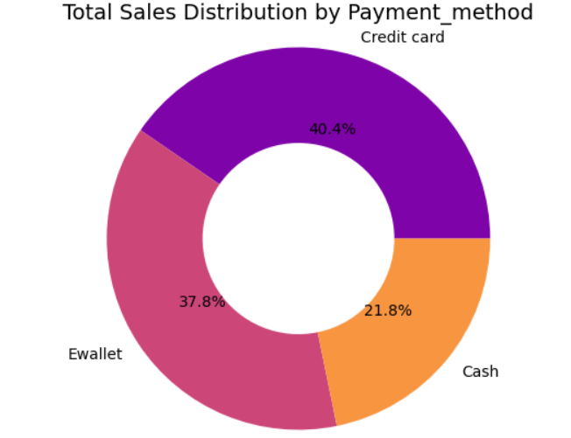
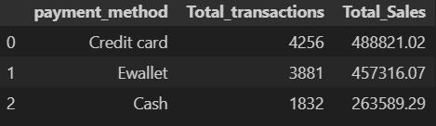
Payment Method Preferences
The majority of sales are completed using credit cards, accounting for 40% of total sales, indicating a strong customer preference for this payment method. In contrast, cash transactions contribute only 21%, making it the least preferred option.
This trend underscores the growing reliance on digital payment methods, particularly credit cards, which offer advantages such as convenience, faster transactions, and reward benefits, driving their popularity among customers.

Slide 7
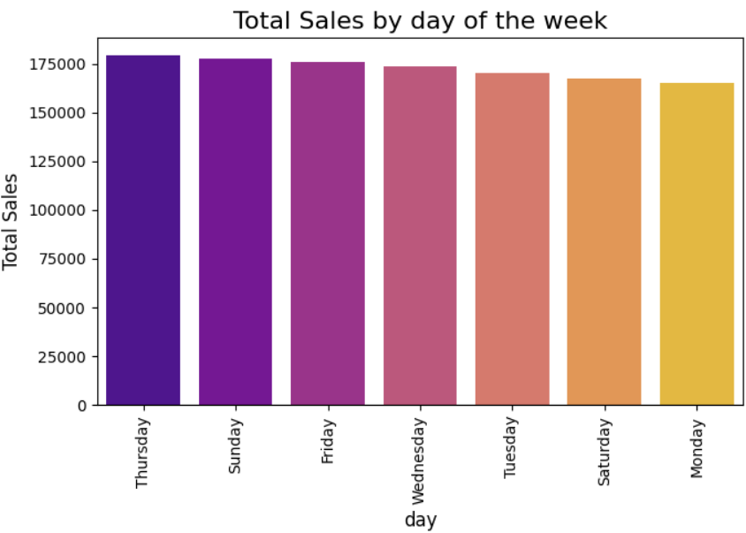
Weekly Sales Patterns
Sales across the week have remained relatively consistent, with a slight peak observed on Thursday, contributing to 15% of the total weekly sales.
In contrast, Monday recorded the lowest sales at approximately 13%, highlighting minor fluctuations in customer purchasing behavior across the days of the week.

Slide 8
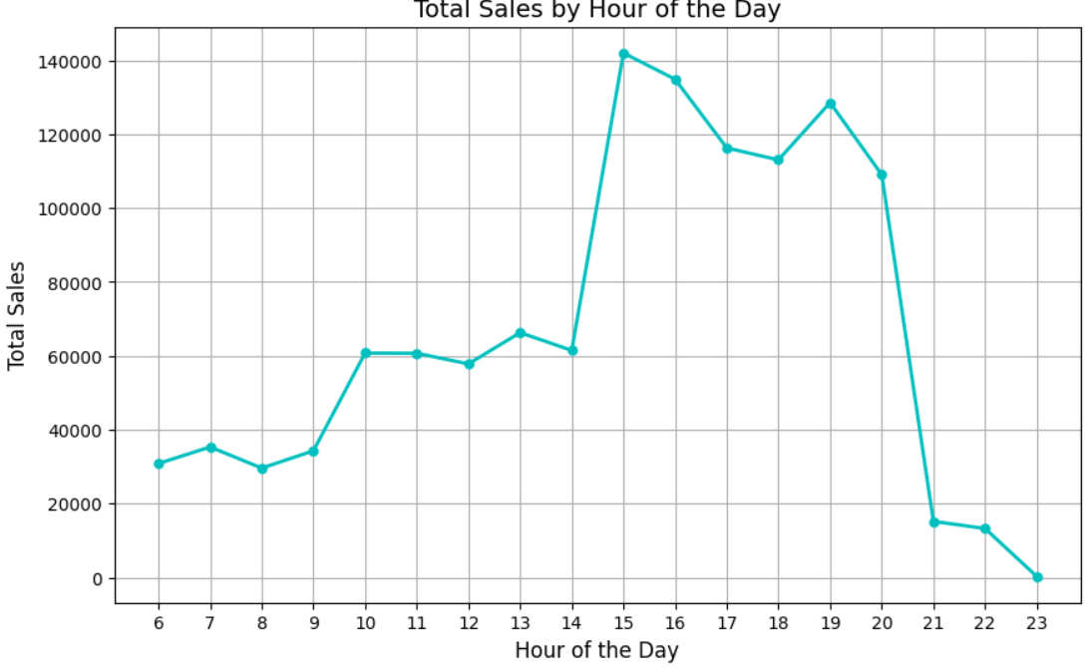
Time-of-Day Sales Trends
Between 2:00 PM to 3:00 PM, we observe the highest sales, indicating a peak period of customer activity.
In contrast, 11:00 PM sees the lowest sales, likely due to the close of business operations and reduced customer engagement during late hours.

Slide 9
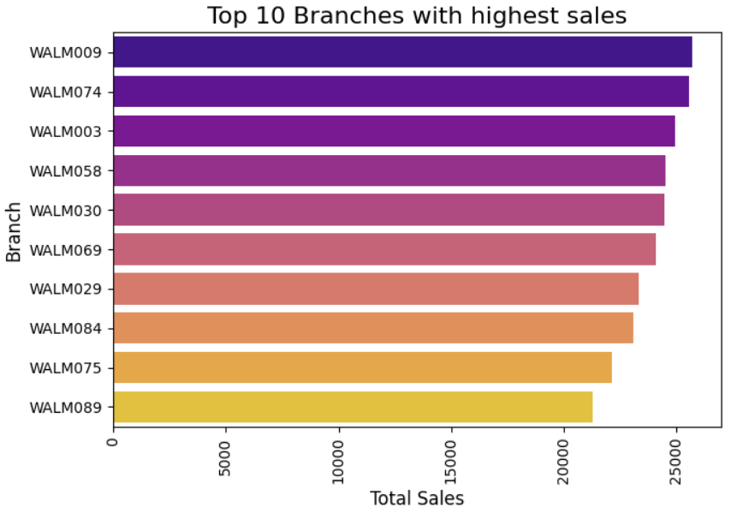
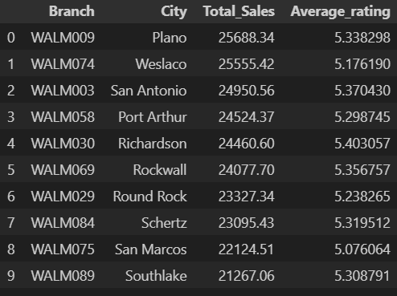
Branch Performance Analysis
The WALM009 branch in Plano city stands out with the highest sales, generating $25,688 in revenue, accounting for 2% of total global sales from Walmart stores. Following this, the WALM074 and WALM003 branches rank second and third, respectively, in terms of revenue.
However, it is noteworthy that despite being among the top 10 branches with the highest revenue, the customer ratings for these branches are relatively low, averaging around 5. This discrepancy highlights a potential area for improvement in customer satisfaction, which could be addressed to further enhance sales performance

Slide 10
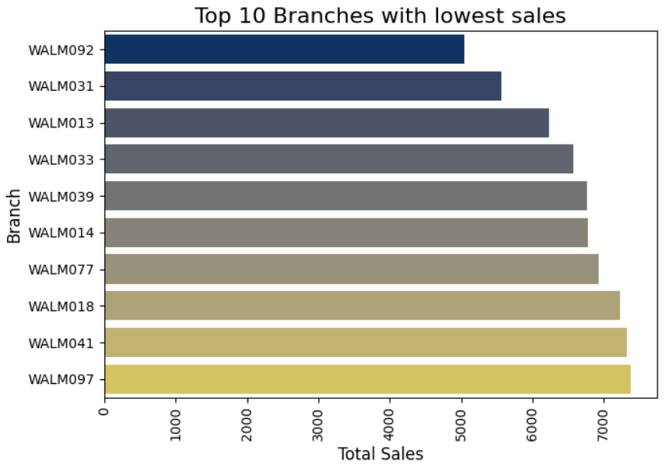
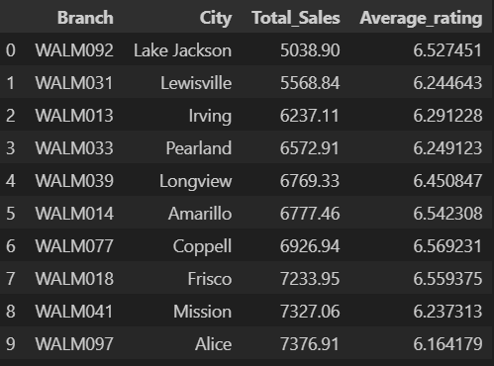
Branch Performance Analysis
The WALM092 branch in Lake Jackson city has the lowest total revenue, generating only $5,038 in sales, followed by the WALM031 and WALM013 branches, respectively.
Interestingly, despite having the lowest sales, these branches show relatively higher customer ratings compared to the top revenue-generating branches.
This observation highlights an underlying pattern in the analysis of branch performance, where some lower-revenue branches may have higher customer satisfaction scores, potentially indicating that customer experience is not always directly correlated with sales volume.

Slide 11
Recommendations
1. Focus on Underperforming Cities:
Lake Jackson recorded the lowest sales share (0.5%). This indicates potential for growth in this region.
Implement localized marketing strategies, promotions, and loyalty programs to increase brand awareness and customer engagement in Lake Jackson. Consider targeted campaigns that resonate with the local customer base, potentially leveraging the higher customer ratings to attract more sales.
2. Strengthen the Health & Beauty Category:
Health & Beauty accounts for only 4% of total sales, signaling untapped potential.
Revamp the product offerings in this category, focusing on in-demand products or emerging trends. Introduce targeted marketing campaigns, collaborate with influencers, or run seasonal promotions to increase customer engagement.
3. Leverage Credit Card Preference:
Credit card payments dominate, accounting for 40% of total sales, reflecting a strong customer preference for digital payment methods.
Enhance customer convenience by promoting digital payment options and loyalty rewards for credit card users. Consider partnerships with credit card providers to offer exclusive deals or promotions for credit card users, further boosting digital payment adoption.

Slide 12
Recommendations
4. Capitalize on Thursday Peak Sales:
Thursday shows the highest sales (15% of total weekly sales).
Action: Maximize Thursday's peak by offering special promotions, flash sales, or time-limited discounts to drive even higher sales. You can create “Thursday Deals” to encourage customers to shop on this day.
5. Target High-Activity Window (3-4 PM):
The period between 3:00 PM to 4:00 PM sees the highest sales activity.
Action: Use this time window to push time-sensitive promotions, flash sales, or exclusive discounts to maximize sales. Coordinate marketing efforts such as social media posts and email campaigns to align with this peak hour.

Slide 13
Recommendations
6. Improve Customer Satisfaction in High-Revenue Branches:
Top-performing branches like WALM009 in Plano show high revenue but relatively low customer ratings (around 5).
Action: Focus on improving customer service, addressing pain points, and enhancing the overall shopping experience in high-revenue branches. Train staff on customer satisfaction best practices and ensure product availability and quality.
7. Align Customer Experience with Sales Performance:
There is a noticeable pattern where some lower-revenue branches have higher customer satisfaction.
Action: Investigate how customer experience drives satisfaction in lower-revenue branches and replicate these best practices in higher-revenue branches. Consider implementing customer-first strategies like personalized recommendations, better in-store experiences, or more responsive customer service.

