Slide 1
FACE RECOGNITION ATTENDANCE SYSTEM USING RASPBERRY PI
ABHISH KUMAR D 2015105502
SAKTHI SRI P 2015105528
SABARINATH M 2015105558
VAISHALI B 2015105566
Guided By, DR M.SHANMUGAPRIYA,
ECE Department

Slide 2
Table Of Contents
Aim and Objective
Block diagram
Module Diagram
Workflow
Timeline chart
Reference

Slide 3
Aim and Objective
The main motto of this work is to take and manage attendance using face recognition.
it is important to construct an efficient method for managing attendance automatically.
Open Command Visualization (Open-CV) is an open source library in which the source code is open and it is useful in visual field such as image processing

Slide 4
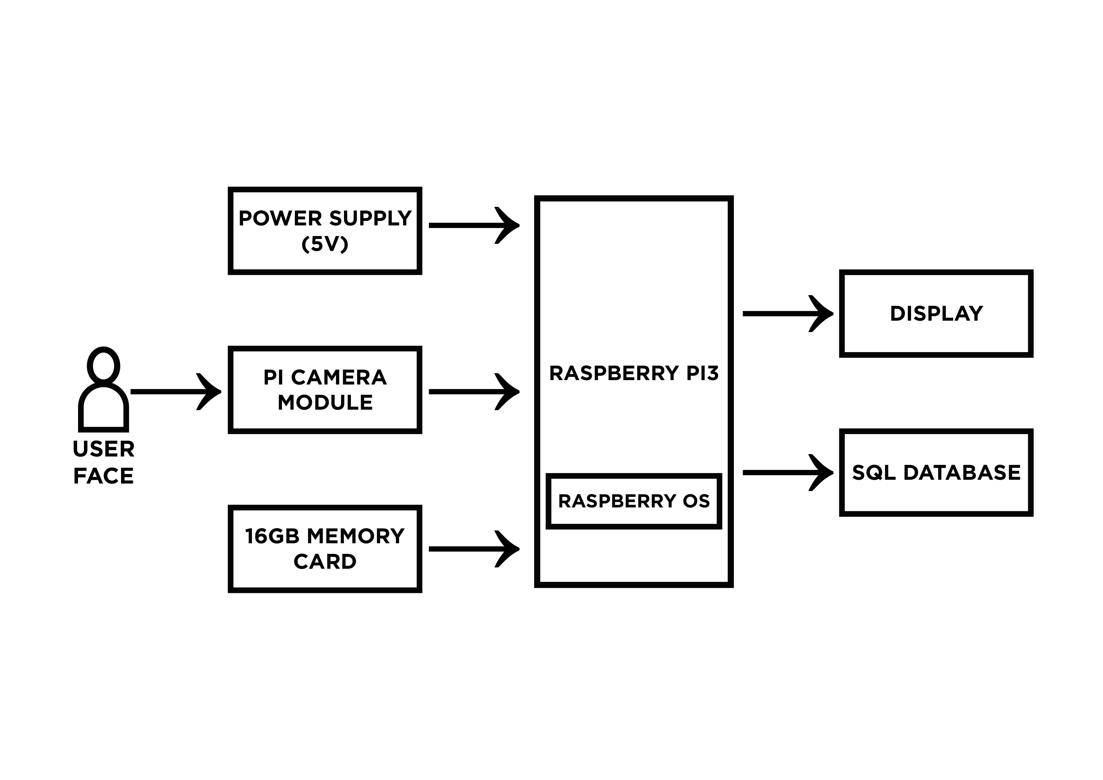
Block diagram

Slide 5
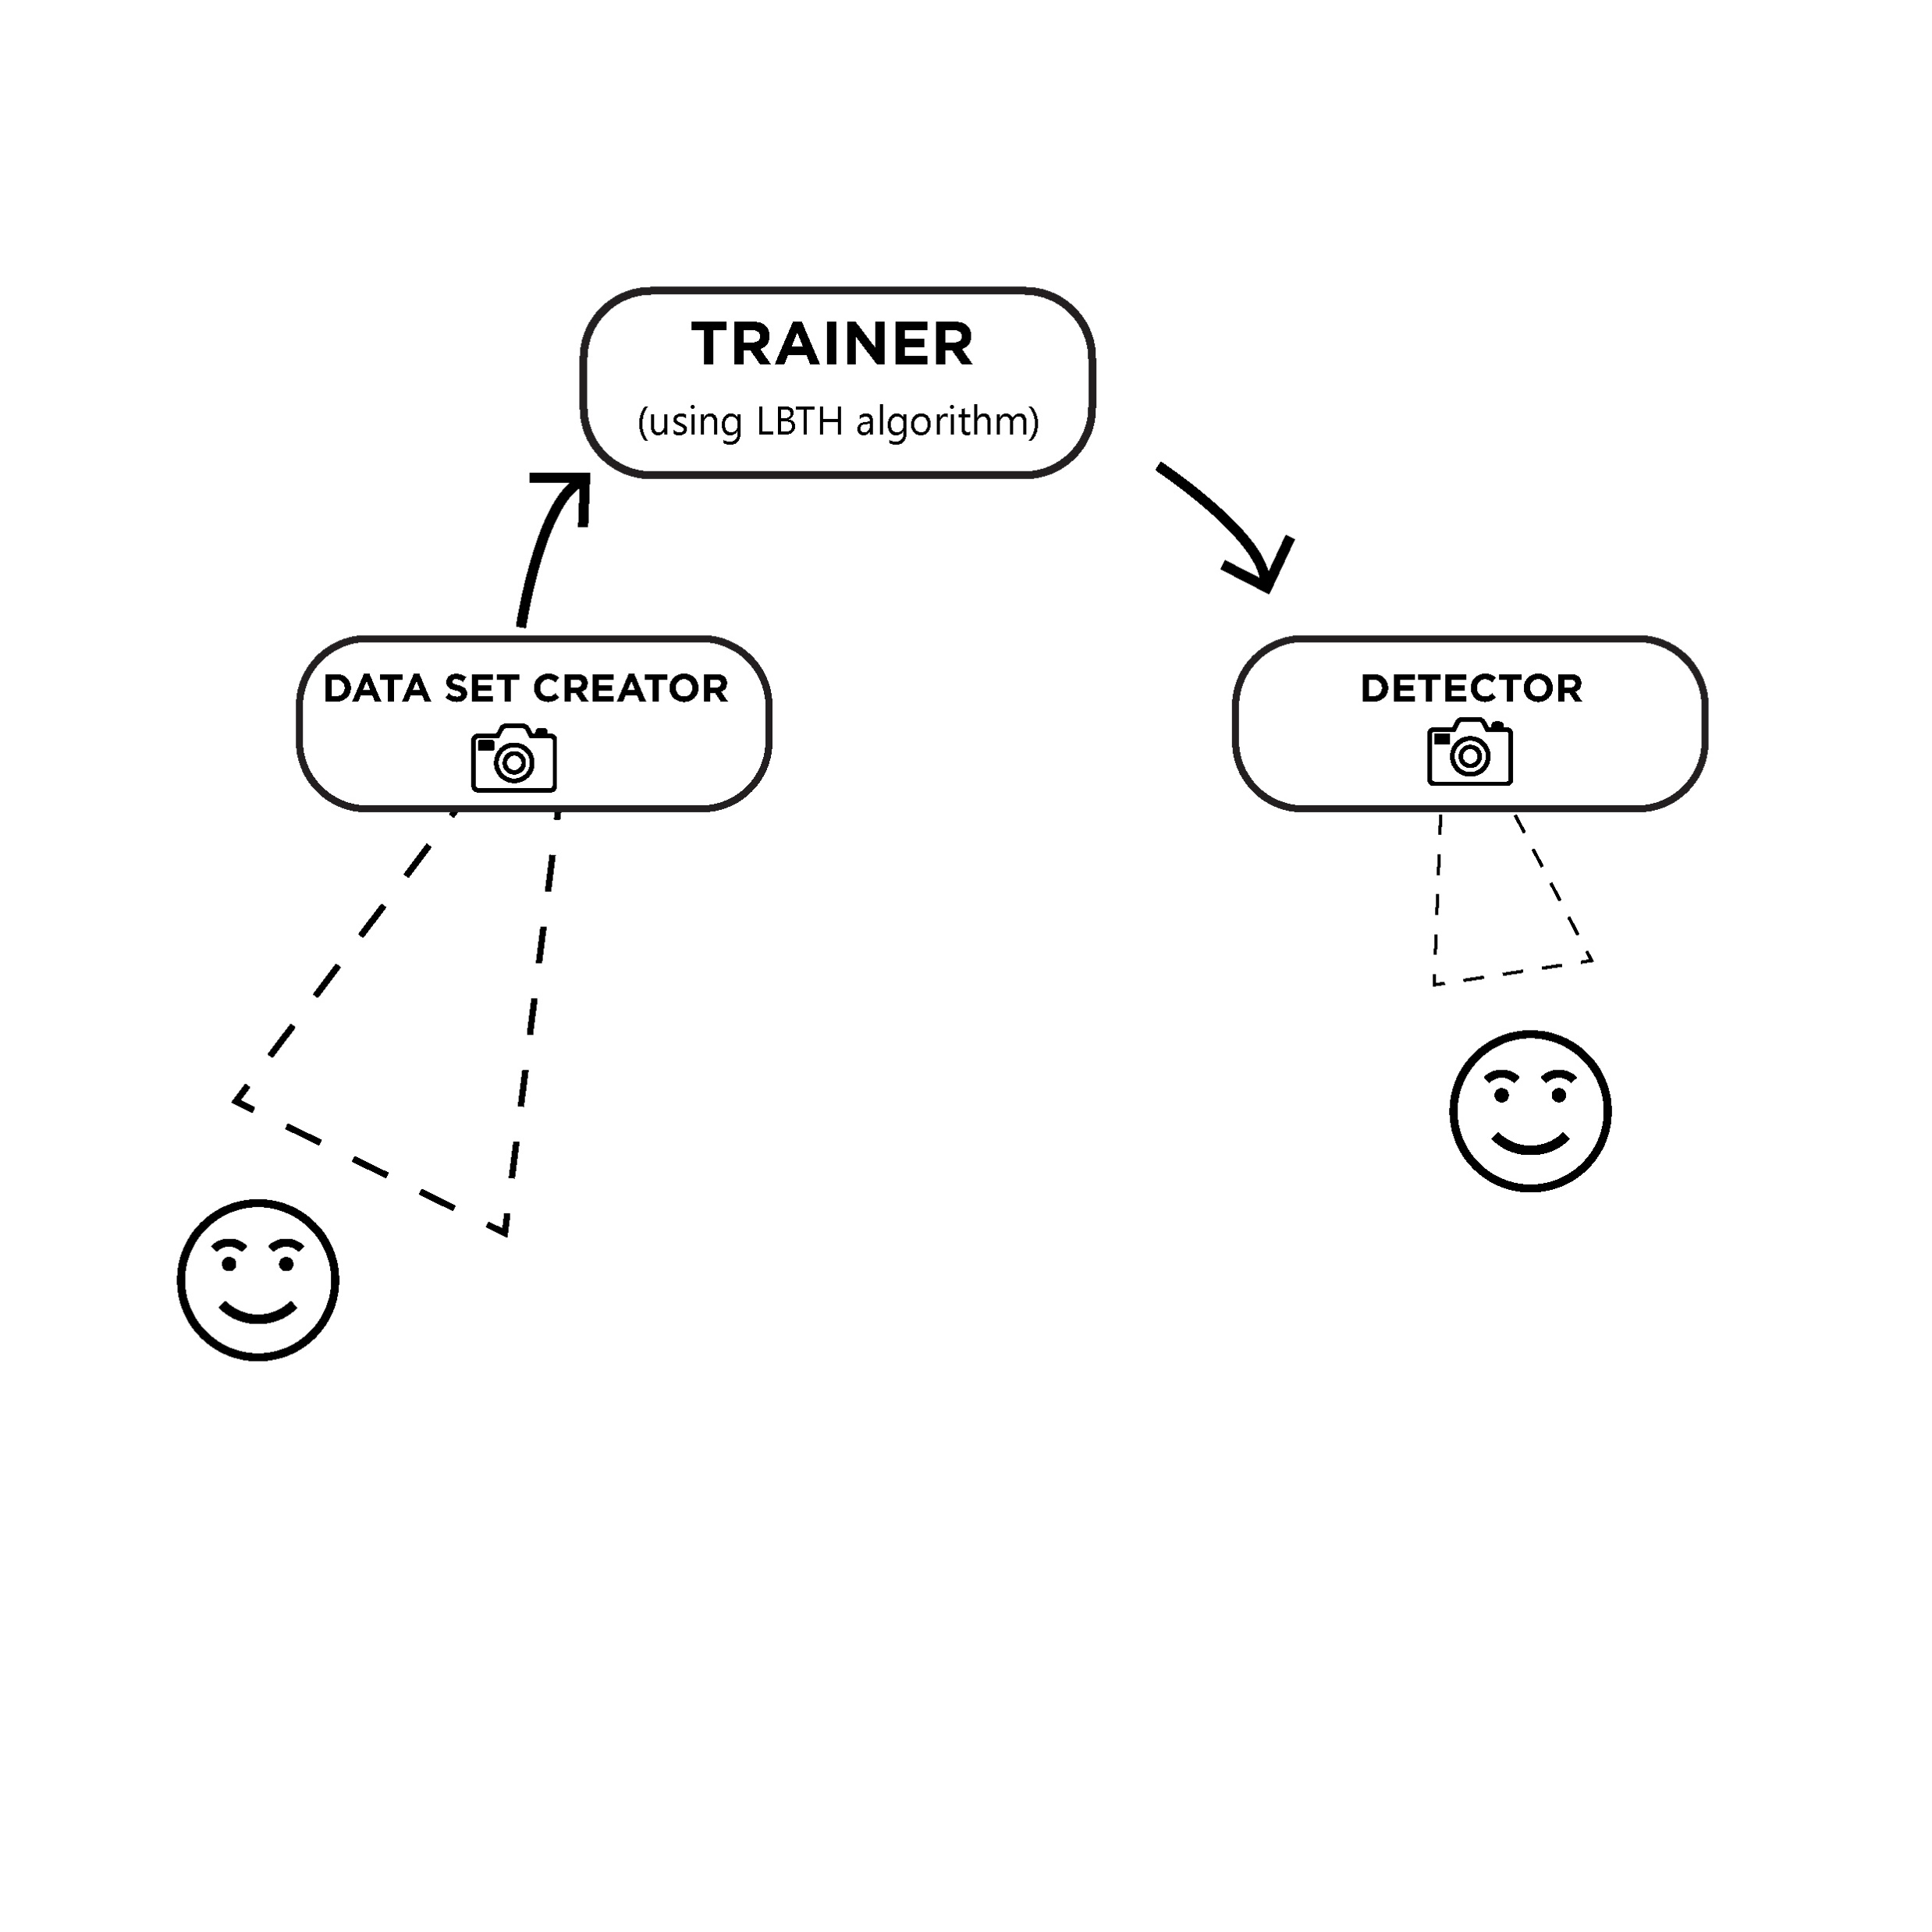
Module Diagram

Slide 6
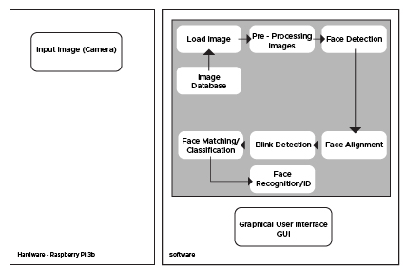
ARCHITECTURE DIAGRAM

Slide 7
Workflow
Data Gathering
Train the Recognizer
Verification and identification

Slide 8
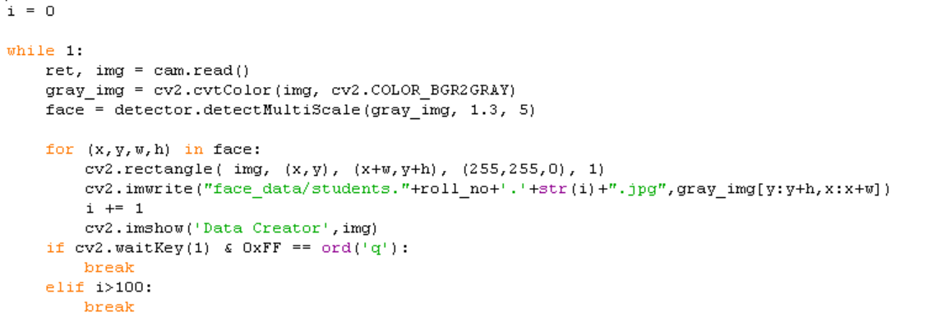
Dataset Creation

Slide 9
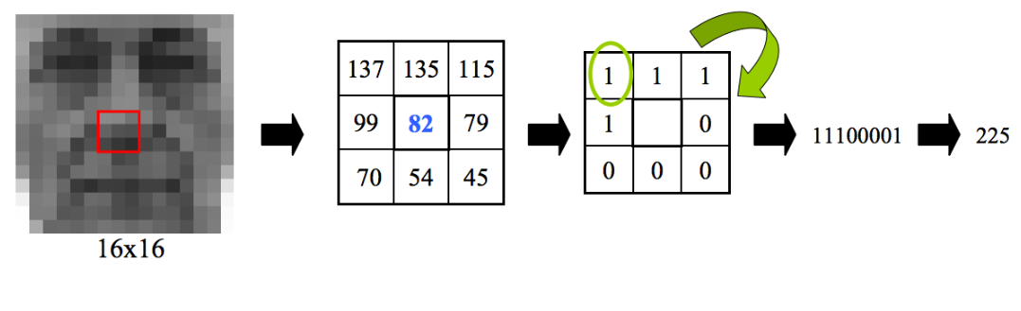
Train the Recognizer
We use LBPH algorithm(Local Binary Patterns Histograms)
Vectorizing images

Slide 10
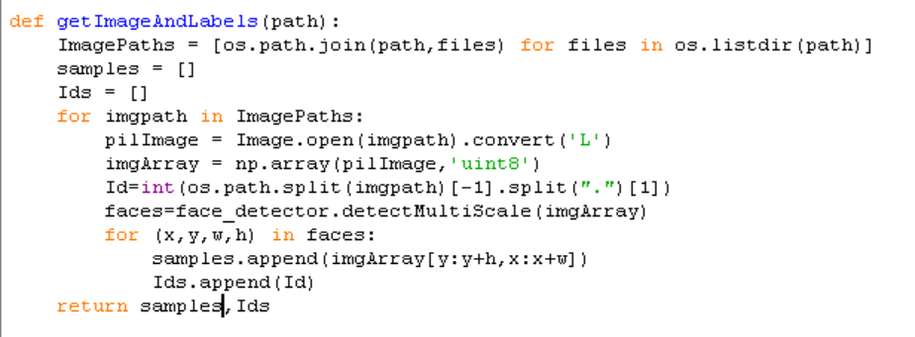
Train the Recognizer

Slide 11
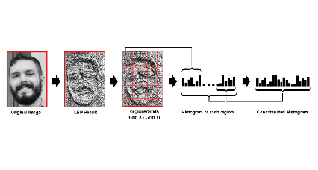
HISTOGRAM

Slide 12
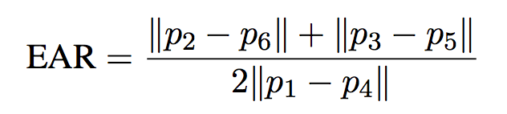
TRACKING THE EYE MOVEMENT
Algorithm for blink detection is also implemented to avoid fraudulent cases wherein a static photo can be used to enter attendance and not by the actual person.
To build our blink detector, we’ll be computing a metric called the eye aspect ratio (EAR),

Slide 13
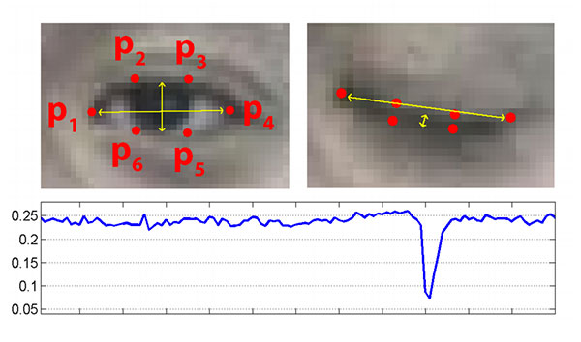
Eye aspect ratio (EAR)

Slide 14
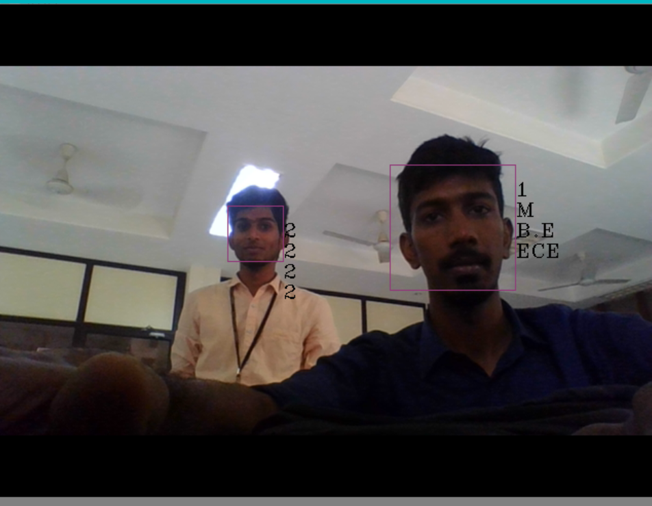
Verification and identification

Slide 15

USER INTERFACE

Slide 16


Slide 17
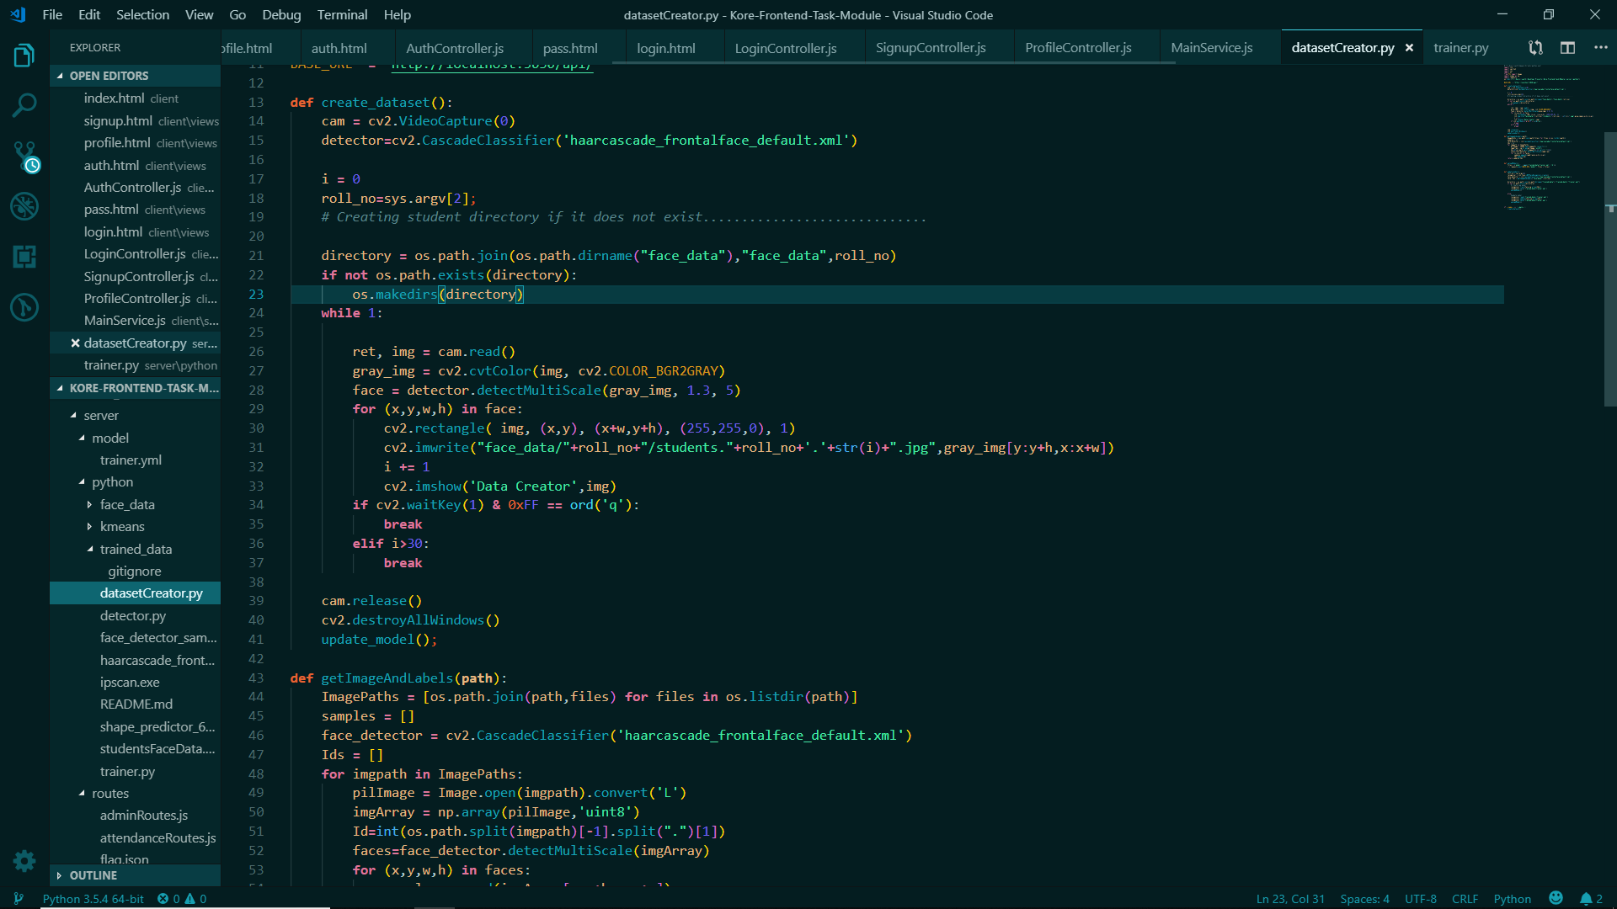
CODE SNIPPETS

Slide 18
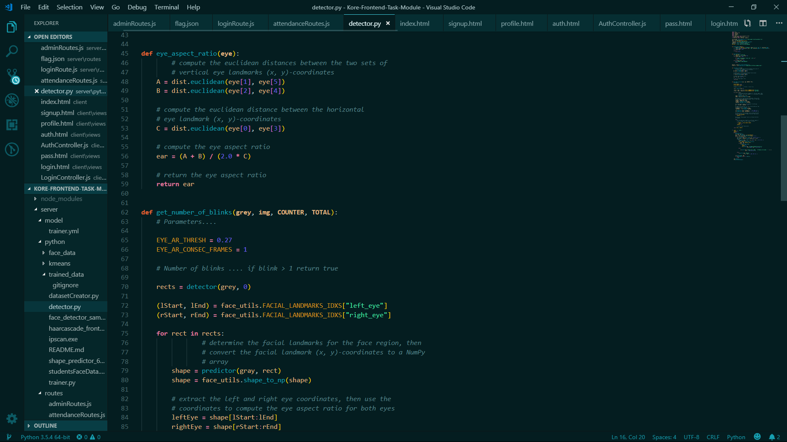

Slide 19
Timeline chart
JANUARY | Literature survey
FEBRUARY | Face detection, recognition and system training
MARCH | Database creation and updation using the dataset
APRIL | Complete testing of the system

Slide 20
REFERENCE
U. Eze peter; Owerri Nigeria; C.K.A. JoeUzuegbu; Laz Uzoechi; F.K. Opera biometric based attendance system with remote real time monitoring tertary institutions in developing countries emerging and sustainable technologies for power and ICT in a developing society NIGERCON, IEEE.
Adam Schmidt, Andrzej Kasinski, “The Performance of the Haar Cascade Classifiers Applied to the Face and Eyes Detection”, Computer Recognition Systems.

