Slide 1
Sakthisundaresan V 2021503550

Slide 2
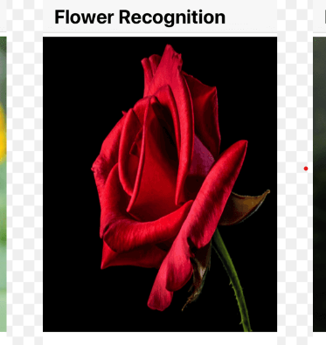
FLOWer RECOGNITION USING CNN

Slide 3
AGENDA
Problem Statement
Project Overview
End Users
Solution and Value Proposition
The Wow in Our Solution
Modelling Approach
Results
Conclusion

Slide 4
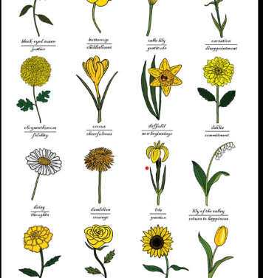
Problem Statement
. Challenge: Variations in lighting, background clutter, and diverse appearances of flowers.
Objective: Develop a robust flower recognition system for accurate species identification.
Importance: Crucial for applications in botanical research, agriculture, and environmental monitoring.

Slide 5
Project Overview
Our project aims to develop a robust flower recognition system using Convolutional Neural Networks (CNN) to accurately identify flowers from images or videos.
01

Slide 6




End users
Botanists and Researchers
Florists and Gardeners
Agriculturists and Horticulturists
Environmentalists and Conservationists

Slide 7
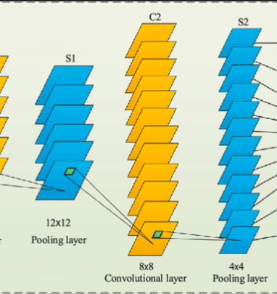
Solution and Value Proposition
Utilizing CNN for Flower Recognition:
Improved accuracy and reliability compared to traditional methods.
Our Solution:
Real-time flower detection and recognition.
Enhances security and efficiency for diverse applications.

Slide 8
The Wow in Our Solution
Leveraging advanced CNN algorithms for precise flower identification.
Instantaneous detection and classification of flowers, ensuring swift decision-making.
Improving security and efficiency in agriculture, botany, and environmental monitoring.

Slide 9
Modeling Approach
Data collection and preprocessing
CNN architecture design and training
Model evaluation and optimization techniques

Slide 10
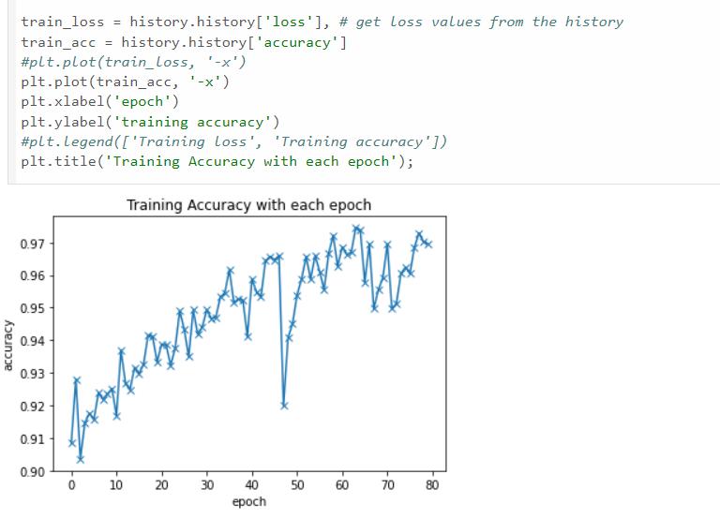
RESULTS
Achieved accuracy rates on benchmark datasets
Performance metrics such as precision, recall, and F1-score
Potential applications and future enhancements

