Slide 1


Welcome you all
GIT
D.Sakthivel
Assistant Professor & Trainer,
KG Micro College
KGiSL Campus, Coimbatore – 641 035.

Slide 2
Day 4
Getting Started with Git
Staging Area and Commit

Slide 3
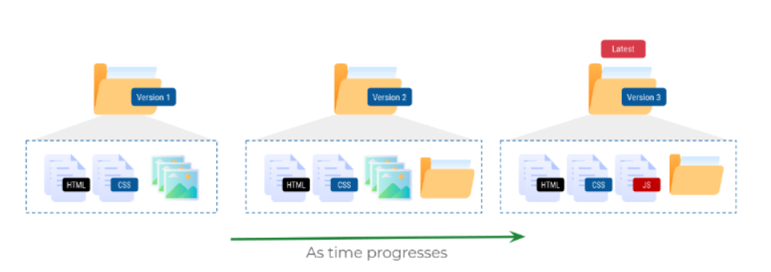
Working on a Project:
Managing Versions of a Document:
We keep making many changes when building software or even writing anything.
Advantages of Versioning:
We can quickly revert back to any of the older versions or pick up changes from an older version.
We can check how the files are modified over time.
Managing Versions of a Project:
When working on a software project, we keep making changes to existing files to add new features and fix existing bugs.

Slide 4
Collaboration:
When working on a huge project with many files which is being developed by multiple people it is hard to manually keep track of the changes.
Any small change may completely crash the project.
Versioning:
When working with multiple people, it is useful to know,
Who made changes to a given file?
When are these made changes made?
Source Code Management:
Version Control System:
Each change to project can be considered a new version of the project.
Version Control System simplifies tracking changes to the project and allow us switch back to any previous version.
There are several tools that help us manage versions of the source code of software.
Git
Subversion
Mercurial

Slide 5
Git:
Git is a free, open-source and most widely used distributed version control system.
A software used for tracking changes in any set of files.
Repository:
A Git Repository (Repo) is like a database which maintains different versions of the project files.
Snapshots:
Git allows us to take a snapshot of our project files to create versions of the project.
These versions or snapshots are referred to as commits in Git Terminology
Tracking Files:
By default, Git doesn’t track changes to a file and doesn’t maintain versions automatically.
We have to explicitly specify git to track file changes and save versions.
Selecting Specific Changes:
Most of the times we want to have a selective set of changes as part of the snapshot.
Git creates a snapshot of all the changes that are part of staging area.

Slide 6
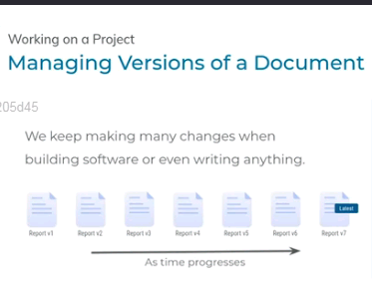

Slide 7

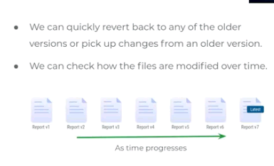

Slide 8

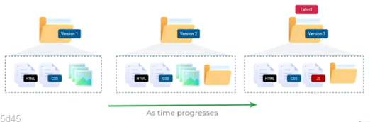

Slide 10

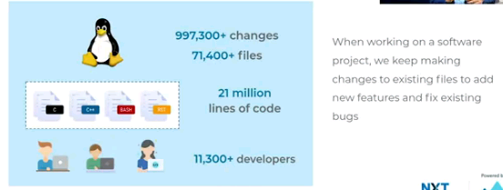

Slide 11

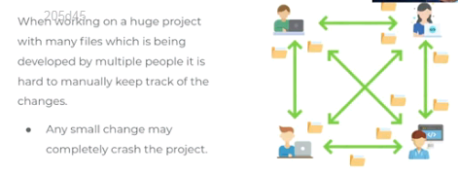

Slide 12

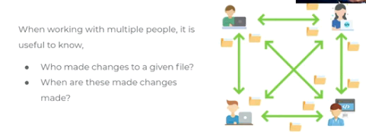

Slide 14

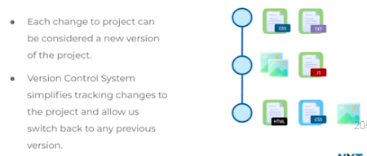

Slide 15
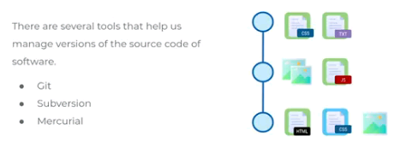

Slide 16

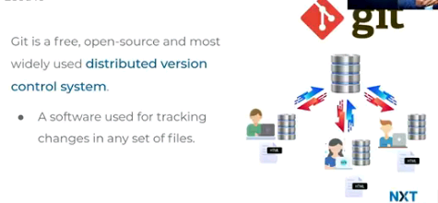

Slide 17

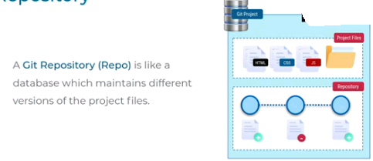

Slide 18

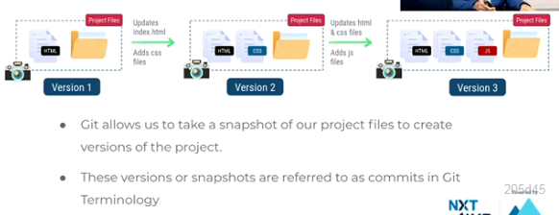

Slide 19
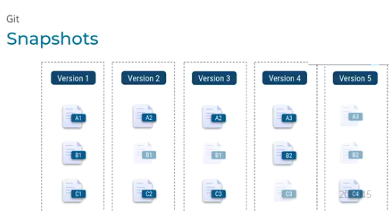

Slide 20
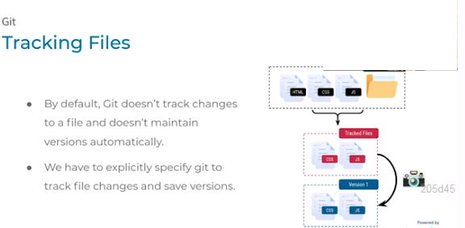

Slide 21
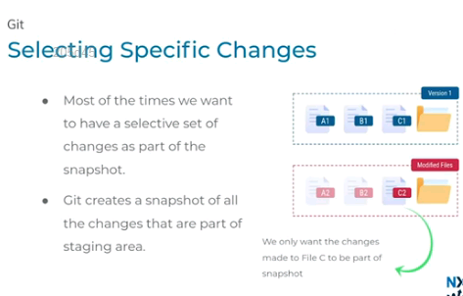

Slide 22
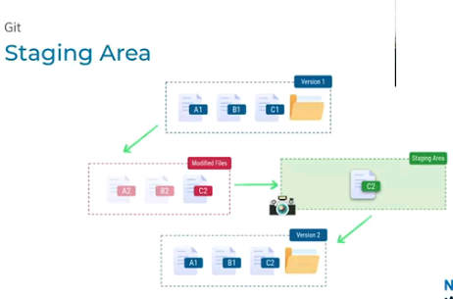

Slide 23
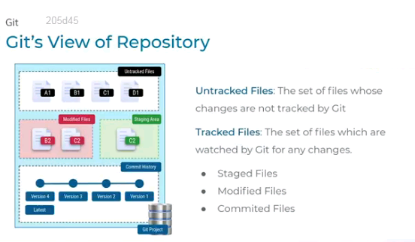

Slide 24
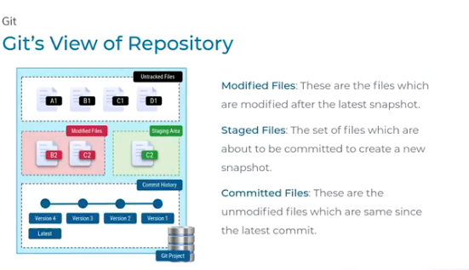

Slide 25
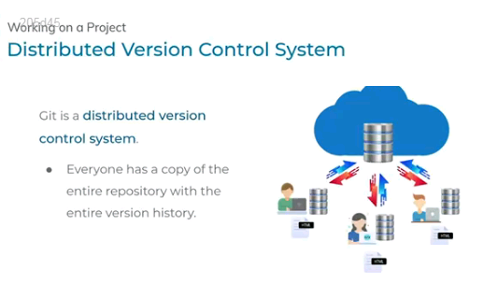

Slide 26
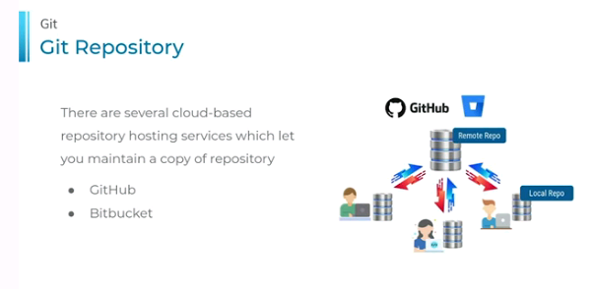

Slide 27
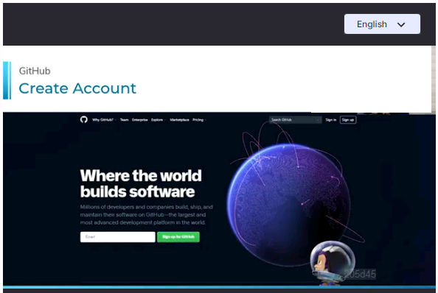

Slide 28
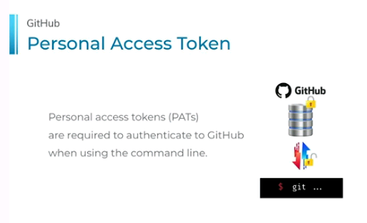

Slide 29
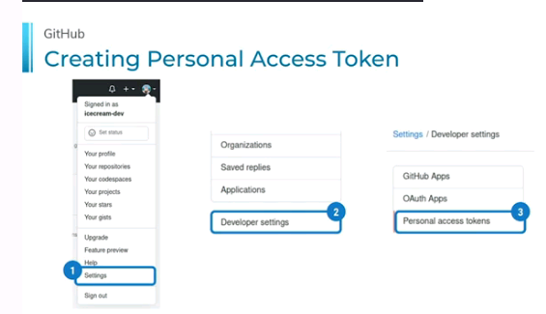

Slide 30
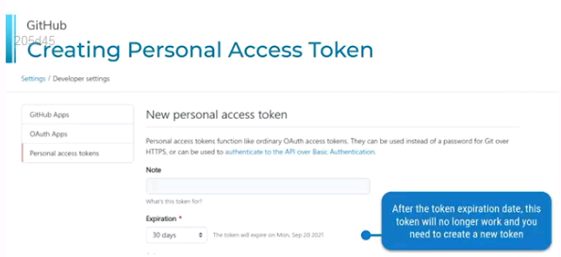

Slide 31
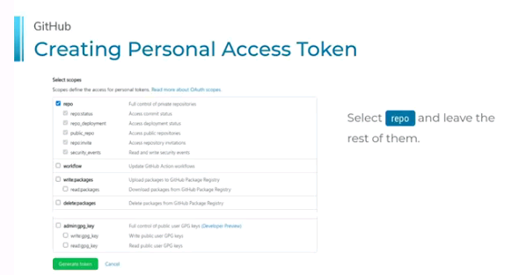

Slide 32
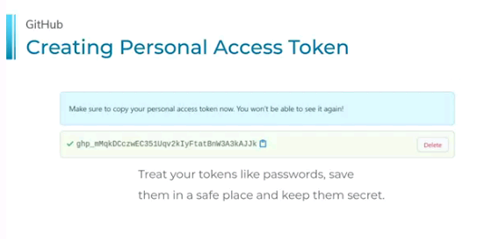

Slide 33
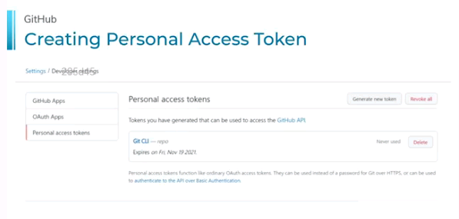

Slide 34
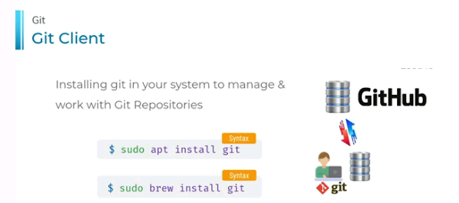

Slide 35
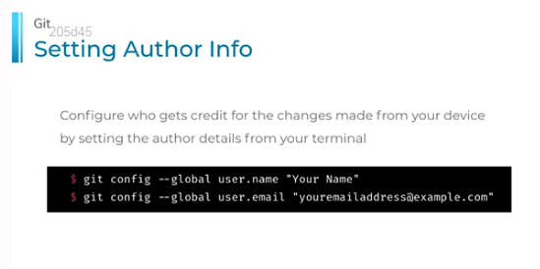

Slide 36
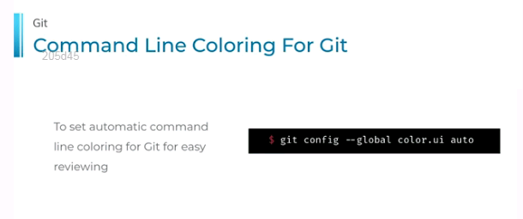

Slide 37
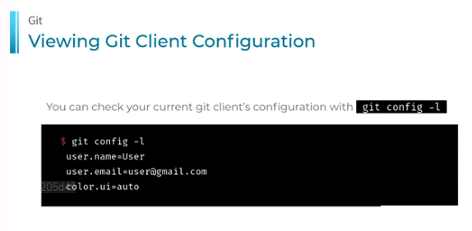

Slide 38
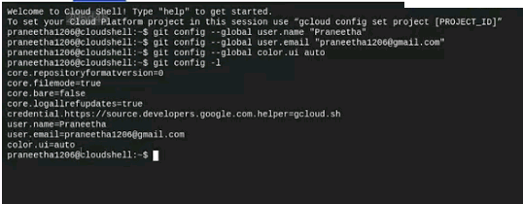

Slide 39
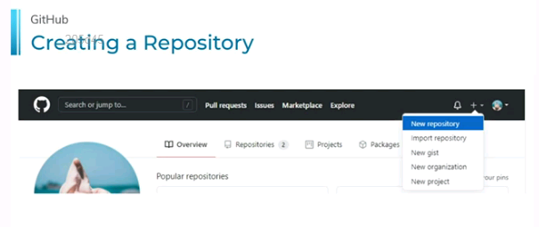

Slide 40
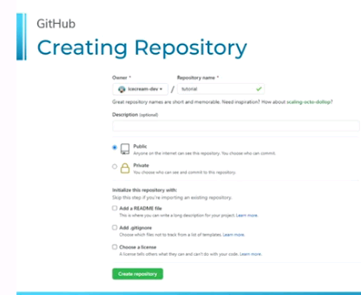

Slide 41
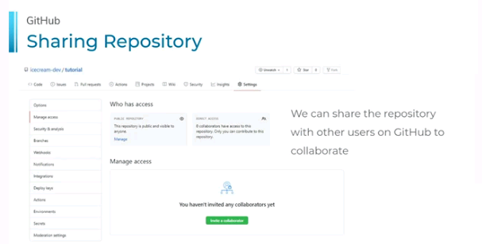

Slide 42
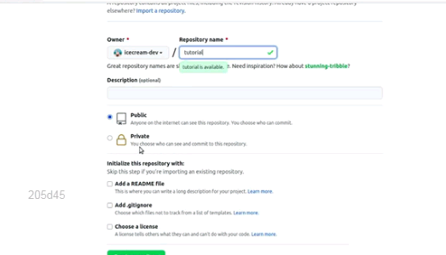

Slide 43
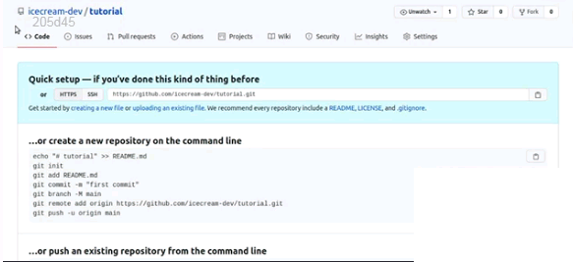

Slide 44
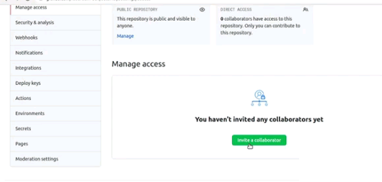

Slide 45
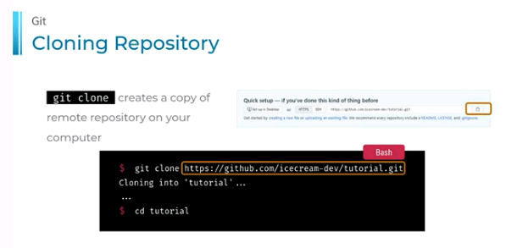

Slide 46
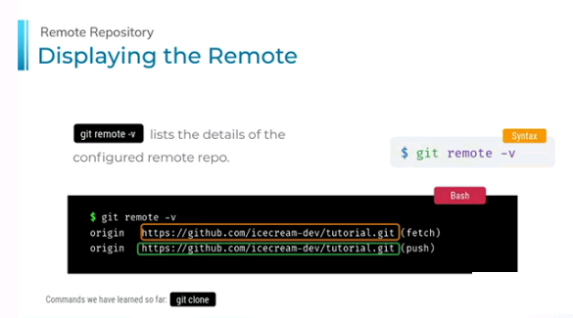

Slide 47
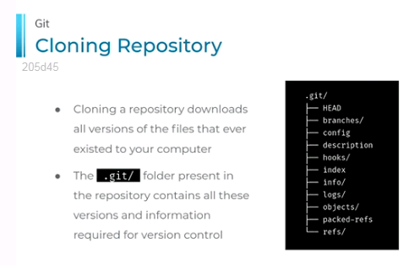

Slide 48
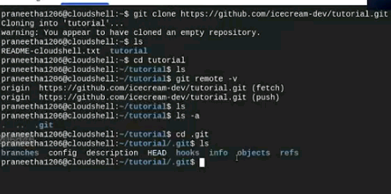

Slide 49
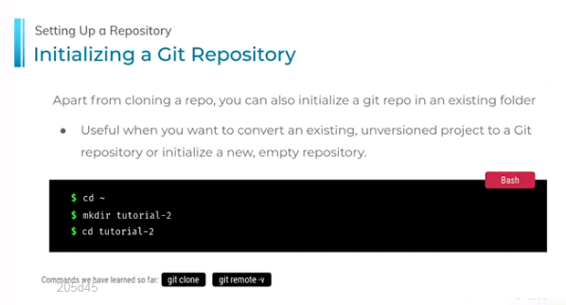

Slide 50
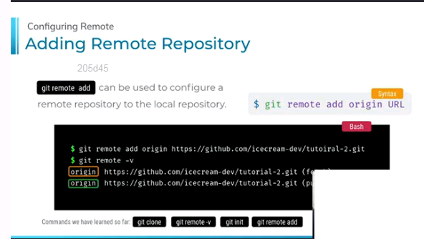

Slide 51
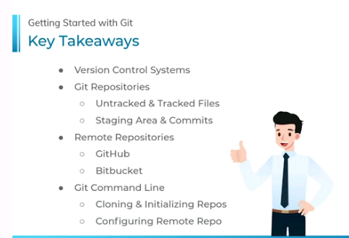

Slide 52
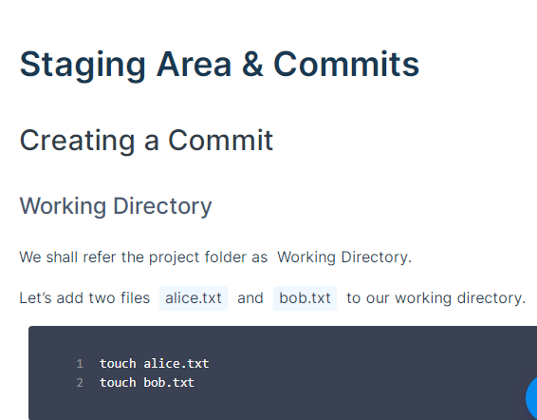

Slide 53
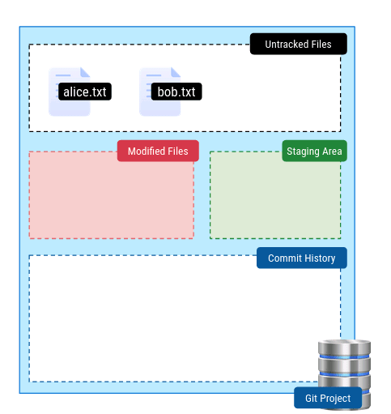
Git’s View of Repository

Slide 54
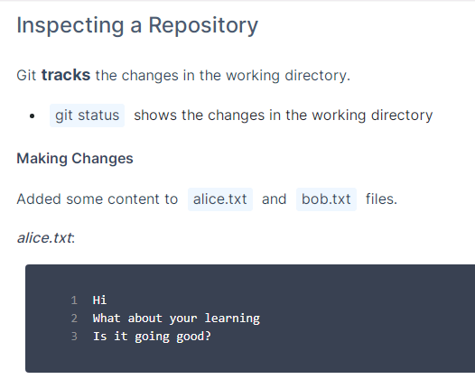
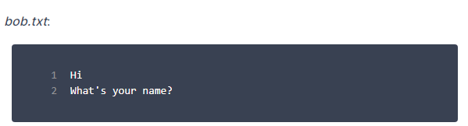

Slide 55
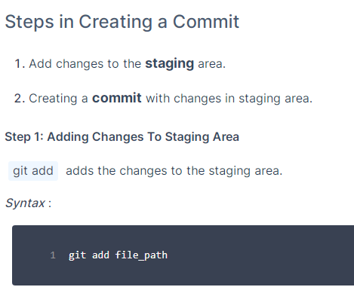


Slide 56


Slide 57


Slide 58


Slide 59


Slide 60


Slide 61


Slide 62


Slide 63


Slide 64


Slide 65


Slide 66


Slide 67


Slide 68



Thank You

