Slide 1
Agenda
What is Dynatrace.
Advantage of Dynatrace
Types Of Monitoring
Dynatrace supported platforms
How Dynatrace Work
Alert & Active Gate in Dynatrace.
Dynatrace Dashboard.
Configuring Dynatrace.
Demo

Slide 2
What is DynaTrace.
It is a tool providing a SAAS.
Its doing monitoring, Observability, Metrics.
Enables monitoring of hosts, process & network.
Log monitoring and network, Memory, CPU usage of your hosts.
Compare the things over the time - ex. Speed, CPU, RAM etc

Slide 3
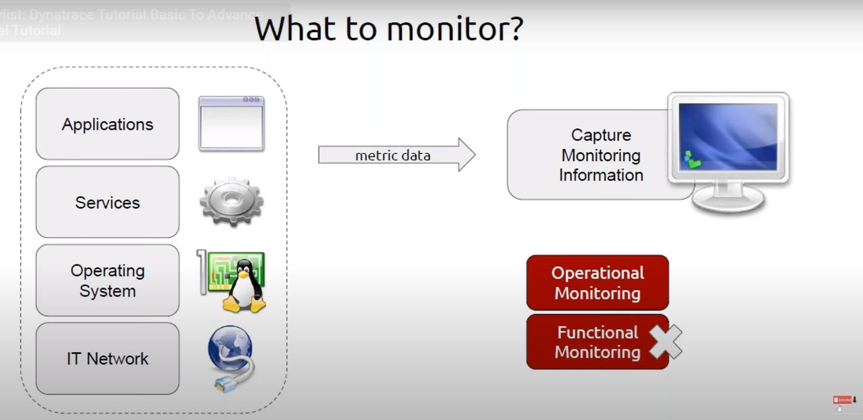

Slide 4
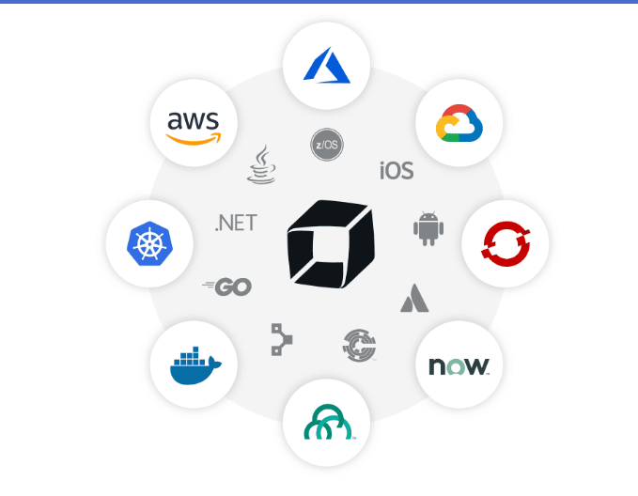
Dynatrace supported platforms

Slide 5
Advantage of Dynatrace
No need of coding knowledge.
Providing SAAS
Alert notification.
Single Application handling Entire host monitoring,
It having Black box & Whitebox Monitoring
Analyzing long Term Data.
Building Dashboards.

Slide 6
Types Of Monitoring :-
1. White Box Monitoring –
White Box Monitoring is a monitoring of application running on servers.
Monitoring based on metrices exposed by the internals of the system, including logs, interfaces like JVM profiling interface, or an http handler which emits internal statistics
You will get internal statistics of System, Applications & Services
2. Black Box Monitoring :-
Black box monitoring refers to the monitoring of servers with a focus on areas such as disk space, CPU usage, memory usage, load averages, etc.
Testing externally visible behavior as a user would see it. These are what most in the industry would deem as the standard system metrics to monitor.

Slide 7
List Of White Box Monitoring tools :-
Prometheus
Zabbix
NewRelic
AppDynamics
Dynatrace
List Of Black Box Monitoring tools :-
Nagios
Datadog
Sysdig
Dynatrace

Slide 8
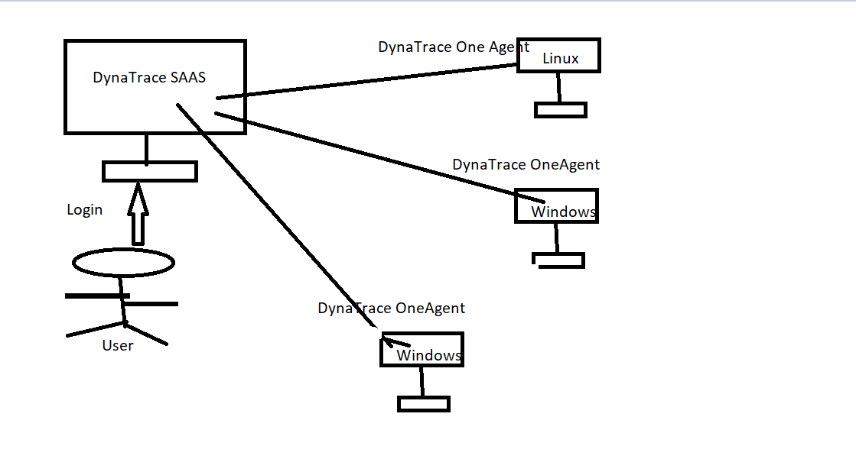
How Dynatrace Work

Slide 9
Alert & Active Gate in Dynatrace.
Alert the user via mail.
It can be configurable based on user logic.
Active Gate previously called as a Security Gateway
Active Gate is a Proxy
secure the data transmission from one agent to Dynatrace server.
Two type active gate
1.Cluster active gate - it is for Dynatrace Manager
2.Environment active gate – it is for one agent

Slide 10
Dynatrace Dashboard.
Tracking multiple host’s is difficult at a time
Easy to configure
No coding Required
Need Basic understanding of Charts
It support various charts
Stacked Area, Graph
Pie, table, Top List
Heat Map

Slide 11
Configuring Dynatrace.
..\Documents\Dynatrace Host Configuration steps.docx

Slide 12
DEMO

Slide 13
Thank You
Any Questions?

