Slide 1



TRAVELMATE
- TRAVEL MANAGEMENT SYSTEM
By Sakthivel Jayaraj (30435)

Slide 2
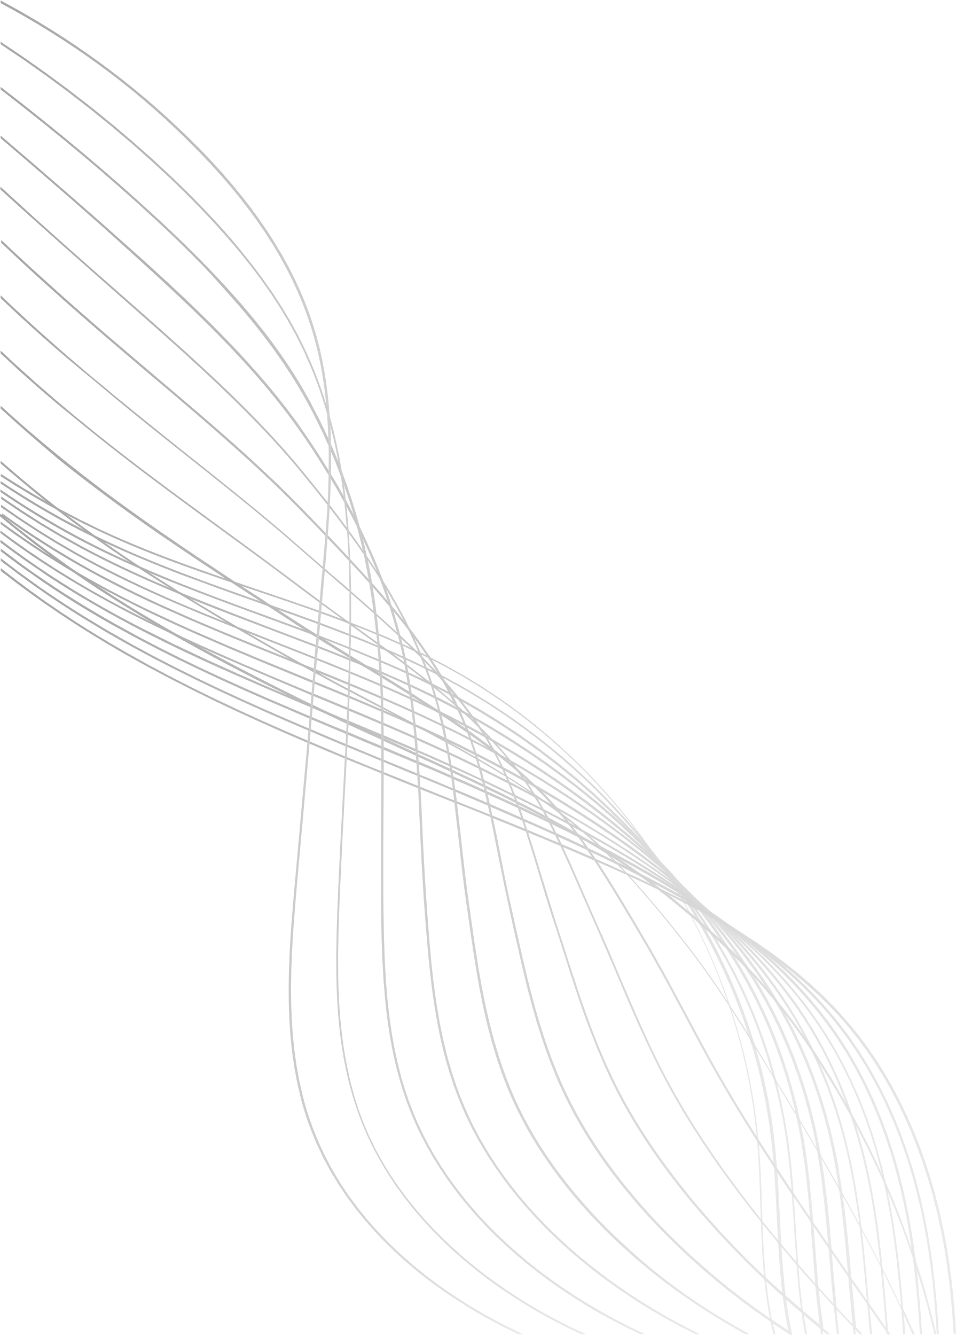
DESCRIPTION
1.
A Web-based Travel booking system
2.
Provides Customer features (browse packages, booking, history, reviews).
3.
Provides Admin features (manage packages, customers, bookings, reviews).
4.
Built using Angular (frontend) + Flask Microservices (backend) + Sqlite.
5.
Secure access using Role-based Authentication (Admin vs Customer).
01

Slide 3
ARCHITECTURE USED
Microservices Architecture is used here.
Each service is independent & containerize.
Services communicate over REST APIs
Deployed using Docker Compose
02

Slide 4
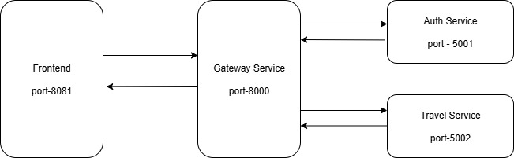
ARCHITECTURE
03

Slide 5
SERVICE OVERVIEW
AUTH SERVICE
POST/register - Register New User.
POST/login - Login User
GET/users – Get all Users
PUT/users/<id>/role – Update role (Admin or Customer)
PUT/users/<id>/status – Update Status (Block or Active)
DELETE/users/<id> – Delete user
04

Slide 6
SERVICE OVERVIEW
TRAVEL SERVICE - PACKAGES
POST /packages – Add package
PUT /packages/<id> – Update package
PATCH /packages/<id> – Partially update package
DELETE /packages/<id> – Delete package
GET /packages – List all packages
GET /packages/<id> – Get package details
05

Slide 7
SERVICE OVERVIEW
TRAVEL SERVICE - BOOKINGS
POST /bookings – Create booking
GET /bookings – Get all bookings
GET /bookings/user/<id> – Get bookings by user
PUT /bookings/<id> – Update booking
DELETE /bookings/<id> – Delete booking
PUT /bookings/<id>/cancel – Cancel booking
06

Slide 8
SERVICE OVERVIEW
TRAVEL SERVICE - REVIEWS
GET /reviews – Get all reviews
POST /reviews – Add review
DELETE /reviews/<id> – Delete review
07

Slide 9
CONTAINERS
Each service runs inside a separate Docker container.
Containers created:
frontend → Angular UI
auth-service → Flask Auth
travel-service → Flask Travel (Packages, Booking, Reviews)
gateway-service → Flask API Gateway (single entry point)
08

Slide 10
DEPLOYMENT
All services deployed in Docker containers.
Docker Compose used for orchestration.
Volumes for data persistence.
Services exposed via ports:
Gateway → 8000
Auth → 5001
Travel → 5002
Frontend → 8080
09

Slide 11
RESULT
Successfully developed a Travel Booking Platform using Microservices Architecture.
Implemented User Authentication, Package Management, Booking & Reviews.
Integrated API Gateway for centralized request handling.
Deployed services in Docker containers with isolated environments.
Frontend (Angular) interacts seamlessly with backend microservices via Gateway.
10

Slide 12
THANK YOU
11

