Slide 1

blindride

Slide 2


Slide 4

Safal | Shabbir | Himanshu | Adarsh
www.blindride.in

Slide 5
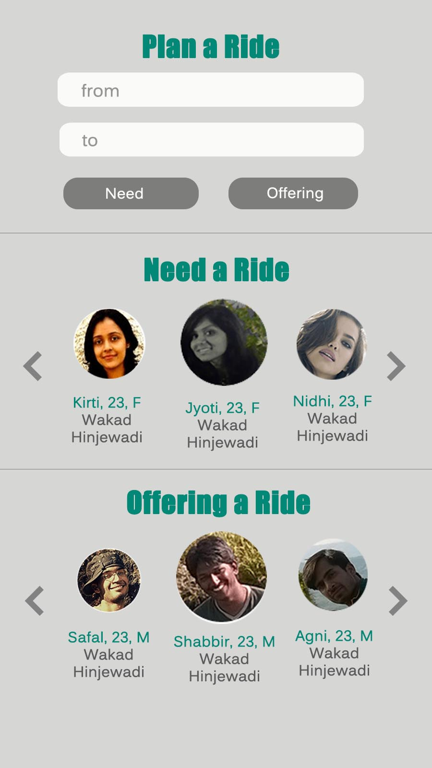

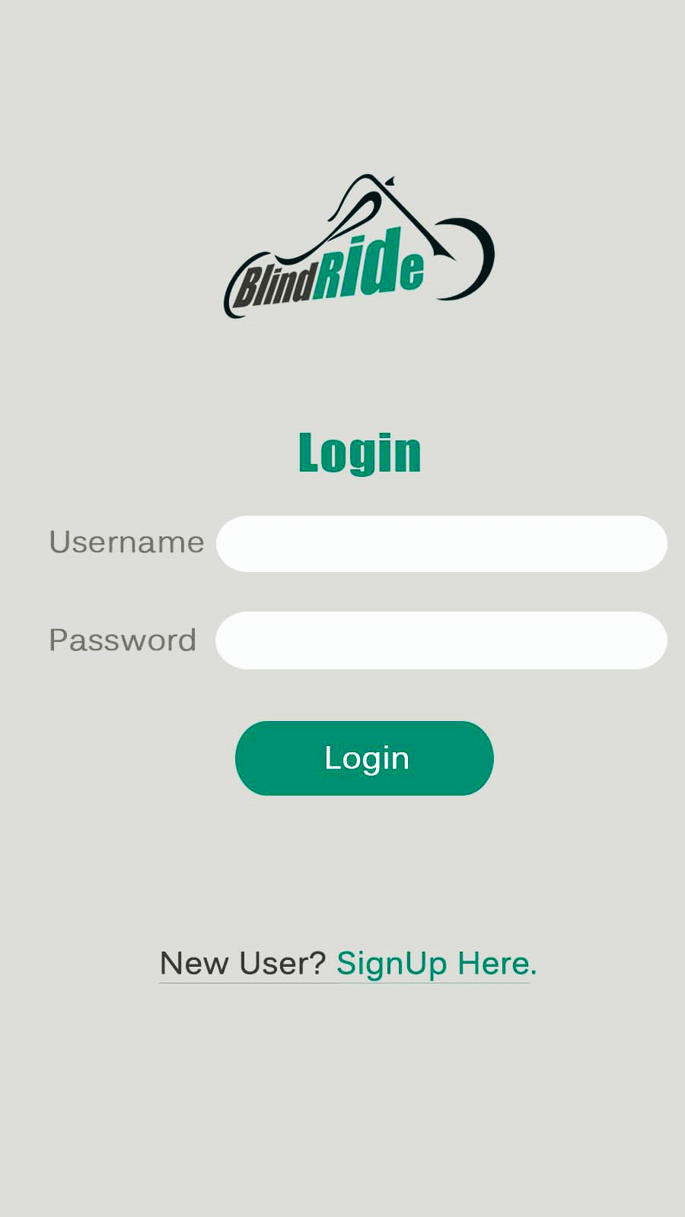
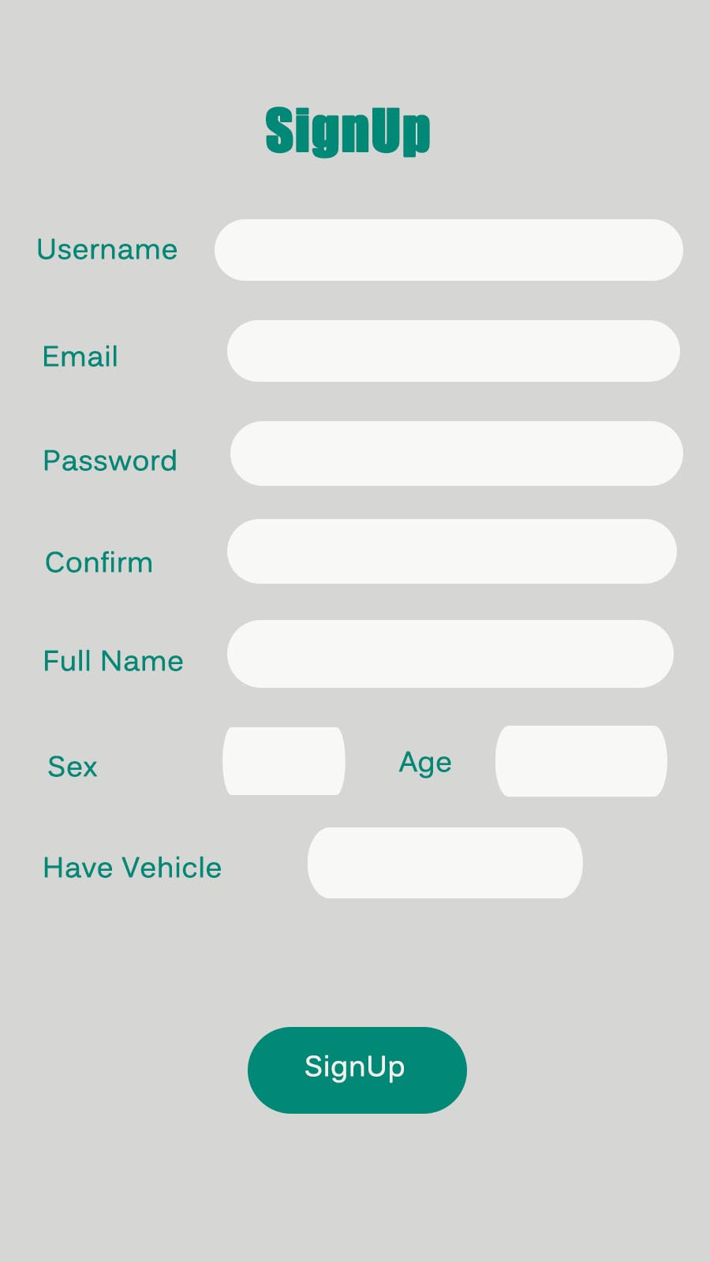
Flow Chart
If new user
If have Vehicle
launch
login
signup
Vehicle details

Slide 6
Flow Chart

Slide 7
Launch Screen

Slide 8
Login

Slide 9
SignUp

Slide 10
Main

