Slide 1
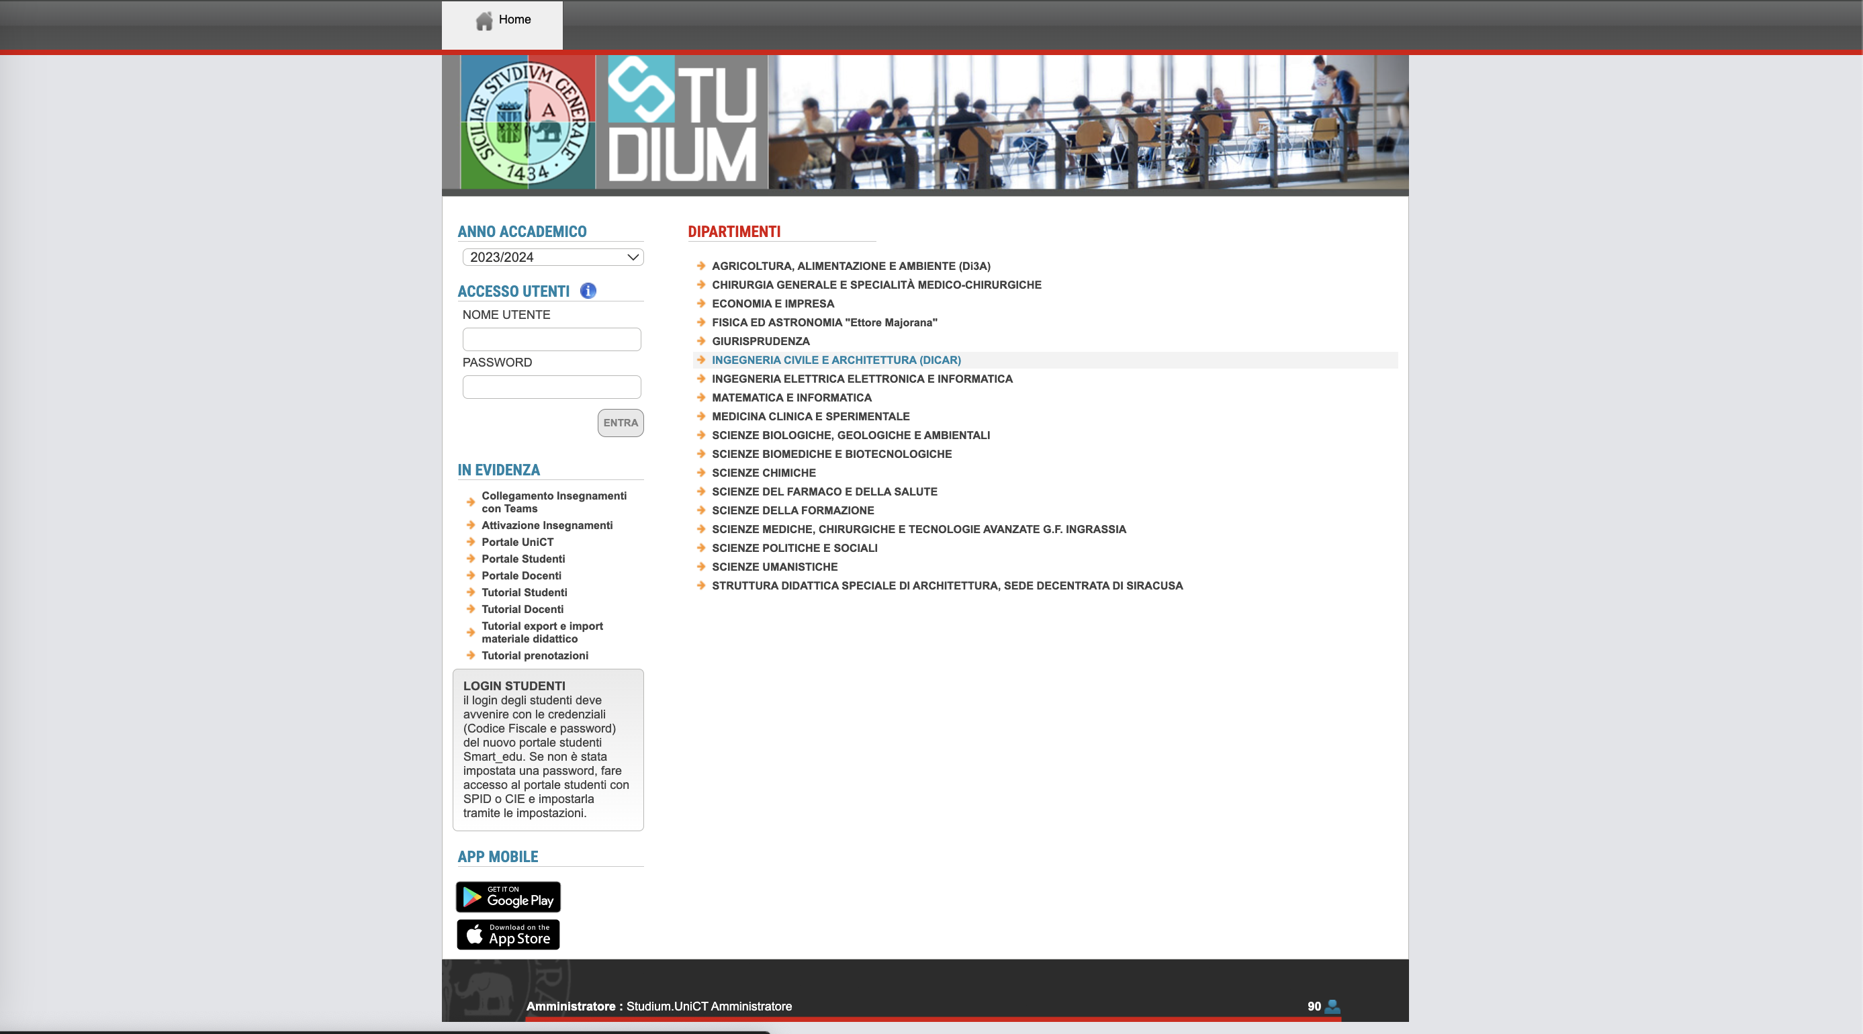
https://studium.unict.it/dokeos/2024/index.php

