Slide 1
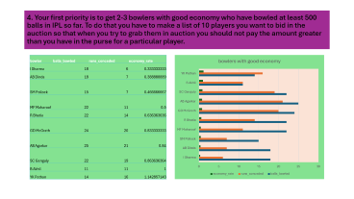
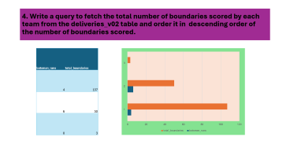
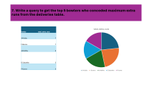
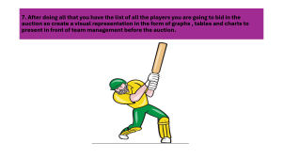
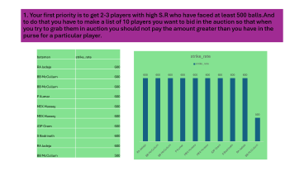
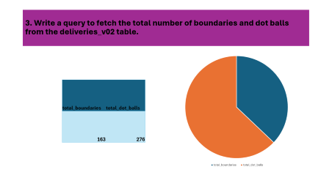
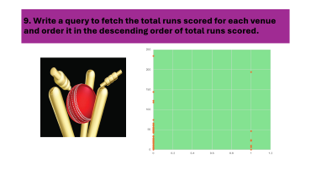
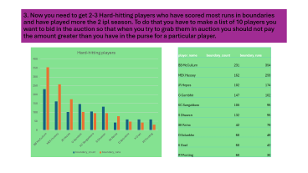
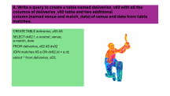
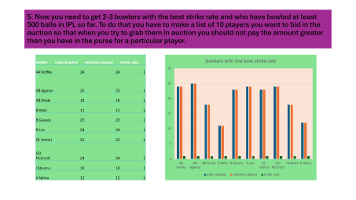
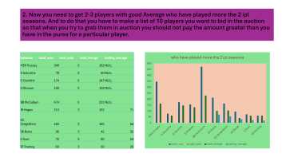
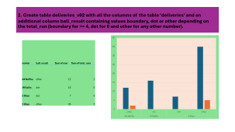
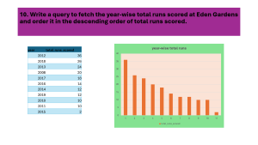

Slide 2

Presented by
- Sakuntala Bastola

Slide 3
1. Your first priority is to get 2-3 players with high S.R who have faced at least 500 balls.And to do that you have to make a list of 10 players you want to bid in the auction so that when you try to grab them in auction you should not pay the amount greater than you have in the purse for a particular player.
SELECT batsman, strike_rate
FROM IPL_Ball
WHERE strike_rate >= 500
ORDER BY Strike_Rate DESC
LIMIT 10;

Slide 4
1. Your first priority is to get 2-3 players with high S.R who have faced at least 500 balls.And to do that you have to make a list of 10 players you want to bid in the auction so that when you try to grab them in auction you should not pay the amount greater than you have in the purse for a particular player.
batsman | strike_rate
RA Jadeja | 600
BB McCullum | 600
BB McCullum | 600
P Kumar | 600
MEK Hussey | 600
MEK Hussey | 600
JDP Oram | 600
S Badrinath | 600
RA Jadeja | 600
BB McCullum | 500

Slide 5
2. Now you need to get 2-3 players with good Average who have played more the 2 ipl seasons. And to do that you have to make a list of 10 players you want to bid in the auction so that when you try to grab them in auction you should not pay the amount greater than you have in the purse for a particular player.
WITH PlayerStats AS (
SELECT
ib.batsman,
COUNT(DISTINCT im.season) AS seasons_played,
SUM(ib.batsman_runs) AS total_runs,
COUNT(*) AS total_innings,
SUM(CASE WHEN ib.is_wicket = 1 THEN 1 ELSE 0 END) AS total_outs
FROM
ipl_ball ib
INNER JOIN
ipl_matches im ON ib.id = im.id
GROUP BY
ib.batsman
HAVING
COUNT(DISTINCT im.season) > 2
AND COUNT(*) > 28
),
PlayerAverages AS (
SELECT
batsman,
total_runs,
total_outs,
total_innings,
CASE
WHEN total_outs > 0 THEN total_runs::decimal / total_outs
ELSE NULL
END AS batting_average
FROM
PlayerStats
)
SELECT
batsman,
total_runs,
total_outs,
total_innings,
batting_average
FROM
PlayerAverages
ORDER BY
batting_average DESC
LIMIT 3;

Slide 6
2. Now you need to get 2-3 players with good Average who have played more the 2 ipl seasons. And to do that you have to make a list of 10 players you want to bid in the auction so that when you try to grab them in auction you should not pay the amount greater than you have in the purse for a particular player.
batsman | total_runs | total_outs | total_innings | batting_average
MEK Hussey | 348 | 0 | 162 | NULL
D Salunkhe | 78 | 0 | 60 | NULL
G Gambhir | 174 | 0 | 147 | NULL
S Dhawan | 156 | 0 | 132 | NULL
BB McCullum | 474 | 0 | 231 | NULL
JR Hopes | 213 | 3 | 102 | 71
KC Sangakkara | 162 | 3 | 105 | 54
SK Raina | 96 | 3 | 42 | 32
K Goel | 72 | 3 | 60 | 24
RT Ponting | 60 | 3 | 60 | 20

Slide 7
3. Now you need to get 2-3 Hard-hitting players who have scored most runs in boundaries and have played more the 2 ipl season. To do that you have to make a list of 10 players you want to bid in the auction so that when you try to grab them in auction you should not pay the amount greater than you have in the purse for a particular player.
WITH BoundaryScorers AS (
SELECT
ib.batsman AS player_name,
COUNT(*) AS boundary_count,
SUM(CASE WHEN ib.batsman_runs IN (4, 6) THEN ib.batsman_runs ELSE 0 END) AS boundary_runs
FROM
IPL_ball ib
JOIN
IPL_matches im ON ib.id = im.id
GROUP BY
ib.batsman
HAVING
COUNT(DISTINCT im.season) > 2
)
SELECT
*
FROM
BoundaryScorers
ORDER BY
boundary_runs DESC
LIMIT 10;

Slide 8
3. Now you need to get 2-3 Hard-hitting players who have scored most runs in boundaries and have played more the 2 ipl season. To do that you have to make a list of 10 players you want to bid in the auction so that when you try to grab them in auction you should not pay the amount greater than you have in the purse for a particular player.
player_name | boundary_count | boundary_runs
BB McCullum | 231 | 354
MEK Hussey | 162 | 258
JR Hopes | 102 | 174
G Gambhir | 147 | 102
KC Sangakkara | 105 | 96
S Dhawan | 132 | 96
SK Raina | 42 | 78
D Salunkhe | 60 | 48
K Goel | 60 | 42
RT Ponting | 60 | 30

Slide 9
4. Your first priority is to get 2-3 bowlers with good economy who have bowled at least 500 balls in IPL so far.To do that you have to make a list of 10 players you want to bid in the auction so that when you try to grab them in auction you should not pay the amount greater than you have in the purse for a particular player.
WITH BowlerStats AS (
SELECT
bowler,
COUNT(*) AS balls_bowled,
SUM(total_runs - extra_runs) AS runs_conceded
FROM
IPL_ball
WHERE
is_wicket = 0
GROUP BY
bowler
HAVING
COUNT(*) >= 10 -- 500 not found
),
BowlerEconomy AS (
SELECT
bs.bowler,
bs.balls_bowled,
bs.runs_conceded,
(bs.runs_conceded::numeric / bs.balls_bowled) AS economy_rate
FROM
BowlerStats bs
)
SELECT
be.bowler,
be.balls_bowled,
be.runs_conceded,
be.economy_rate
FROM
BowlerEconomy be
WHERE
be.economy_rate > 0
ORDER BY
be.economy_rate ASC
LIMIT 10;

Slide 10
4. Your first priority is to get 2-3 bowlers with good economy who have bowled at least 500 balls in IPL so far. To do that you have to make a list of 10 players you want to bid in the auction so that when you try to grab them in auction you should not pay the amount greater than you have in the purse for a particular player.
bowler | balls_bowled | runs_conceded | economy_rate
I Sharma | 18 | 6 | 0.333333333
AB Dinda | 18 | 7 | 0.388888889
SM Pollock | 15 | 7 | 0.466666667
MF Maharoof | 22 | 11 | 0.5
R Bhatia | 22 | 14 | 0.636363636
GD McGrath | 24 | 20 | 0.833333333
AB Agarkar | 25 | 21 | 0.84
SC Ganguly | 22 | 19 | 0.863636364
B Akhil | 11 | 11 | 1
YK Pathan | 14 | 16 | 1.142857143

Slide 11
5. Now you need to get 2-3 bowlers with the best strike rate and who have bowled at least 500 balls in IPL so far. To do that you have to make a list of 10 players you want to bid in the auction so that when you try to grab them in auction you should not pay the amount greater than you have in the purse for a particular player.
WITH BowlerStats AS (
SELECT
bowler,
COUNT(*) AS balls_bowled,
COUNT(DISTINCT id) AS matches_played
FROM
IPL_ball
WHERE
is_wicket = 0
GROUP BY
bowler
HAVING
COUNT(*) >= 10 -- Bowlers who have bowled at least 10 balls
),
BowlerStrikeRate AS (
SELECT
bs.bowler,
bs.balls_bowled,
bs.matches_played,
(CAST(bs.balls_bowled AS numeric) / bs.matches_played) AS strike_rate
FROM
BowlerStats bs
)
SELECT
bsr.bowler,
bsr.balls_bowled,
bsr.matches_played,
bsr.strike_rate
FROM
BowlerStrikeRate bsr
ORDER BY
bsr.strike_rate ASC
LIMIT 10;

Slide 12
5. Now you need to get 2-3 bowlers with the best strike rate and who have bowled at least 500 balls in IPL so far. To do that you have to make a list of 10 players you want to bid in the auction so that when you try to grab them in auction you should not pay the amount greater than you have in the purse for a particular player.
bowler | balls_bowled | matches_played | strike_rate
AA Noffke | 24 | 24 | 1
AB Agarkar | 25 | 25 | 1
AB Dinda | 18 | 18 | 1
B Akhil | 11 | 11 | 1
B Geeves | 23 | 23 | 1
B Lee | 24 | 24 | 1
DL Vettori | 23 | 23 | 1
GD McGrath | 24 | 24 | 1
I Sharma | 18 | 18 | 1
A Nehra | 12 | 12 | 1

Slide 13
6. Now you need to get 2-3 All-rounders with the best batting as well as bowling strike rate and who have faced at least 500 balls in IPL so far and have bowled minimum 300 balls. To do that you have to make a list of 10 players you want to bid in the auction so that when you try to grab them in auction you should not pay the amount greater than you have in the purse for a particular player.
SELECT
id AS player_id,
COUNT(*) FILTER (WHERE is_wicket = 0 AND batsman_runs > 0) AS runs_scored,
COUNT(*) FILTER (WHERE is_wicket = 1) AS wickets_taken,
COUNT(*) AS balls_faced,
SUM(total_runs - extra_runs) AS runs_conceded,
strike_rate,--COUNT(*) FILTER (WHERE is_wicket = 0 AND batsman_runs > 0) / NULLIF(COUNT(*) FILTER (WHERE is_wicket = 0), 0) AS batting_strike_rate,
COUNT(*) FILTER (WHERE is_wicket = 1) / NULLIF(COUNT(*), 0) AS bowling_strike_rate
FROM
IPL_ball
GROUP BY
id, strike_rate
HAVING
COUNT(*) >= 10
AND COUNT(*) FILTER (WHERE ball IS NOT NULL) >= 10
limit 10;

Slide 14

7. After doing all that you have the list of all the players you are going to bid in the auction so create a visual representation in the form of graphs , tables and charts to present in front of team management before the auction.

Slide 15
1. Get the count of cities that have hosted an IPL match.
SELECT COUNT(DISTINCT city) AS city_count
FROM matches;
city_count
33

Slide 16
2. Create table deliveries_v02 with all the columns of the table ‘deliveries’ and an additional column ball_result containing values boundary, dot or other depending on the total_run (boundary for >= 4, dot for 0 and other for any other number).
CREATE TABLE deliveries_v02 AS
SELECT *,
CASE
WHEN total_runs >= 4 THEN 'boundary’
WHEN total_runs = 0 THEN 'dot'
ELSE 'other'
END AS ball_result
FROM deliverie
limit 10;
select * from deliveries_v02;
id | inning | over | ball | batsman | non_striker | bowler | batsman_runs | extra_runs | total_runs | is_wicket | extras_type | batting_team | bowling_team | strike_rate | fielder | player_dismissed | dismissal_kind | ball_result
335982 | 1 | 6 | 5 | RT Ponting | BB McCullum | AA Noffke | 1 | 0 | 1 | 0 | NA | Kolkata Knight Riders | Royal Challengers Bangalore | 20 | NA | NA | NA | other
335983 | 1 | 6 | 6 | BB McCullum | RT Ponting | AA Noffke | 1 | 0 | 1 | 0 | NA | Kolkata Knight Riders | Royal Challengers Bangalore | 16.66666667 | NA | NA | NA | other
335984 | 1 | 7 | 1 | BB McCullum | RT Ponting | Z Khan | 0 | 0 | 0 | 0 | NA | Kolkata Knight Riders | Royal Challengers Bangalore | 0 | NA | NA | NA | dot
335985 | 1 | 7 | 2 | BB McCullum | RT Ponting | Z Khan | 1 | 0 | 1 | 0 | NA | Kolkata Knight Riders | Royal Challengers Bangalore | 50 | NA | NA | NA | other
335986 | 1 | 7 | 3 | RT Ponting | BB McCullum | Z Khan | 1 | 0 | 1 | 0 | NA | Kolkata Knight Riders | Royal Challengers Bangalore | 33.33333333 | NA | NA | NA | other
335987 | 1 | 7 | 4 | BB McCullum | RT Ponting | Z Khan | 1 | 0 | 1 | 0 | NA | Kolkata Knight Riders | Royal Challengers Bangalore | 25 | NA | NA | NA | other
335988 | 1 | 7 | 5 | RT Ponting | BB McCullum | Z Khan | 1 | 0 | 1 | 0 | NA | Kolkata Knight Riders | Royal Challengers Bangalore | 20 | NA | NA | NA | other
335989 | 1 | 7 | 6 | BB McCullum | RT Ponting | Z Khan | 1 | 0 | 1 | 0 | NA | Kolkata Knight Riders | Royal Challengers Bangalore | 16.66666667 | NA | NA | NA | other
335990 | 1 | 8 | 1 | BB McCullum | RT Ponting | JH Kallis | 0 | 0 | 0 | 0 | NA | Kolkata Knight Riders | Royal Challengers Bangalore | 0 | NA | NA | NA | dot
335991 | 1 | 8 | 2 | BB McCullum | RT Ponting | JH Kallis | 0 | 0 | 0 | 0 | NA | Kolkata Knight Riders | Royal Challengers Bangalore | 0 | NA | NA | NA | dot

Slide 17
2. Create table deliveries_v02 with all the columns of the table ‘deliveries’ and an additional column ball_result containing values boundary, dot or other depending on the total_run (boundary for >= 4, dot for 0 and other for any other number).
bowler | ball_result | Sum of over | Sum of total_runs
AA Noffke | other | 12 | 2
JH Kallis | dot | 16 | 0
Z Khan | dot | 7 | 0
Z Khan | other | 35 | 5

Slide 18
3. Write a query to fetch the total number of boundaries and dot balls from the deliveries_v02 table.
SELECT
SUM(CASE WHEN ball_result = 'boundary' THEN 1 ELSE 0 END) AS total_boundaries,
SUM(CASE WHEN ball_result = 'dot' THEN 1 ELSE 0 END) AS total_dot_balls
FROM deliveries_v02;

Slide 19
3. Write a query to fetch the total number of boundaries and dot balls from the deliveries_v02 table.
total_boundaries | total_dot_balls
163 | 276

Slide 20
4. Write a query to fetch the total number of boundaries scored by each team from the deliveries_v02 table and order it in descending order of the number of boundaries scored.
SELECT batsman_runs,
COUNT(*) AS total_boundaries
FROM deliveries_v02
WHERE total_runs IN (4, 6)
GROUP BY batsman_runs
ORDER BY total_boundaries DESC;

Slide 21
4. Write a query to fetch the total number of boundaries scored by each team from the deliveries_v02 table and order it in descending order of the number of boundaries scored.
batsman_runs | total_boundaries
4 | 107
6 | 50
0 | 3

Slide 22
5. Write a query to fetch the total number of dot balls bowled by each team and order it in descending order of the total number of dot balls bowled.
SELECT batsman_runs,
COUNT(*) AS total_dot_balls
FROM deliveries_v02
WHERE total_runs = 0
GROUP BY batsman_runs
ORDER BY total_dot_balls DESC;
batsman_runs | total_dot_balls
0 | 276

Slide 23
6. Write a query to fetch the total number of dismissals by dismissal kinds where dismissal kind is not NA.
SELECT dismissal_kind,
COUNT(*) AS total_dismissals
FROM deliveries_v02
WHERE dismissal_kind != 'NA'
GROUP BY dismissal_kind
ORDER BY total_dismissals DESC;

Slide 24
6. Write a query to fetch the total number of dismissals by dismissal kinds where dismissal kind is not NA.
dismissal_kind | total_dismissals
caught | 21
bowled | 10
run out | 4
lbw | 2
stumped | 1
retired hurt | 1

Slide 25
7. Write a query to get the top 5 bowlers who conceded maximum extra runs from the deliveries table.
SELECT bowler,
SUM(extra_runs) AS total_extra_runs
FROM deliverie
GROUP BY bowler
ORDER BY total_extra_runs DESC
LIMIT 5;

Slide 26
7. Write a query to get the top 5 bowlers who conceded maximum extra runs from the deliveries table.
bowler | total_extra_runs
JH Kallis | 7
I Sharma | 7
AA Noffke | 6
D Salunkhe | 5
P Kumar | 5

Slide 27

8. Write a query to create a table named deliveries_v03 with all the columns of deliveries_v02 table and two additional column (named venue and match_date) of venue and date from table matches.
CREATE TABLE deliveries_v03 AS
SELECT dv02.*, a.neutral_venue, a.match_date
FROM deliveries_v02 AS dv02
JOIN matches AS a ON dv02.id = a.id;
select * from deliveries_v03;

Slide 28
9. Write a query to fetch the total runs scored for each venue and order it in the descending order of total runs scored.
SELECT
batsman,
neutral_venue,
SUM(total_runs) AS total_runs_scored
FROM deliveries_v03
GROUP BY batsman, neutral_venue
ORDER BY total_runs_scored DESC
limit 10;
batsman | neutral_venue | total_runs_scored
MEK Hussey | 0 | 234
BB McCullum | 1 | 194
JR Hopes | 0 | 144
BB McCullum | 0 | 144
G Gambhir | 0 | 122
S Dhawan | 0 | 118
KC Sangakkara | 0 | 74
SK Raina | 0 | 66
RA Jadeja | 0 | 66
S Badrinath | 0 | 62
ST Jayasuriya | 0 | 60
SM Pollock | 0 | 56
RV Uthappa | 0 | 54
ML Hayden | 0 | 54
D Salunkhe | 0 | 52
K Goel | 0 | 50
RT Ponting | 0 | 48
KC Sangakkara | 1 | 46
Yuvraj Singh | 0 | 46
P Kumar | 0 | 46
AM Nayar | 0 | 44
R Dravid | 0 | 44
SR Watson | 0 | 42
S Chanderpaul | 0 | 34
PA Patel | 0 | 32
JDP Oram | 0 | 28
SK Warne | 0 | 28
SM Katich | 0 | 26
SC Ganguly | 1 | 24
V Sehwag | 0 | 24
AA Noffke | 0 | 22
SM Katich | 1 | 22
M Kaif | 0 | 22
MV Boucher | 0 | 20
YK Pathan | 0 | 20
DJ Hussey | 0 | 18
JH Kallis | 0 | 18
W Jaffer | 0 | 16
L Ronchi | 0 | 16
T Kohli | 0 | 16
CL White | 0 | 12
V Kohli | 0 | 10
DJ Thornely | 0 | 10
Mohammad Hafeez | 1 | 10
SB Joshi | 0 | 10
DJ Hussey | 1 | 6
IK Pathan | 0 | 6
Z Khan | 0 | 6
SK Trivedi | 0 | 6
M Rawat | 0 | 4
MS Dhoni | 0 | 4
PR Shah | 0 | 4
Harbhajan Singh | 0 | 4
DS Lehmann | 0 | 2
LRPL Taylor | 0 | 2
RT Ponting | 1 | 0
B Akhil | 0 | 0

Slide 29

9. Write a query to fetch the total runs scored for each venue and order it in the descending order of total runs scored.

Slide 30
10. Write a query to fetch the year-wise total runs scored at Eden Gardens and order it in the descending order of total runs scored.
SELECT EXTRACT(YEAR FROM match_date) AS year,
SUM(deliverie.total_runs) AS total_runs_scored
FROM matches
JOIN deliverie ON matches.id = deliverie.id
WHERE city = 'Delhi' ---- Eden Gardens could not found
GROUP BY EXTRACT(YEAR FROM match_date)
ORDER BY total_runs_scored DESC;

Slide 31
10. Write a query to fetch the year-wise total runs scored at Eden Gardens and order it in the descending order of total runs scored.
year | total_runs_scored
2012 | 36
2018 | 26
2013 | 24
2008 | 20
2017 | 18
2016 | 14
2014 | 12
2019 | 12
2010 | 10
2011 | 10
2015 | 2

