Slide 1
DataTransfer
A common data transfer framework
Explore how to apply on Azure Function
Author: Hao Ge
Mentor: Yehan Wang
Date: 2021.8.26

Slide 2
DataTransfer
Background
Architecture Design
Performance Analysis
Azure Function Explore
Outline
Notes:
背景：项目背景介绍，DataTransfer的由来，前后链路
架构设计：先展示目前的整体架构，然后从串行->多线程->线程池->task->channel读写分离…讲探索过程，描述自己是如何一步一步得到最终的这个代码架构的
性能测试：memory问题和cpu问题，两个重要的指标：内存占用、时间消耗
Azure Function上的探索：之前的测试环境是本机，将代码在Azure Function上跑：memory、cpu不如本机，http超过5min运行超时… 如何解决？

Slide 3
BACKGROUND
Get the Tenant-Asn mapping from daily café log.
Based on this mapping, we can do some monitor and alert related work.
Business Requirement
Cosmos café log
Scope
Cosmos tenant-asn
Copy Data
Azure Blob
HTTP Trigger
Azure Function
Call Api
DB
Dataflow
Memory issues: when transfer large amount of the data(unit: GB), OOM will happen, we should concern the buzus in memory.
CPU issues: when we solved the memory issue, we still want shorter run time, we should concern the cpu utilization.
Code reuse: the solution for memory and cpu issues needs to be abstracted and used for most similar tasks.
Challenge
Notes:
业务逻辑
工作流
DataTransfer：
内存问题：如何解决OOM；
cpu问题：如何让程序跑的更快，thead、thread pool、async、parallel；
代码复用：大量类似任务和场景，通用逻辑可以被抽象成一个框架，进行代码复用

Slide 4
DataTransfer
Background
Architecture Design
Performance Analysis
Azure Function Explore
Outline
Notes:
架构设计（项目两点）：主要分为两个部分
通用框架：插件化思想：message抽象、reader和writer解耦（热加载 vs 泛型）=> 实现代码复用，任意两个数据源之间的传输
线程模型：

Slide 5
ARCHITECTURE
Design Ideas
A common data transfer framework
The DataTransfer Framework is used to transfer data between any two data sources and is typically suitable for transferring large amounts of data when your machine has buzus in memory.
What’s the DataTransfer
Cosmos
MySQL
Cosmos
MySQL
Azure Blob
SQL Server
Azure Blob
Data Transfer
SQL Server
Azure MQ
DB
Azure MQ
DB
Network Topology
Star Topology
Notes:
期待能够达到的最终效果

Slide 6
ARCHITECTURE
Design Ideas
A common data transfer framework
The DataTransfer Framework is used to transfer data between any two data sources and is typically suitable for transferring large amounts of data when your machine has buzus in memory.
What’s the DataTransfer
Pattern
framework + plugin
Plug-ins only care about reading or writing to the data itself
The framework will handle all cpu issues and memory issues
DataTransfer
Framework
Data Source
Data Target
Reader
Plugin
Writer
Plugin

Slide 7
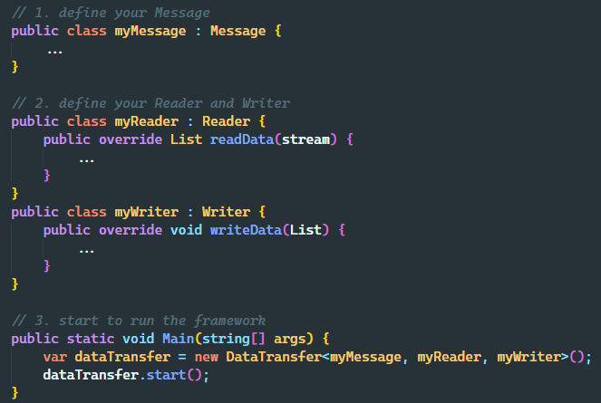
ARCHITECTURE
Design Ideas
DataTransfer
Framework
Data Source
Data Target
framework + plugin
Reader
Plugin
Writer
Plugin
Plug-ins only care about reading or writing to the data itself
The framework will handle all cpu issues and memory issues
Just 3 steps:
define your Message
define your Reader and Writer
start to run the Framework

Slide 8
ARCHITECTURE
Design Practice
memory issues:
Solve the buzus in memory
Data Sharding: split the total data into smaller data slices
Data Pooling?: like slub allocator, a memory object cache pool
cpu issues:
Shorter Run Time:
Serial vs Parallel
Synchronize vs Asynchronise
Reader & Writer => Channel
Reader
Channel
Writer
IO device
IO device
kernel
requests
kernel
request
Data Source
VS
Data Source
Data Slice
slice
user
slice
slices
user
slice
slice
IO Time
IO Time
Serial
Parallel
Notes:
Memory issues：数据分片
Cpu issues：
串行 vs 并行？
假设data slice size一样(在memory能够承受的住的前提下)，parallel比serial可以节省n倍的IO时间和数据处理时间
假设data slice size不一样(serial当然希望一次性读更大的size)，此时两者的IO time是相同的，但数据处理时间parallel是serial的n倍
同步 vs 异步？
假设采用同步，并行起了多个线程，该线程的生命周期：kernel向IO发出请求->等待IO，此时CPU阻塞在IO处，一直处于空转状态（cpu调度没有那么智能，对同步线程来说，给定时间片就一定要用完，而IO未返回之前线程又没有其他事情可以做，只能空转阻塞）
假设使用异步，某个线程进入kernel，发出一个“我要取数据”的IO请求后，直接返回，此时cpu资源会被直接释放给有任务的线程，而不会给那个等待io的线程，那等待io的线程什么时候被唤醒呢？当数据到达IO时（比如网口），注意此时还没必要唤醒线程，DMA会帮你去做数据从io buffer到内存空间的搬运操作，当这个搬运完成时，kernel会触发一个中断，此时把等待io的线程放入等待队列，准备开始运行
可以看到，使用异步不会出现某个核空耗在一整个等待IO的时间上，而是将该核的cpu资源交给其他有运行任务需求的线程，这样效率显然会高一些；那么问题来了，这个其他有运行需求的线程是什么呢？理论上发出读取数据请求的线程运行内容都差不多，他们差不多会在同一时刻释放cpu资源，而除了这批线程，好像只剩下main线程了，然而main线程本身又是阻塞在这些线程上的，emmm，这个节省出来的cpu资源好像没人用啊 => 实际上可以拆分成reader和writer，我们没必要把读取数据写数据放在同一个线程里做，这样太耦合了；理论上我们的data source和data target是会变的，之前所说的reader插件和writer插件本身的逻辑又是独立的，我们完全可以将读和写放在两个完全独立的线程里去做，那这两种线程怎么进行数据交互呢？消息队列--channel

Slide 9
ARCHITECTURE
Design Practice
Channel Design:
Reader & Writer => Channel
Reader
Channel
Writer
Borrow the idea of ​​message queues, decouple reader and writer, make them act as producer and consumer respectively
By controlling the limited capacity of the channel, we can control the total memory usage
Plug-in, the reader and writer will be abstracted for developers to achieve, the rest things will be executed by the framework, which benefits to code reuse
The execute time for producer and consumer is obviously not equal, by separating them, we can control the number of reader threads and writer threads separately
Note: The basic unit of channel transmission is List instead of Object, to ensure that each consumer does not do too much or too little (frequent context switching takes time)
Notes:
详细说说channel的设计：
借鉴了消息队列的思想，使reader和writer解耦，分别充当生产者和消费者的角色，它们做的事情逻辑上是不相关的，生产者只需要从source data中读取数据并解析成对象list，而消费者则是拿到这些对象再进行进一步业务逻辑上的处理，最终写入target data中
作为channel，我们可以通过控制它的限制容量，从而达到控制内存占用的目的
作为出reader和writer，插件化，抽象给开发者实现，其余内容由框架完成，实现代码复用
生产者和消费者单次任务花费的时间明显是不相等的，不必要让读和写这两件事情绑定在同一个线程上，channel对reader和writer隔离，我们就可以分别控制reader线程和writer线程的数量，如果写线程执行的更快，就设置地少一点，这样更加灵活、节省资源
注：channel传输的基本单元是list而不是object，保证每个消费者既不做太多的事情，也不做太少的事情（频繁的上下文切换耗费时间）

Slide 10
ARCHITECTURE
Design Practice
Thread Model:
Parallel + Asynchronize
Multi-Thread
ThreadPool
Task ⬄ C#-maintained thread pool
Limit the concurrency
Parallel.Foreach ⬄ not suitable to async methods
Realize the Parallel.ForeachAsync to supports Async methods
NIO ThreadPool
Notes:
前面讲的是整个框架大致的设计方案选型 – 已经敲定了使用并行+异步的方案，接下来就来聊聊具体怎么去利用C#的特性去搭建线程模型
Task特性：线程什么时候完成、获得返回值、选择性取消运行，和异步天然的兼容

Slide 11
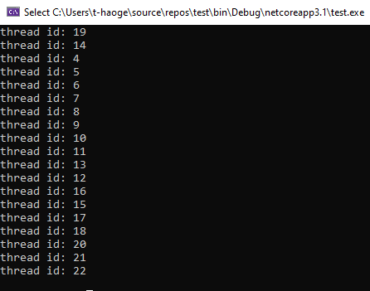
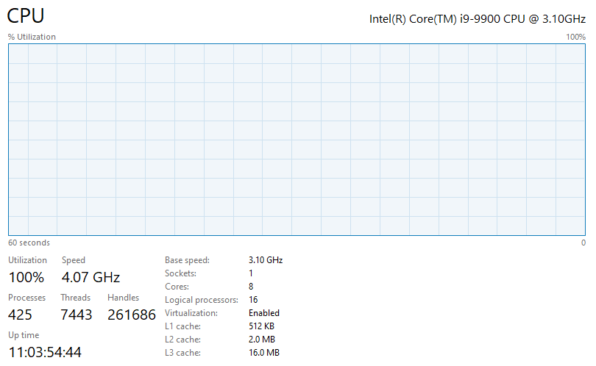
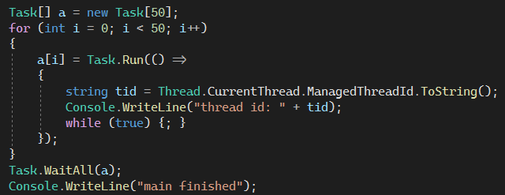
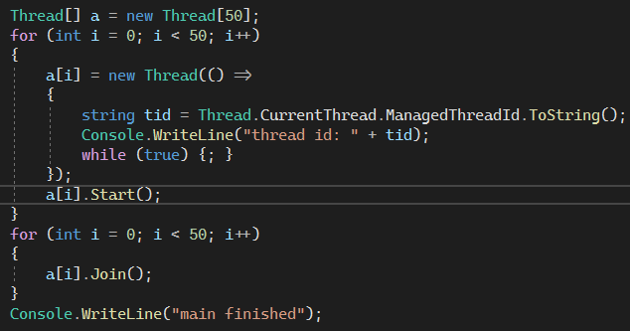
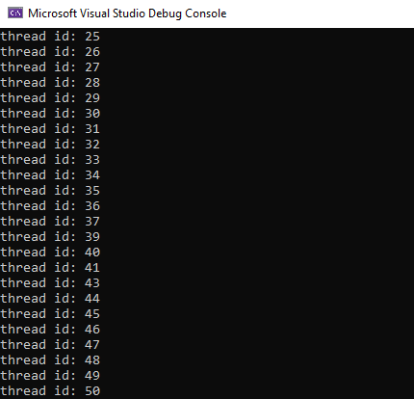
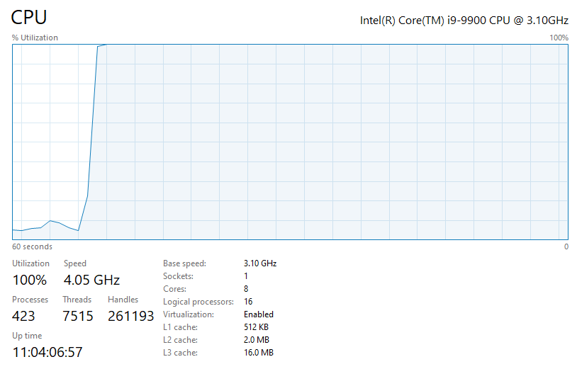
ARCHITECTURE
Design Practice
Thread Model:
Parallel + Asynchronize
Task ⬄ C#-maintained thread pool
Task vs Thread
Suppose we create 50 tasks and 50 threads respectively
Task
Thread
Notes:
Task底层使用的是线程池（我们可以通过设置线程池的最大最小数量来控制Task所能动用的线程数），而不是每new一个task直接new一个线程，假设我们分别创建50个task和50个thread，最终的cpu占用率都是100%
Task：总共8核，使用了20个线程（底层的线程池预先分配好的数量？），基本cpu就跑不动了
Thread：直接使用Thread起50个线程，成功创建了

Slide 12
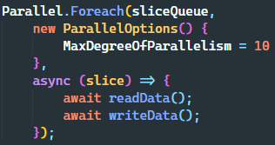
ARCHITECTURE
Design Practice
Thread Model:
Parallel + Asynchronize
Limit the concurrency: Parallel.Foreach
Suppose there are n tasks (data slices).
Should we create n tasks directly?
Have you considered the maximum concurrency the threadpool supports?
What if the tasks are all crowded in the waiting queue?
We need to limit the concurrency
Parallel.Foreach supports limiting concurrency
But it’s not suitable to Async Func. This will lead to bugs:
Async delegates return `Task` and the Parallel construct doesn't await that task.
This means exceptions are unobserved and you can't be sure after the `Parallel.For` invocation has run that all the work has actually been completed
Notes:
Task底层使用的是线程池而不是每new一个task直接new一个线程
假设有n个任务（数据分片），直接创建n个Task就好了吗？是否考虑过线程池本身的能力，支持的最大并发度？万一任务全挤在等待队列里怎么办？
我希望给100个task，每次只去线程池里申请20个线程的资源来执行，而不是一股脑起100个task去抢占线程池里的线程 -> 需要自己额外维护一个任务队列，而不是直接抢占线程池的
这个工作实质上就是限制并发度嘛，而parallel并行库天然支持限制并发度，然而parallel仅支持同步任务，而读写的任务是异步的，异步函数会立马返回Task，Parallel认为得到返回值该函数就已经执行完毕了，并不会等待该Task完成，这意味着异常没法被观测，也没法验证执行parallel.foreach最终执行是否成功

Slide 13
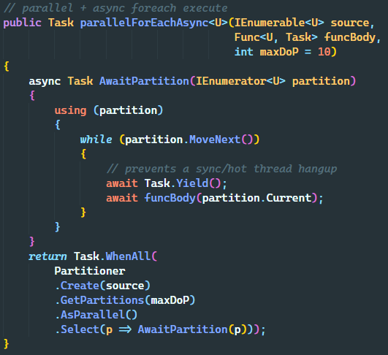
ARCHITECTURE
Design Practice
Thread Model:
Parallel + Asynchronize
Realize the Parallel.ForeachAsync
We hope to limit n tasks run at the same time, and await the final outcome.
Task.WhenAll(): can wait for all tasks to finish, but it has a tendency to become unperformant with large scale/amount of tasks firing simultaneously => without moderation/throttling.
Partitioner: partition all the tasks into multiple chunks that can be accessed concurrently by multiple threads, and the partition number will be the limit on the degree of parallelism. So we just need to use Task.WhenAll() to await n tasks, which work on the n trunks.
Notes:
支持异步任务的并行foreach：https://stackoverflow.com/questions/38634376/running-async-methods-in-parallel、https://medium.com/@alex.puiu/parallel-foreach-async-in-c-36756f8ebe62
Partitioner：https://stackoverflow.com/questions/4031820/when-to-use-partitioner-class
我们希望每一时刻只有n个task在运行，且期望等待最终执行结果
Task.WhenAll() 可以等待所有task运行完毕，但它有在大规模/大量任务同时触发的情况下变得性能不佳的趋势 - 没有节制/节流，它会同时启动所有的任务，导致线程池的等待队列被挤爆
为了限制并行度，我们可以使用partitioner先将所有的任务划分为n个集合，再去申请n个task/thread去执行这n个集合里的任务，相当于分区数就是并发度

Slide 14
ARCHITECTURE
Design Practice
Configuration
Slice Size
Reader Num
Channel Limit
Writer Num
Data Source
DataTransfer
Framework
Data Target
Data Slice
Partition
Reader
Data Slice
Writer
call api
Reader
Channel
(Message Queue)
Data Slice
Partition
split
Writer
call api
Data Slice
Reader
Writer
call api
Data Slice
Partition
Reader
Data Slice
Producer
Consumer
ThreadPool
Notes:
框架模型
开发者可以配置的参数

Slide 15
DataTransfer
Background
Architecture Design
Performance Analysis
Azure Function Explore
Outline
Notes:
性能测试和分析

Slide 16
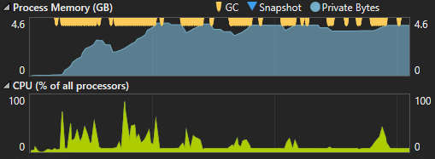
PERFORMANCE
Memory Usage
Memory Leak or Memory Blocking ?
Read 1G files, the memory usage has soared to 6-7G.
Configuration: slice size=5MB, reader=10, writer=5, channel limit bound=20
Analysis：reader num < writer num, channel bounded => the slice blocks are piled up continuously, and cannot be GC if not consumed.
Solution:
1. Increase channel bound
2. Reduce data slice size
3. Make writer num > reader num
Notes:
读取1G的文件，内存占用竟然飙到了6-7G，内存泄漏？内存阻塞：此时slice size=5MB，而reader num=10，大于writer num=5，channel limit=20，分析可知：
读线程的数量大于写线程的数量，由于模拟的是从blob读再写回blob，因此读和写的io时间应该差不多，因此writer的消费速度跟不上reader的生产速度，又由于对channel进行了slice数量的limit限制，因此很快channel就满了，此时reader产生的slice块大量堆积，没有被消费也就无法被GC，最终导致内存占用率大幅上升
解决方案：提高channel bound（考虑内存占用限制？）、减少slice size、使writer数量大于reader

Slide 17
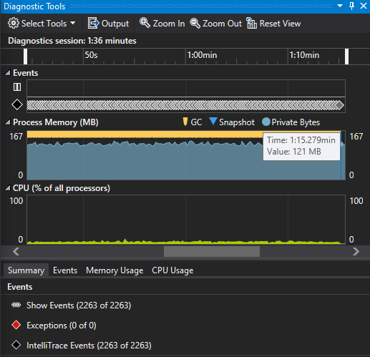
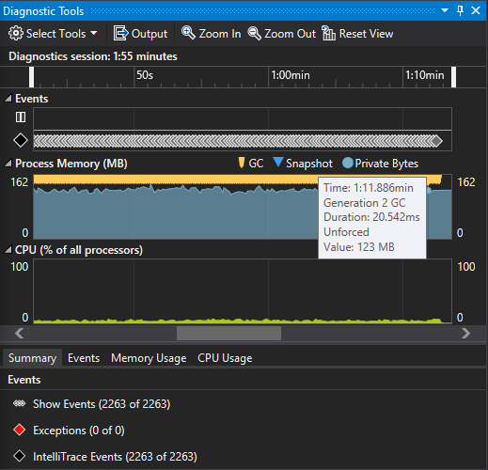
PERFORMANCE
Thread Model Comparison
Sequential Execute
about 1min13s, low cpu utilization

Slide 18
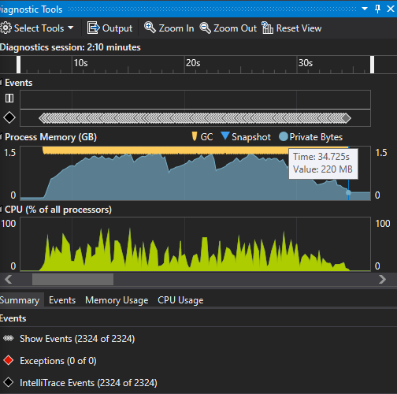
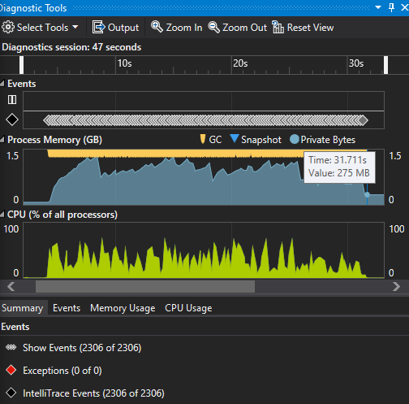
PERFORMANCE
Thread Model Comparison
MaxDegreeOfParallelism = 10
about 32s, high cpu utilization
Parallel Sync Execute, no Channel

Slide 19
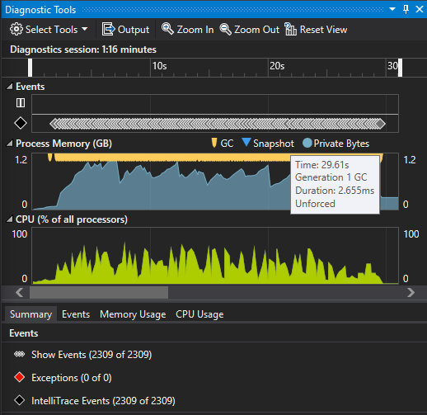
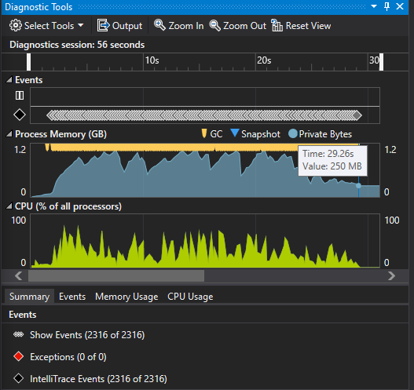
PERFORMANCE
Thread Model Comparison
MaxDegreeOfParallelism = 10
about 29s, high cpu utilization
Parallel Async Execute, no Channel

Slide 20
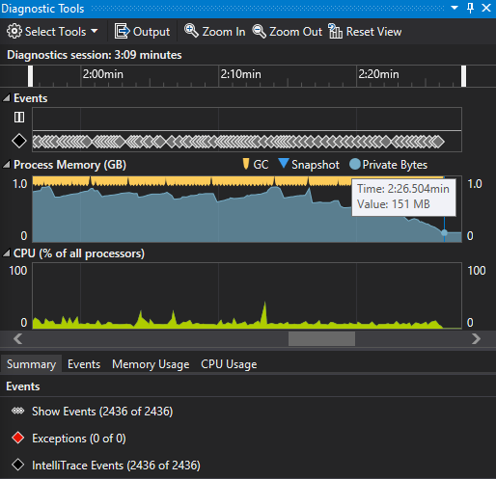
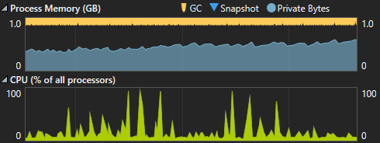
PERFORMANCE
Thread Model Comparison
channel bound = 100
reader threads num = 10, writer threads num = 5
about 2min26s! low cpu utilization
Parallel Async Execute, with Channel 1. channel bounded: bad performance
Why does the performance drop so much after adding channels to separate the reader and writer threads?
It would be seen that the CPU utilization rate cannot continue to maintain high occupancy, which is different from the previous cases.
Obviously due to the use of channels, some resources and some threads are blocked.

Slide 21
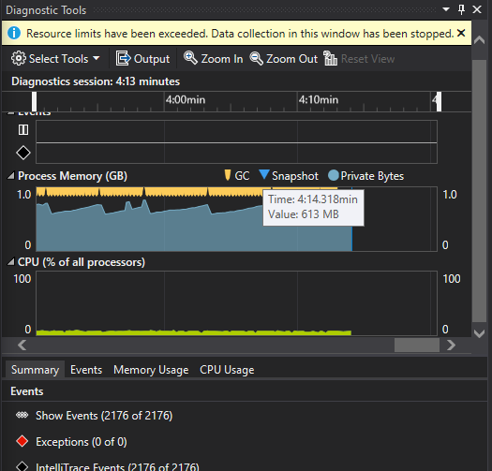
PERFORMANCE
Thread Model Comparison
Parallel Async Execute, with Channel 1. channel bounded: bad performance
I try to set the reader thread num = 1, writer thread num = 1, the senario would be close to the sequential case, but it even takes about 4min14s!

Slide 22
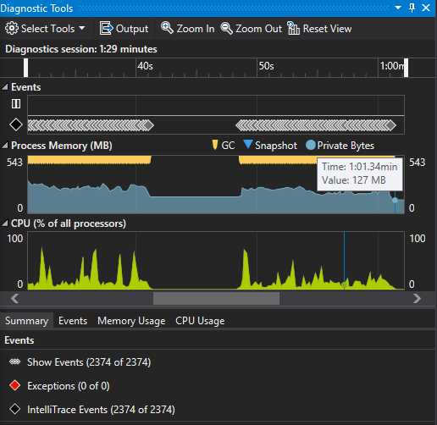
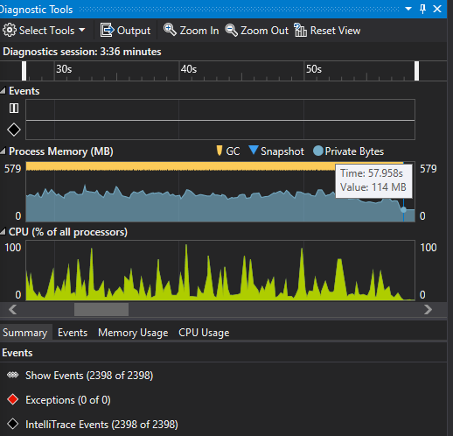
PERFORMANCE
Thread Model Comparison
Obviously the speed of consumption cannot keep up with the speed of production, resulting in congestion of resources.
so I adjust the thread num: make writer threads more than reader threads
Parallel Async Execute, with Channel 2. channel bounded: better performance
reader threads num = 5, writer threads num = 10
about 1min
reader threads num = 8, writer threads num = 15
about 58s

Slide 23
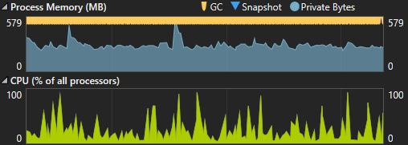
PERFORMANCE
Thread Model Comparison
Parallel Async Execute, with Channel 2. channel bounded: better performance
Case 1:
reader threads num = 5, writer threads num = 10
about 1min
You will find that the overall cpu and memory occupancy are more balanced.
Case 2:
reader threads num = 8, writer threads num = 15
about 58s
Obviously the speed of consumption cannot keep up with the speed of production, resulting in congestion of resources.
so I adjust the thread num: make writer threads more than reader threads

Slide 24
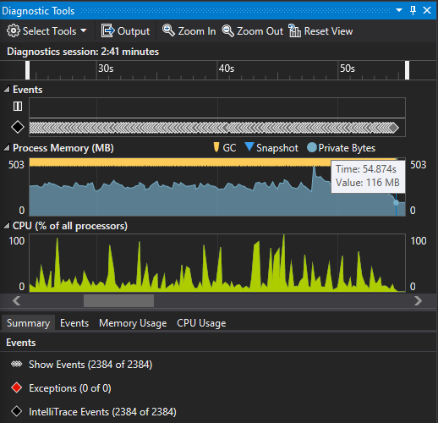
PERFORMANCE
Thread Model Comparison
Parallel Async Execute, with Channel 3. channel unbounded: better performance
I also try to unlimit the channel capacity, that is: channel bound = ∞
reader threads num = 8, writer threads num = 15
about 54s

Slide 25
PERFORMANCE
Thread Model Comparison
Analysis
Although the "parallel async with channel " is more time-consuming than parallel methods without channel, but it still performs better than the sequential method, and It will bring some benefits we are more hopeful of:
Decoupling reader and writer by using the channel can be more conducive to expansion and separation of read and write.
The most important thing is that the number of reader threads and writer threads can be independently controlled. And then we can control the memory usage to keep it at a low level. eg: the memory usage with channel is mostly around 300MB, but if it's without channel, the memory usage will rise to 1-2GB.
Notes:
有channel虽然比纯并行、无channel异步并行的耗时长，但利用channel将reader和writer解耦能够更有利于扩展、读写分离，最重要的是可以独立分别地控制读线程和写线程的数量，进而达到控制内存占用（带channel的内存占用基本在300M左右，不带channel的会上升到1-2GB）
所以我们只牺牲了一部分并行带来的速度性能（仍然比串行快），但最终我们可以获得对内存使用的控制。前者是系统的优化，后者是我们整个系统的瓶颈，也是我们更期待解决的问题。
并行需要通过控制线程数来控制内存占用，如果想要更少的内存占用就需要设置更少的线程数，最终会退化到单线程模型；但使用channel，理论上只要writer比reader多，就可以快速消费掉数据块，因此可以将线程数的绝对值设置地高一点也没事，充分利用当前机器的cpu资源，此外，当机器配置、环境不同时，单独修改读、写线程的配置比直接修改并行的线程数要更好一些

Slide 26
PERFORMANCE
Thread Model Comparison
Analysis
By the way, I also try to analyze the influence of the channel, there are two main aspects should be taken into account:
The reader -> channel -> writer process will definitely take longer than the direct reader->writer process, but the performance loss is worth the decoupling and scalability. It can be seen from the final tuning results that it can be still faster than the serial method.
When the channel is full, the writer‘s consumption capacity cannot keep up with the reader’s production capacity. At this time, the asynchronous thread of the reader is blocked and cannot push data into the channel, then the task cannot be ended. Assume that none of the total 10 parallel threads are released, no one can come to read new IO data, that is why the CPU occupancy rate suddenly drops in the last figures. Solution：1. increase writer number 2. use external message queue storage
Notes:
思考：channel的影响其实有两点：
reader -> channel -> writer的流程耗时肯定会比直接reader->writer要长，但这个性能损耗换来解耦和扩展性以及对内存占用的管理是值得的，从最终调参结果中可以看出，它还是可以比串行快的
当channel满时，writer消费能力跟不上reader的生产能力，此时reader的异步线程被阻塞住，无法往channel里push数据，那该任务就无法结束，假设10个并行线程都没有被释放，也就无法再去读新的io数据，这也是图中cpu占用率突然降低的原因
解决方案：1. 提高writer线程数 2. 使用外部消息队列存储，此时channel本身就不会再受到内存的限制

Slide 27
DataTransfer
Background
Architecture Design
Performance Analysis
Azure Function Explore
Outline

