Slide 2
SHD ASN scope posting
Hao Ge

Slide 3
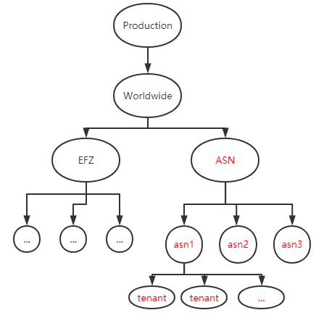
BACKGROUND
Get the Tenant-Asn mapping from daily café log.
Based on this mapping, SHD posting can navigate to notify these tenants accurately when incident happens.
Business Requirement
The topology and tenant mapping structure in SHD database

Slide 4
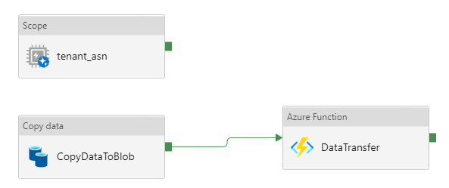
BACKGROUND
Get the Tenant-Asn mapping from daily café log.
Based on this mapping, SHD posting can navigate to notify these tenants accurately when incident happens.
Business Requirement
Tenant-Asn Mapping
Azure Function Tuning
Cosmos café log
Scope
Cosmos tenant-asn
Copy Data
Azure Blob
HTTP Trigger
Azure Function
Call Api
DB
Dataflow
daily
Azure Data
Factory
weekly

Slide 5
Tenant-Asn Mapping
SCOPE PIPELINE
organization
prefix
Mapi Http
Top café log
with domain
org
is_ipv6
Tenant ID
request_bytes
Top café log
tmp1
Group
prefix
response_bytes
Default
organization == “xxx.xxx.xxx”
Union
Top Tenants & Café Log
is_ipv6
…
org == Domain
ipv6_prefix
Top protocols café log
request_count
Ews
Top café log
with tenantID
org
tmp2
request_bytes
response_bytes
Eas
organization == tenant ID
org == Tenant ID
Rest
Domain
Tenant ID
prefix
ipv6_prefix
Tenant ID
Tenants
Tenant ID
EXOusers
Owa
IsS500
Top Tenants
…
Filter by TOP 200 ASNs
Mailbox Delivery
Tenant ID
Domains
Domain
bucket
MoiIPv4
bucket
tmp1
…
Domain
asn
…
Union
TenantAsn Mapping
Outlook Service
EXO users >= threshold || IsS500
bucket == prefix
prefix
MoiIPv6
prefix
tmp2
asn
result
…
bucket == ipv6_prefix
Tenant ID
Asn

Slide 6
BACKGROUND
Get the Tenant-Asn mapping from daily café log.
Based on this mapping, we can do some monitor and alert related work.
Business Requirement
Azure Function Tuning
Cosmos café log
Scope
Cosmos tenant-asn
Copy Data
Azure Blob
HTTP Trigger
Azure Function
Call Api
DB
Dataflow
Memory issues: when transfer large amount of the data(unit: GB), OOM will happen, we should concern the busy in memory.
CPU issues: when we solved the memory issue, we still want shorter run time, we should concern the cpu utilization.
Code reuse: the solution for memory and cpu issues needs to be abstracted and used for most similar tasks.
Challenge

Slide 7
Azure Function Tuning
A common data transfer framework
The DataTransfer Framework is used to transfer data between any two data sources and is typically suitable for transferring large amounts of data when your machine has buzus in memory.
DataTransfer
Cosmos
MySQL
Cosmos
MySQL
Azure Blob
SQL Server
Azure Blob
Data Transfer
SQL Server
Azure MQ
DB
Azure MQ
DB
Network Topology
Star Topology

Slide 8
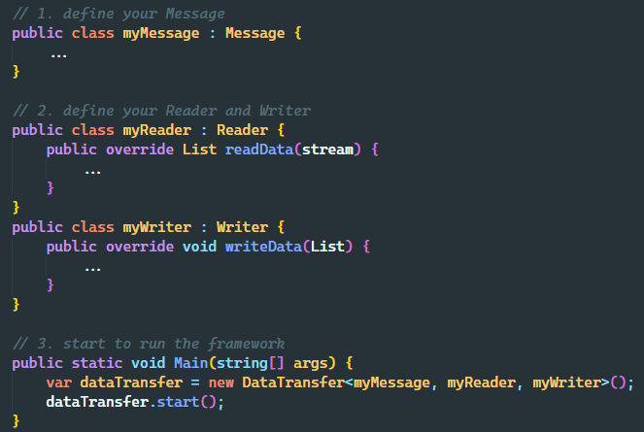
ARCHITECTURE
Design Ideas
DataTransfer
Framework
Data Source
Data Target
framework + plugin
Reader
Plugin
Writer
Plugin
Plug-ins only care about reading or writing to the data itself
The framework will handle all cpu issues and memory issues
Just 3 steps:
define your Message
define your Reader and Writer
start to run the Framework

Slide 9
ARCHITECTURE
Design Practice
memory issues:
Solve the buzus in memory
Data Sharding: split the total data into smaller data slices
Data Pooling?: like slub allocator, a memory object cache pool
cpu issues:
Shorter Run Time:
Serial vs Parallel
Synchronize vs Asynchronise
Reader & Writer => Channel
Reader
Channel
Writer
IO device
IO device
kernel
requests
kernel
request
Data Source
VS
Data Source
Data Slice
slice
user
slice
slices
user
slice
slice
IO Time
IO Time
Serial
Parallel

Slide 10
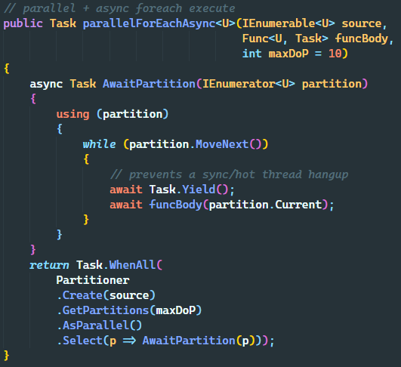
ARCHITECTURE
Design Practice
Thread Model:
Parallel + Asynchronize
Realize the Parallel.ForeachAsync
We hope to limit n tasks run at the same time, and await the final outcome.
Task.WhenAll(): can wait for all tasks to finish, but it has a tendency to become unperformant with large scale/amount of tasks firing simultaneously => without moderation/throttling.
Partitioner: partition all the tasks into multiple chunks that can be accessed concurrently by multiple threads, and the partition number will be the limit on the degree of parallelism. So we just need to use Task.WhenAll() to await n tasks, which work on the n trunks.

Slide 11
ARCHITECTURE
Design Practice
Configuration
Slice Size
Reader Num
Channel Limit
Writer Num
Data Source
DataTransfer
Framework
Data Target
Data Slice
Partition
Reader
Data Slice
Writer
call api
Reader
Channel
(Message Queue)
Data Slice
Partition
split
Writer
call api
Data Slice
Reader
Writer
call api
Data Slice
Partition
Reader
Data Slice
Producer
Consumer
ThreadPool

Slide 12
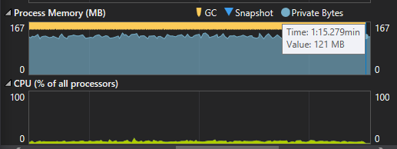
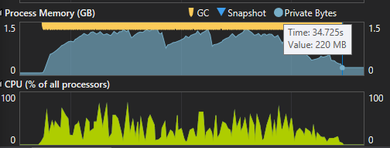
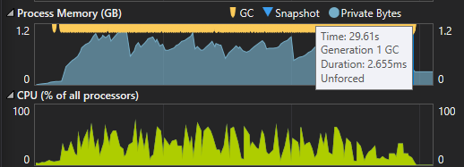
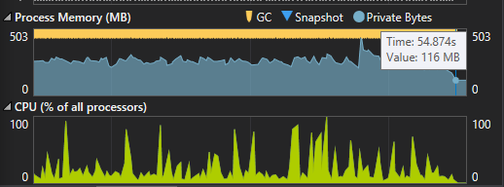
Thread Model Comparison
Sequential Execute: about 1min13s, low cpu utilization.
Parallel Sync Execute, no Channel: about 34s, high cpu utilization, but high memory usage.
Parallel Async Execute, no Channel: about 29s, high cpu utilization, but high memory usage.
Parallel Async Execute, with Channel : about 54s, a better trade-off between cpu utilization and memory usage

Slide 13
Progress
Current status:
The Scope part could run in cosmos and get the data.
The Azure Function part could import the topology and tenants successfully in the PPE environment.
TODO: deploy and test in the production environment
What I have learned:
CPU and Memory tuning experience, Features of C# language
Keep asking mentor and other workmates when have problems
Communication between different teams
Be patient, keep try, never give up

