Slide 1

Trendythreads
https://trendythread-e87ef5.ingress-haven.ewp.live/

Slide 2
Group member
ITBIN-2110-0060 D.S.Lanka
ITBIN-2110-0092 R.M.RuwaniPrathibhashiniRajapaksha
ITBIN-2110-0115 P.G.S.D.LWanasinghe
ITBIN-2110-0118 W.M.V.AWijayatunga
ITBIN-2110-0120 W.P.D.S.Wijemanna

Slide 3
Purpose of Trendythreads
Having a ladies clothing store serves several important purposes. Firstly, it provides a convenient and one-stop shopping experience for women. They can find everything they need in one place, from casual wear to formal attire and from everyday basics to special occasion outfits.
Secondly, the store offers expertise in selecting the right sizes, styles, and fabrics to suit individual body types, preferences, and occasions. This expertise ensures that customers can find the perfect outfit for any occasion.

Slide 4
Cont..
Thirdly, the ladies clothing store fosters a sense of community. Women can connect with like-minded individuals, share fashion tips, and enjoy a welcoming and inclusive shopping environment. Lastly, the ladies clothing store contributes to the local economy by providing jobs, supporting local designers and manufacturers, and generating sales tax revenue.This economic impact is beneficial to the local community and helps support local businesses.
In conclusion, having a ladies clothing store serves multiple purposes, including convenience, expertise, community, and economic benefits. It provides a one-stop shopping experience for women, offers expert advice on clothing selection, fosters a sense of community, and contributes to the local economy

Slide 5
ABOUT US
The famous ladies clothing and accessories website, where we are dedicated to providing high-quality and stylish products for women of all shapes and sizes.
Our mission is to empower women to feel confident and beautiful in their own skin, and we believe that fashion should be accessible to everyone.
Our team of talented designers and fashion experts work tirelessly to bring you the latest trends and styles, while ensuring that each piece is comfortable, durable, and made to last. We believe that fashion is a form of self-expression, and we strive to offer a diverse range of products that cater to every woman’s individual style and personality.
At our website, we are committed to creating a positive and inclusive community, where women can feel supported, inspired, and empowered.

Slide 6
Business process
1.Product Selection: The site's administrators select and upload clothing items to the site.
2.Order Receiving: When a customer places an order, the site receives the order details and communicates with the payment processor to verify the payment.
3.Order Confirmation: Once the payment is verified, the site sends an order confirmation email to the customer.
4.Inventory Management: The site updates the inventory levels to reflect the items sold.
5.Order Fulfillment: The site sends the order details to the warehouse or fulfillment department, which picks, packs, and ships the items to the customer.
6.Customer Service: The site provides customer service support via email, phone, or chat to answer any questions or concerns the customer may have.
7.Feedback Collection: The site collects customer feedback through reviews and ratings to improve the product offerings and customer experience.
8.Data Analysis: The site uses data analytics tools to analyze customer behavior, sales trends, and other metrics to optimize the site's performance and profitability.

Slide 7
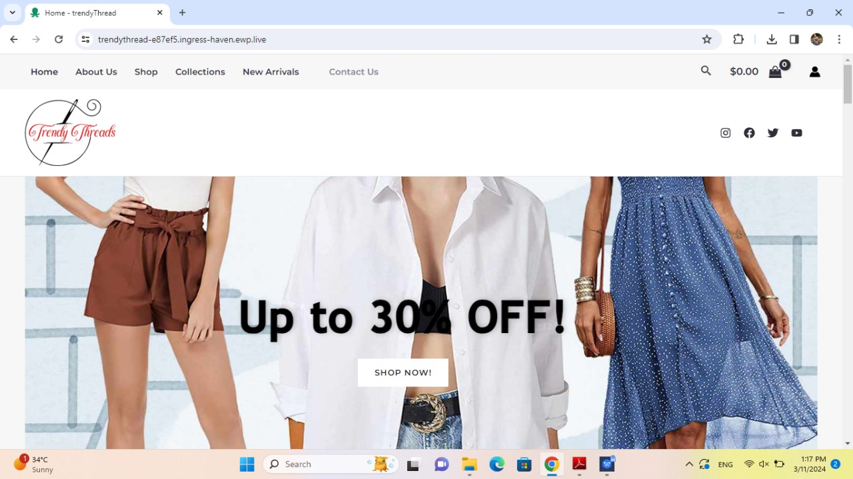
Some snippets from our website..
Home
Page

Slide 8
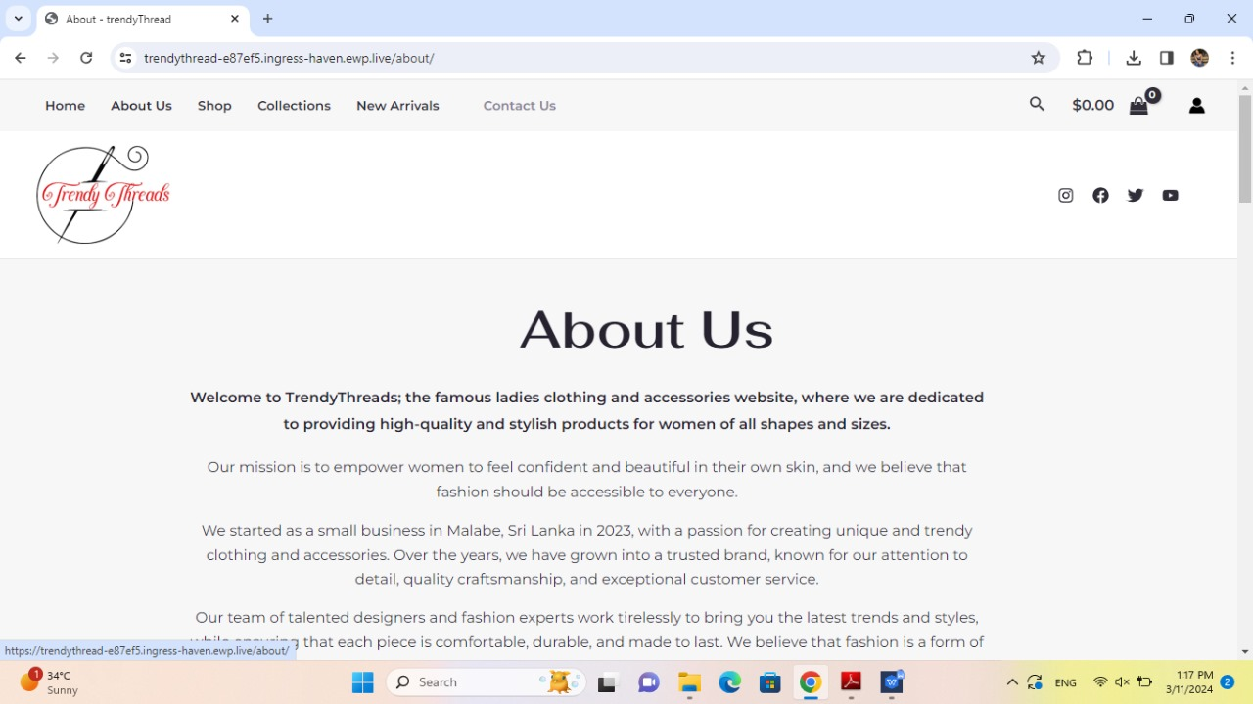
About Us Page

Slide 9
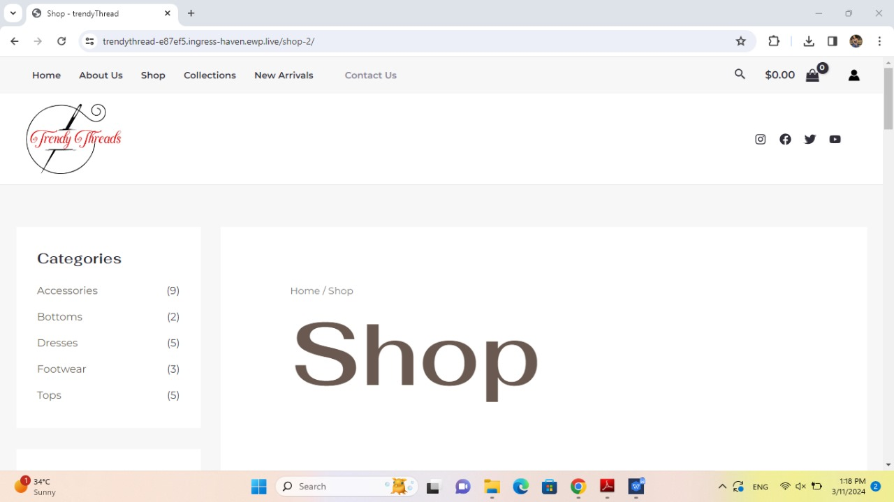
Shop Page

Slide 10
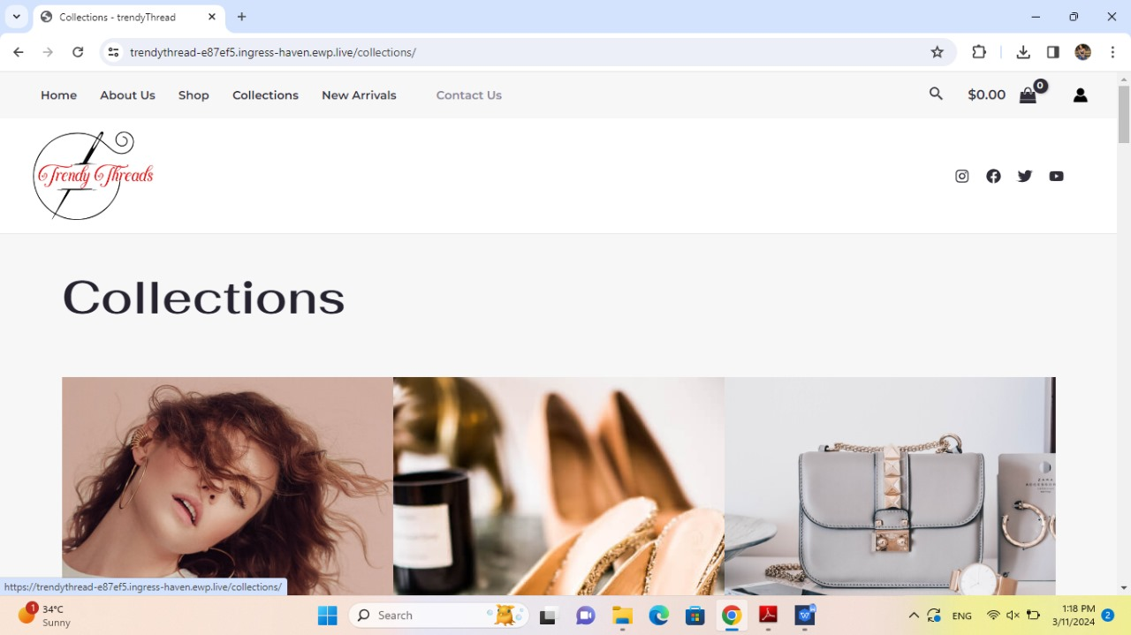
Col lect ion Page

Slide 11
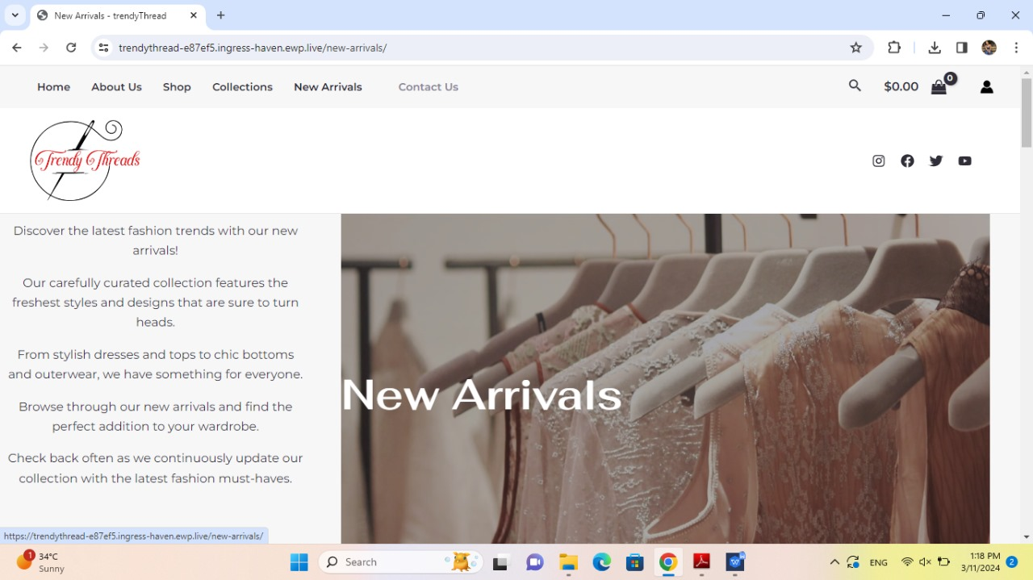
New Arrivals

Slide 12
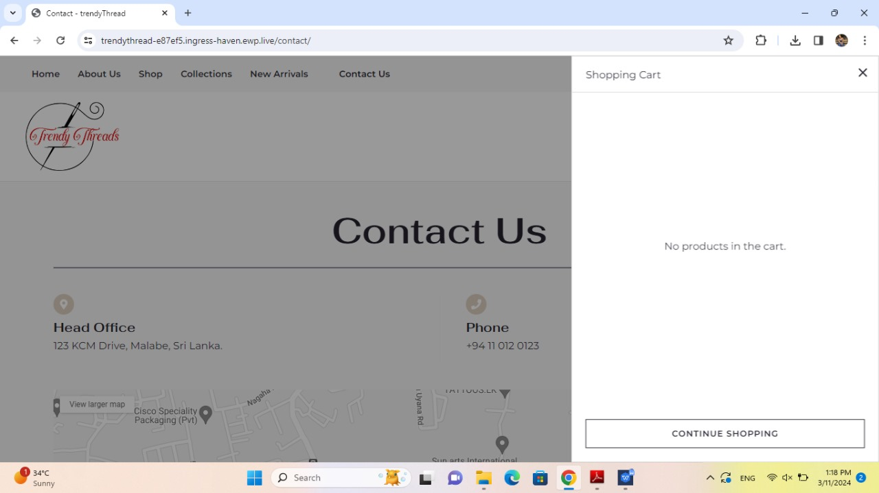
Shopping Cart

Slide 13
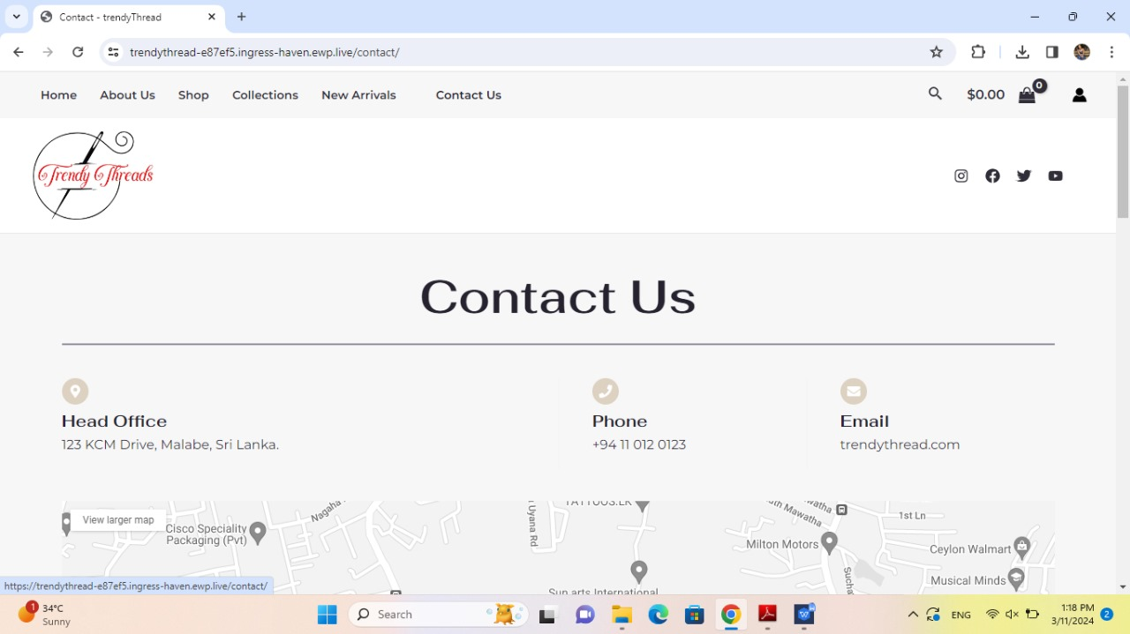
Contact Us

Slide 14
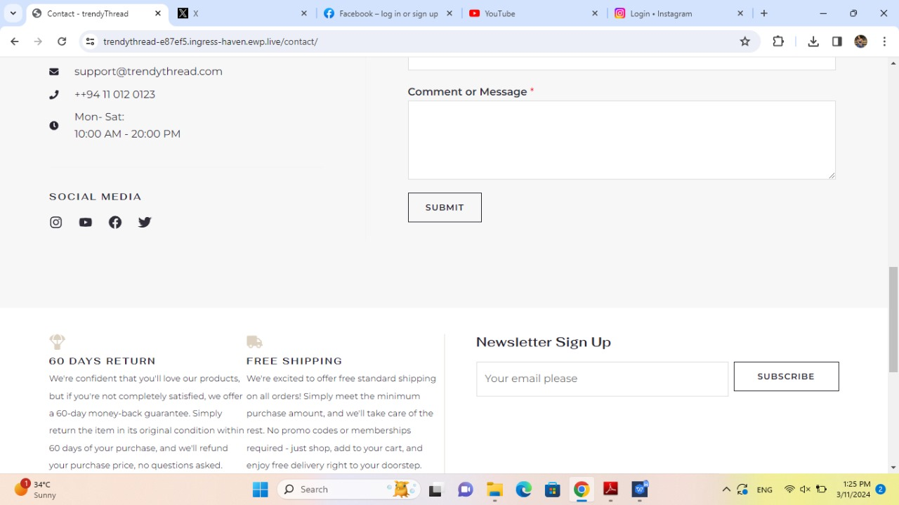
Cont ..

Slide 15
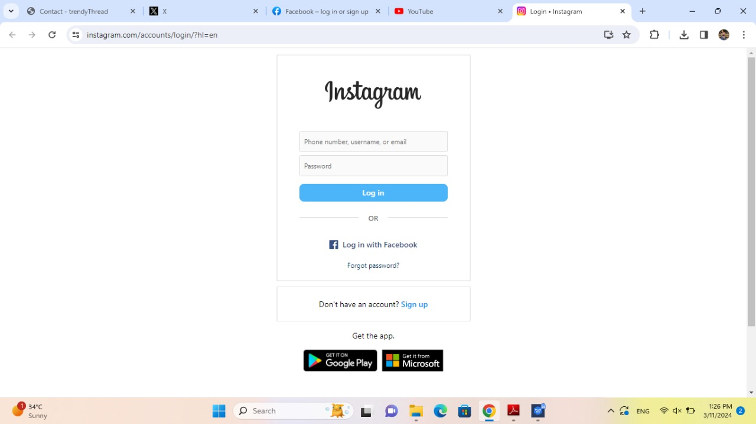
Cont ..

Slide 16
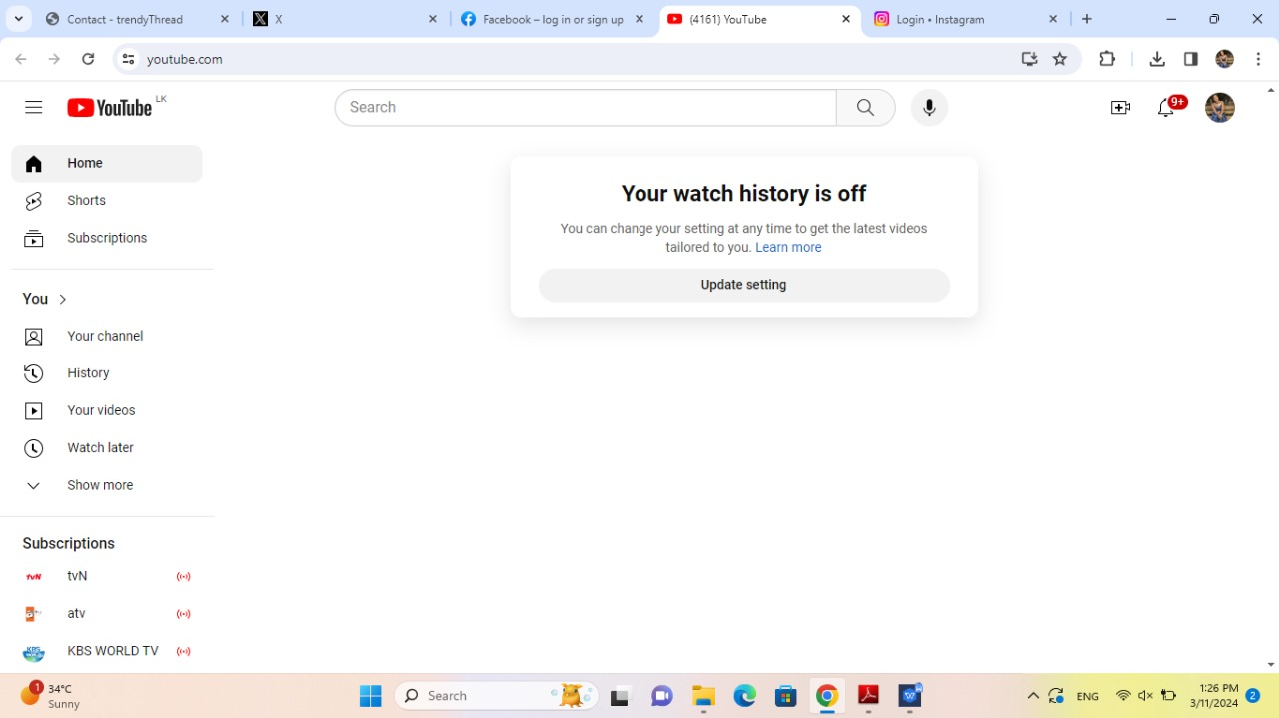
Cont ..

Slide 17
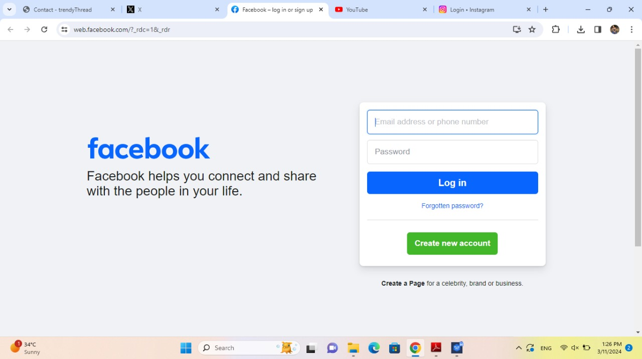
Cont ..

Slide 18
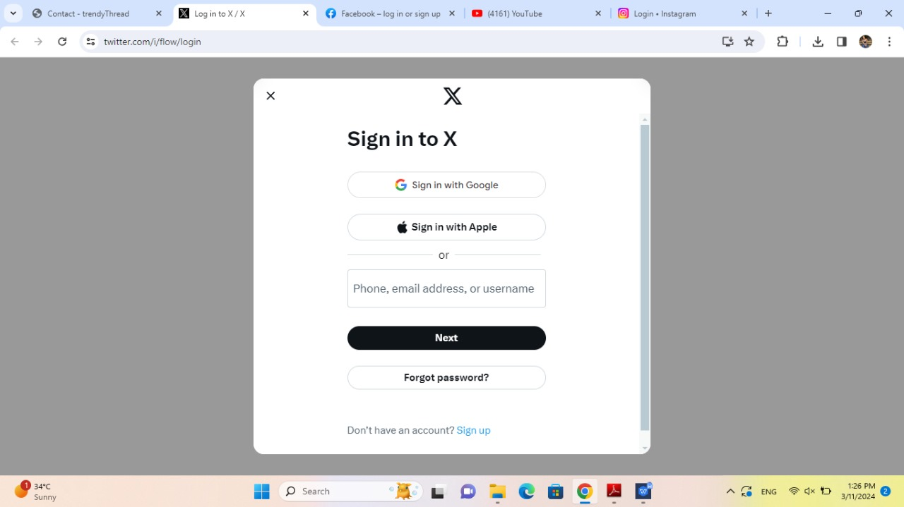
Cont..

Slide 19
CONCLUSION
In conclusion, having a ladies clothing store serves multiple purposes, including convenience, expertise, community, and economic benefits. It provides a one-stop shopping experience for women, offers expert advice on clothing selection, fosters a sense of community, and contributes to the local economy

Slide 20
THANK YOU

