Slide 1
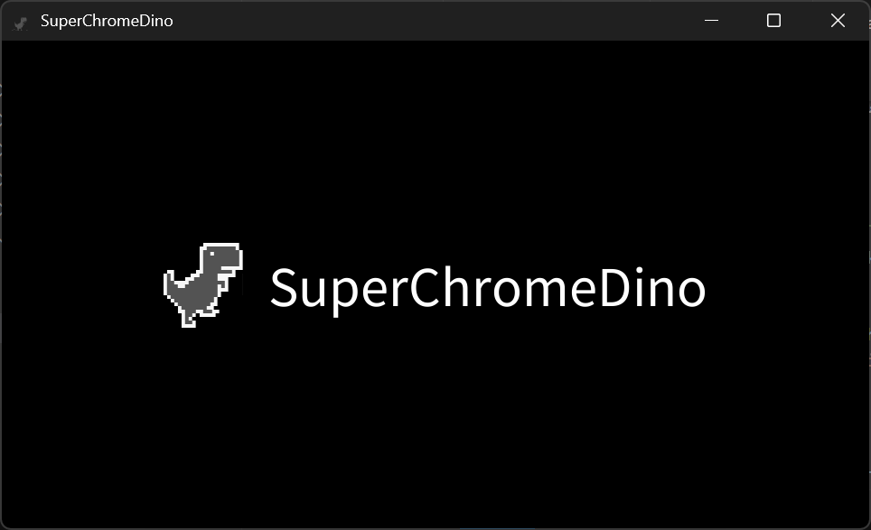




Continue
New Game
Settings
Quit Game
Select
Confirm

Slide 2




Stage Select
1
2
3
Select
Confirm
Return to Title

Slide 3

Stage Select
1
2
3
Select
Confirm
Return to Title

Slide 4
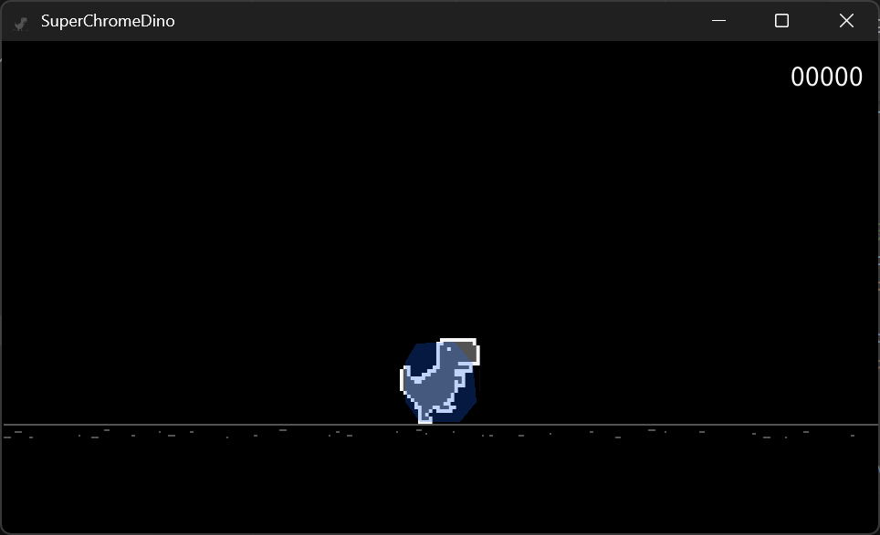
Move
Jump
Return to Stage Select

Slide 5
Settings
FPS
60
30
Select Option
SE Volume
0 1 2 3 4 5 6 7 8 9
BGM Volume
0 1 2 3 4 5 6 7 8 9
Change Option
Cursor in Window
Show
Hide
Return to Title
Arrows
+ Space
WASD
+ Enter
Dino Control
Saved!

Slide 6
Made with
NeneEngine

