Slide 1
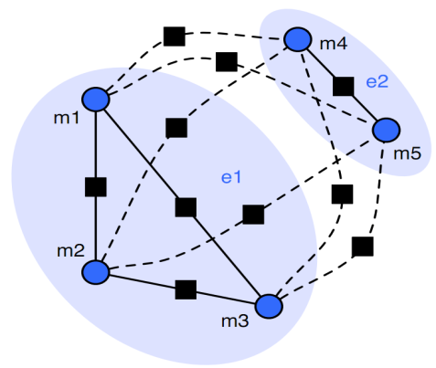
Result
Query
Context
Approx.
Match
Document Ranking
Collective Entity Resolution

