Slide 1
LLFREE: Scalable and Optionally-Persistent Page-Frame Allocation
2023 USENIX Annual Technical Conference
Problem Analysis: Linux Frame Allocator——Buddy
The LLFREE Page-Frame Allocator
Evaluation

Slide 2

Memory Management Challenges
Many processing elements
CPU
CPU CPU
Accelerator
RDMA
Large and diverse memory
DRAM
DRAM DRAM
Persistent HBM
Memory Subsystem
Frame Allocator
Huge Frames
Fragmentation

Slide 3
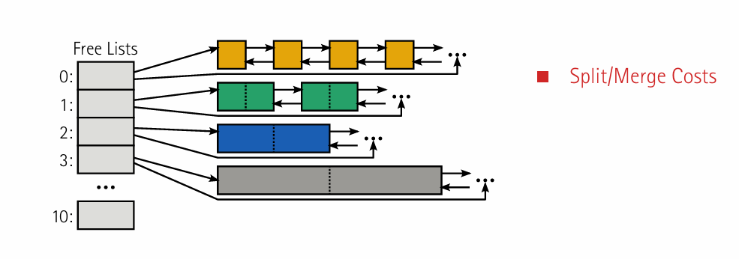
Problem Analysis: Linux Frame Allocator——Buddy
混合处理 帧分配和对内核对象的连续物理块的分配，使对分配器的要求变得更加复杂
在最坏的情况下，需要进行511次伙伴合并,合并的开销相当大。

Slide 4
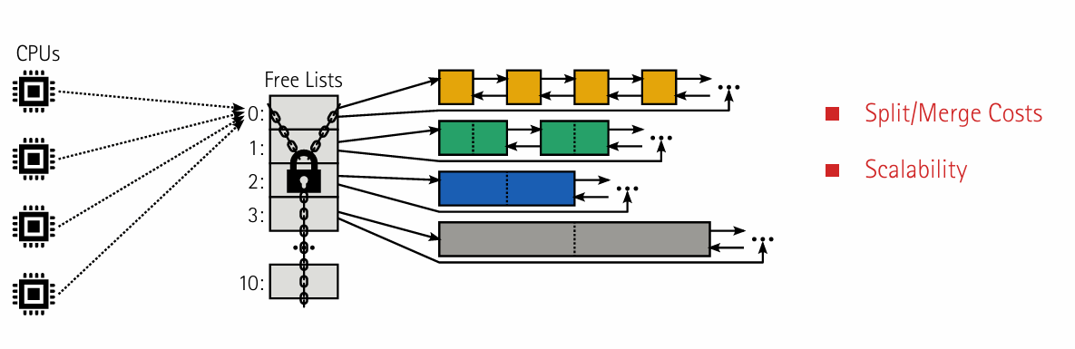
Problem Analysis: Linux Frame Allocator——Buddy

Slide 5
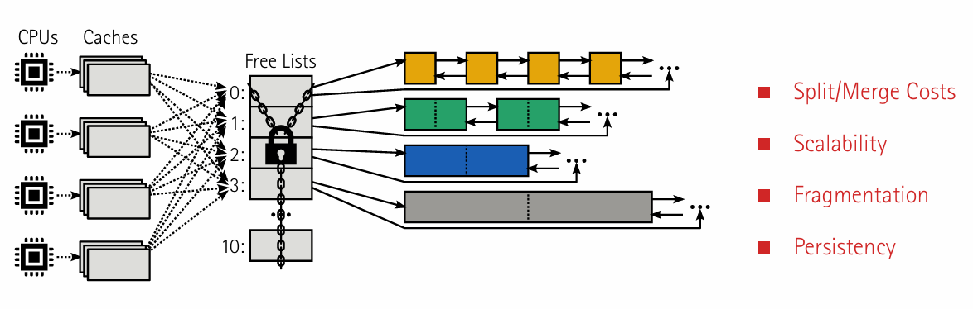
Problem Analysis: Linux Frame Allocator——Buddy
延迟合并的操作，进一步加剧了内存的碎片化
并没有专门致力于最小化大页框的碎片化处理方法
尚未出现能够在持久性分配方面实现与易失性分配相近分配时间的持久性分配器

Slide 6
LLFREE: Scalable and Optionally-Persistent Page-Frame Allocation
Problem Analysis: Linux Frame Allocator——Buddy
The LLFREE Page-Frame Allocator
Evaluation

Slide 7
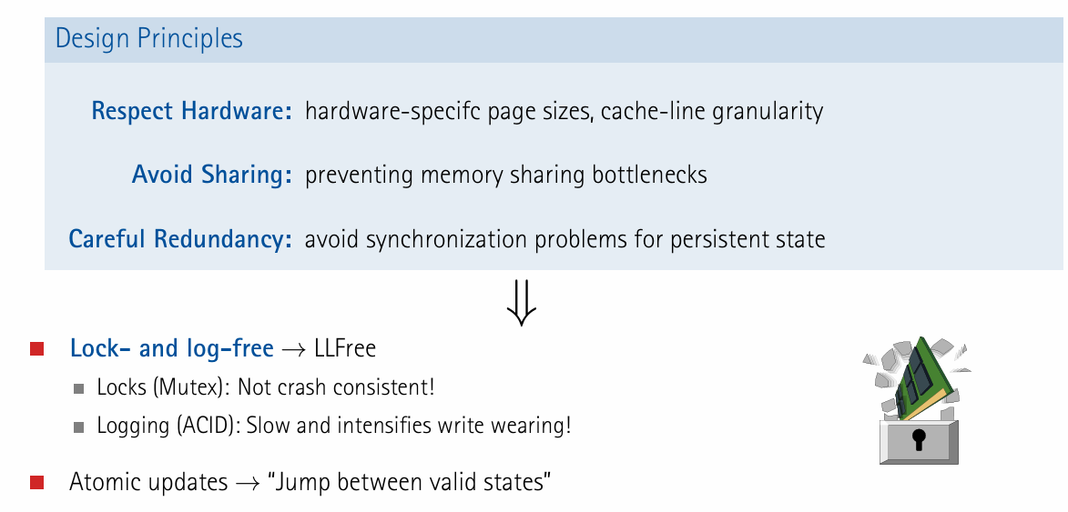
The LLFREE Page-Frame Allocator

Slide 8
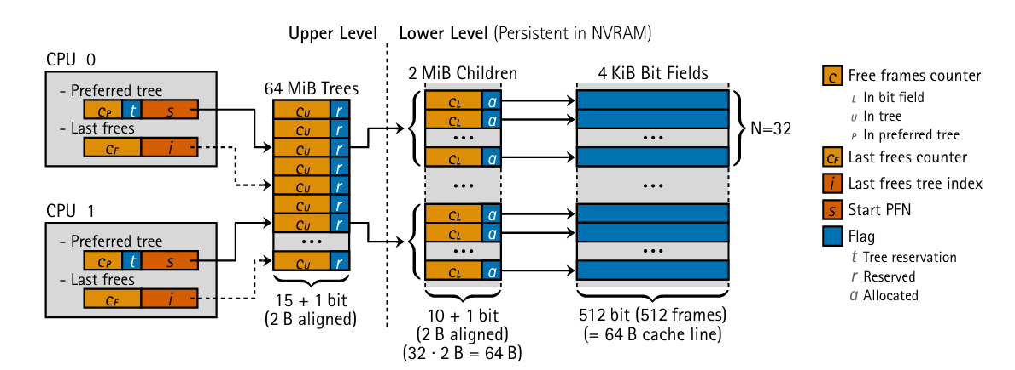
The LLFREE Page-Frame Allocator
Layered Mechanism:
Low-Level: Handles the allocation of basic page frames and large page frames, responsible for mitigating crash consistency issues, and ensures persistence in the NVRAM region.
High-Level: Aims to minimize false sharing and fragmentation of large page frames to enhance system scalability.

Slide 9
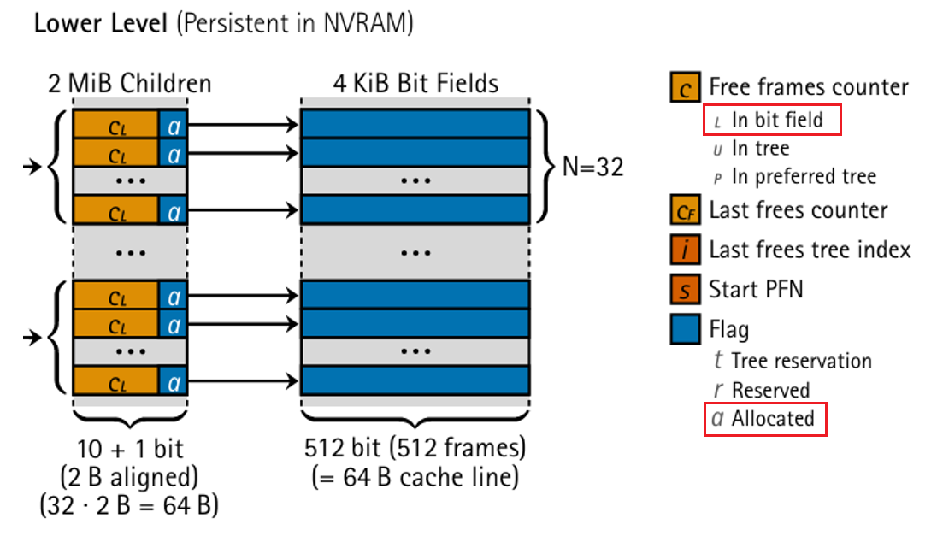
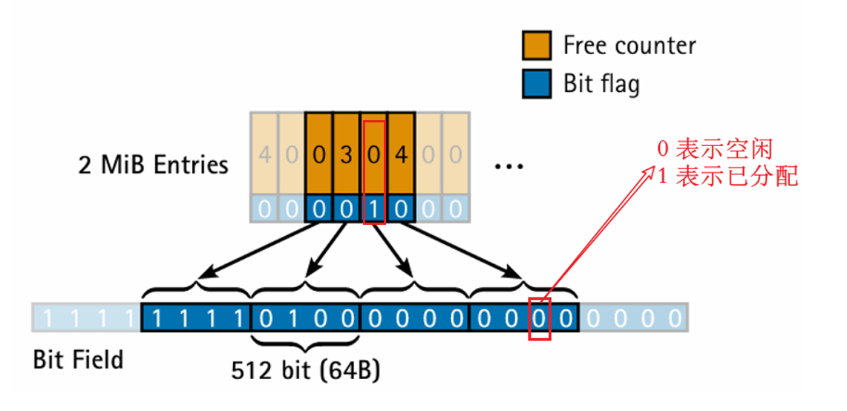
The LLFREE Page-Frame Allocator

Slide 10
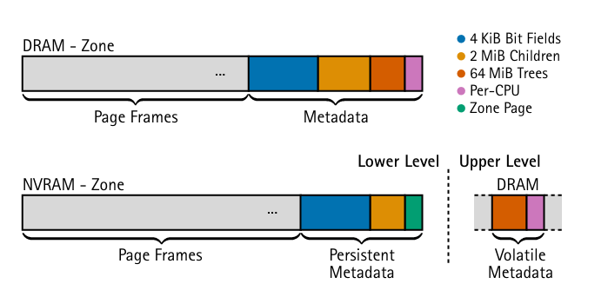
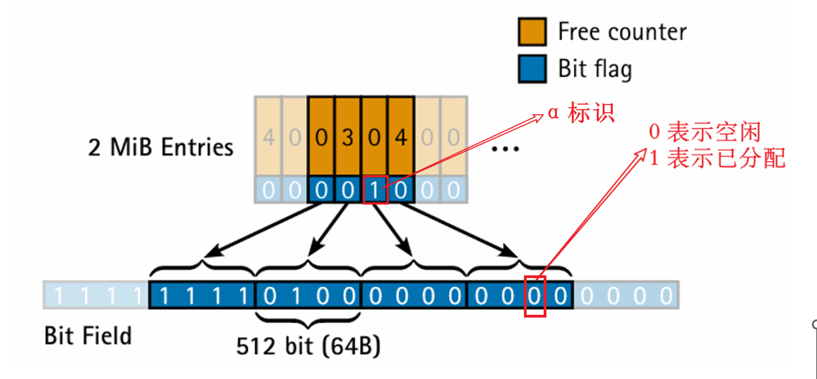
The LLFREE Page-Frame Allocator
Low-Level: Handles the allocation of basic page frames and large page frames, responsible for mitigating crash consistency issues, and ensures persistence in the NVRAM region.

Slide 11
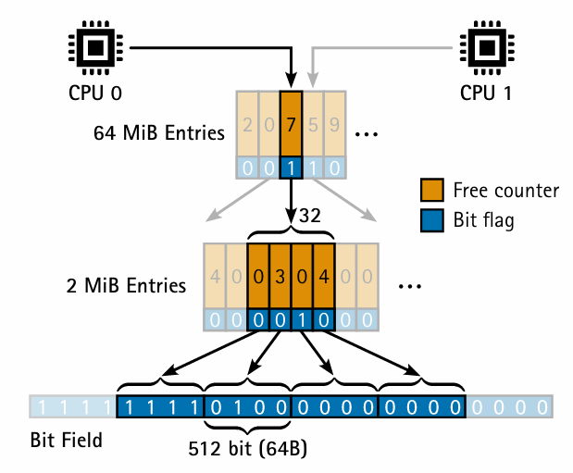
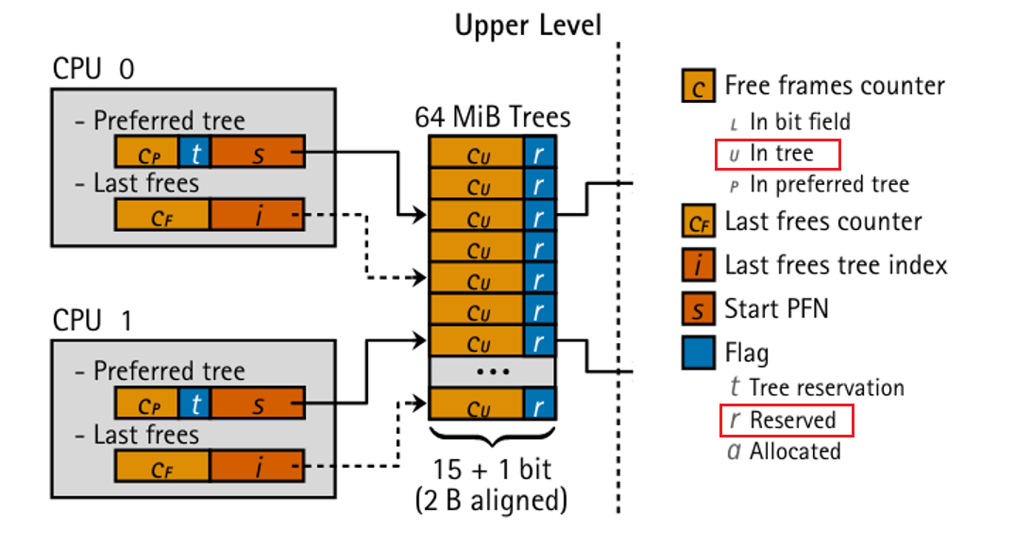
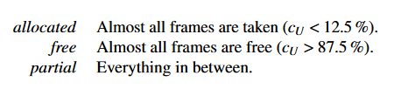
The LLFREE Page-Frame Allocator
High-Level: Aims to minimize false sharing and fragmentation of large page frames to enhance system scalability.

Slide 12
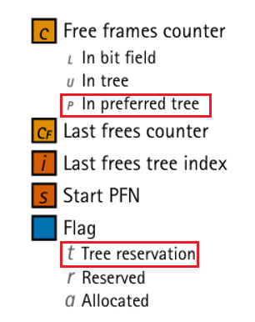
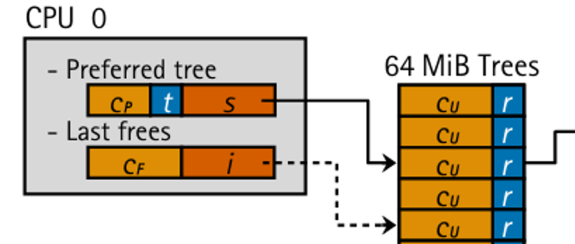
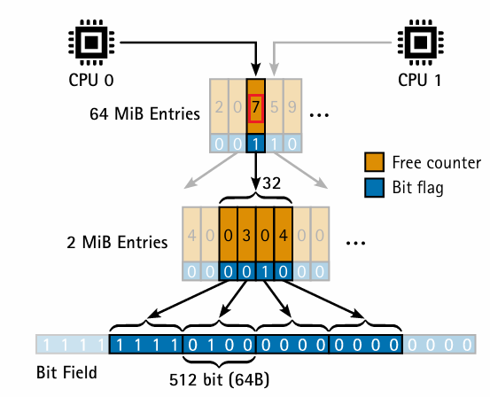
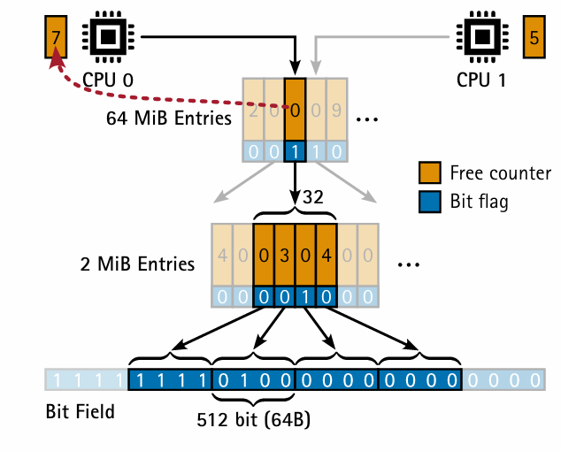
The LLFREE Page-Frame Allocator
虚假共享问题：

Slide 13
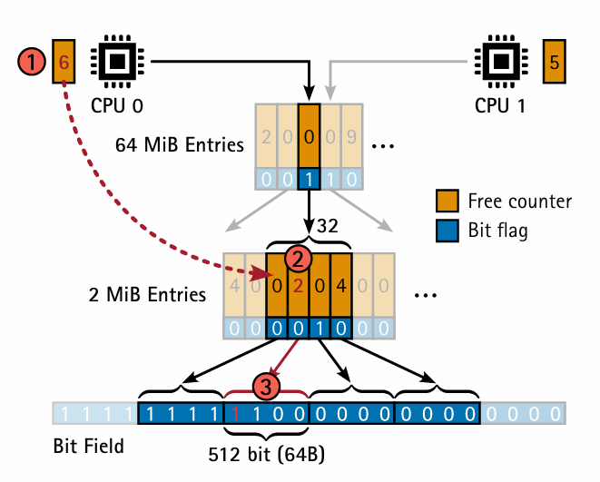
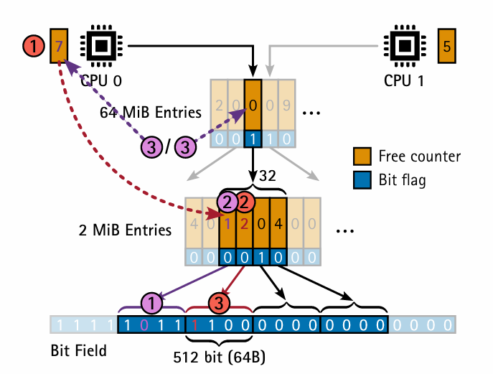
The LLFREE Page-Frame Allocator

Slide 14
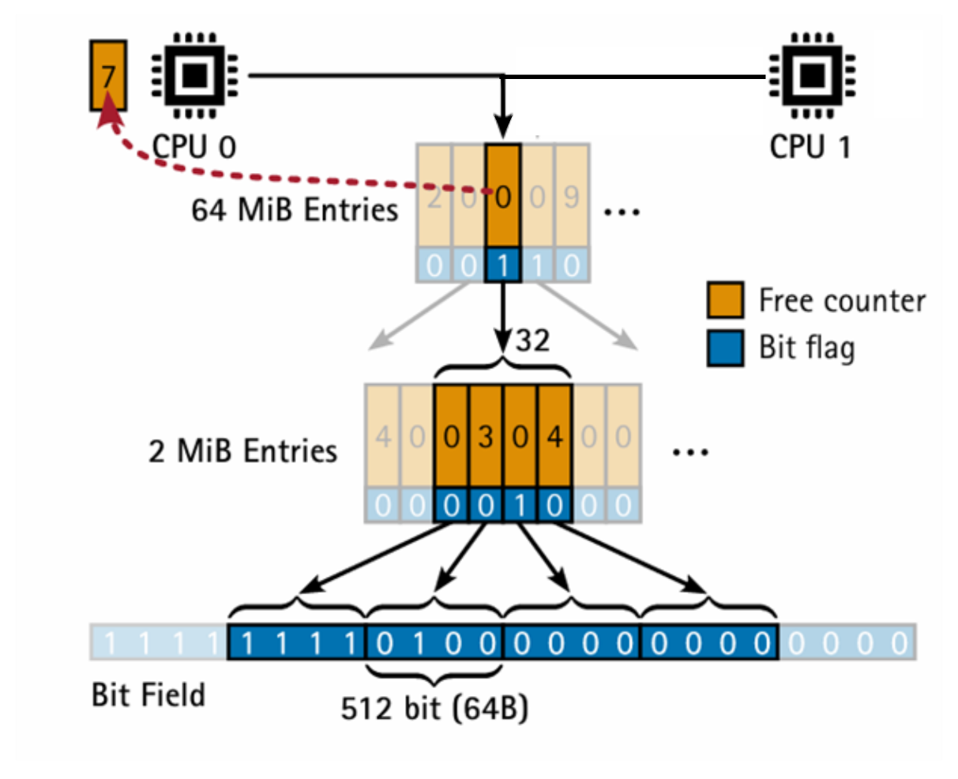
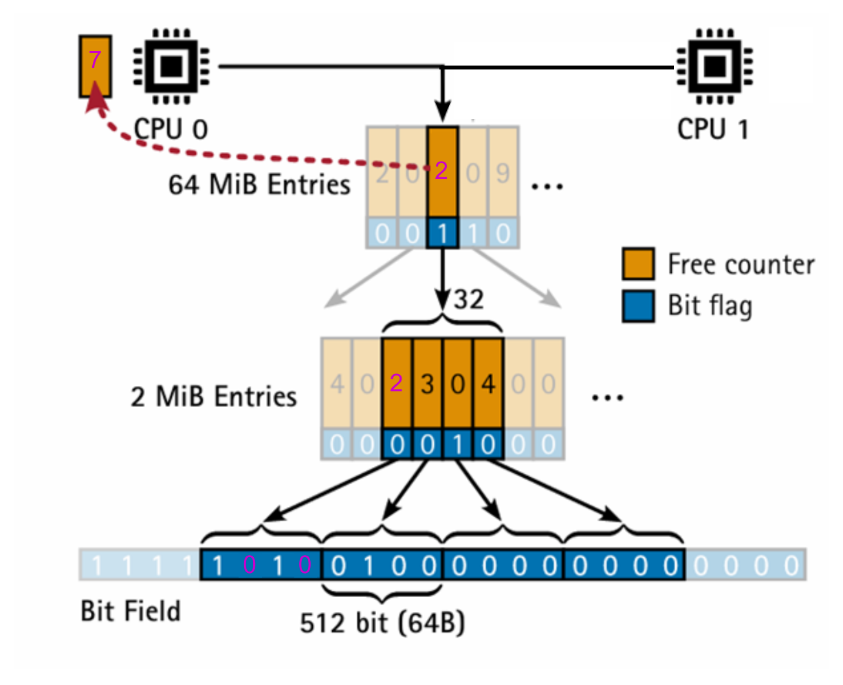
The LLFREE Page-Frame Allocator
CPU预留树的外部释放问题：

Slide 15
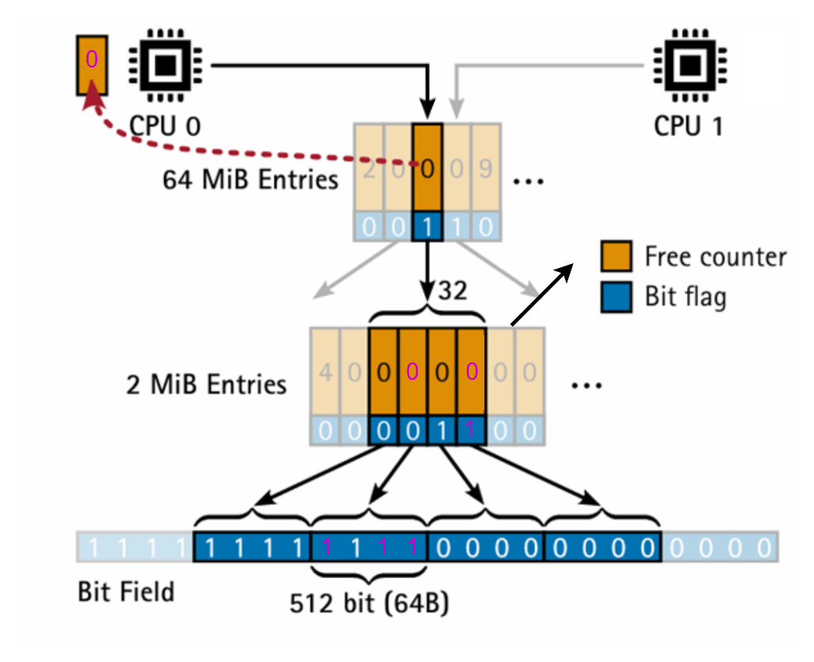
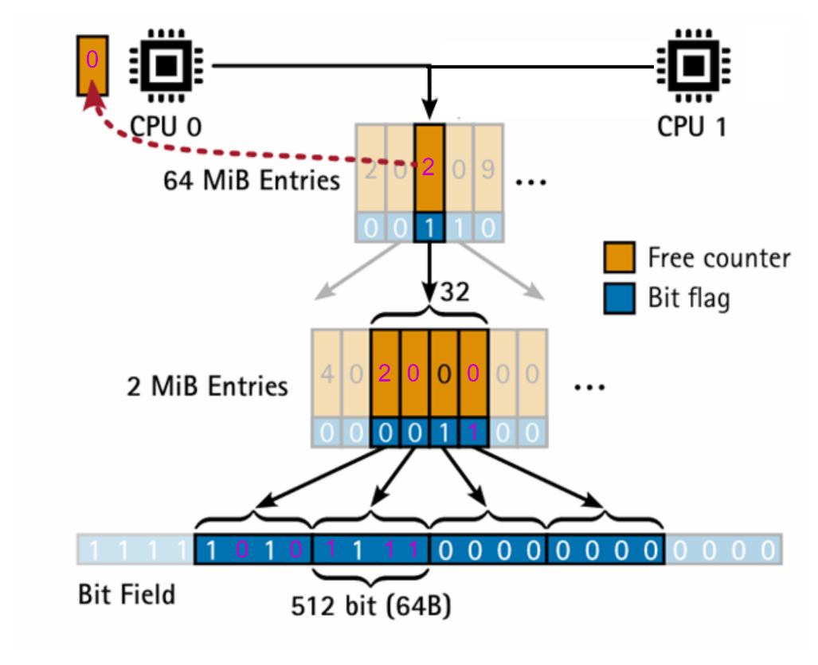

The LLFREE Page-Frame Allocator
本地内存耗尽后的处理：
图1
图2
图3

Slide 16
The LLFREE Page-Frame Allocator
释放过程中的虚假共享问题：
“Reserve-on-Free” 假设：如果一个CPU在连续F次释放操作中都释放到同一个树上，那么它会将这个树保留为其首选树。这个假设的基础是期望随后的释放操作也会影响到同一个树。

Slide 17
LLFREE: Scalable and Optionally-Persistent Page-Frame Allocation
Problem Analysis: Linux Frame Allocator——Buddy
The LLFREE Page-Frame Allocator
Evaluation

Slide 18
synthetic benchmarks that cover a wide range of allocation patterns:
the bulk benchmark : all cores allocate half of the available memory at once and directly free it up again; this process is repeated.
The random benchmark : allocates all memory(similar to the bulk benchmark) and frees the frames in random order; we only measure free operations.
the repeat benchmark :each core allocates and frees a single frame as fast as possible.

Slide 19
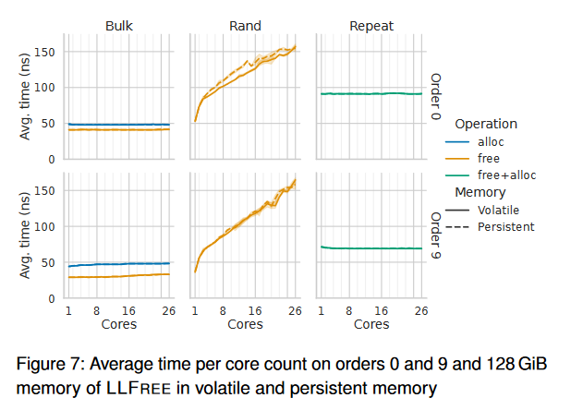
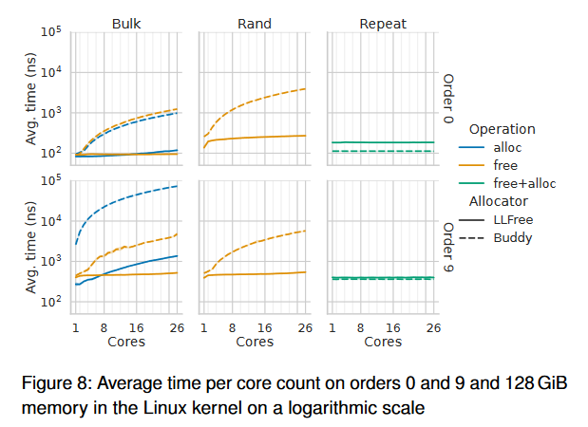
Evaluation
Multi core Scalability

Slide 20
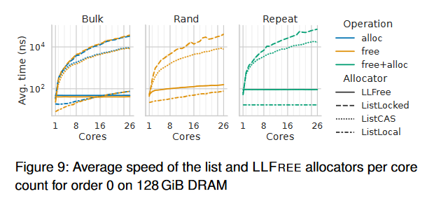
Evaluation
List-Based Allocators

Slide 21
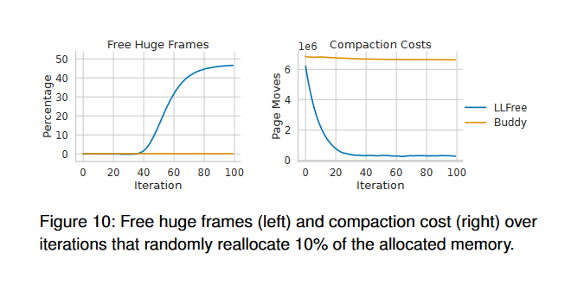
Evaluation
Fragmentation and Compaction Cost

Slide 22
Evaluation
Crash Recovery
Experiment Steps: a. Initialize the LLFREE allocator on a 128 GiB region. b. Randomly allocate half of the memory. c. Repeat memory allocation and deallocation, simulating normal operations.
Simulating Crashes:
For regular shutdowns, the process terminates after step (b).
To simulate crashes, we randomly kill the benchmark with SIGKILL during step (c).
Injected 1,000 crashes,
LLFREE successfully recovered its state in all cases.

