Slide 1

Yelp
Recommendation
Model
Univ.ai ML1 Project
Anshika Gupta
Niegil Francis
Sakthisree
Vishnu

Slide 2
Problem Statement
To create a recommendation system for restaurants using collaborative filtering (CF). You will be using the Yelp Dataset for this.
The general structure of a recommendation system is that there are users and there are items. Users express explicit or implicit preferences towards certain items. CF thus relies on users' past behavior.
01
Data Loading, Preprocessing & EDA
02
Baseline Bias SGD CF Model
03
Deep Learning CF Model

Slide 3
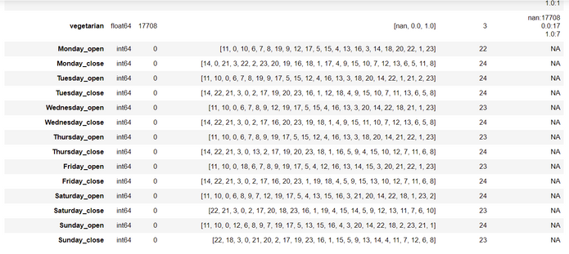
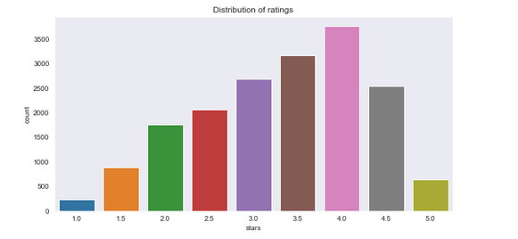
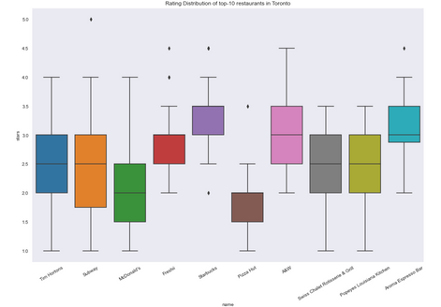
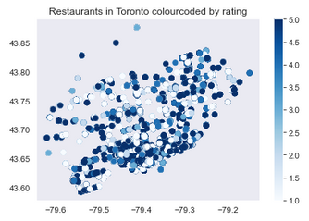
01
Data Loading & Preprocessing EDA
Preprocessing Data
Very Sparse data
Many Null values - performed imputation of taking most frequently occuring
Removed certain attributes - only focused on restarants & food.
Type Driven Transformation
yelp_academic_dataset_business.json
118.62 MB
NULL Handling
Join Tables
Cleaning column values & rows
Imputation
Toronto had highest reviews.
EDA
Most restaurents were concentrated along the coast.
yelp_academic_dataset_review.json
6.46 GB
Top 10 Cities with Most Reviews
The average rating for all restaurants were between 3-4.
And more.
Reviews Distribution
Geographic Mapping of Restaurents
High Scoring Restaurents
And much more....

Slide 4
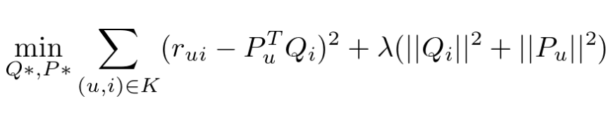
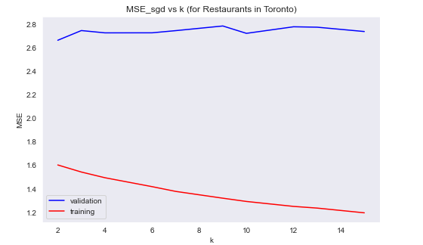
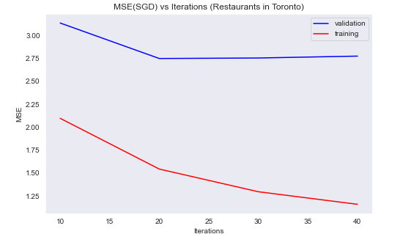
02
Bias Stochastic Gradient Descent CF Baseline Model
Chose data as Toronto alone for SGD model
MSE Value of our Model
2.71

Slide 5
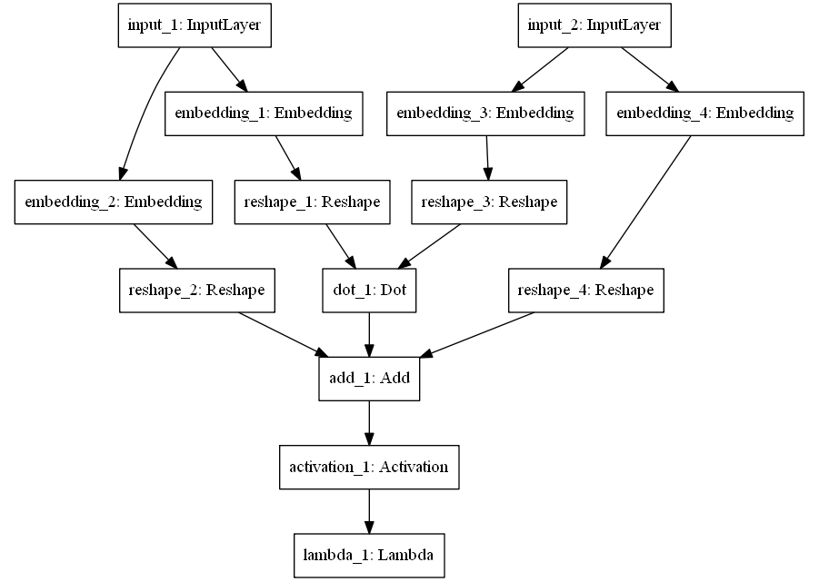
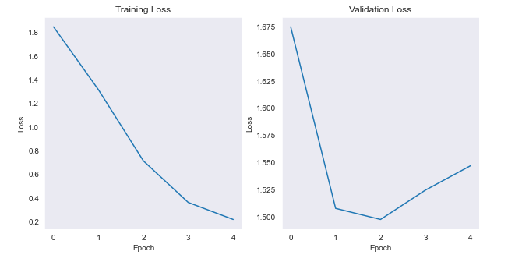
03
Deep Learning CF Model
Chose data as Toronto alone Deep Learning CF Model
MSE Value of our Model
1.50
Running Neural Network was better computationally than running Cosine similarity model
24000509 trainable parameters were present - using which our MSE < 2 which is relatively good performance.

Slide 6
Conclusion
Clearly, the neural network worked better than SGD model.
Neural Network has a chance of over-fitting and can be furthered looked at.
Trend of data were analyzed in the EDA phase - most of the reviews were centered around 3-4.
Cosine similarity based models are hard computationally to scale up but Neural Networks and SGD seem to be computationally better.
Further work
Trying out ALS - alternating least squares method
Spending more time on tuning model & increasing metric rates
Figuring out ways to further work well with sparse matrix
Trying out ensemble modelling for better predictions
Making a user interface for the model - using streamlit
Figuring out ways to effectively handle new user recommendations

