Slide 1

Coarse & Fine-Grained
Image Classification on ImageWoof and OxfordPets
Motivation and Goal
CNNs excel at coarse recognition
Fine-grained breed ID is much harder: subtle inter-class differences, large intra-class variation (pose, lighting, background)
Goal: discover breed structure unsupervised — no labels at clustering time
Datasets Used
Using Pretrained CNN Feature Extractors
CIFAR-10 Dogs
6,000 imgs · 1 coarse class · 32×32px · No breed labels → Abandoned
Imagewoof
9,025 imgs · 10 dog breeds · 160px → 224×224 · 80/10/10 split
Oxford Dogs
4,978 imgs · 25 breeds · Variable res → 224×224 · Flickr (independent of ImageNet)
Oxford Cats
2,371 imgs · 12 breeds · Variable res → 224×224 · Flickr source
Models Evaluated
What Models Predict
Feature vectors per image (frozen extractor)
K-Means cluster assignments (unsupervised)
Evaluated vs. true breed labels using ARI + NMI
ResNet-18 (512-d, 11.7M)
VGG-16 (4,096-d, 134M)
ViT-B/16 (768-d, 86M)
ViT-L/16 (1,024-d, 307M)
Salamot Fakoya and Isabella Ran
sif240000 and ixr220014
University of Texas at Dallas
CS 4375.002

Slide 2
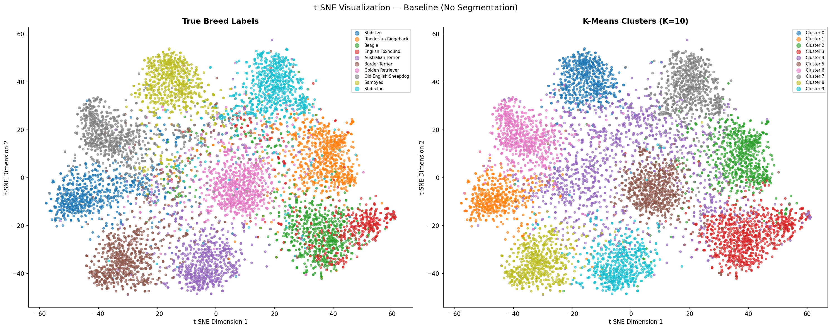
t-SNE: Imagewoof (ResNet-18, K=10)
10 dog breeds · ARI 0.581 · NMI 0.687 · Average purity 77.3% · Best K = 10 (matches true breed count)
Key Observation: Samoyed (top-left) and Shiba Inu (top-right) form the tightest isolated clusters — consistent with their 80%+ per-breed purity. English Foxhound and Beagle overlap in both panels, directly explaining why those two breeds share a cluster in the output.

Slide 3
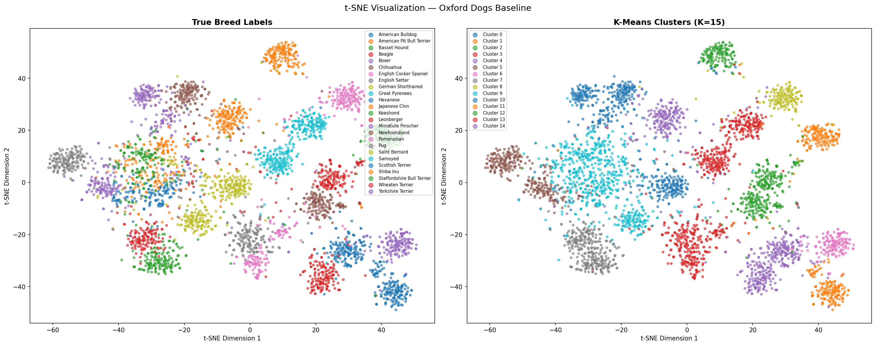
t-SNE: Oxford Dogs (ResNet-18, K=15)
25 dog breeds · ARI 0.530 · NMI 0.789 · Average purity 90.2% · 22 of 25 breeds exceed 80% purity
Key Observation: 25 breeds form well-separated compact blobs — far more distinct than Imagewoof. Cluster sharing is biologically meaningful: Basset Hound + Beagle, Leonberger + Newfoundland, Great Pyrenees + Samoyed. Keep this image in mind — Oxford Cats looks very different.

Slide 4
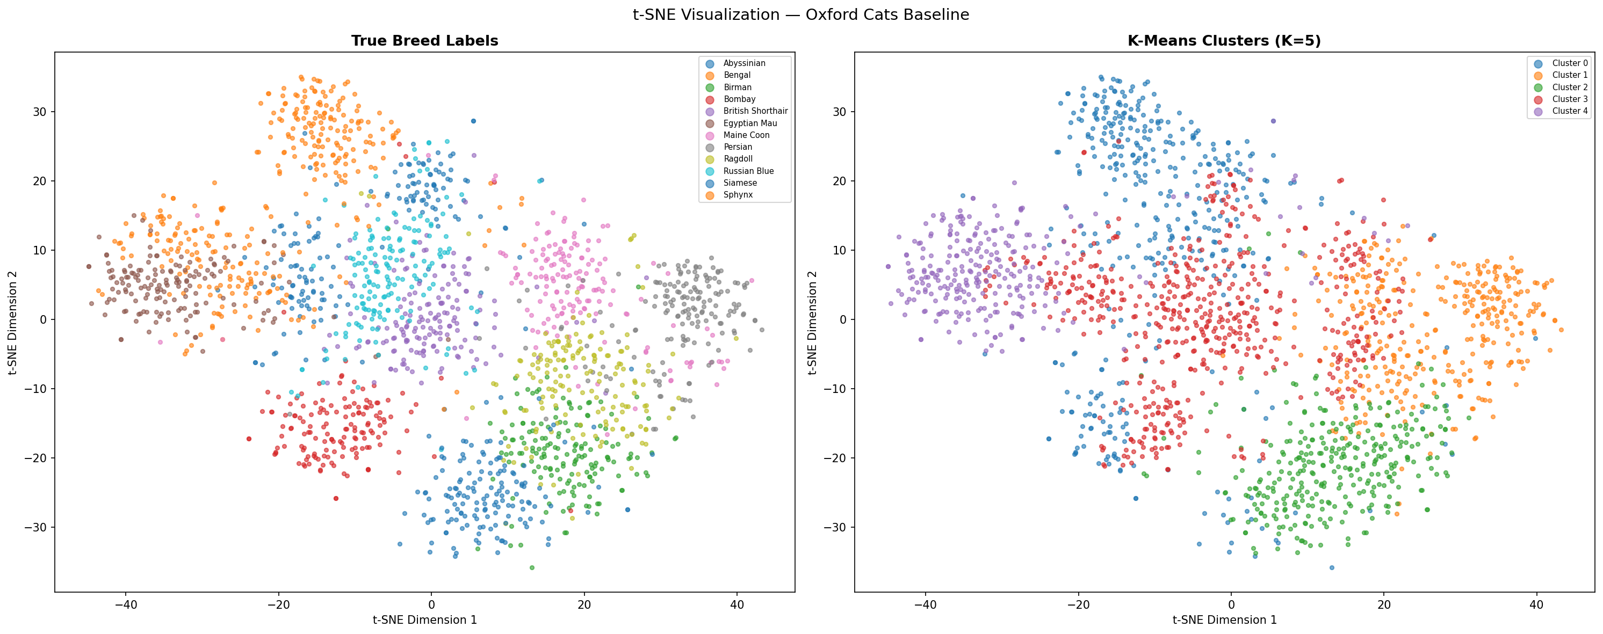
t-SNE: Oxford Cats (ResNet-18, K=5)
12 cat breeds · ARI 0.261 · NMI 0.482 · Average purity 73.0% · Best K = 5 (silhouette goes negative at K≥10)
Key Observation: Compare to Oxford Dogs — 12 breeds show far more inter-class overlap. Only Persian (isolated top) and Sphynx (far left) separate clearly; most other breeds blend together. This directly explains why cat ARI (0.261) is half that of dogs (0.530) across every model and experiment.

Slide 5
Models & Architectures Compared
Raw Image
Frozen
Extractor
StandardScaler
+ t-SNE / PCA
K-Means
Clustering
ARI / NMI
Evaluation
No labels used during clustering — labels only at evaluation time
ResNet-18
VGG-16
ViT-B/16
ViT-L/16
Baseline CNN
Deep CNN
Vision Transformer
Large Transformer
512-d · 11.7M params
4,096-d · 134M params
768-d · 86M params
1,024-d · 307M params
13 conv layers + 2 FC blocks retained
fc8 (classifier head) removed
VGG16_Weights.IMAGENET1K_V1
PCA to 100 components before K-Means
8× more features than ResNet-18
Larger CLS token (1,024-d)
Same pretraining as ViT-B/16
Slightly weaker on dogs vs ViT-B
Strongest on cats: ARI 0.437
Higher capacity → better cat breeds
18-layer residual network
AdaptiveAvgPool → 512-d vector
Classification head removed
K sweep: {5,8,10,12,15,20,25}
No PCA required (low dim)
CLS token output (768-d)
Self-attention weights foreground
No explicit segmentation needed
Outperforms CNNs on dogs by 50%
Best K=20 on Oxford Dogs

Slide 6
Results, Analysis & Conclusion
Dataset | Model | Best K | ARI | NMI | Purity | Silhouette
CIFAR-10 | ResNet-18 | 5 | N/A | N/A | N/A | 0.014
CIFAR-10 | VGG-16 | 2 | N/A | N/A | N/A | 0.054
Imagewoof | ResNet-18 | 10 | 0.581 | 0.687 | 77.3% | 0.066
Imagewoof | VGG-16 | 12 | 0.571 | 0.680 | 70.8% | 0.056
Oxford Dogs | ResNet-18 | 15 | 0.530 | 0.789 | 90.2% | 0.063
Oxford Dogs | VGG-16 | 15 | 0.493 | 0.765 | — | 0.051
Oxford Dogs | ViT-B/16 | 20 | 0.796★ | 0.925★ | — | 0.191
Oxford Dogs | ViT-L/16 | 20 | 0.773 | 0.918 | — | 0.137
Oxford Cats | ResNet-18 | 5 | 0.261 | 0.482 | 73.0% | 0.036
Oxford Cats | VGG-16 | 5 | 0.283 | 0.533 | — | 0.000
Oxford Cats | ViT-L/16 | 8 | 0.437★ | 0.662★ | — | 0.052
Key Findings
Resolution is the #1 bottleneck — CIFAR-10 fails regardless of model
VGG-16 ≈ ResNet-18 — 8× more features, no consistent gain; shared AvgPool bottleneck
ViT-B/16 wins: ARI 0.796 on Oxford Dogs (+62% over VGG-16)
Robustness Observations
SAM background removal degrades both CNNs across all 18 comparisons
Lighting: dog ARI drops 77–85% at very dark; cats only 67–69% — dogs rely on color, cats on shape
★ Best result per dataset
Limitation
K-Means assumes spherical equal-size clusters which is not practical; also, our pipeline was not robust to non-standard lighting
Future Improvements
Fine-tune on small breed-labeled set; try UMAP/HDBSCAN; add brightness augmentation during pretraining

Slide 7
Robustness Analysis: SAM Background Removal & Lighting Conditions
SAM Background Removal Impact
Lighting Condition Impact
Dataset Model Pipeline ARI NMI Purity
Model Brightness Species ARI NMI Drop
Imagewoof
ResNet-18
ResNet Baseline 0.580 0.690 77.3%
ResNet SAM Black 0.251 0.411 46.6%
ResNet SAM White 0.143 0.254 50.6%
VGG-16 Baseline 0.571 0.680 70.8%
VGG-16 SAM Black 0.171 0.310 ~45%
VGG-16 SAM White 0.132 0.251 ~45%
Normal Dogs 0.530 0.789 ---
Dark Dogs 0.254 0.556 -0.276
Very Dark Dogs 0.124 0.377 -0.406
Normal Cats 0.261 0.482 ---
Dark Cats 0.202 0.404 -0.059
Very Dark Cats 0.080 0.228 -0.181
Oxford Dogs
VGG-16
ResNet Baseline 0.530 0.789 90.2%
ResNet SAM Black 0.248 0.539 68.1%
ResNet SAM White 0.362 0.614 65.1%
VGG-16 Baseline 0.493 0.765 85.6%
VGG-16 SAM Black 0.206 0.518 68.4%
VGG-16 SAM White 0.318 0.608 68.2%
Normal Dogs 0.493 0.765 ---
Dark Dogs 0.295 0.620 -0.198
Very Dark Dogs 0.075 0.266 -0.418
Normal Cats 0.283 0.533 ---
Dark Cats 0.163 0.381 -0.120
Very Dark Cats 0.094 0.255 -0.189
Oxford Cats
ResNet Baseline 0.261 0.482 73.0%
ResNet SAM Black 0.143 0.316 58.2%
ResNet SAM White 0.261 0.451 54.2%
VGG-16 Baseline 0.283 0.533 85.8%
VGG-16 SAM Black 0.152 0.325 60.4%
VGG-16 SAM White 0.194 0.402 64.8%
SAM: Background removal consistently degrades both CNNs across all 18 comparisons — context is informative, not noise. Lighting: Dog ARI collapses 77–85% at very dark vs. cats only 67–69% — dogs rely on color, cats on shape.

