Slide 1
Credit Card Fraud Detection
By: Jacob Avchen, Sal Russo, & Jacob Hollander

Slide 2

Project Proposal
Create a user interactive interface that will utilize machine learning to identify whether a credit card purchase is fraudulent or not fraudulent

Slide 3
Tools
Python for data acquisition, data cleaning, & machine learning modeling
Keras for Neural Network
HTML/CSS to create webpage
JavaScript
Flask Server

Slide 4
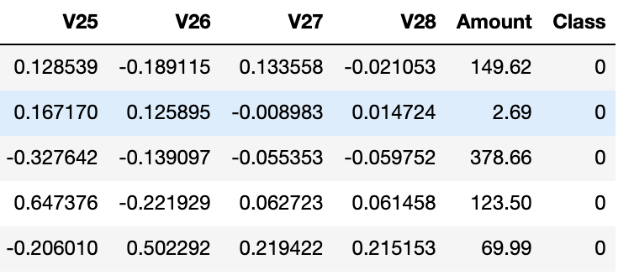
Our Dataset
Data is extracted from a csv file provided by Kaggle
Roughly 280,000 transactions
Cut into snippets of equal cases of fraud & not fraud transactions
V1-V28 were produced through an obfuscation process. For security reasons, we cannot backtrack these numbers to any values that would make sense to us, so our model will only be specific to the non-sensitive data here.

Slide 5
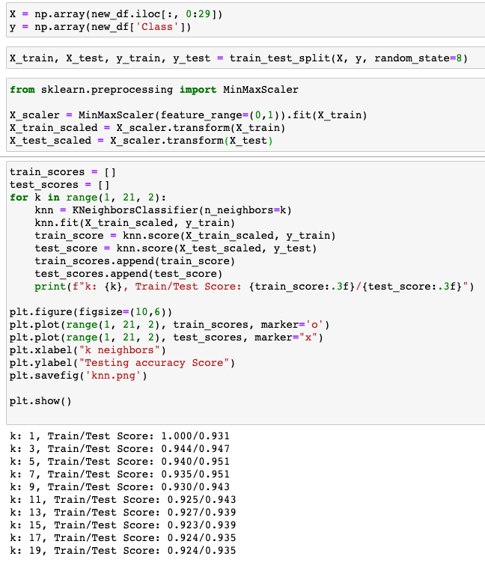
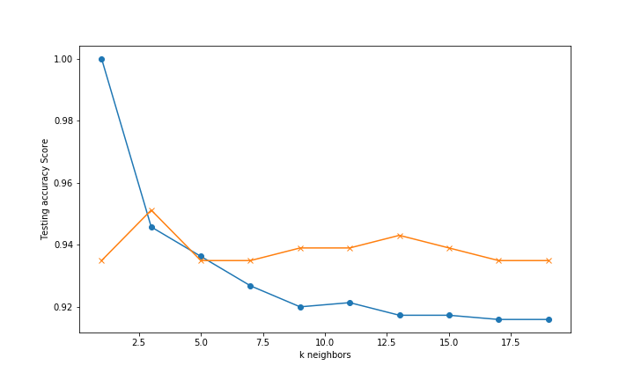
K Nearest Neighbor

Slide 6
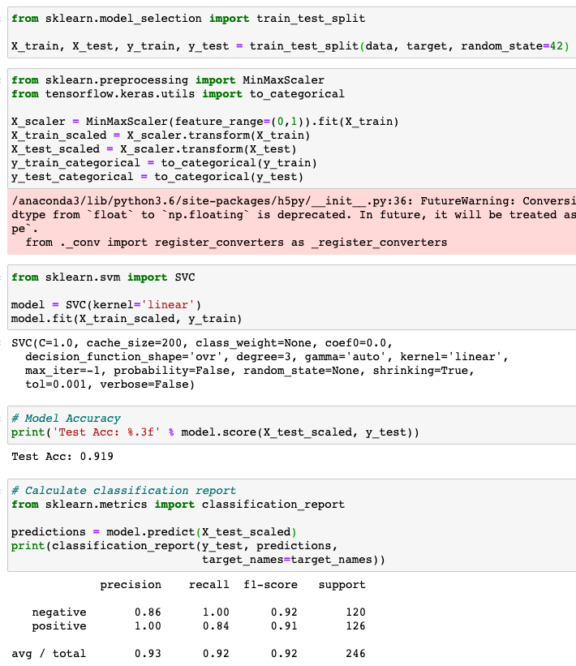
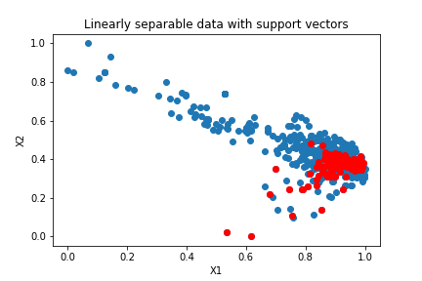
SVM

Slide 7
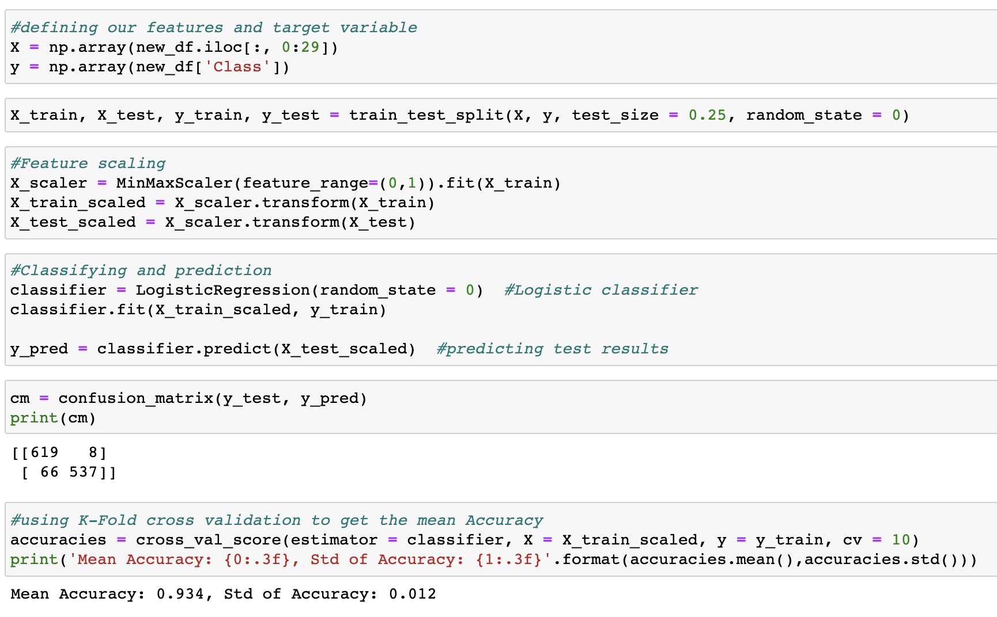
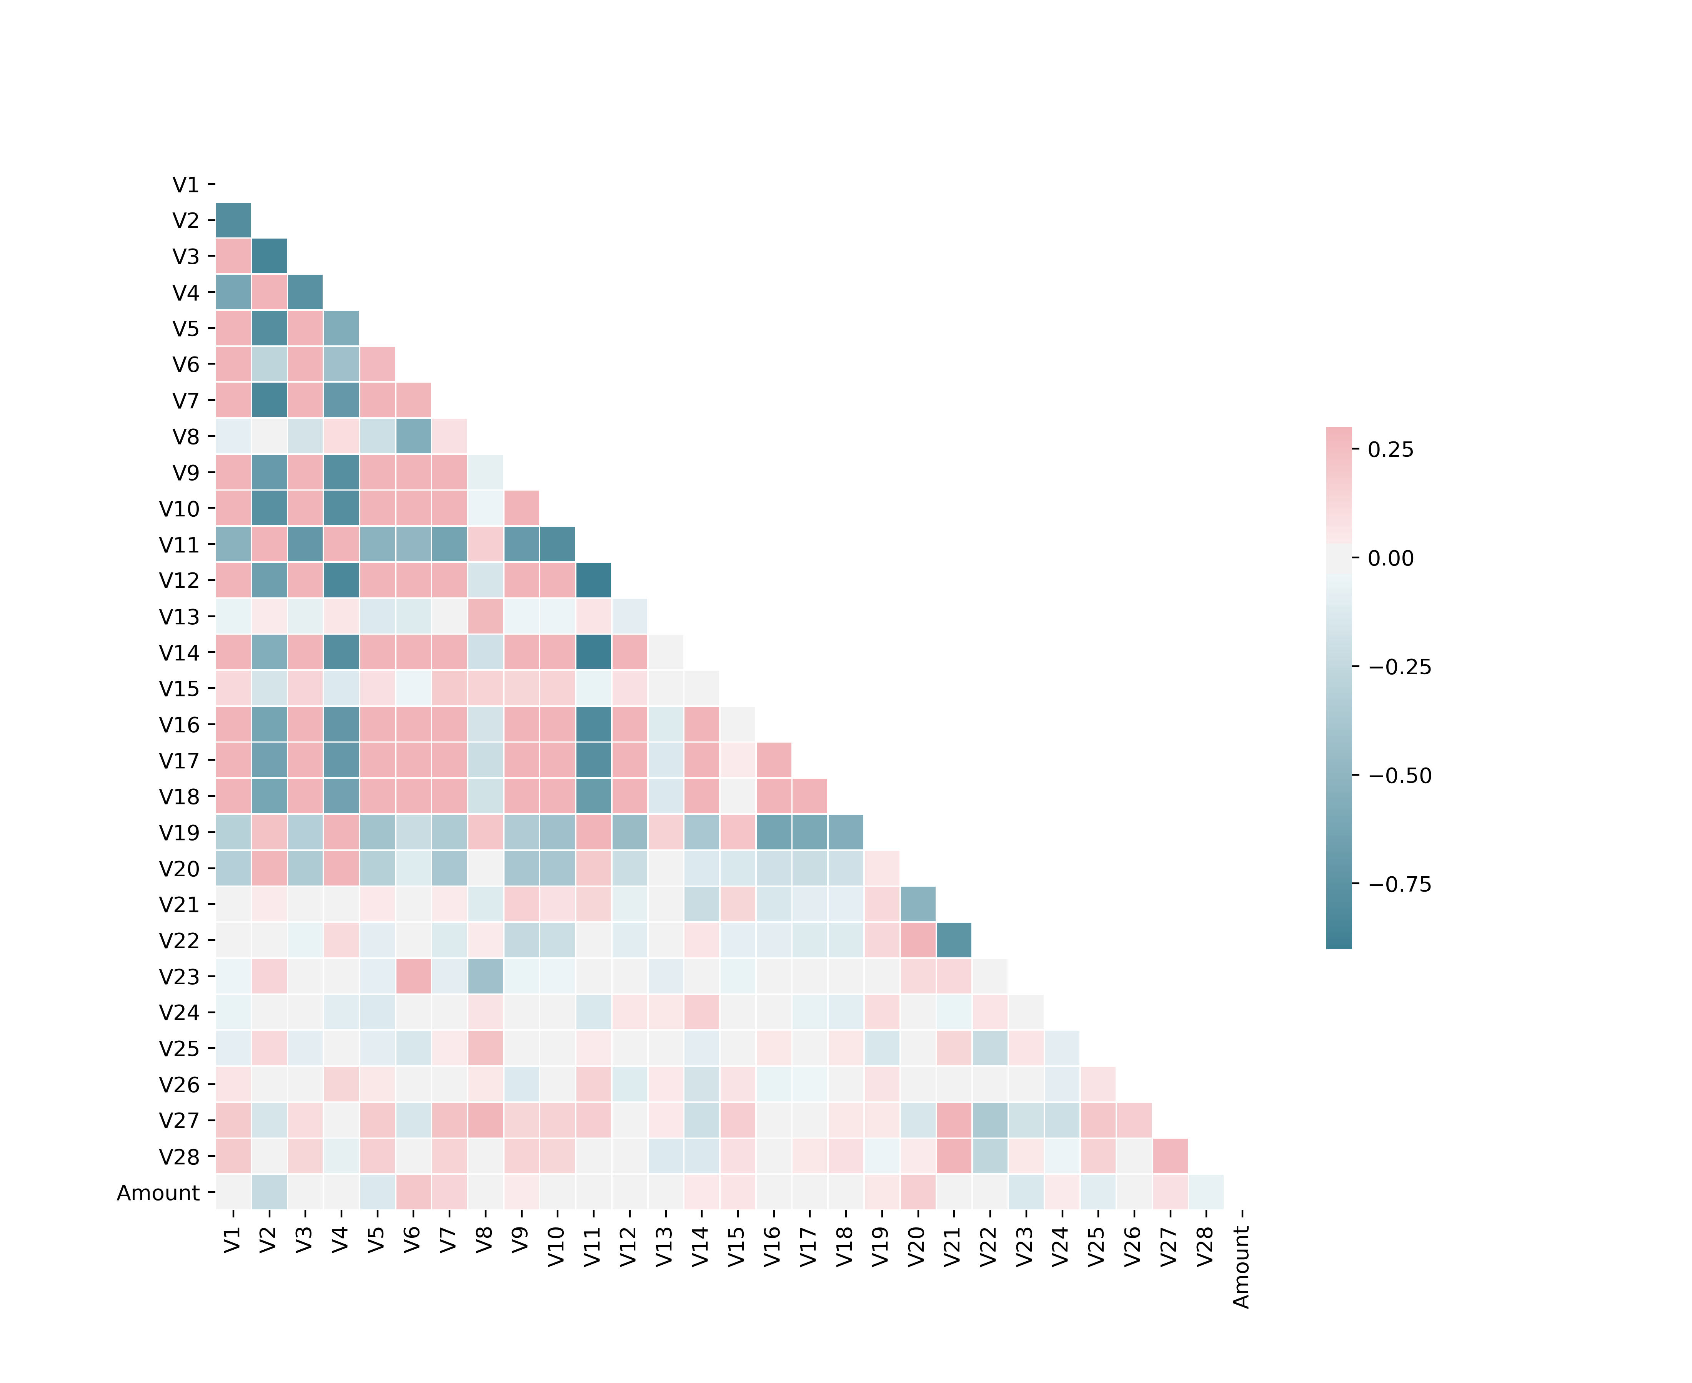
Logistic Regression

Slide 8
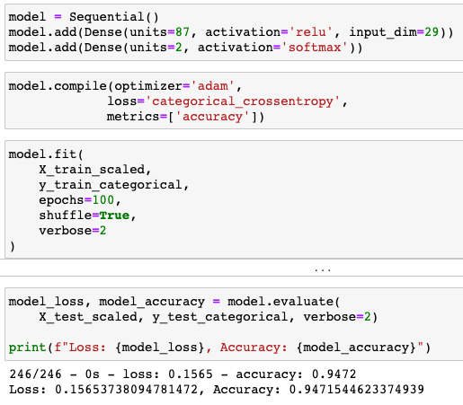
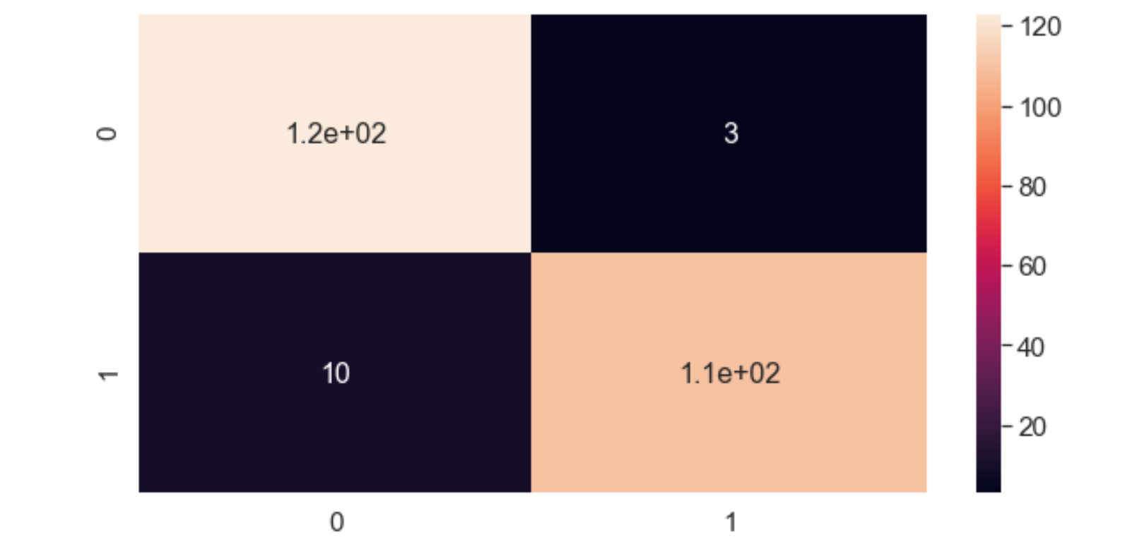
Neural Network
Our first Neural Model has a single hidden layer.
We used all 28 V values in our data and the Amount column.
The model’s predictive accuracy rounded out to 94.7%.
Compared to the actual values, the model returned 3 False Positive values and missed 10 cases of fraud out of 246 points of data.

Slide 9
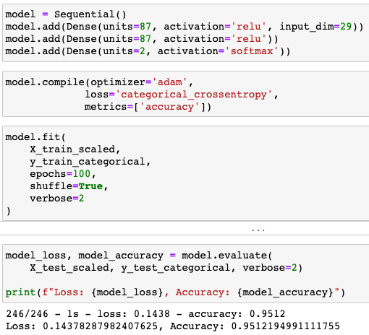
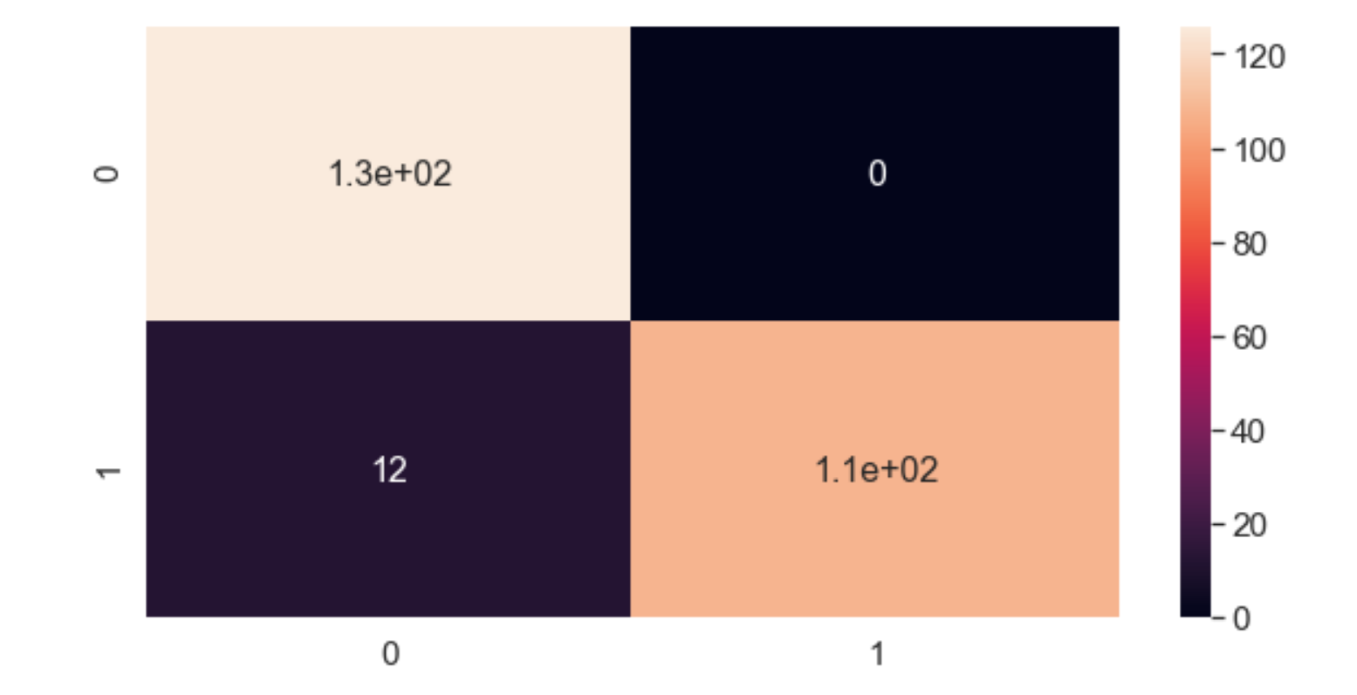
Deep Neural Network
Our second Neural Model has 2 hidden layers.
We used the same distribution of data for both models.
The Deep Model’s predictive accuracy rounded out to 95.1%.
Compared to the actual values, the Deep Model did not return any False Positives and missed 12 cases of fraud.
Despite higher accuracy than the first model, this model missed more cases of actual fraud.

Slide 10
Project Demonstration

Slide 11
Improvements

Slide 12
Thank You!
Questions?

