Slide 1
Credit Card Fraud Detection
By: Jacob Avchen, Sal Russo, & Jacob Hollander

Slide 2

Project Proposal
Utilize multiple machine learning modeling techniques to identify whether a credit card purchase is fraudulent or not fraudulent

Slide 3
Tools
Pandas for data acquisition & data cleaning
Matplotlib & Seaborn for data visualization
SciKit learn for machine learning modeling & scaling
Keras for Neural Network

Slide 4
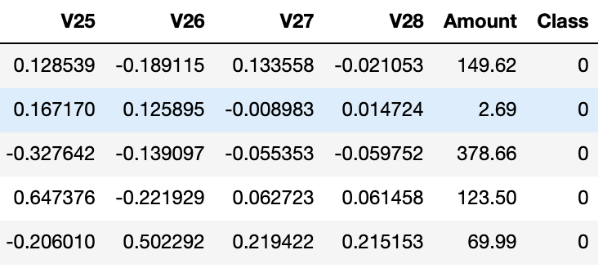
Our Dataset
Data is extracted from a csv file provided by Kaggle
Roughly 280,000 transactions
Cut into snippets of equal cases of fraud & not fraud transactions
V1-V28 were produced through an obfuscation process. For security reasons, we cannot backtrack these numbers to any values that would make sense to us, so our model will only be specific to the non-sensitive data here

Slide 5
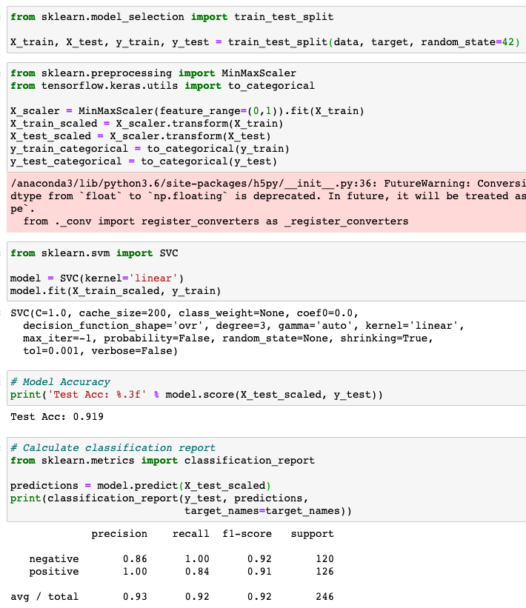
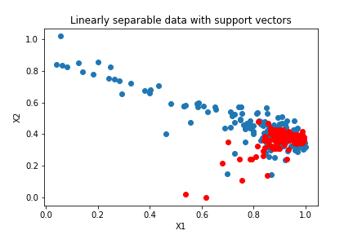
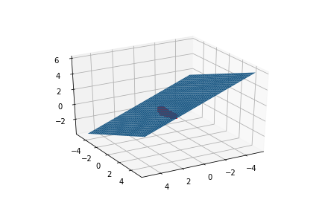
SVM
Tested a 75/25 train/test split of balanced fraud to not fraud transactions
Plotted X1 & X2 (2 features)
Plotted X1, X2 & X3 (3 Features)
Because our dataset has 29 Features, we are not able to see the separation in a 2D Graph or a 3D Graph
Achieved a .919 Test Accuracy with the SVM Model

Slide 6
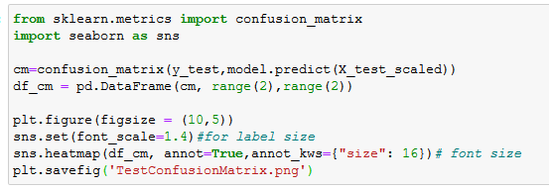
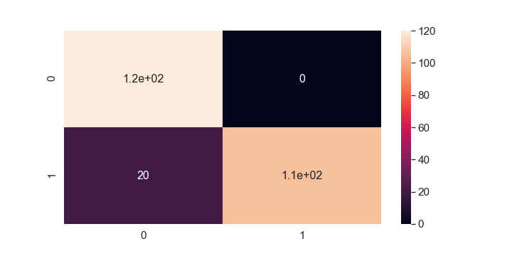
SVM
Tested a 75/25 train/test split of balanced fraud to not fraud transactions
Achieved a .919 Test Accuracy with the SVM Model
All of our errors were “true negative” which means the model failed to catch 20 cases of fraud

Slide 7
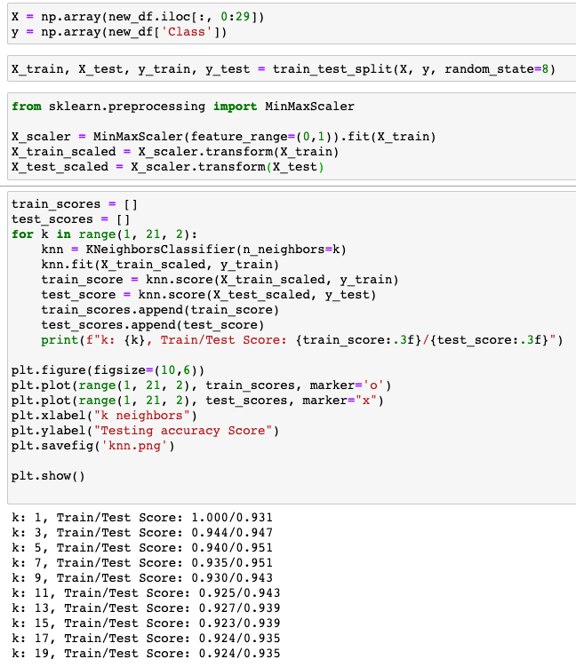
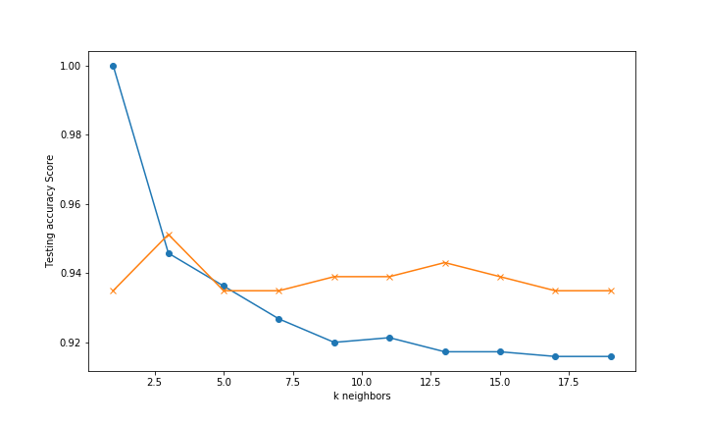
K Nearest Neighbors
Tested a 75/25 train/test split of balanced fraud to not fraud transactions
Plotted K1-K19
Closest accuracy was using K=3 at 0.944/0.947
Highest test accuracy was at K=5 with an accuracy of 0.951

Slide 8
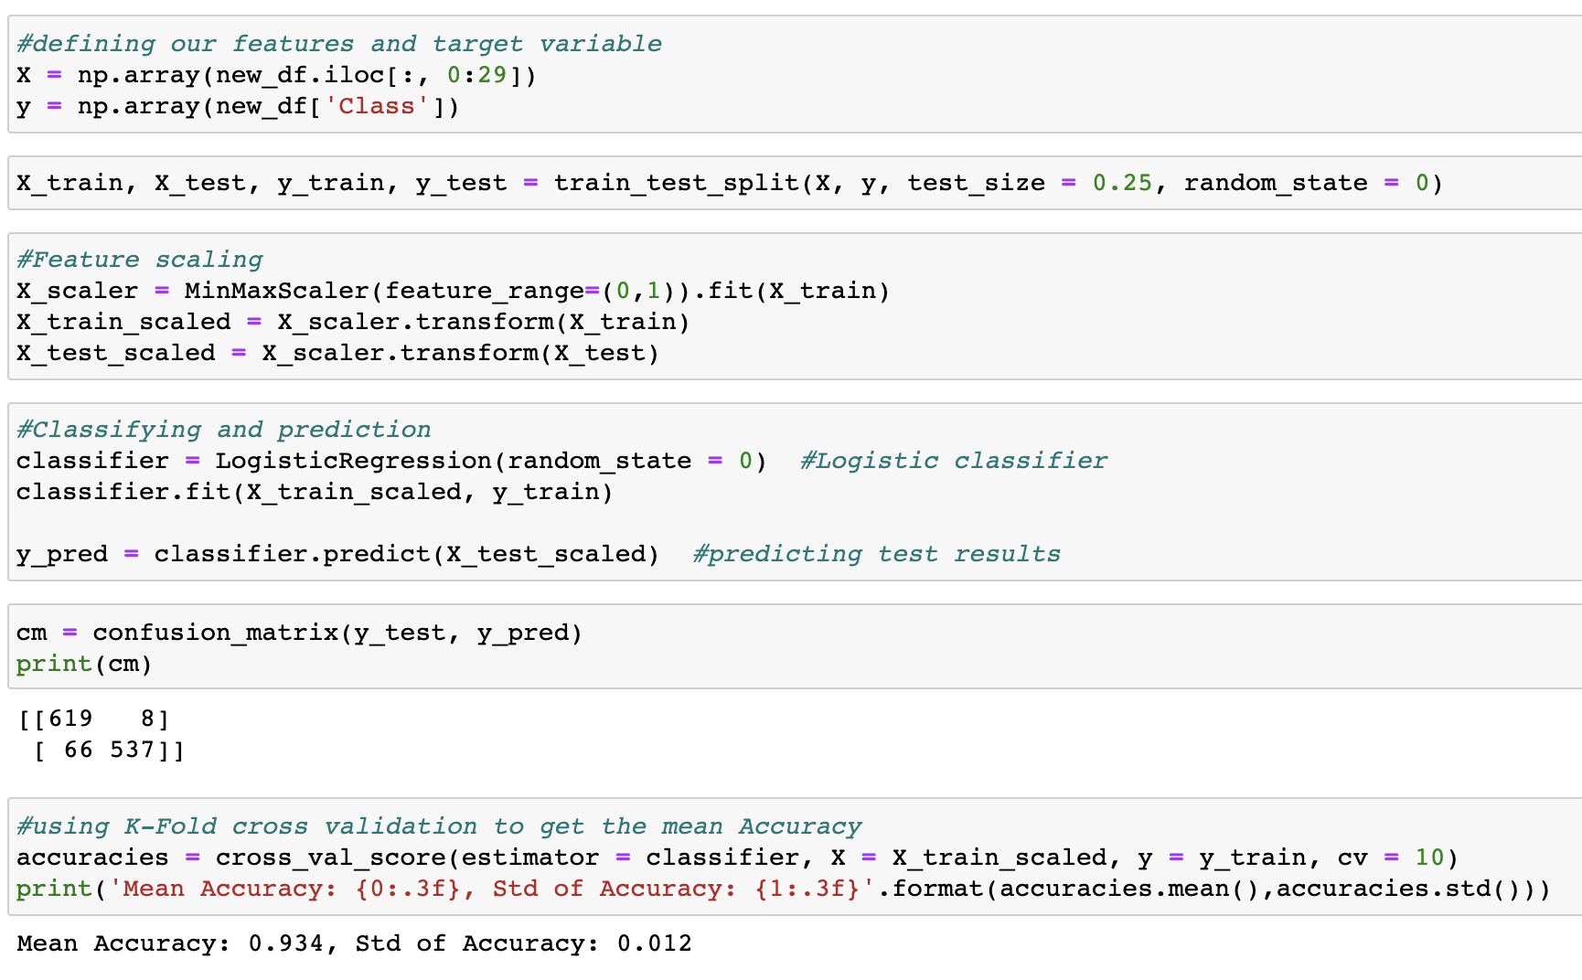
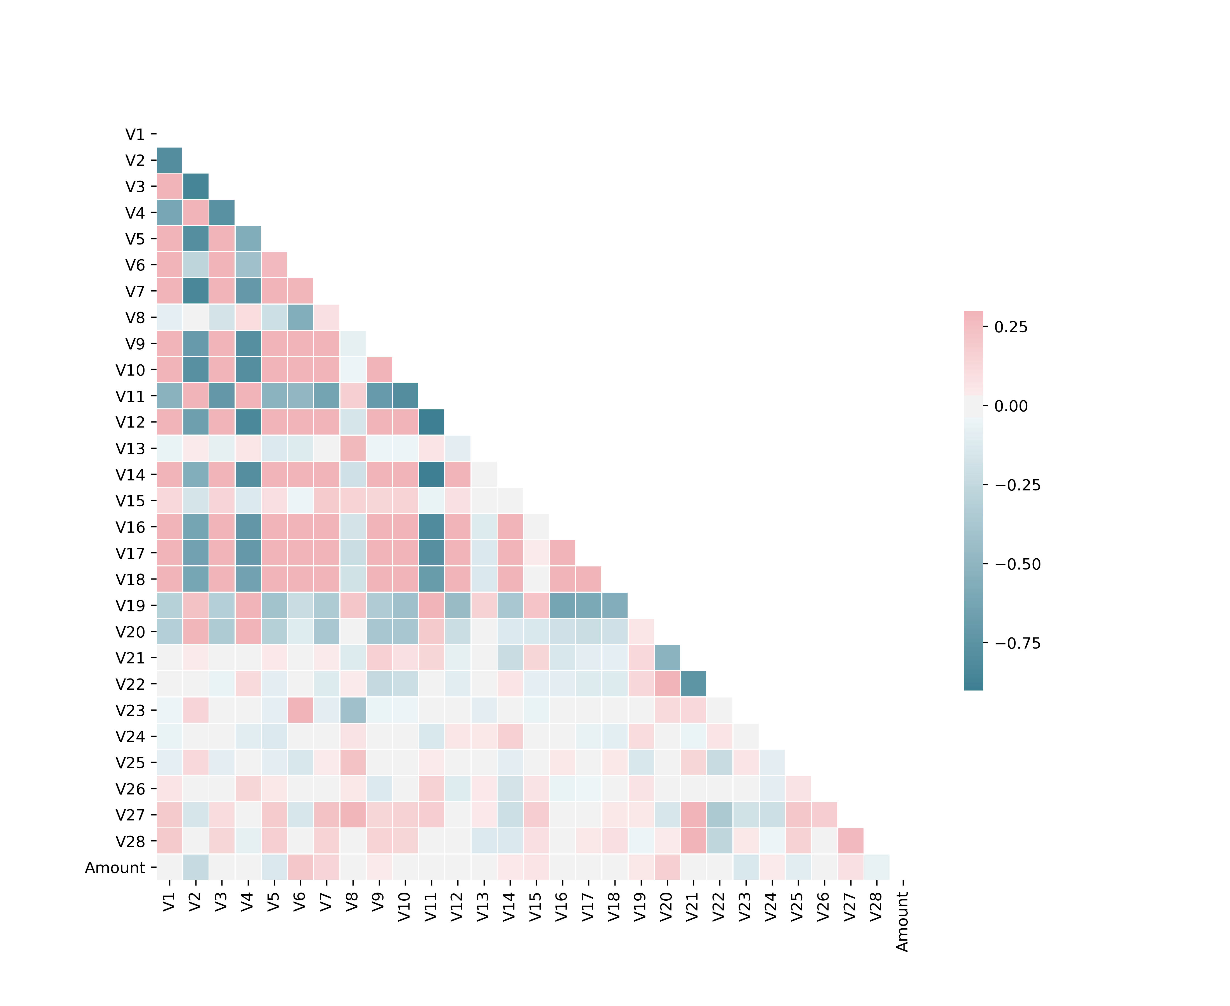
Logistic Regression
Used a balanced snippet of our dataset
Confusion Matrix shows 8 false positives
Achieved an accuracy of 0.934 with a standard deviation of 0.012
Heat map shows strong correlations between features 1 thru 20 but drops off after

Slide 9
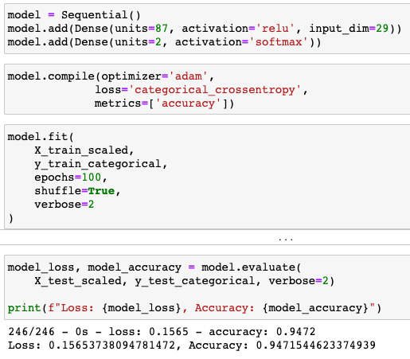
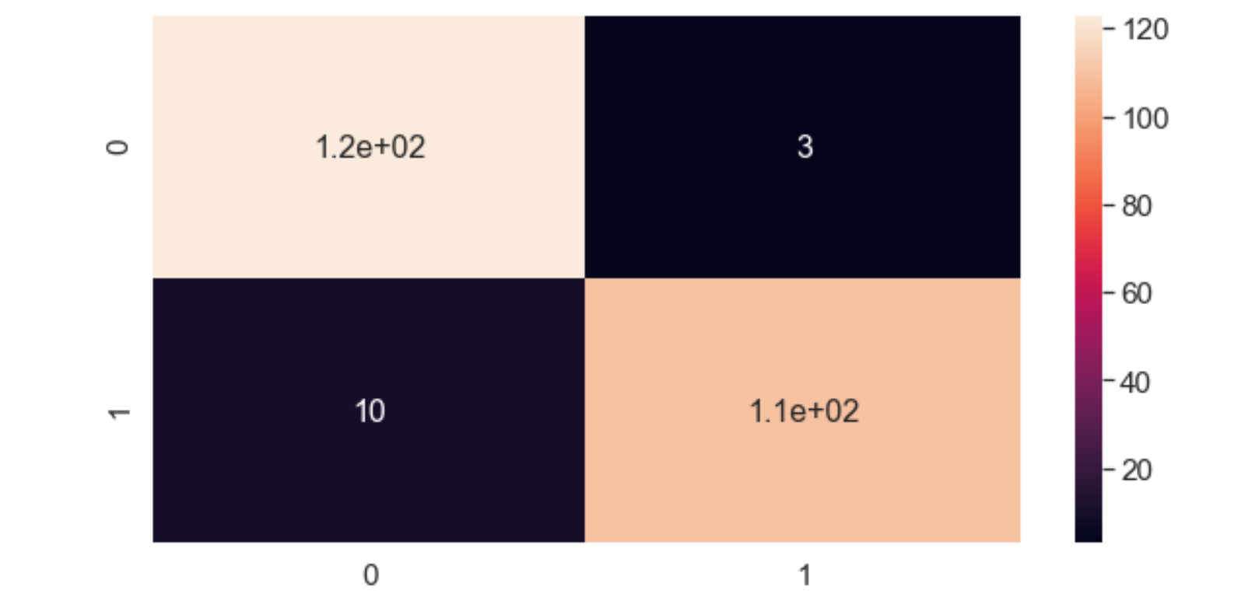
Neural Network
Our first Neural Model has a single hidden layer
We used all 28 V values in our data and the Amount column
The model’s predictive accuracy rounded out to 94.7%
Compared to the actual values, the model returned 3 False Positive values and missed 10 cases of fraud out of 246 points of data

Slide 10
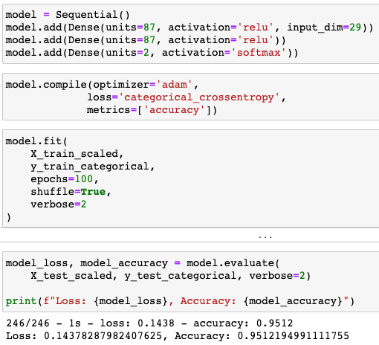
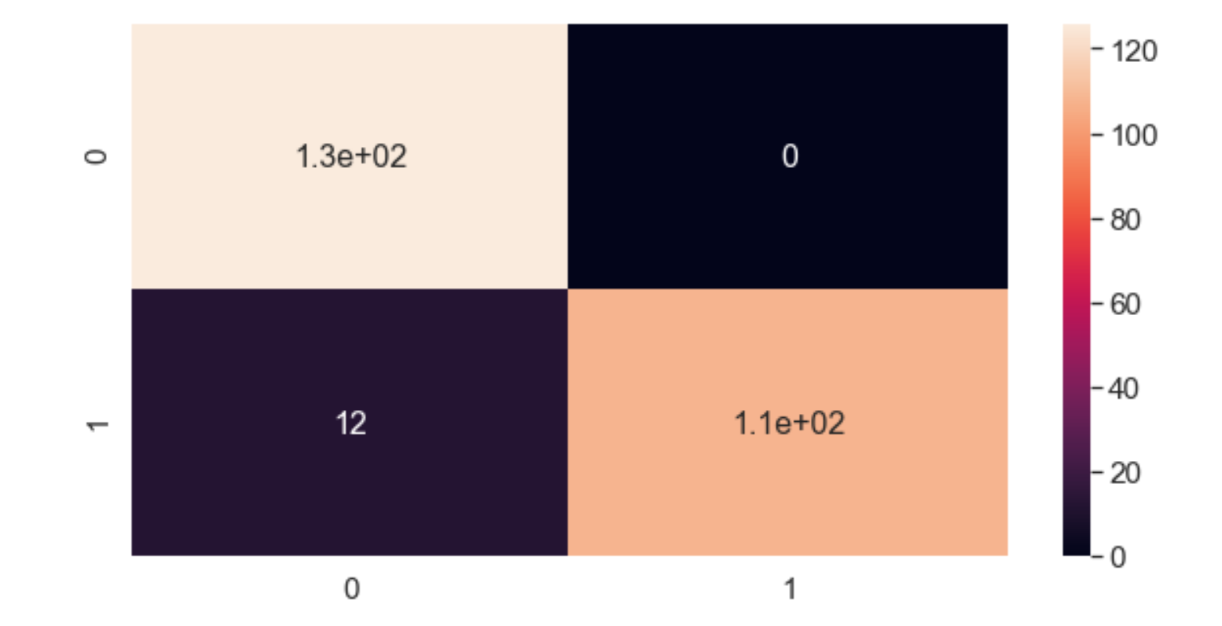
Deep Neural Network
Our second Neural Model has 2 hidden layers
We used the same distribution of data for both models
The Deep Model’s predictive accuracy rounded out to 95.1%
Compared to the actual values, the Deep Model did not return any False Positives and missed 12 cases of fraud
Despite higher accuracy than the first model, this model missed more cases of actual fraud

Slide 11
Comparison of Model Accuracies
 | SVM | K Nearest Neighbors | Logistic Regression | Neural Network | Deep Neural Network
Accuracy | 0.919 | 0.951 | 0.934 | 0.947 | 0.951

Slide 12
Improvements/Limitations
Improvements
Limitations
Create a user interactive webpage to demonstrate our model
Apply & train our models with datasets that contain more fraudulent transactions
Our features (V’s) came from sensitive information and therefore could not be backtracked to any values that would make sense to us
Original data was unbalanced & had to be trimmed down to be worked with

Slide 13
Thank You!
Questions?

