Slide 1
Credit Card Fraud Detection
By: Jacob Avchen, Sal Russo, & Jacob Hollander

Slide 2
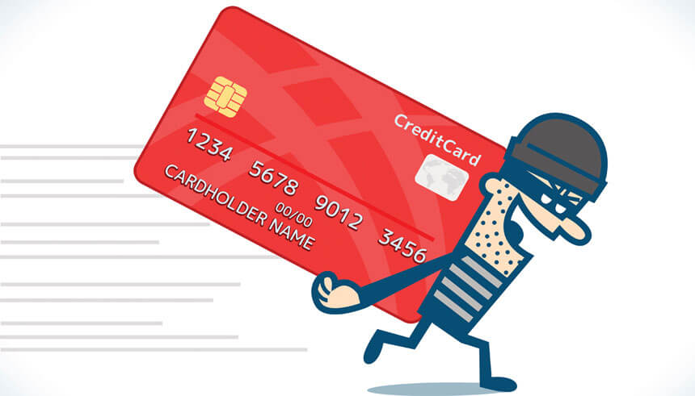
Project Proposal
Create a user interactive interface that will utilize machine learning to identify whether a credit card purchase is fraudulent or not fraudulent

Slide 3
Tools
Python for data acquisition, data cleaning, & machine learning modeling
Keras for Neural Network
HTML/CSS to create webpage
JavaScript
Flask Server

Slide 4
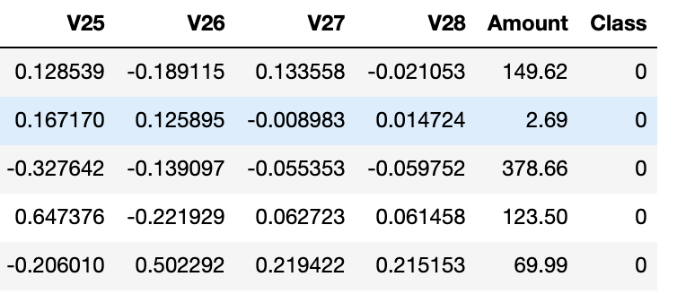
Our Dataset
Data is extracted from a csv file provided by Kaggle
Roughly 280,000 transactions
Cut into snippets of equal cases of fraud & not fraud transactions
V1-V28 were produced through an obfuscation process. For security reasons, we cannot backtrack these numbers to any values that would make sense to us, so our model will only be specific to the non-sensitive data here.

Slide 5
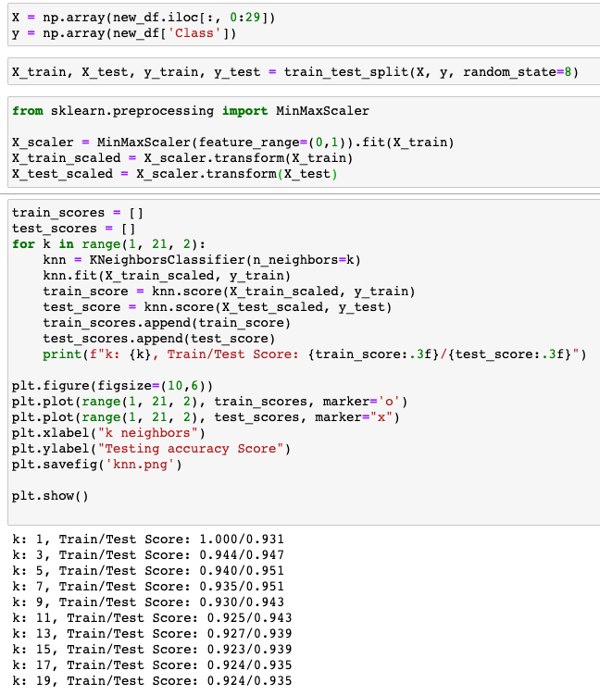
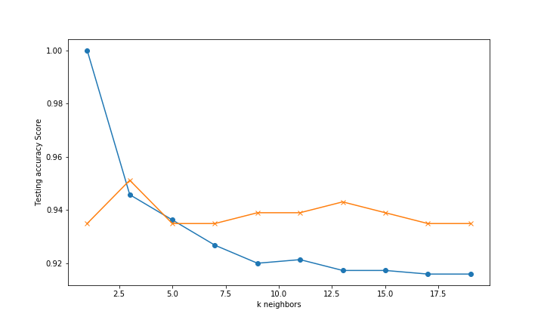
K Nearest Neighbor

Slide 6
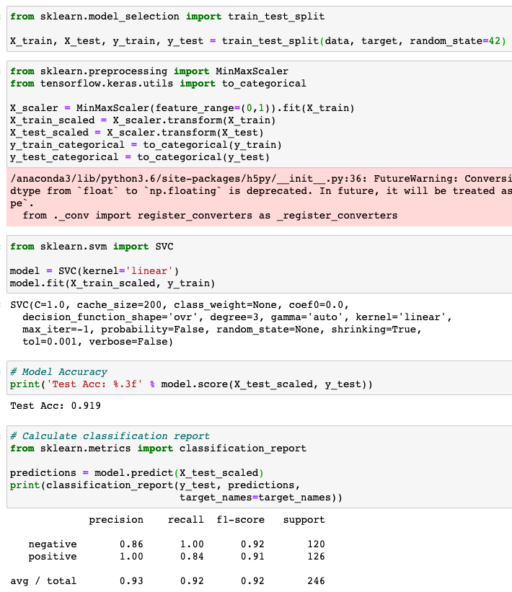
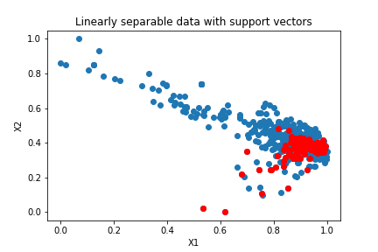
SVM

Slide 7
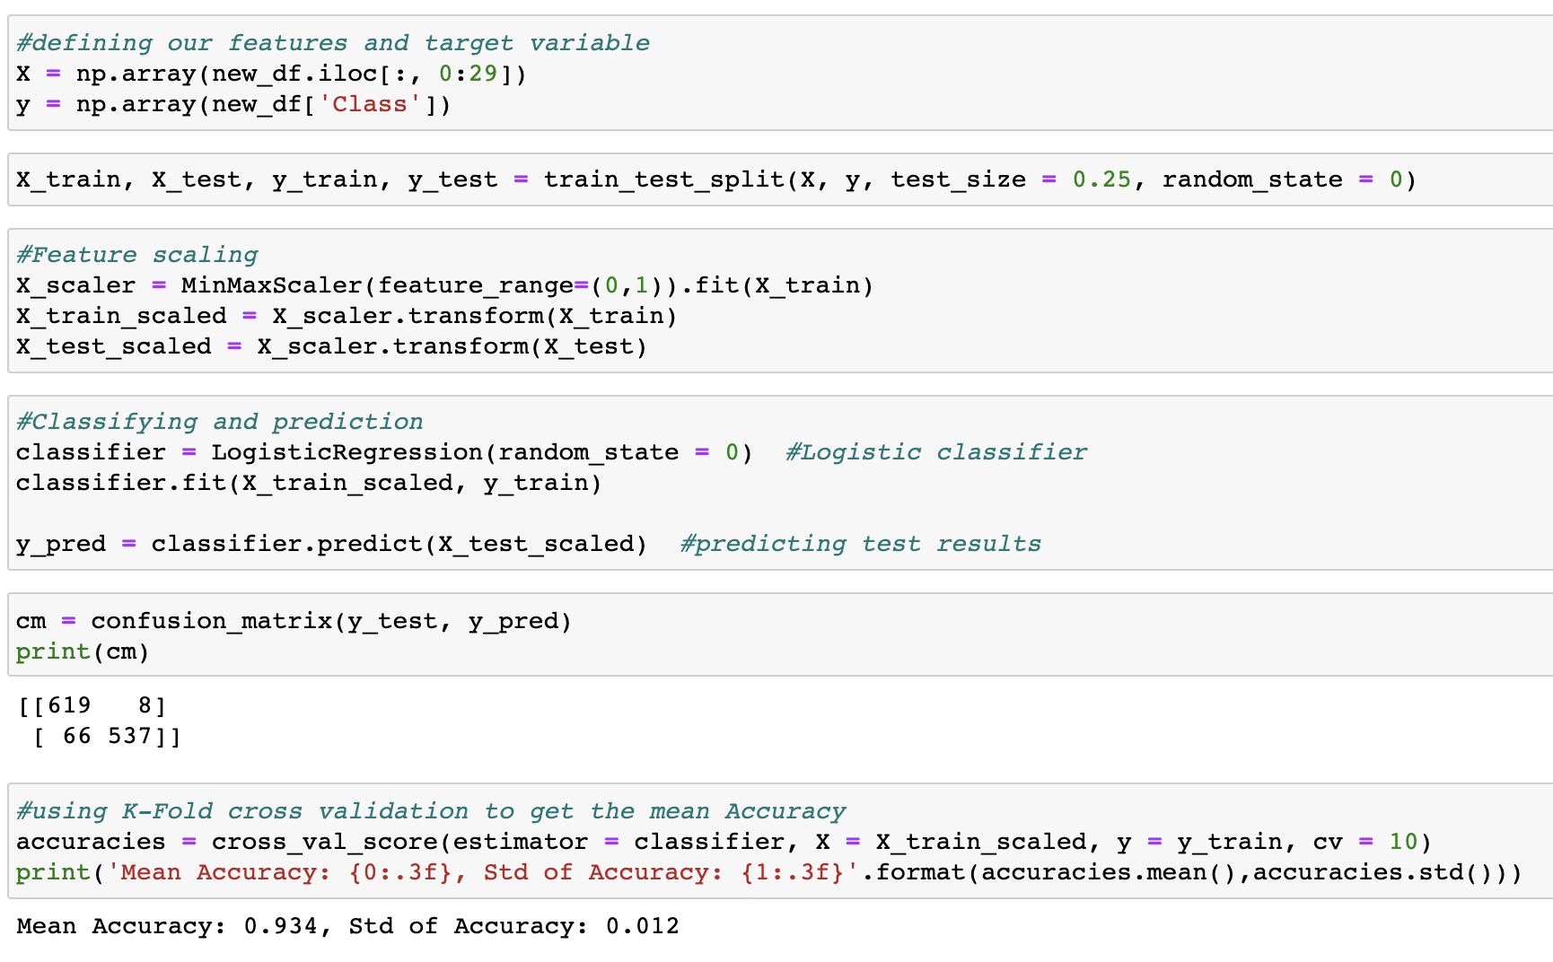
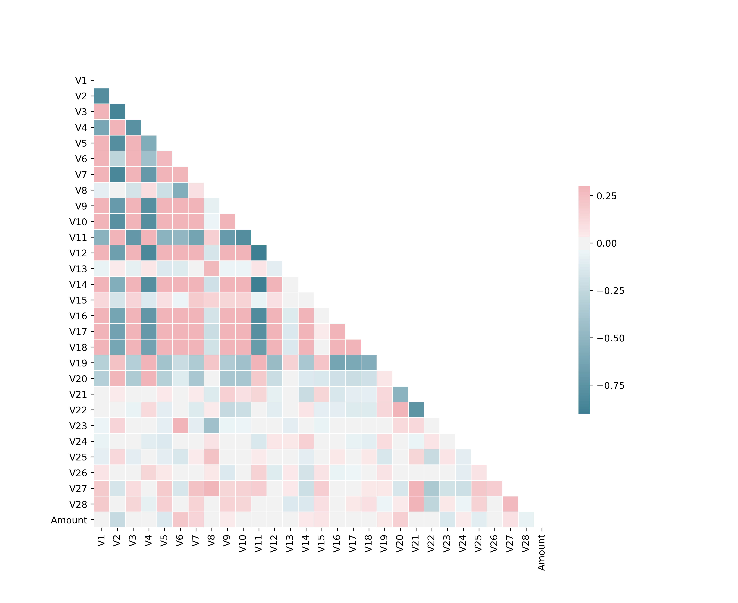
Logistic Regression

Slide 8
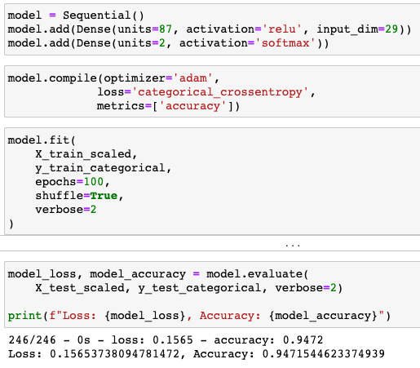
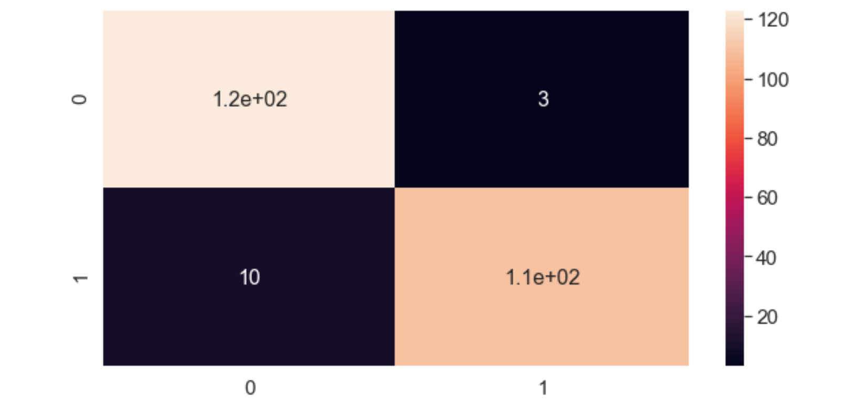
Neural Network

Slide 9
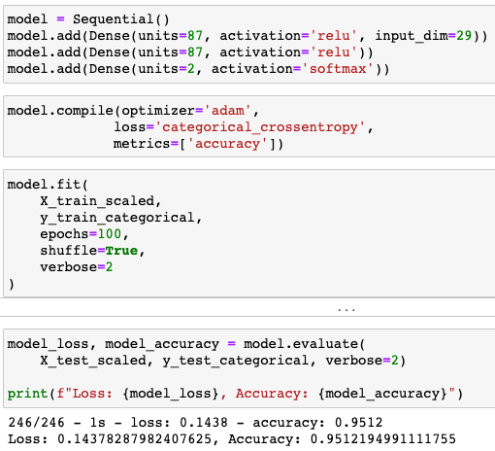
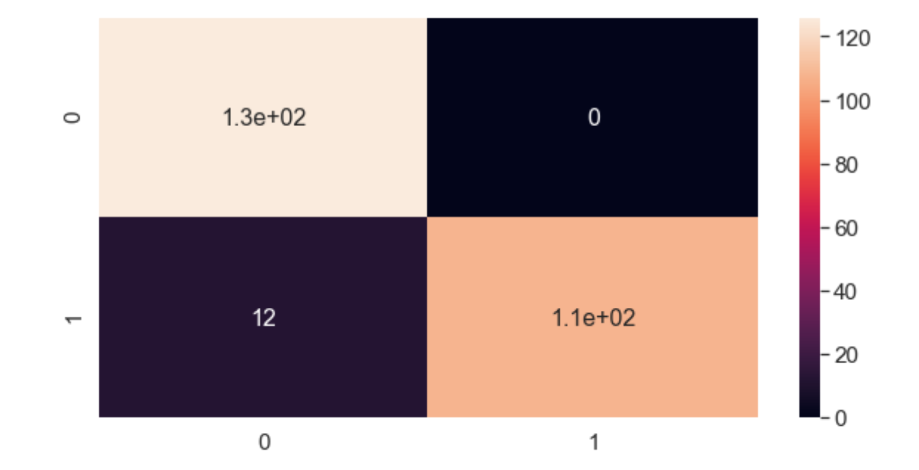
Deep Neural Network

Slide 10
Project Demonstration

Slide 11
Improvements

Slide 12
Thank You!
Questions?

