Slide 1

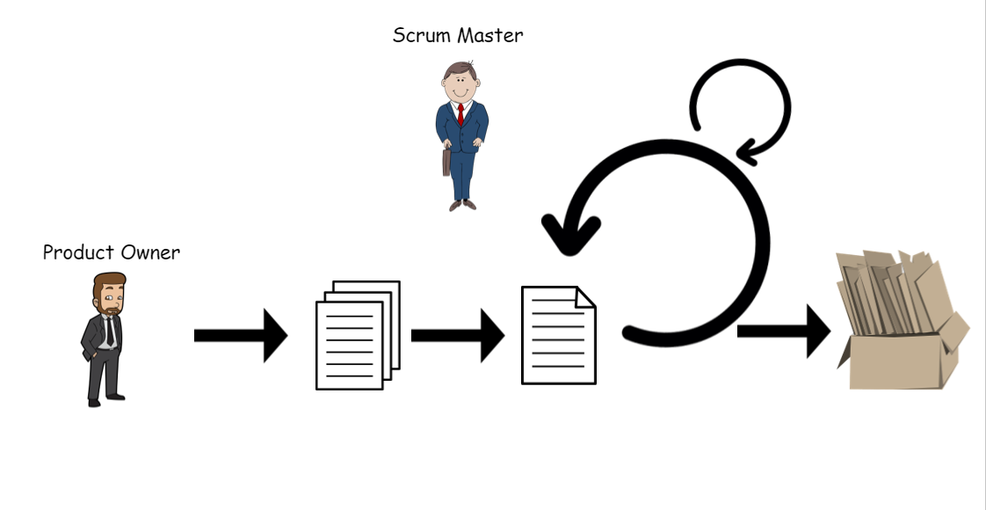






Team Member
Sprint
Demonstrating what the team accomplished during the sprint.
Inputs from executives, costumers, users, stakeholders
Stand Up daily.
Scrum Master
………….
1-4. Week Sprint
Product Increment.
(Finished Work)
Sprint Meeting
(Goal, Scope, Selecting stories)
Product
Owner
…Product Backlog
…………...
(Ranked list of
what is required)
Sprint Backlog.
………….
(Selected stories to complete during the Sprint)
Sprint Overwiew.
What went well?
What went wrong?
Improvement Areas?

