Slide 1
Salamun Nuhin & Tian-Hao zhang
Matching Algorithm:
Alon-Itai-Babai & Greedy Bipartite

Slide 2
Brief overview
Alon-Itai-Babai
Greedy Bipartite

Slide 3
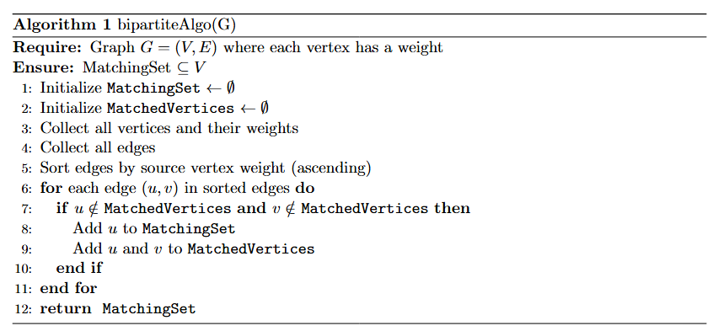
Greedy Bipartite Algorithm

Slide 4
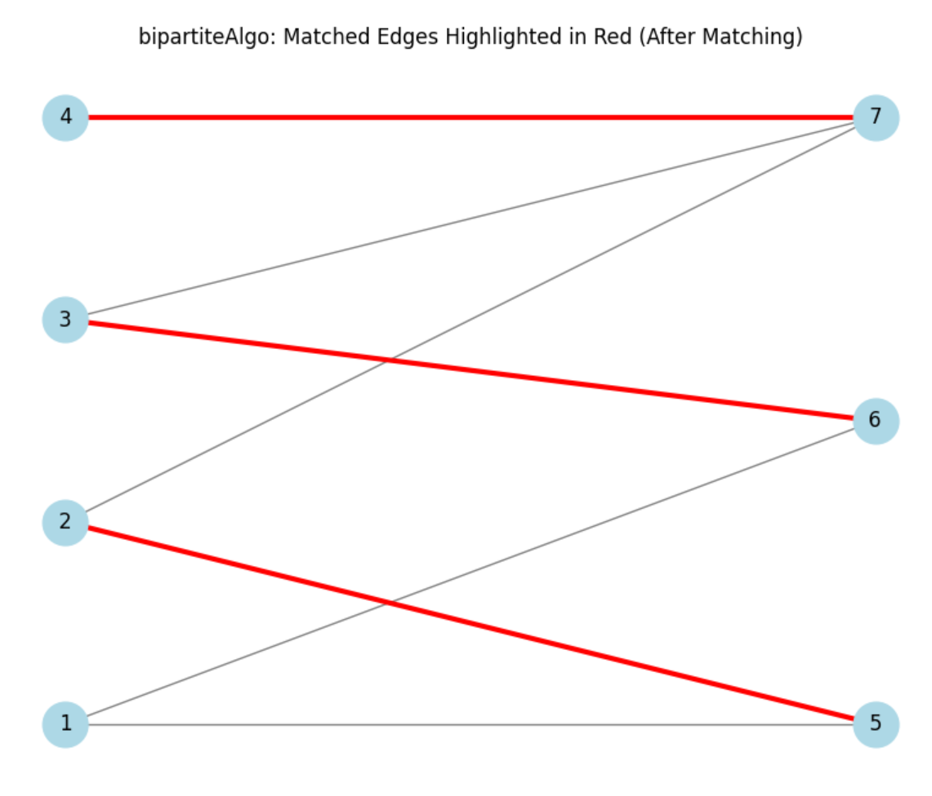
How the Matching looks like

Slide 5
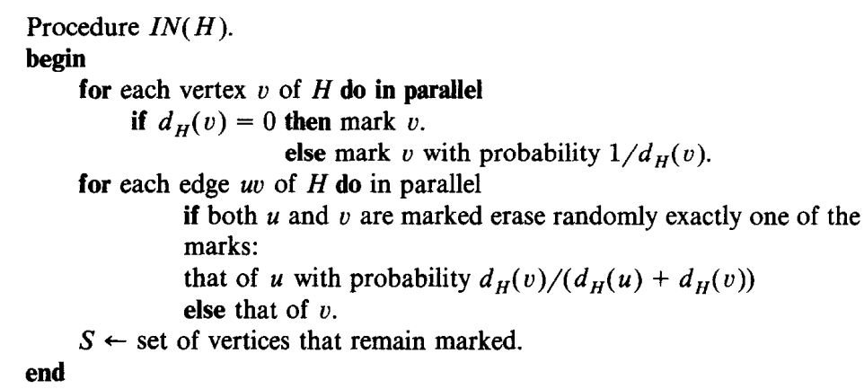
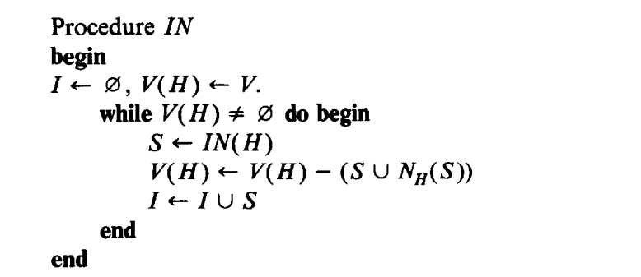
Alon-Itai-Babai
Algorithm

Slide 6
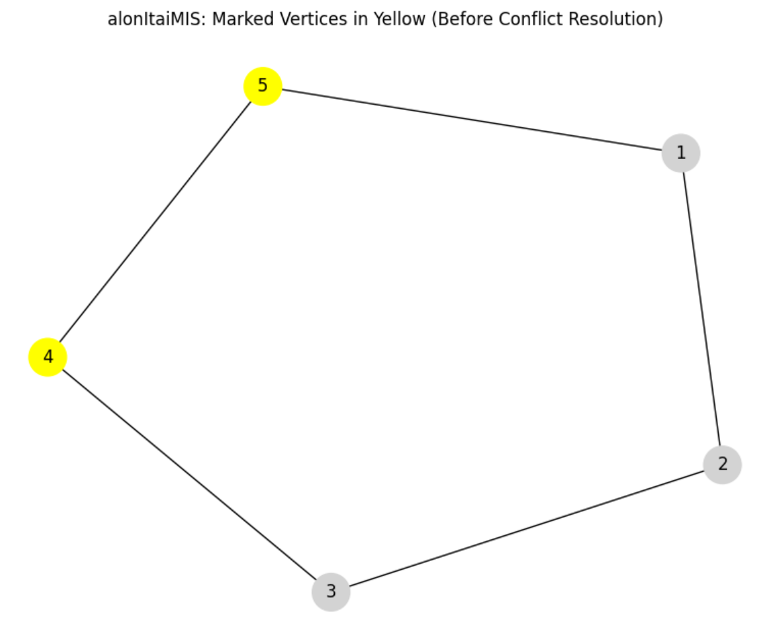
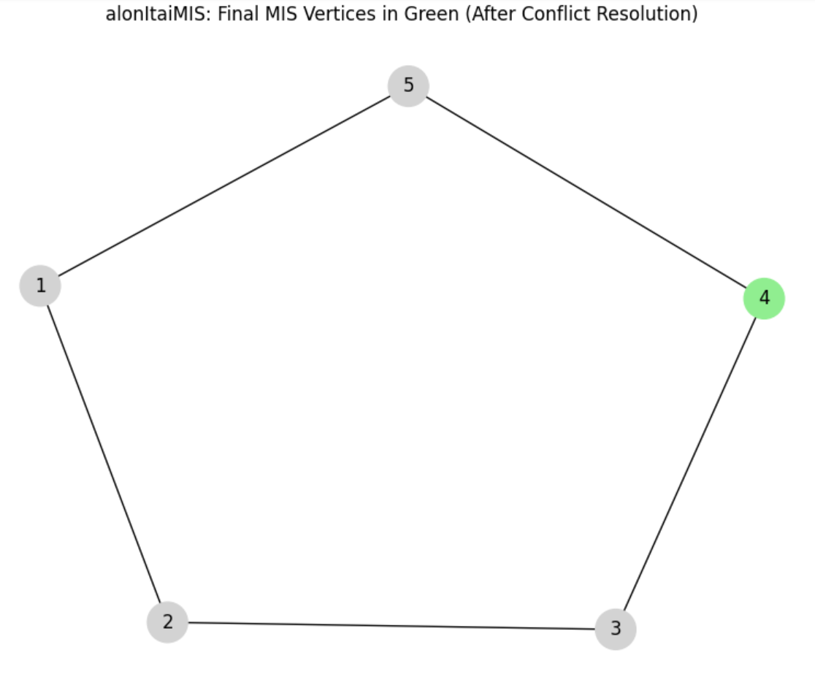
How the Matching looks like

Slide 7
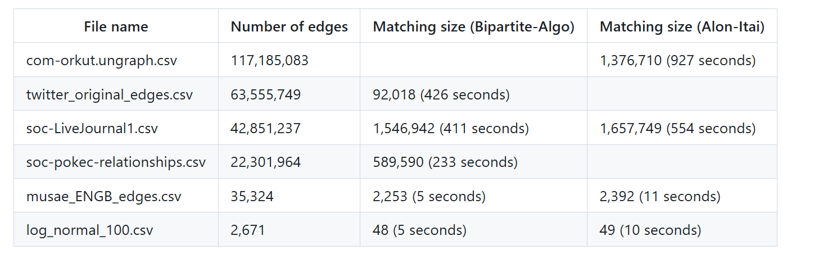
results
Biggest one: 2x4 N2 for master and worker nodes
Other ones: 2x4 N1 for both master and workers on GCP
Smallest ones : Ran locally

Slide 8
Parallelization and Scalability
Bipartite greedy algorithm faster
Not as dynamic
Alon-Itai-Babai more powerful & dynamic
Works on any graph even if cyclical, sparse or irregular
Randomization + local degree info -> robust structure and adaptable
Higher accuracy

Slide 9
DrawBacks
Heap pressure for Bipartite Greedy Algorithm
Collects all edges for partitioning
Inefficient garbage collection -> frequent pauses
Spark failures
Bad caching
Unbalanced partitions
Limited number of partitions

Slide 10

Q&A

