Slide 1
Deep Drowsiness Detection
CNN from scratch and Transfer learning
Student1 Name: salah eldin mountaser
ID: 240102746
Student2 Name: Mohamed Kamel Wagdy Kamel
ID: 240103400

Slide 2
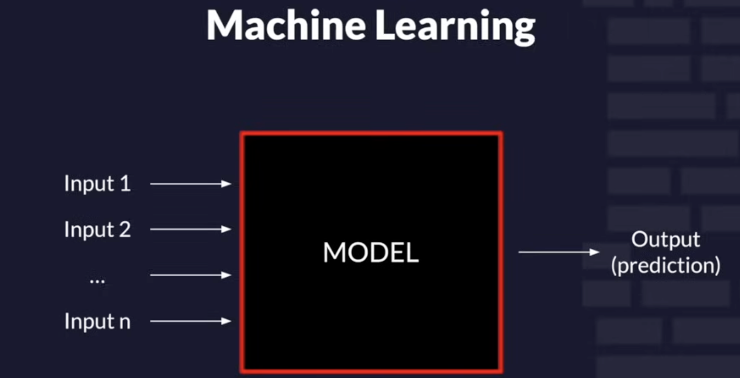
🧠 Section 1: Training a Model

Slide 3
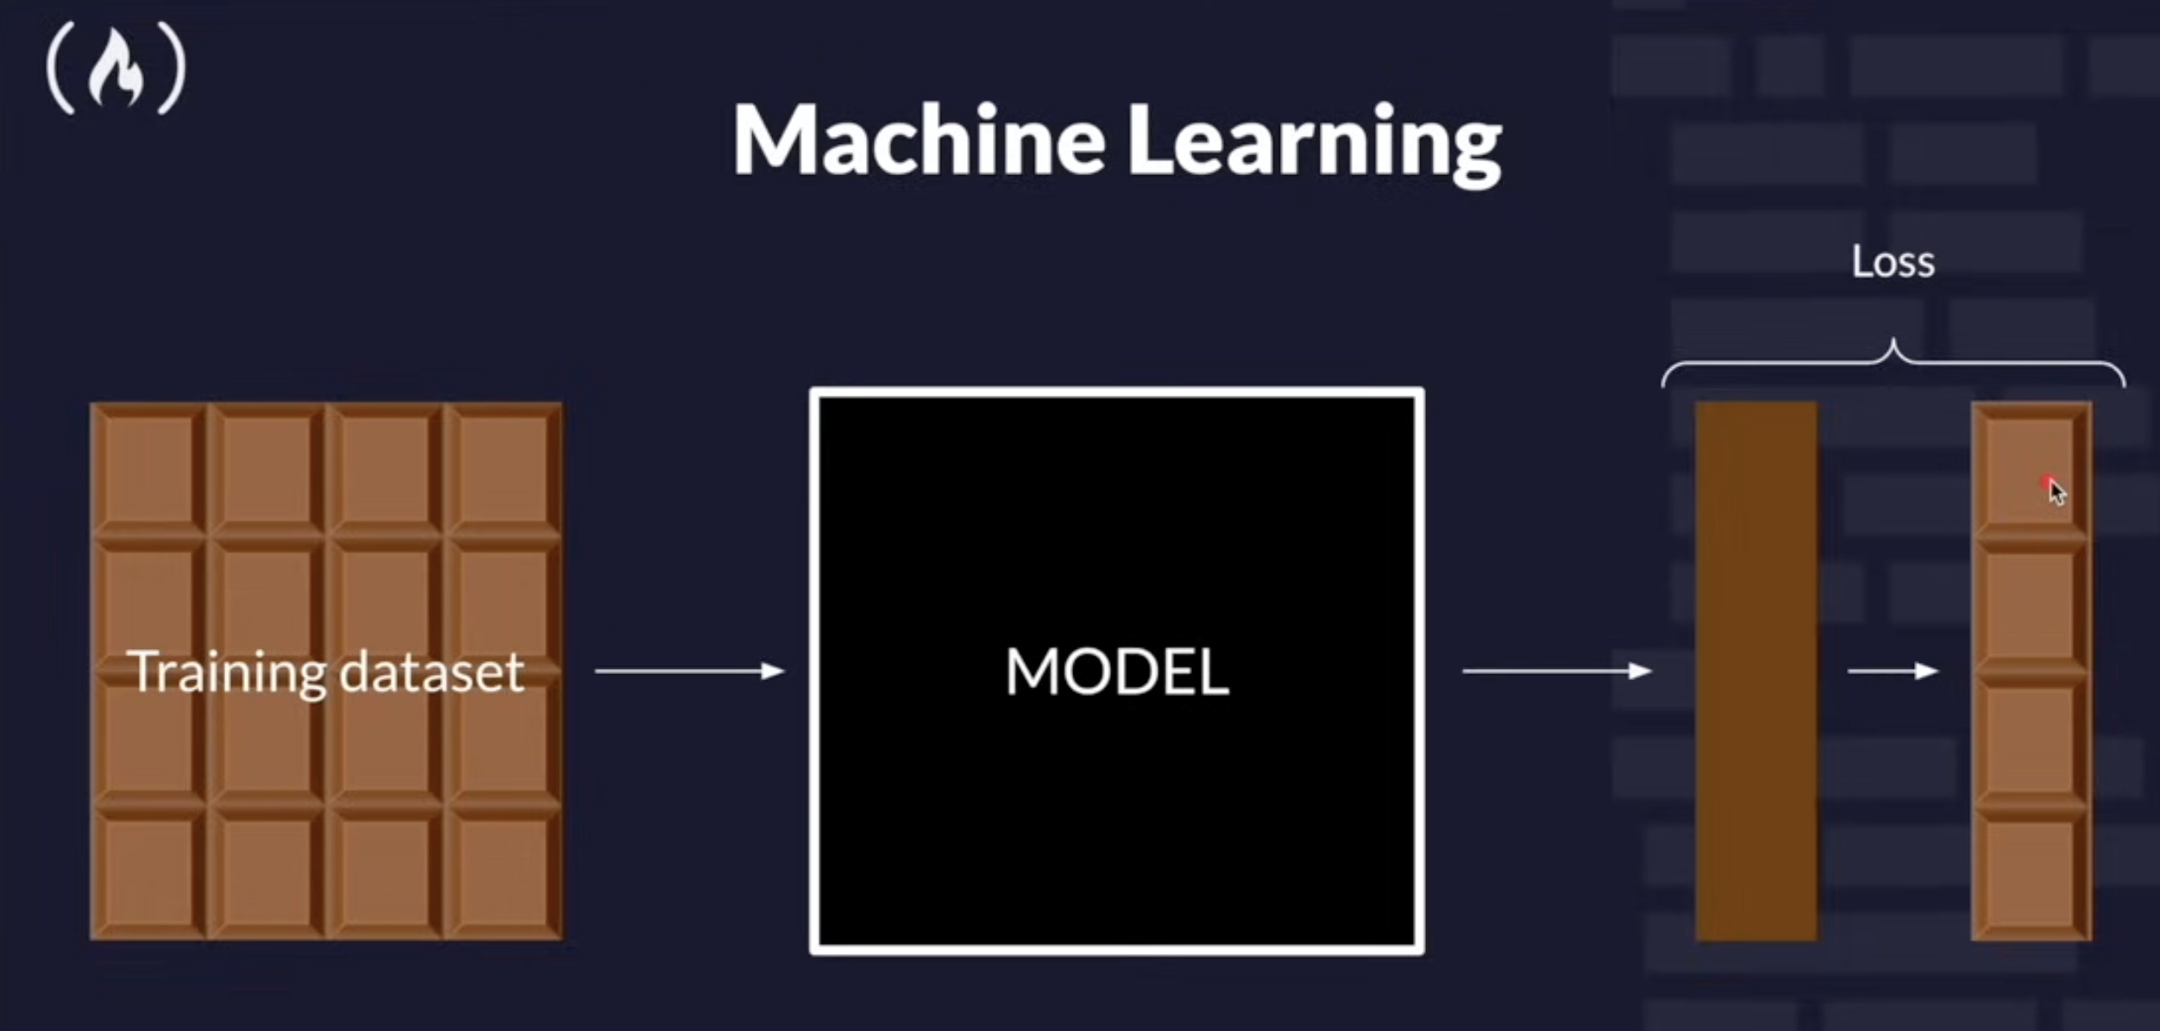

Slide 4
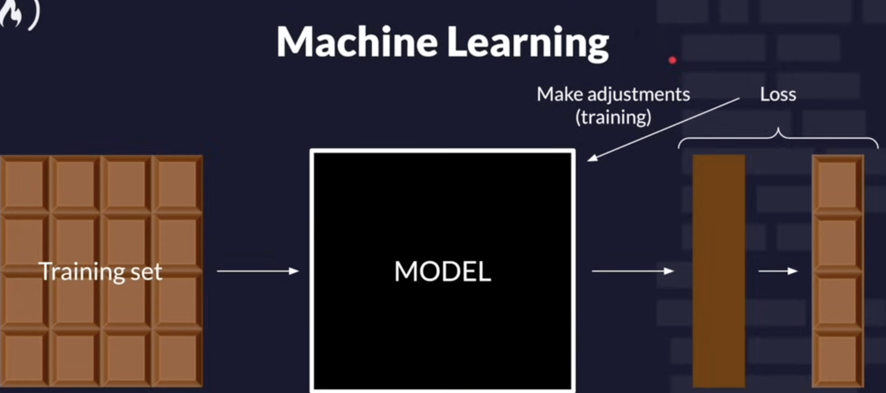

Slide 5
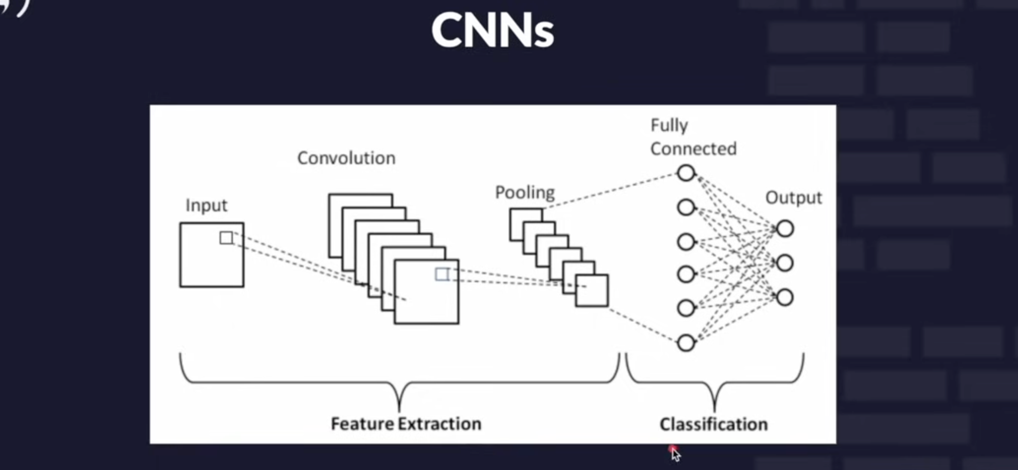
Convolution Neural Nets

Slide 6
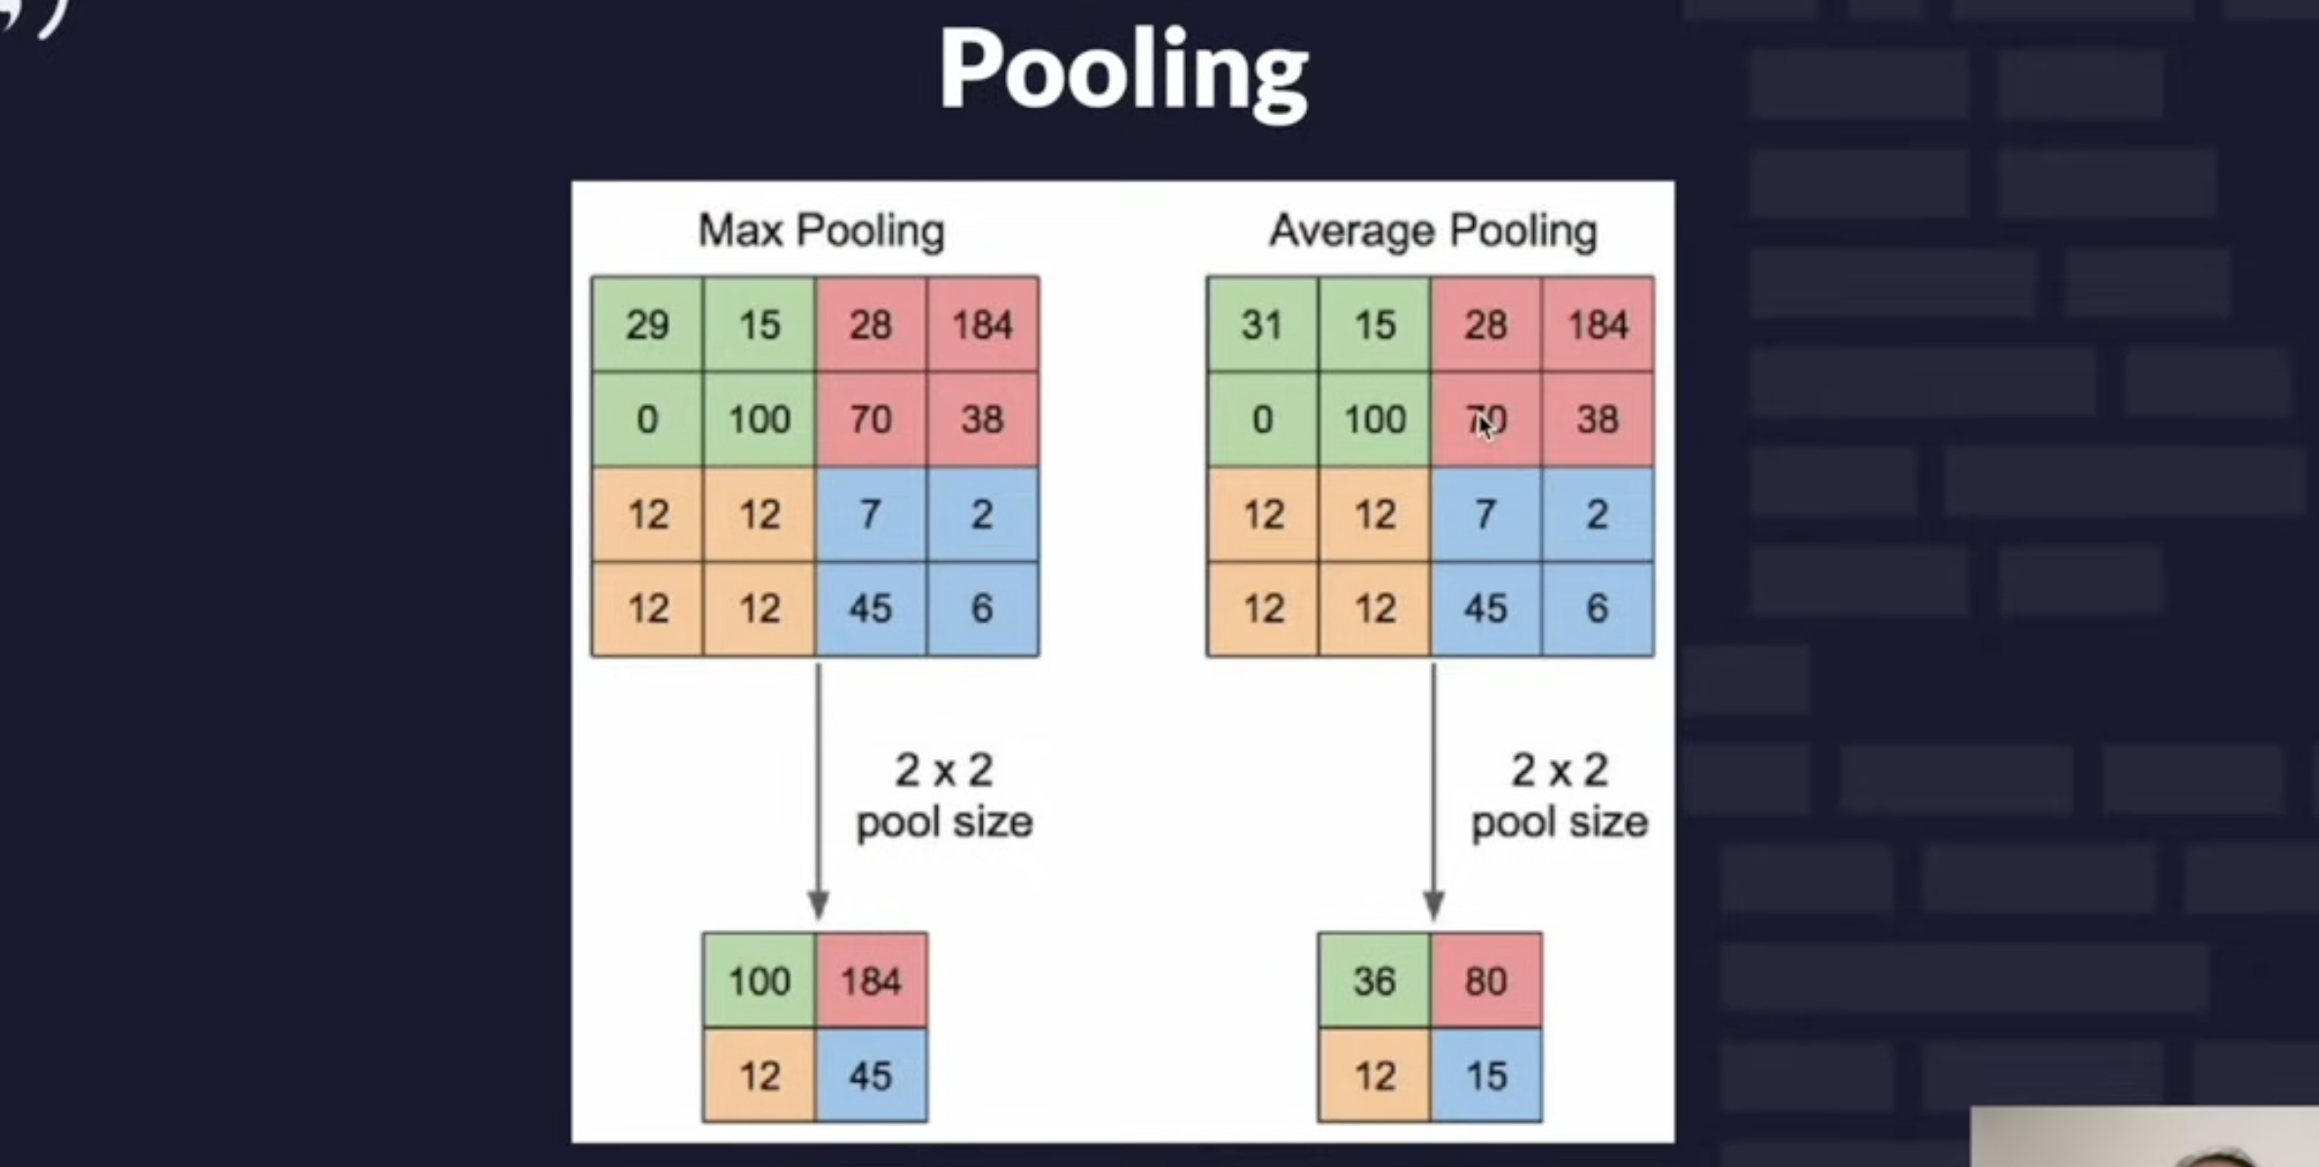
? What is pooling

Slide 7
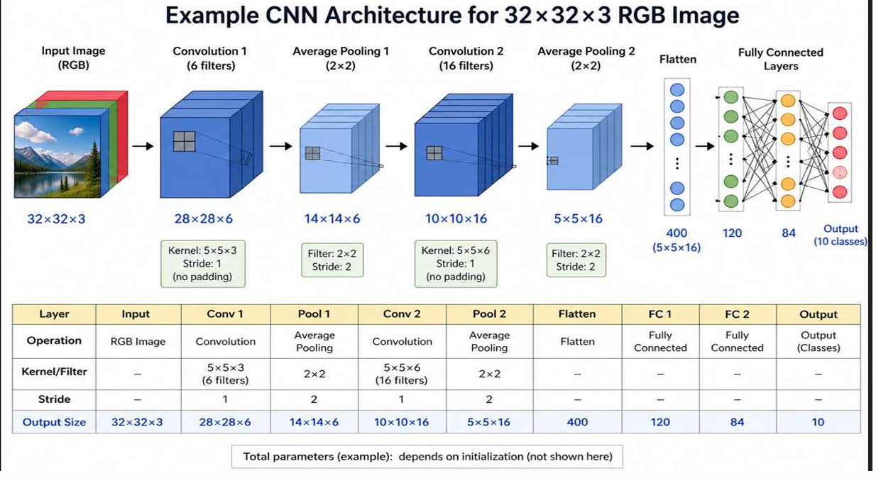
CNN Architecture

Slide 8
-:Build CNN model from scratch
1- Data Preprocessing
2- Build the Model
3- Train the model
4- Validation
5- Test the Model
6- Evaluation

Slide 9
1- Preprocessing
1- Convert to grayscale
2- Resize image
3- Normalization

Slide 10
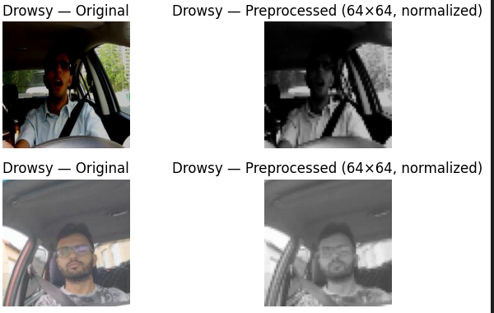

Slide 11
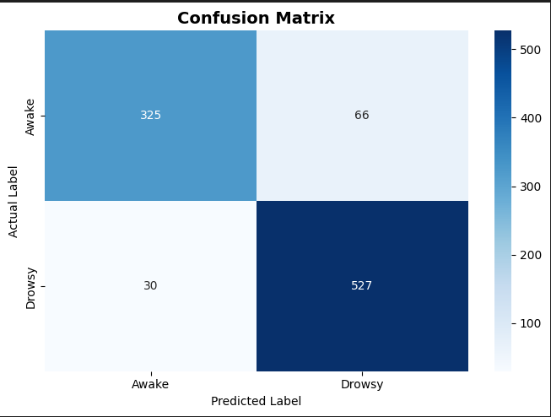
Evaluation the model

Slide 12
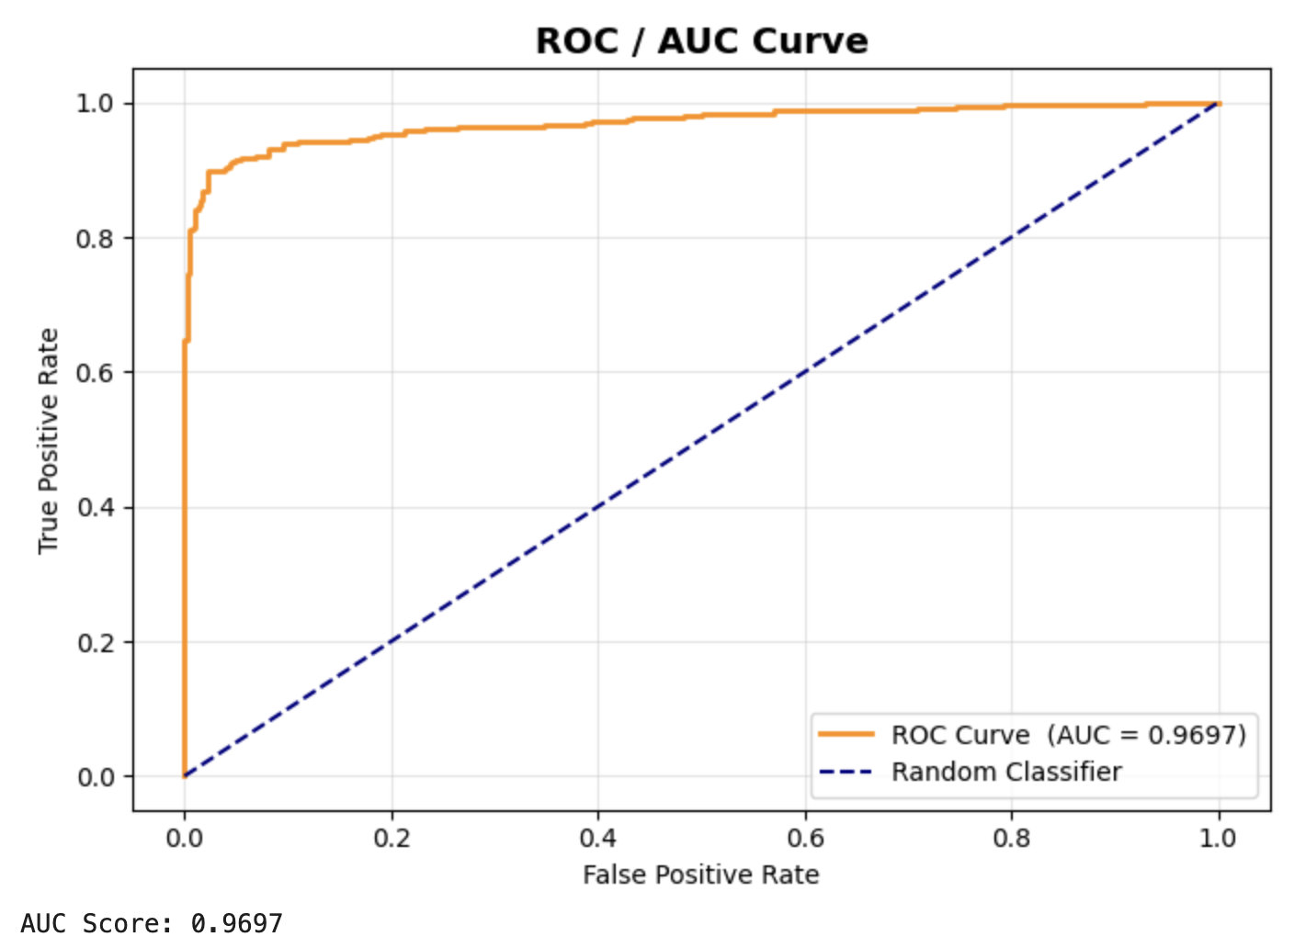

Slide 13
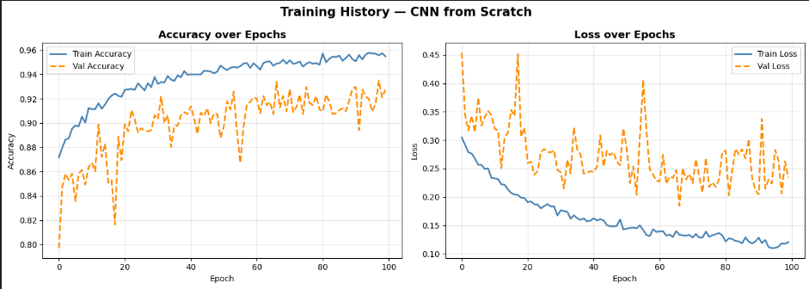

Slide 14
Transfer Learning Approach (MobileNetV2)
1- Stage 1: Head Training (Feature Extractor Frozen)
2- Stage 2: Fine-Tuning (Partial Unfreezing)

Slide 15
Stage 1: Head Training (Feature Extractor Frozen)
- In this stage, the entire MobileNetV2 base model was frozen:
We added a custom classification head on top of it:
GlobalAveragePooling2D
Dense layer (64 units, ReLU activation)
Dropout (0.3)
Dense layer (1 unit, Sigmoid activation)
Only the newly added layers were trained using a learning rate of 1e-3.
Goal:
To quickly learn how to classify the data using the already extracted features from MobileNetV2, without modifying the pre-trained weights.

Slide 16
Stage 2: Fine-Tuning (Partial Unfreezing)
-In this stage, we unfreezed part of the base model:
This means only the last 20 layers of MobileNetV2 were trainable, while the rest remained frozen.
We used a much smaller learning rate of 1e-5 to avoid destroying the pre-trained weights.
Goal:
To slightly adjust the high-level features of the model so they better fit our specific dataset.

Slide 17
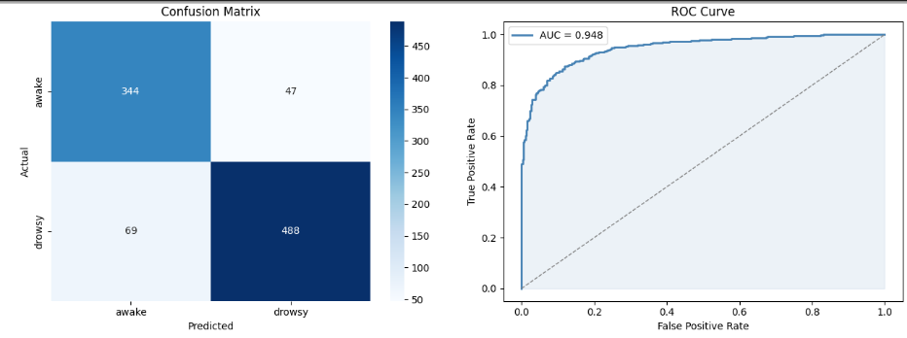

Slide 18
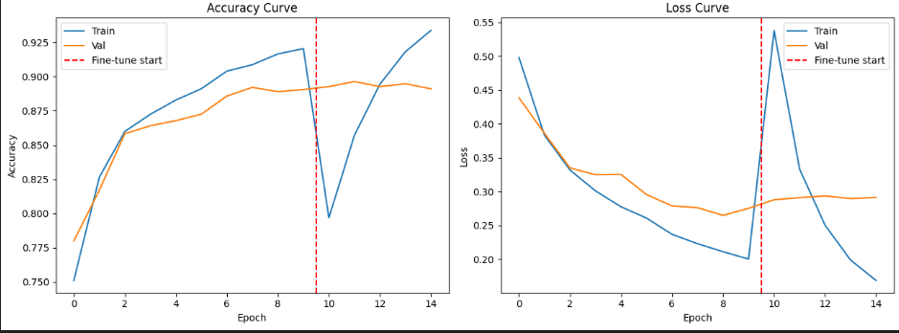

Slide 19
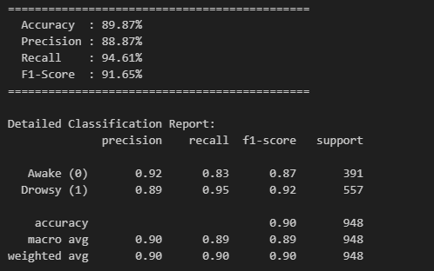
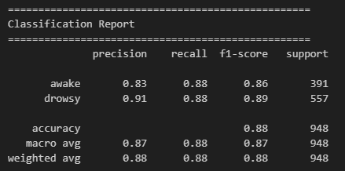
Difference Between two model
From scratch
Transfer learning

