Slide 1

Notes:
Slide 1 from the final LSEG OpenPermID assessment report. Main talk track: explain the graph-analysis result shown on this slide clearly and connect it back to the assessment requirement.

Slide 2
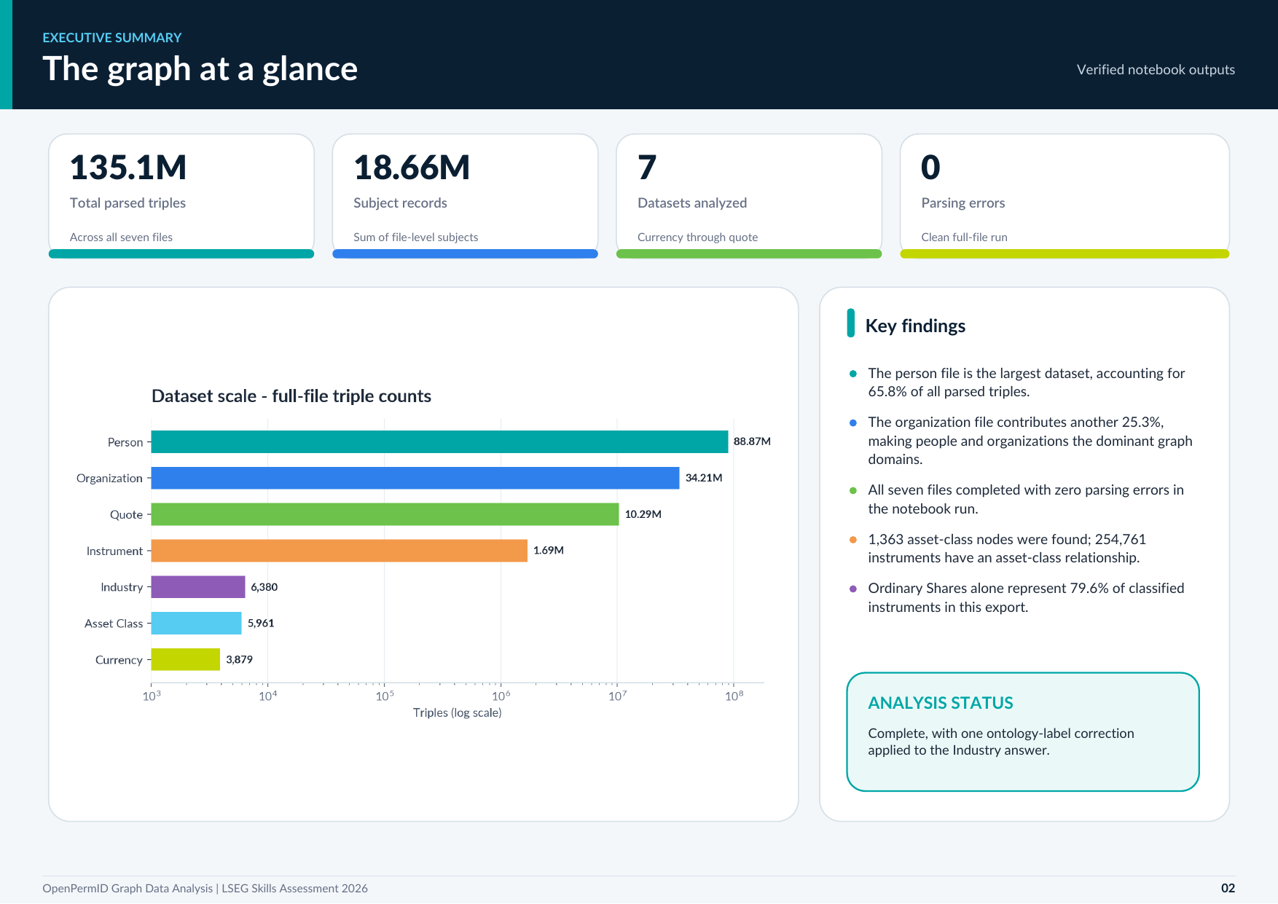
Notes:
Slide 2 from the final LSEG OpenPermID assessment report. Main talk track: explain the graph-analysis result shown on this slide clearly and connect it back to the assessment requirement.

Slide 3
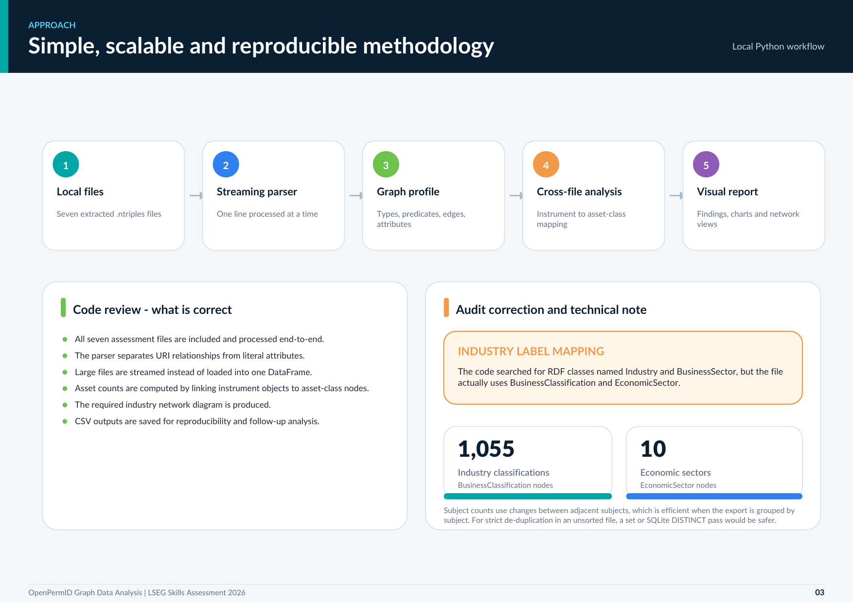
Notes:
Slide 3 from the final LSEG OpenPermID assessment report. Main talk track: explain the graph-analysis result shown on this slide clearly and connect it back to the assessment requirement.

Slide 4
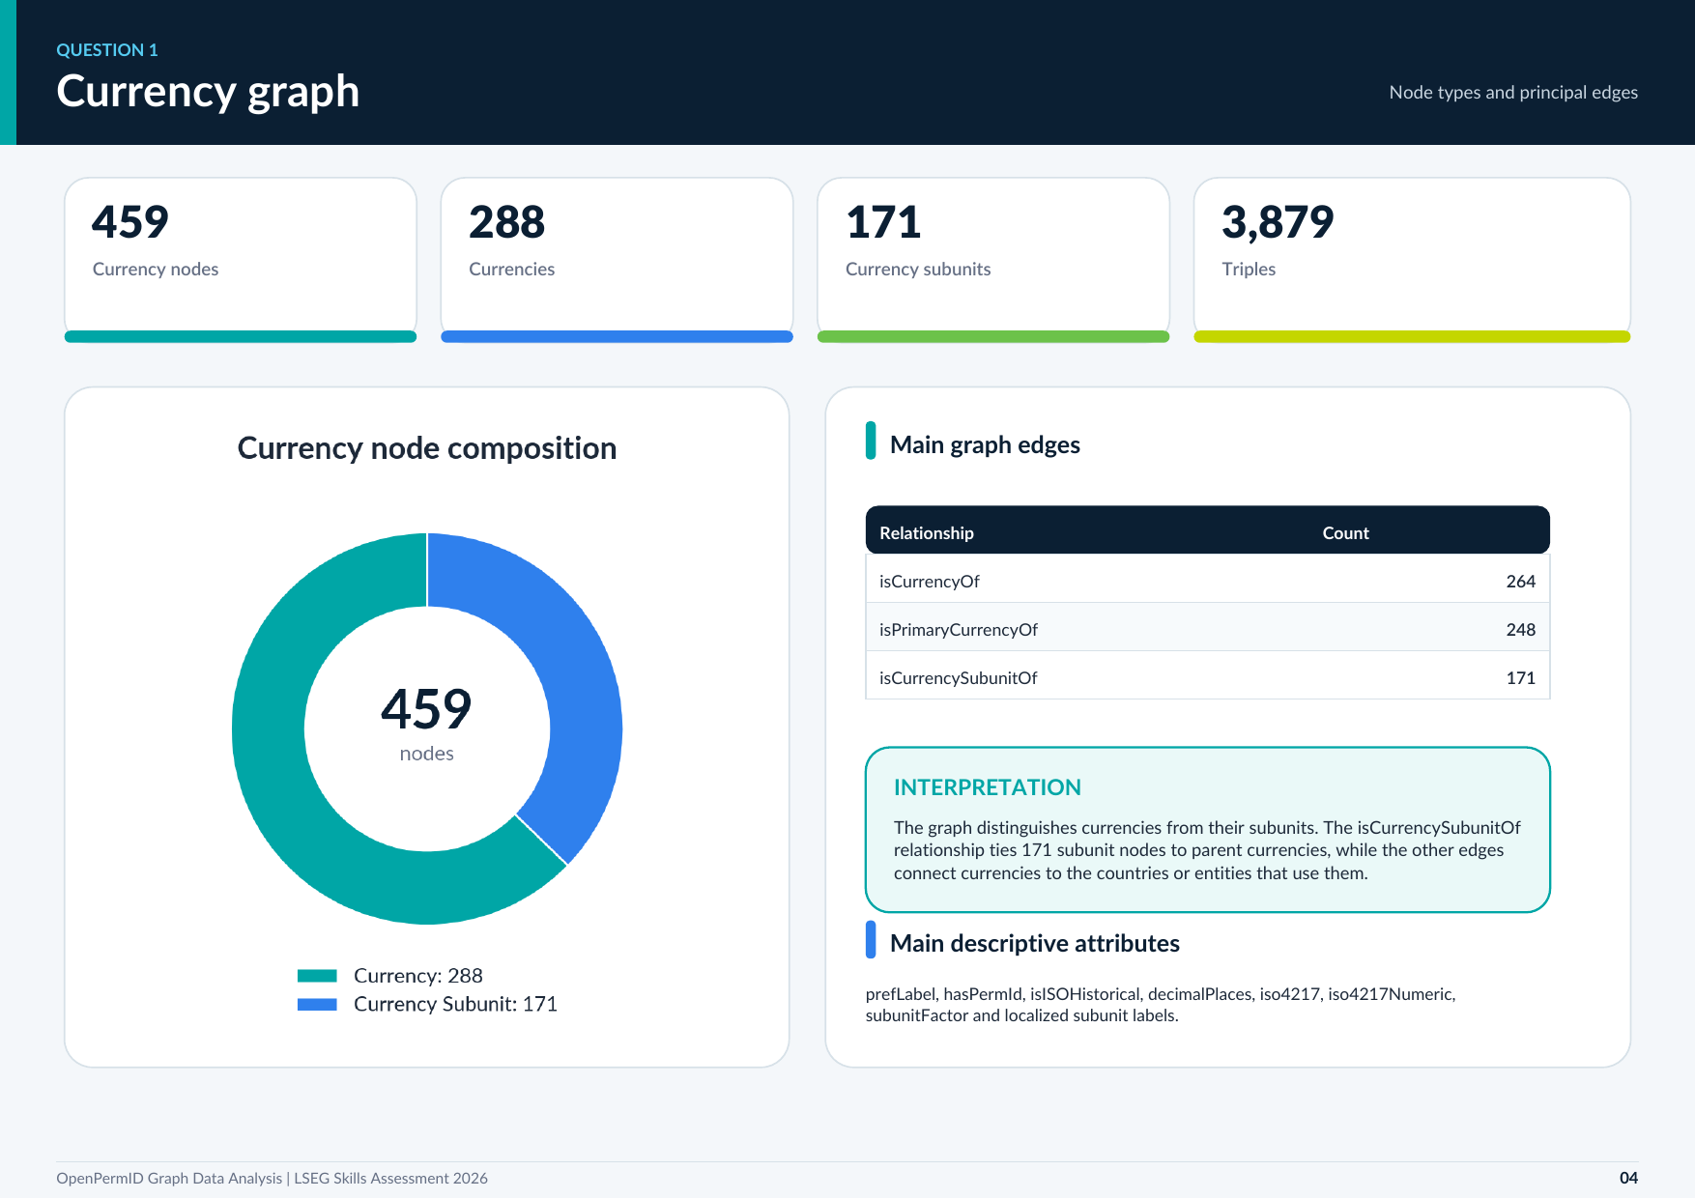
Notes:
Slide 4 from the final LSEG OpenPermID assessment report. Main talk track: explain the graph-analysis result shown on this slide clearly and connect it back to the assessment requirement.

Slide 5
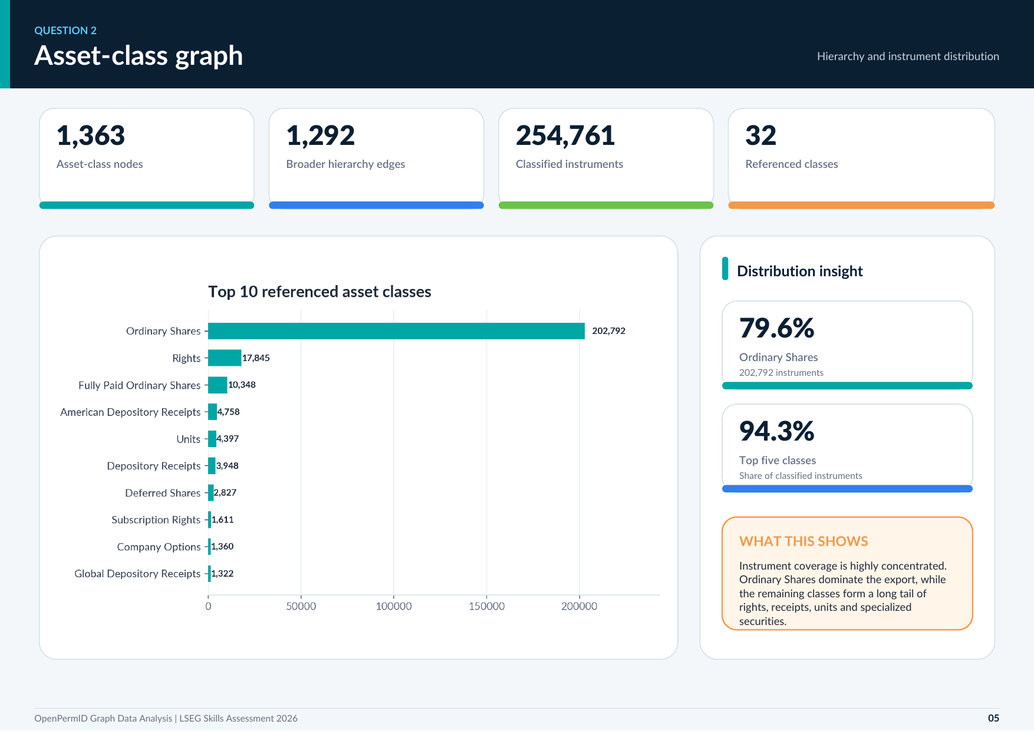
Notes:
Slide 5 from the final LSEG OpenPermID assessment report. Main talk track: explain the graph-analysis result shown on this slide clearly and connect it back to the assessment requirement.

Slide 6
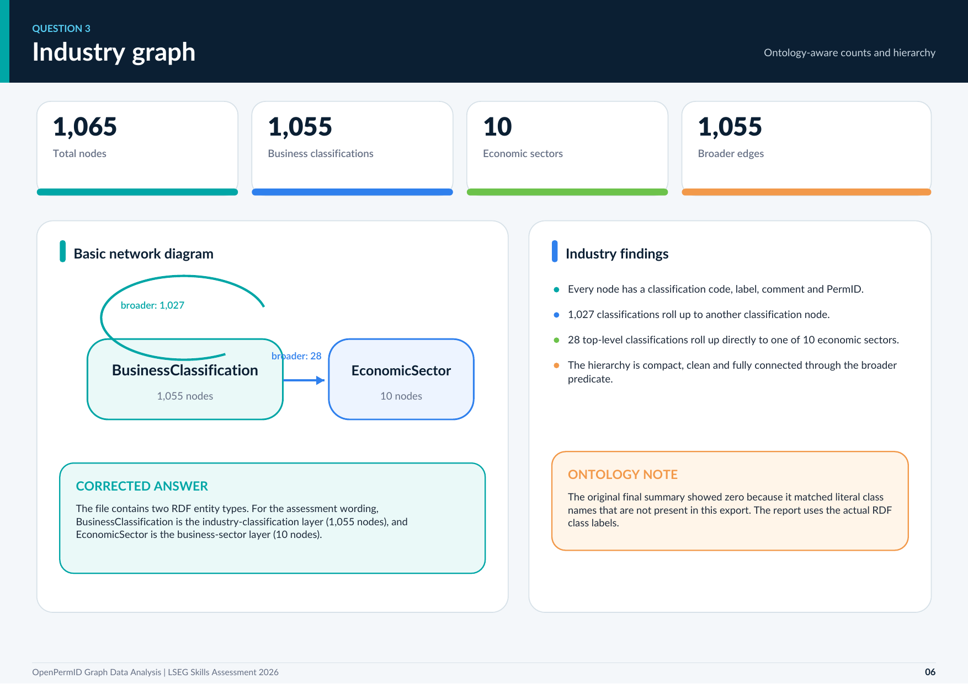
Notes:
Slide 6 from the final LSEG OpenPermID assessment report. Main talk track: explain the graph-analysis result shown on this slide clearly and connect it back to the assessment requirement.

Slide 7
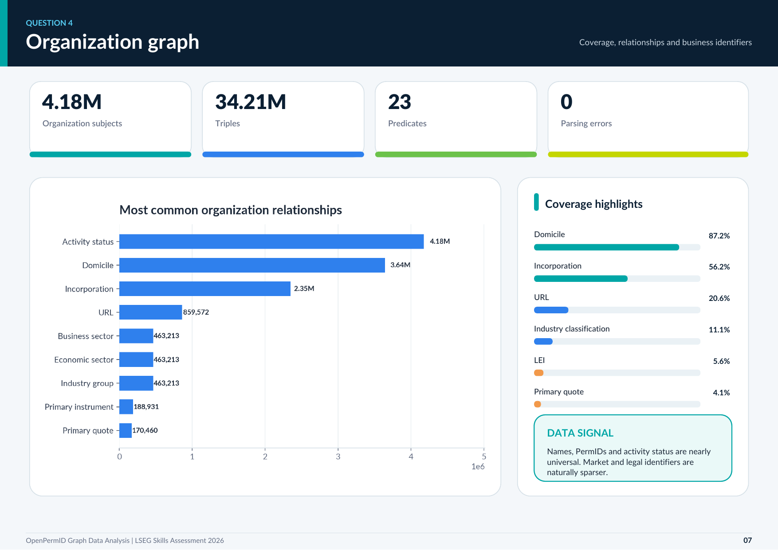
Notes:
Slide 7 from the final LSEG OpenPermID assessment report. Main talk track: explain the graph-analysis result shown on this slide clearly and connect it back to the assessment requirement.

Slide 8
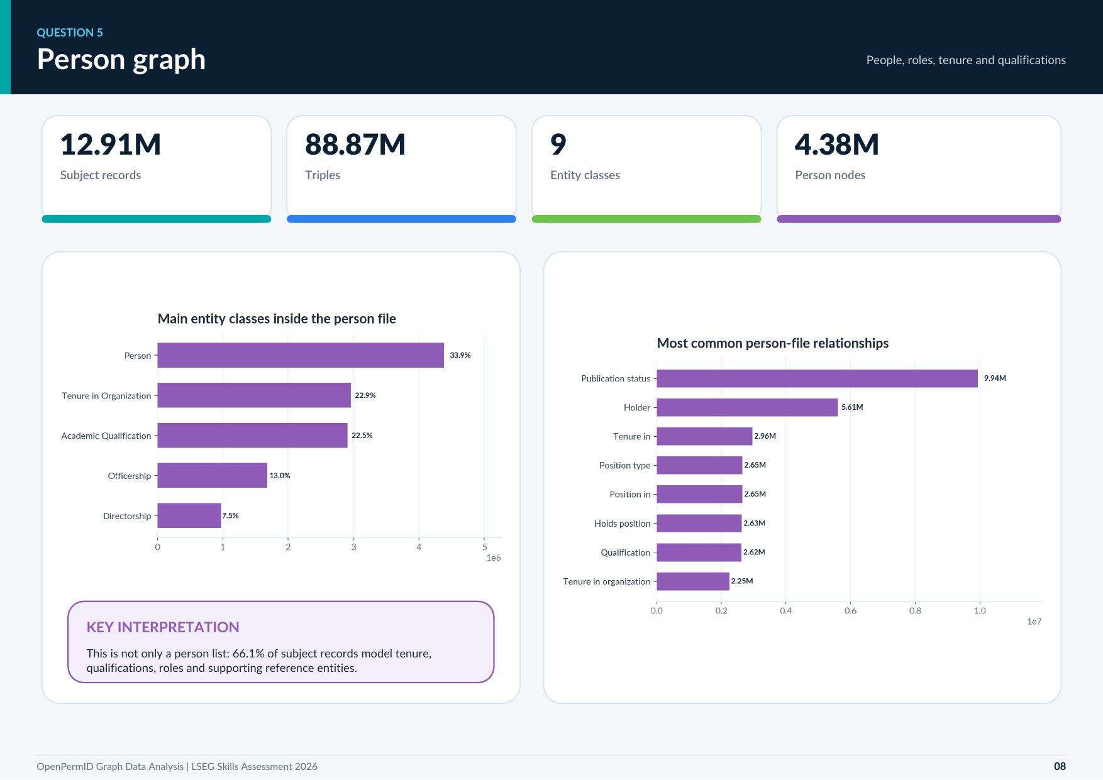
Notes:
Slide 8 from the final LSEG OpenPermID assessment report. Main talk track: explain the graph-analysis result shown on this slide clearly and connect it back to the assessment requirement.

Slide 9
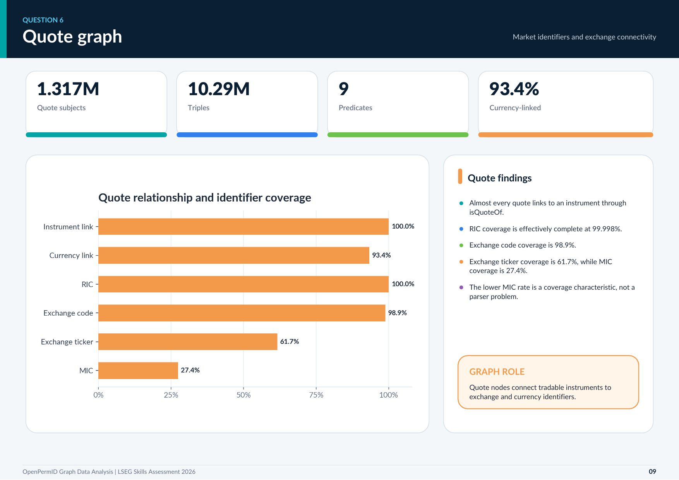
Notes:
Slide 9 from the final LSEG OpenPermID assessment report. Main talk track: explain the graph-analysis result shown on this slide clearly and connect it back to the assessment requirement.

Slide 10
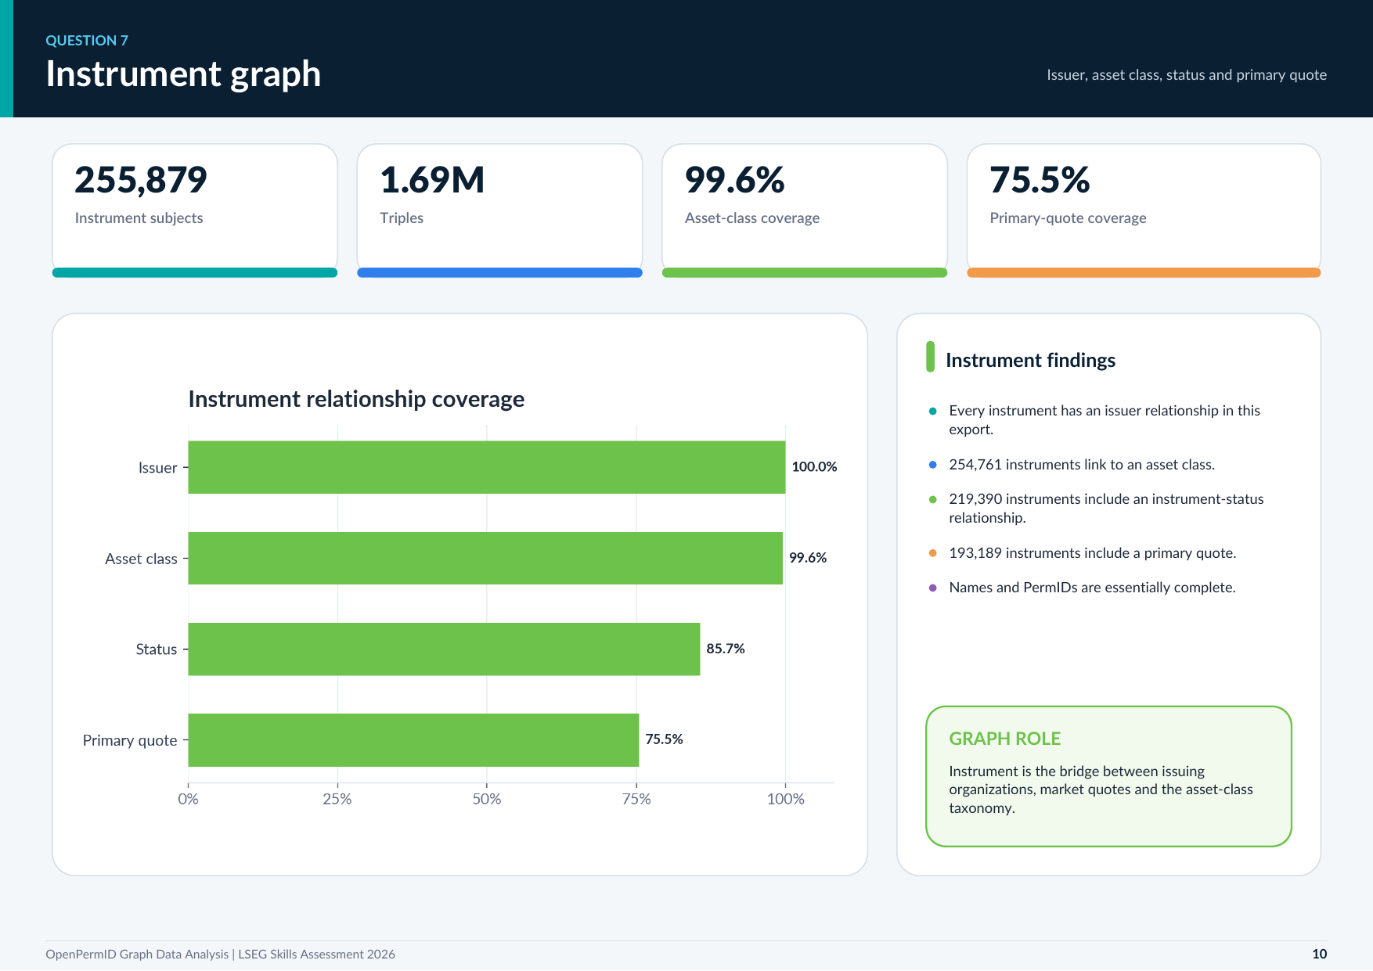
Notes:
Slide 10 from the final LSEG OpenPermID assessment report. Main talk track: explain the graph-analysis result shown on this slide clearly and connect it back to the assessment requirement.

Slide 11
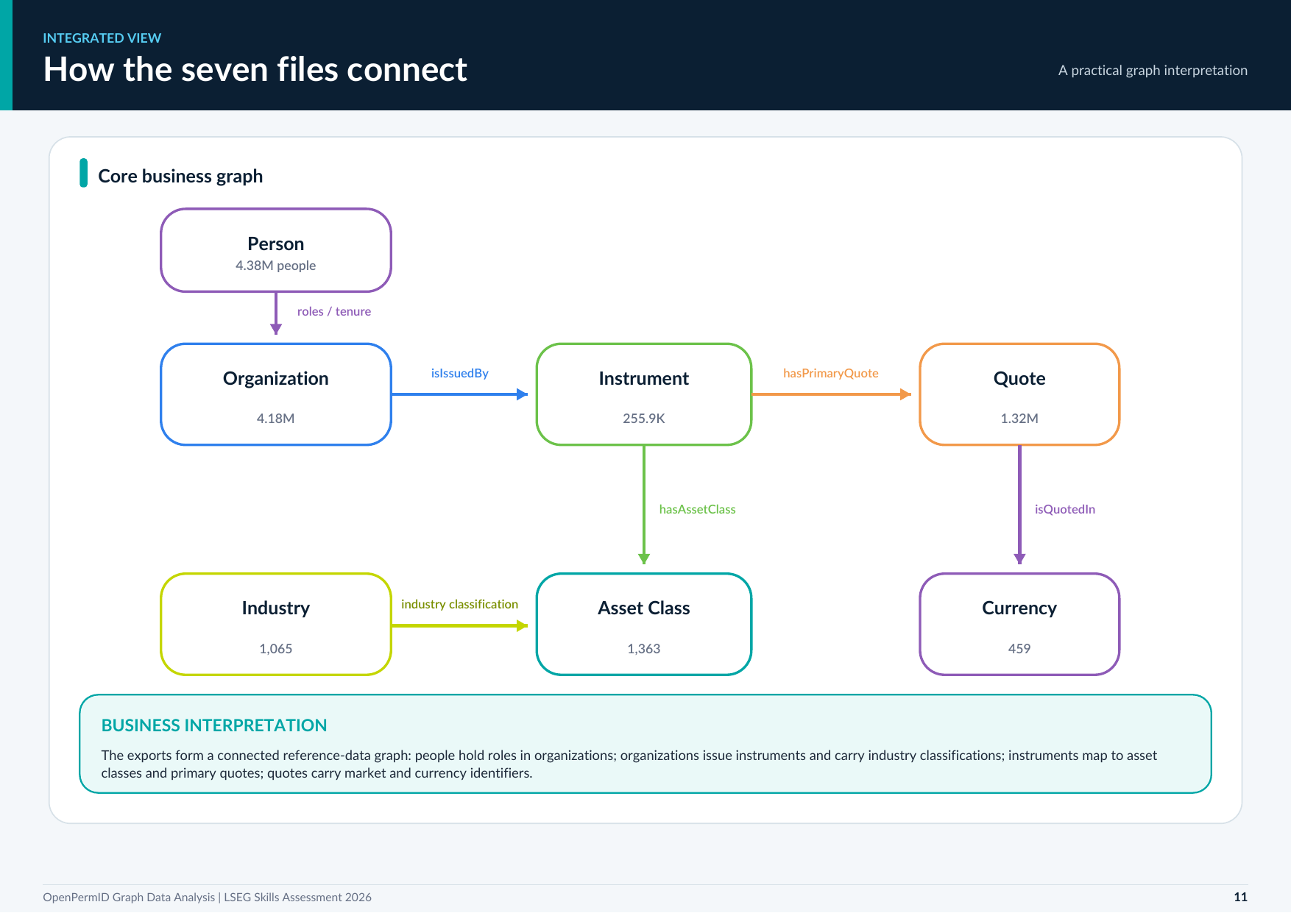
Notes:
Slide 11 from the final LSEG OpenPermID assessment report. Main talk track: explain the graph-analysis result shown on this slide clearly and connect it back to the assessment requirement.

Slide 12
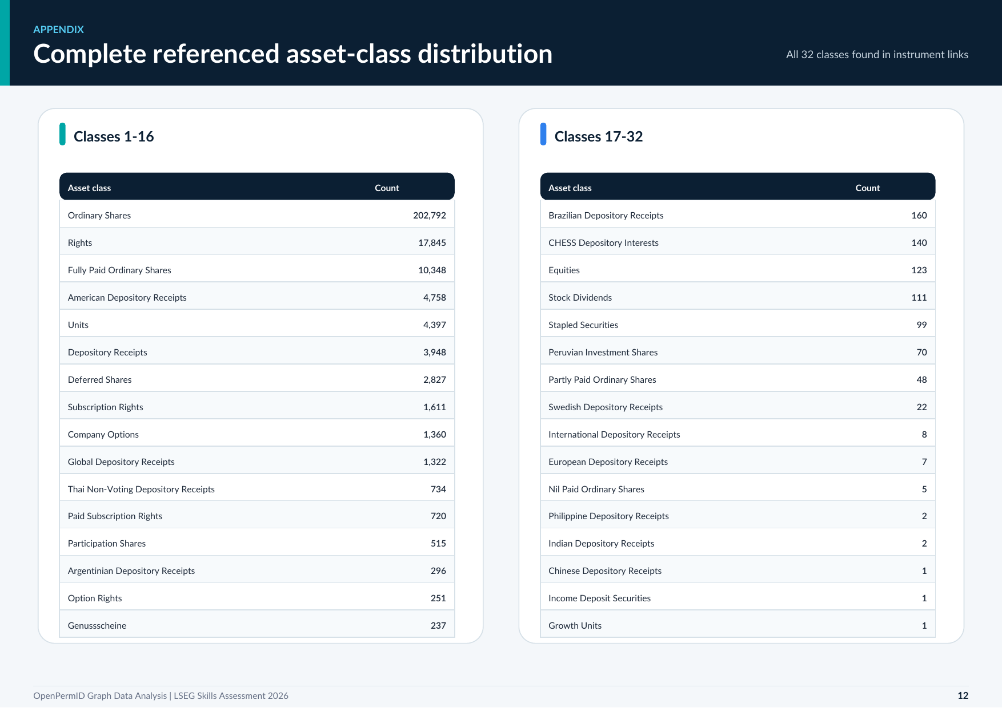
Notes:
Slide 12 from the final LSEG OpenPermID assessment report. Main talk track: explain the graph-analysis result shown on this slide clearly and connect it back to the assessment requirement.

Slide 13
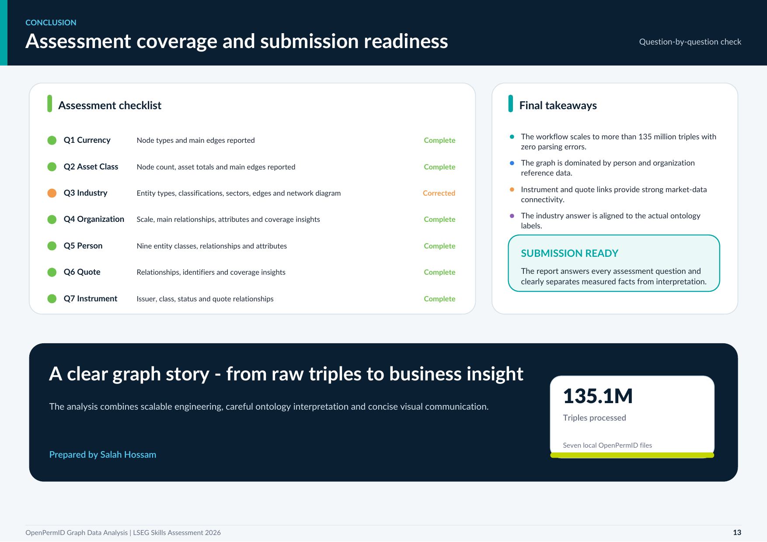
Notes:
Slide 13 from the final LSEG OpenPermID assessment report. Main talk track: explain the graph-analysis result shown on this slide clearly and connect it back to the assessment requirement.

