Slide 1

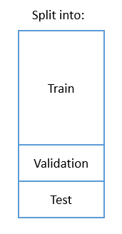
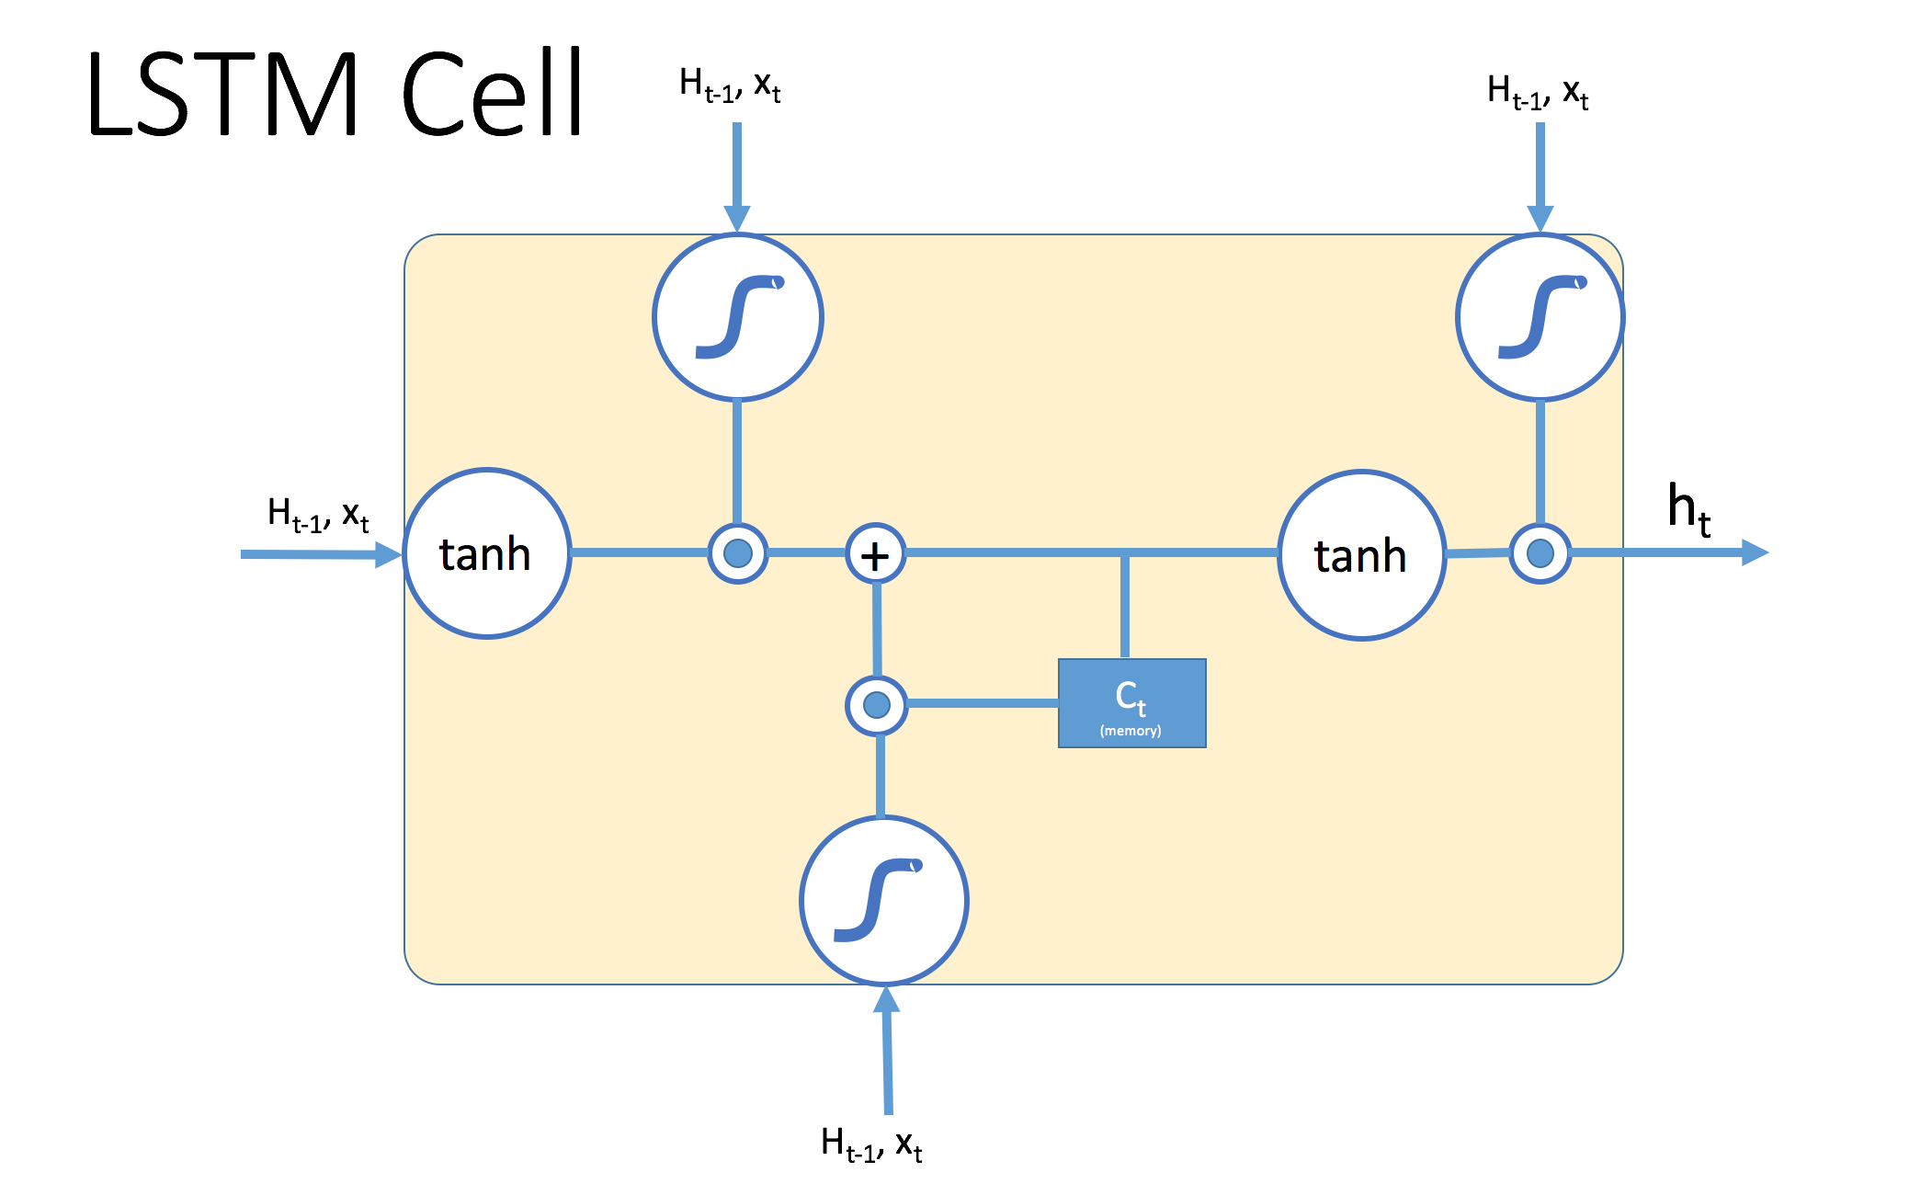
Information Retrieval and Data Mining
Music recommendation engine using Recurrent Neural Networks
Fahad Syed
Avishkar Bhoopchand
Hipolito Iturraspe
Idea
  For each playlist:
  Reset RNN memory
  Feed song sequence into RNN and get prediction
  Compare prediction to actual song using loss functions
  Update model parameters using a variation of Stochastic Gradient Descent
User plays a song → what track should be recommended next? → How should the playlist be set up?
The problem has a temporal component → well suited for Recurrent Neural Networks
Dataset
Song 1
Song 2
Song 3
Input Sequence
Song 1
Song 2
Song 3
Song 4
Embedding Lookup
Embedding Lookup
Embedding Lookup
LSTM/GRU Cell
LSTM/GRU Cell
LSTM/GRU Cell
Initial
Memory
Song 1
Song 2
Song 3
Softmax
Softmax
Softmax
Song 1
Song 2
Song 3
Song 4
Prediction
Prediction
Prediction
Probability distributions
for recommendations
Song 1
Song 2
COMPARE
Compare predictions with targets
Update model parameters with
Backpropagation
Song 2
Song 3
Song 4
Target Sequence
  17.5m songs (track name, artist name) played by 360k users
  Time-stamped
  Metadata on users available: gender, age, country
  Reference to MusicBrainz database for metadata on artists and tracks
Model Validation
Run some baseline models on the same dataset and compare results with our model’s → Use evaluation metrics
Prediction accuracy → see if the next item that the user used is in the top recommended items.
Distance from top → RMSE
Top 5/10 songs → zero-one loss if song appears there
Training
Evaluating is a hard task → user does not listen to song does not imply that recommendation was wrong!
Problems
Important metrics are hard to measure offline, user trust, scalability, novelty and serendipity.
  Fit model parameters to the data → lots of parameters needed for a deep Neural Network!
  Group data by user (and potentially by date) to derive sessions/playlists.
  Map (artist, track) to a unique ID (data can be represented with one-hot encoding)
  Split data into train, validation and test sets
Input: User’s sequence of songs
Song 1
Song 2
Song 3
Song 4
Multiple of these layers
Target: User’s sequence of songs offset by 1
Song 2
Song 3
Song 4
Possible Extension
  User and song metadata available → could this data be incorporated into the model (content-based recommendations) to improve these recommendations?

