Slide 1


Detection of neurodegenerative diseases by the automatic analysis of handwriting
People's Democratic Republic of Algeria Ministry of National Education
Faculty of exact sciences and natural and life sciences
Department of Math and computer science
Master’s thesis In computer science - Systems and Multimedia (SYM)
2021/2022
Presented by:
Habes Salad Eddine
Infront of jury members:
Dr. Mekhaznia. T | President (MCA)
Mr. Abbes. F | Examiner (MCB)
Dr. Bennour. A | Thesis supervisor
Mr. Zemmar. A | Co-supervisor

Slide 2
Summary
In this presentation:
Introduction
Training concepts
Used Datasets
State of the art
Contributions
Results showcase and discussion

Slide 3
Introduction
Neurodegenerative diseases is a serious issue that encompasses a wide range of incurable disorders. However, if diagnosed early, can have their symptoms mitigated.
Modern day healthcare has greatly benefited from machine learning and other health informatics (HIT)
In this research, we focused on: The detection of Parkinson’s disease though the automatic analysis of offline hand-drawing tasks.

Slide 4
Introduction:
Neurodegenerative diseases
Definition : the progressive loss of structure or function of neurons
Incurable but can be mitigated if diagnosed early
Predominantly affect the elderly
types
Dementias: affects cognitive functions.
e.g:
- Alzheimer's disease
- Parkinson's disease
late stages
…
Ataxias: affects movement.
e.g:
- Multiple Sclerosis
- Parkinson's disease
early stages
…
2007 UN report showed:
  1 billion worldwide (1 in 6) afflicted.
  6.8 million deaths a year.

Slide 5
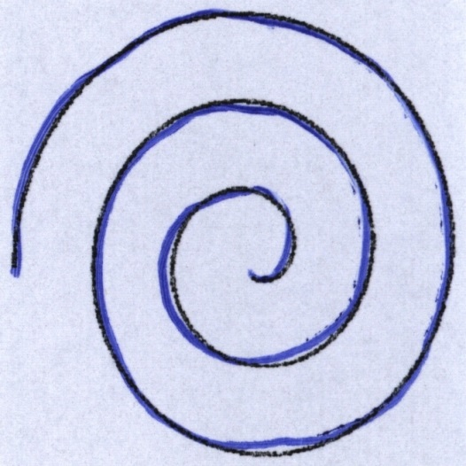
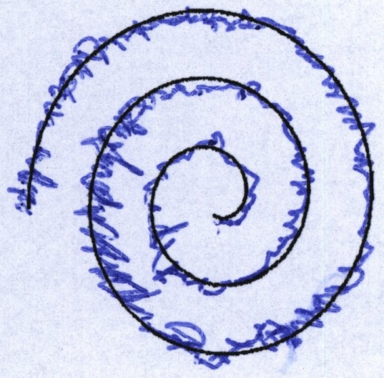
Introduction:
Parkinson’s disease
Long-term degenerative disorder
10 million people worldwide living with PD
Mainly affects the motor system ( motor discoordination )
Symptoms: Tremor, rigidity, slowness of movement.
Greatly affects Handwriting (Micrographia)
Healthy Spiral
PD Spiral

Slide 6
Introduction:
Parkinson’s disease
: Conventional diagnosis
Conventional PD diagnosis procedure:
  Gait analysis (motion study)
  Brain Imaging
  Bio sensors
  Medical history analysis
  Long term observations
Suitable for late detection
  the need for early detection techniques → Handwriting analysis

Slide 7
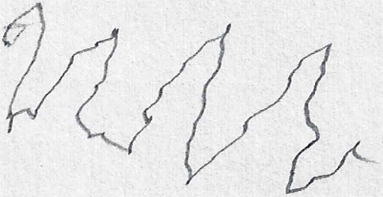
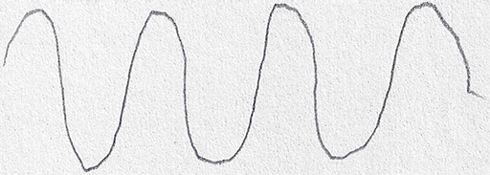
Introduction:
Parkinson’s disease
: Micrographia
A PD symptom
Characterized by:
  Abnormally small handwriting
  Fluctuating writing baseline
  Noticeable jitter
  Slowness
Healthy wave
PD patient wave

Slide 8
Used Datasets
3 Datasets:
  HandPD (Pereira et al. 2016)
  NewHandPD (Papa et al. 2016)
  Parkinson’s drawings (Zham et al. 2017)
Drawings tasks
Pre-segmented

Slide 9
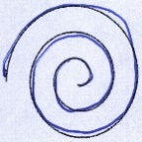

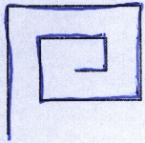
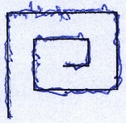
Used Datasets
: HandPD
92 individual (18N, 74P)
Each tasked with drawing:
  4 Spirals
  4 Meanders
736 total samples
HandPD spirals e.g.
HandPD meanders e.g.
Notes:
NewHandPD has Pressure data (not used)

Slide 10
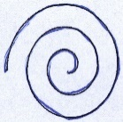
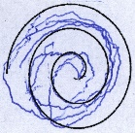
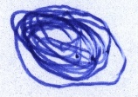
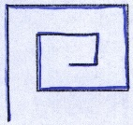
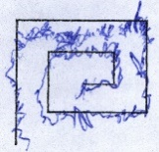
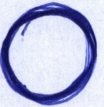
Used Datasets
: NewHandPD
66 individual (35N, 31P)
Each tasked with drawing:
  4 Spirals
  4 Meanders
  1 Circle on-paper
  1 Circle in-air
599 total samples
NewHandPD spirals e.g.
NewHandPD meanders e.g.
NewHandPD circles e.g.

Slide 11
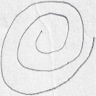
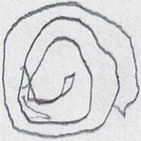

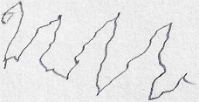
Used Datasets
: Parkinson’s drawings
55 individual (28N, 27P)
Each tasked with drawing:
  2 Spirals
  2 Wave patterns
204 total samples
Parkinson’s drawings spirals e.g.
Parkinson’s drawings waves e.g.
Notes:
NewHandPD has Pressure data (not used)

Slide 12
Training Concepts
Training from scratch (Scratched method)
Transfer learning (Fine-tunning)

Slide 13
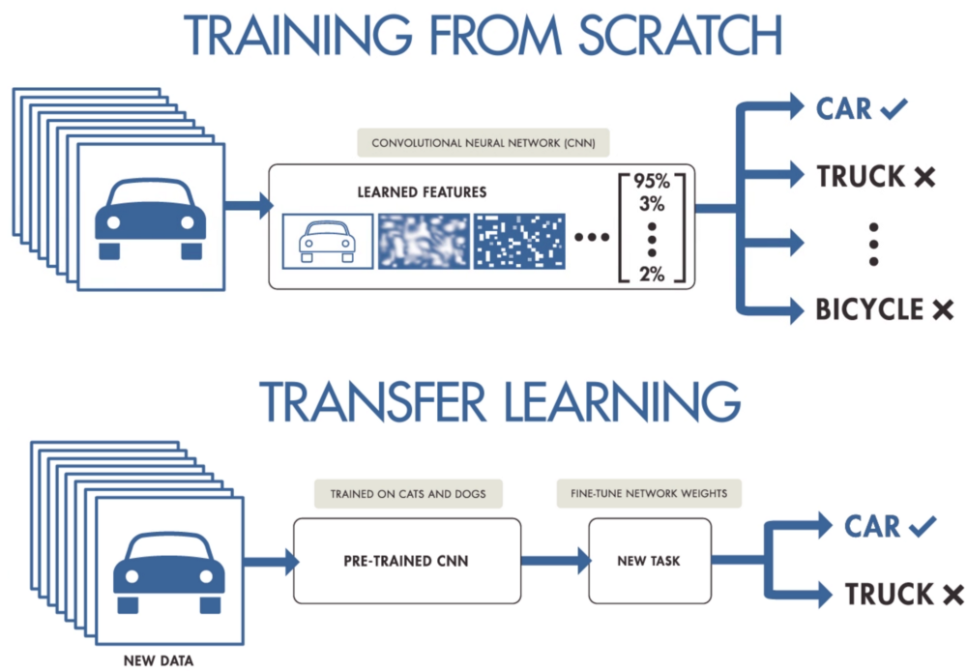
Training Concepts
: Scratched
Weights initialized randomly
Uses PD datasets only
Advantages:
  Better understanding of the CNN
Disadvantages:
  Need a lot of data
  Time consuming

Slide 14
Training Concepts
: Transfer learning
Weights loaded from past trainings
Uses previously acquired knowledge (pre-loaded weights)
Fine-tune the model weights on the new dataset
Advantages:
  Less samples needed for new task
  Quicker training
Disadvantages:
  Less effective when the first dataset is too different from the new task

Slide 15
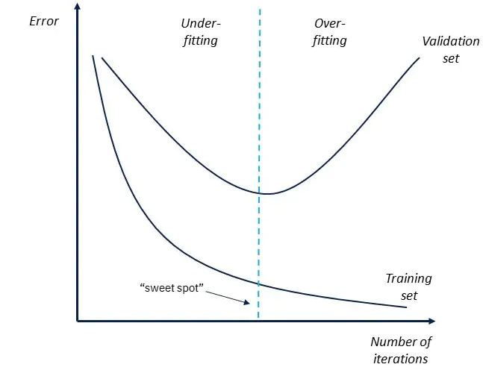
Training Concepts
: Callbacks
Performs certain action(s) at various stages of training
Earlystops
  Stop training when monitored metric stops improving
Checkpoints
  Saves the model mid-training
One of the ways to deal with overfitting
example graph of an Early-stopping in the case of Training-loss vs Validation-loss

Slide 16
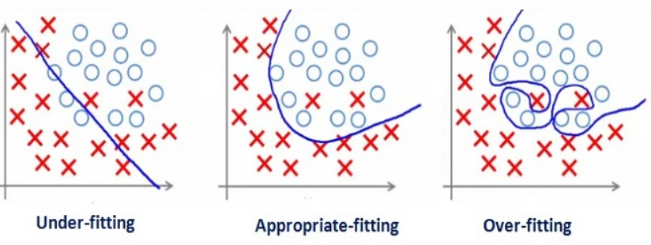
Training Concepts
: Under/Over-fitting:
Under-fitting
  Simple model
  Big dataset
  Too few epochs
Over-fitting
  Complex model
  Small dataset
  Too many epochs
  Both prevent the model from properly generalizing the training dataset.
illustrative graphs displaying the different between Under-fitting, Optimal-fitting, and Over-fitting

Slide 17
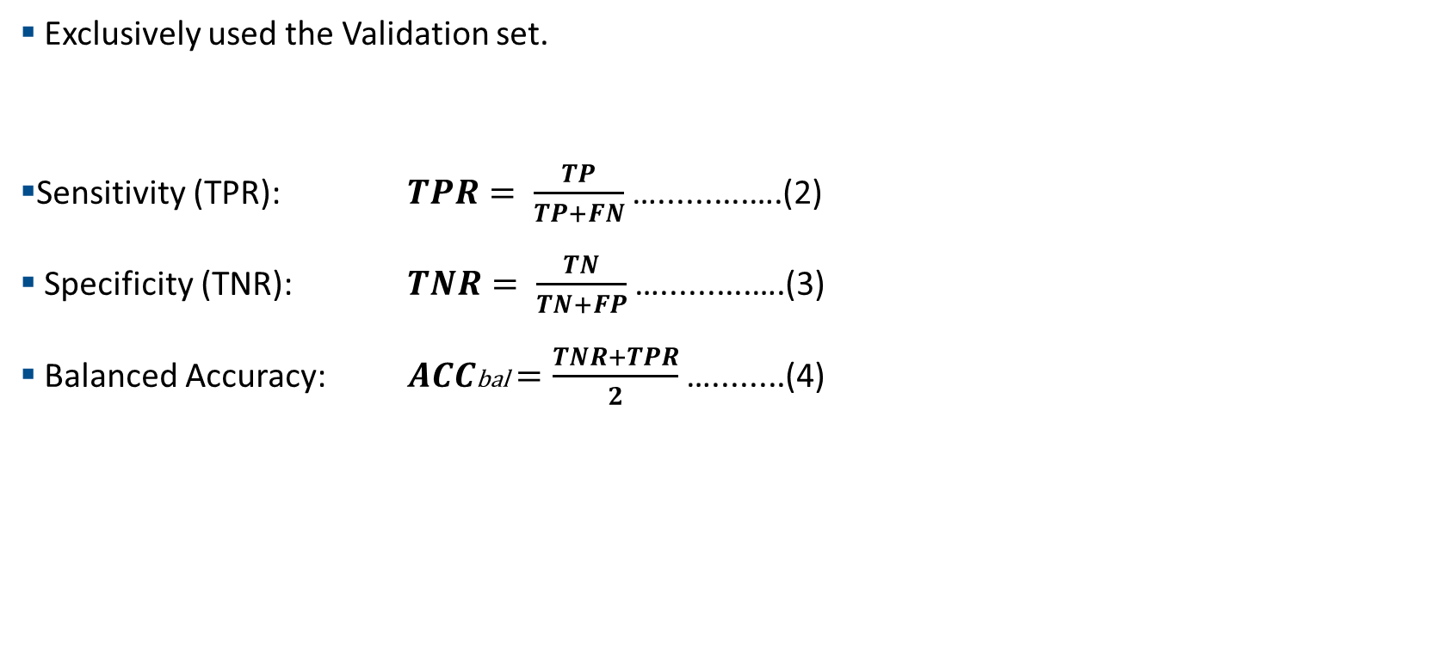
Training Concepts
: Confusion matrix
Exclusively used the Validation set.
Sensitivity (TPR): $TPR= \frac{TP}{TP+FN}$ …..........….(2)
Specificity (TNR): $TNR= \frac{TN}{TN+FP}$ …..........….(3)
Balanced Accuracy: $ACC\text{bal}=\frac{TNR+TPR}{2}$ …........(4)
Binary Classification Confusion matrix
Actual Negative | TN | FN
Actual Positive | FP | TP
 | Predicted as Negative | Predicted as Positive
Notes:
True Positive Rate
True Negative Rate

Slide 18
Training Concepts
: Training Method
  80% training, 20% validation split
  Image Size 244x244
  100 Epochs
  1 EarlyStop: Accuracy (patience = 5)
  3 Checkpoint:
    Validation Accuracy (Max)
    Validation Loss (Min)
    Accuracy (Max)

Slide 19
State of the art
 |  | Year | Dataset | Data type | Approach | Spirals | Meanders | Spirals + Meanders
1 | Pereira et al. | 2016 | HandPD | Offline | Naïve Bayes (NB) SVM | NB 66.37% | SVM 66.72% | SVM 58.61%
2 | Ali et al. | 2019 | NewHandPD | Offline | Chi2 + Adaboost | 72.46% | 78.04% | /
3 | Papa et al. | 2016 | HandPD | Offline + Online | OPF | 83.77% | 84.42% | /
4 | Gazda et al. | 2022 | NewHandPD | Offline | E-CNN | 92.70% | 94.70% | /
Table01: State of the art summary
Other state of the art instances are detailed in “Chapter03: State of the art”

Slide 20


Contributions
Simplify Model
Park-Net
Park-Net SVM
VGG16
(Scratched)
Over-fitting
Transfer-learning
VGG16
(ImageNet)
Augment data
VGG16
(ImageNet)
Park-Net
Research time line

Slide 21
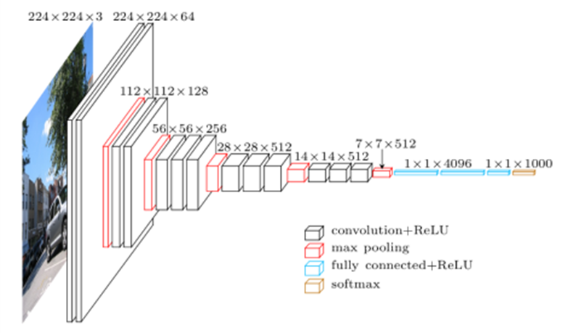
Contributions:
VGG16(ImageNet)
ILSVR 2014 localization task winner.
Pre-trained on imagenet
Fine tuned on the last layer
22 layers:
  13 Conv2D
  5 MaxPooling
  1 flatten
  2 Dense (4096, 4096)
  Sigmoid activation layer
Binary crossentropy as loss function
VGG16 architecture

Slide 22
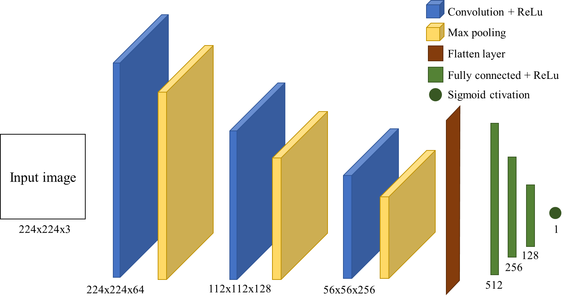
Contributions:
Proposed architecture
: Park-Net
Trained from scratch
11 layers:
  3 Conv2D
  3 MaxPooling
  1 Flatten
  3 Dense
  Sigmoid activation layer
Binary crossentropy loss function
Park-Net architecture

Slide 23
Contributions:
Proposed architecture
: Park-Net SVM
Trained from scratch
Same architecture as Park-Net
Linear activation function
L2 kernel regularizer of 0.01
Hinge loss function

Slide 24
Experimental results
 |  |  |  | VGG16 (ImageNet) | VGG19(ImageNet) | Park-net | Park-net SVM
(a) | HandPD | Case1 | Spirals | 77.74% | 92.86% | 90.45% | 81.31%
 |  | Case2 | Meanders | 67.86% | 62.50% | 83.54% | 87.11%
 |  | Case3 | Spirals + Meanders | 57.15% | 57.15% | 87.86% | 91.67%
(b) | NewHandPD | Case1 | Spirals | 96.43% | 88.22% | 88.22% | 98.00%
 |  | Case2 | Meanders | 89.29% | 53.57% | 86.00% | 96.43%
 |  | Case3 | Circles | 100.00% | 92.86% | 85.72% | 85.72%
 |  | Case4 | Spirals + Meanders | 72.73% | 75.37% | 91.09% | 94.18%
 |  | Case5 | Spirals + Meanders + Circles | 93.49% | 80.16% | 79.12% | 93.15%
(c) | Parkinson's drawings | Case1 | Spirals | 100.00% | 83.34% | 50.00% | 90.91%
 |  | Case2 | Waves | 95.00% | 100.00% | 50.00% | 65.00%
 |  | Case3 | Spirals + Waves | 83.34% | 95.12% | 50.00% | 58.34%
Best achieved result
Only 73 samples
(58 T, 15 V)
102 samples
102 samples
204 samples
Table02: Results table (Balanced accuracy) part01
See page 55 for data splits

Slide 25
Experimental results
 |  |  |  | VGG16 (ImageNet) | VGG19(ImageNet) | Park-net | Park-net SVM
(d) | HandPD + NewHandPD | Case1 | Spirals | 84.53% | 83.93% | 86.31% | 95.24%
 |  | Case2 | Meanders | 53.64% | 50.00% | 93.96% | 94.96%
 |  | Case3 | Spirals + Meanders | 58.42% | 51.58% | 95.35% | 95.87%
 |  | Case4 | Spirals + Meanders + Circles | 66.34% | 58.42% | 92.02% | 93.72%
(e) | All three datasets | Case1 | Spirals | 87.74% | 74.53% | 92.63% | 93.28%
 |  | Case2 | Spirals + Meanders + Circles + Waves | 81.17% | 57.38% | 86.15% | 90.64%
Table03: Results table (Balanced accuracy) part02

Slide 26
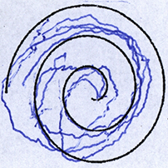
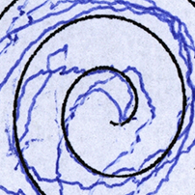
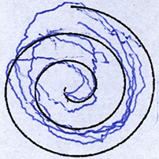
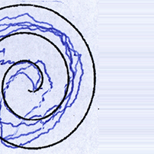
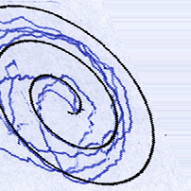
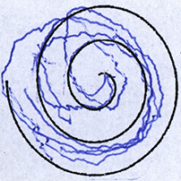
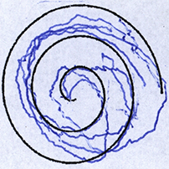
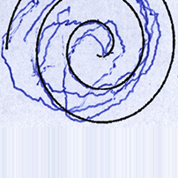
Experimental results
Data augmentation:
  Zoom: 50%
  Rotation: 180%
  Shift: height and width, 50%
  Flip: vertical and horizontal
  Shear: 50%
  Fill mode: nearest.
Original
Zoom
Rotation
Width Shift
Shear
Vertical Flip
Horizontal Flip
Height Shift

Slide 27
Experimental results
Data augmentation:
From Table04 we notice:
  Overall performance did not improve
  Park-net performance decreased bellow that of VGG16
 |  |  |  | VGG16 (ImageNet) | VGG19 (ImageNet) | Park-net | Park-net SVM
(e) | All three datasets | Case1 | Spirals | 83.43% | 78.72% | 73.27% | 82.18%
 |  | Case2 | Spirals + Meanders + Circles + Waves | 88.83% | 69.01% | 80.39% | 84.58%
Table04: Results table (Balanced accuracy) Augmented data

Slide 28
Experimental results
: Comparisons
The HandPD dataset:
 |  | Approach | Spirals | Meanders | Spirals+Meanders
0 | Our work | Park-Net | 90.45% | 83.54% | 87.86%
 |  | Park-Net+SVM | 81.31% | 87.11% | 91.67%
 |  | VGG16 | 77.74% | 67.86% | 57.15%
 |  | VGG19 | 92.86% | 62.50% | 57.15%
1 | Pereira et al. (2016) | Naïve Bayes(NB) SVM | NB 66.37% | SVM 66.72% | SVM 58.61%
2 | Ali et al. (2019) | Chi2+Adaboost | 72.46% | 78.04% | /
Table05: State of the Art comparisons (HandPD)

Slide 29
Experimental results
: Comparisons
The NewHandPD dataset:
 |  | Data type | Approach | Spirals | Meanders
0 | Our work | Offline | Park-Net | 88.22% | 86.00%
 |  |  | Park-Net+SVM | 98.00% | 96.43%
 |  |  | VGG16 | 96.43% | 89.29%
 |  |  | VGG19 | 88.22% | 53.57%
1 | Papa et al. (2016) | Offline + Online | OPF | 83.77% | 84.42%
2 | Gazda et al. (2022) | Offline | E-CNN | 92.70% | 94.70%
Table05: State of the Art comparisons (NewHandPD)

Slide 30
Conclusion
In this research we:
  Conducted a thorough state of the art study.
  Proposed Park-Net and Park-Net SVM.
  Achieved ACC_{bal}=98.00% on the Spiral task of the NewHandPD using Park-Net SVM
Potential improvements:
  Further fine-tuning of the VGG architectures.
  Using VGG in combination with an SVM classifier.
  Testing other CNN architectures.
  Testing our methodology on other disorders.

Slide 31
Thank you.

