Slide 1


Eduflex School Management system Technical Track: .NET web developer supervisor: AST

Slide 2
Team Members
Ahmed Adel Eltantawy Atwa
Mohammed Ashraf Abd-Elmonem Moawad
Salah Ahmed Abdullah Fayyad
Omar Abdullah Elsayed Mohamed
Mariam Mohamed Metwaly Awaad

Slide 3
What is Eduflex?

Slide 4

Overview
EduFlex is a web-based school management system designed to streamline the administrative operations of schools. It includes features for managing students, teachers, courses, attendance, grades, and more. The system will be accessible by administrators only.

Slide 5
Technologies used
ASP.NET Core
MVC
Entity Framework Core & SQL Server
User Authentication and Authorization
Tag Helpers & Razor Pages
Middleware & Dependency Injection

Slide 6
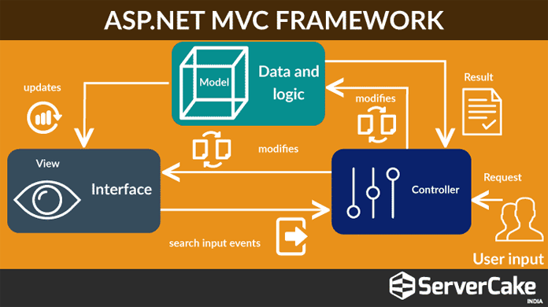

Slide 7
Features and Functionalities
User Authentication and Authorization:
Login & Registration: Secure authentication for admins.
Roles Management: Different access rights for users (admin).

Slide 8
Features and Functionalities
Student, Teacher and Parent Management:
Add/Edit/Delete Students: CRUD functionality to manage student data.
Add/Edit/Delete Teachers: CRUD functionality for teacher management.
Add/Edit/Delete Teachers: CRUD functionality for Parent management.

Slide 9
Features and Functionalities
Courses , Grades and Attendance Management
Course Creation : Ability to create courses, assign teachers, and enroll students.
Managing grading data for students.
Taking attendance data for students.

Slide 10
THANK YOU

