Slide 1
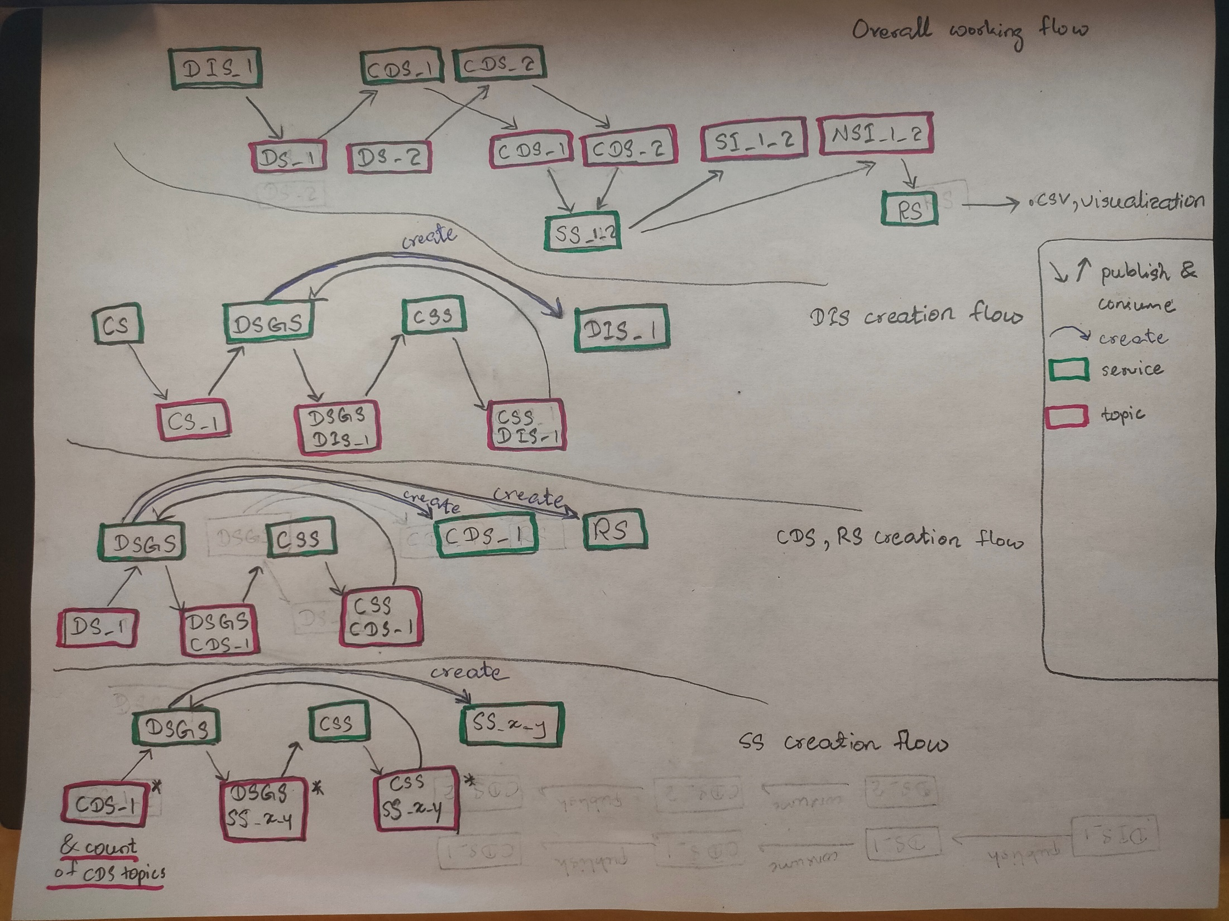

Slide 2
Code Supplier Service 2.0
Software Architecture (SA) - Final Project
Presentation by – Team Avengers
Date: 26th April 2023

Slide 3

Team Members
Asmelash Abrha Guangul
Daniel Aykadu Bogale
Khin Myo Wai
Kidus Desalegn Kebede
Musie Girmatsion Fanuel
Soe Thandar

Slide 4
Agenda
Introductions
Architecture
Class Diagram
APIs
Demo

Slide 5
Introduction : Summary
CSS: Code supplier Service
Responsible for providing the exact code that the Dynamic Service Generator Service (DSGS) requires to compile and execute
3 types of services that need code.
Data Input Service
Change Detector Service,
Scoring Service, and
Reporter Service,

Slide 6

Introduction : Scope
retrieve
CSS Service
call
Creation Service
DSGS Service
create
DIS Service
CDS Service
SS Service
RS Service
publish
consume
Creation topic

Slide 7



Architecture
DSGS Service
(3) Request Source codes
(6) Provide zip
(2) Looks up registry for css service endpoint
localhost:8888
localhost:8085
Config Server
(2) Looks up registry for config service endpoint
REST API
CSS Service
Eureka client
localhost:8080
Eureka client
(1) Register (on startup)
Eureka Server
(5) Prepare
(1) Register (on startup)
(4) Get codes

Slide 8
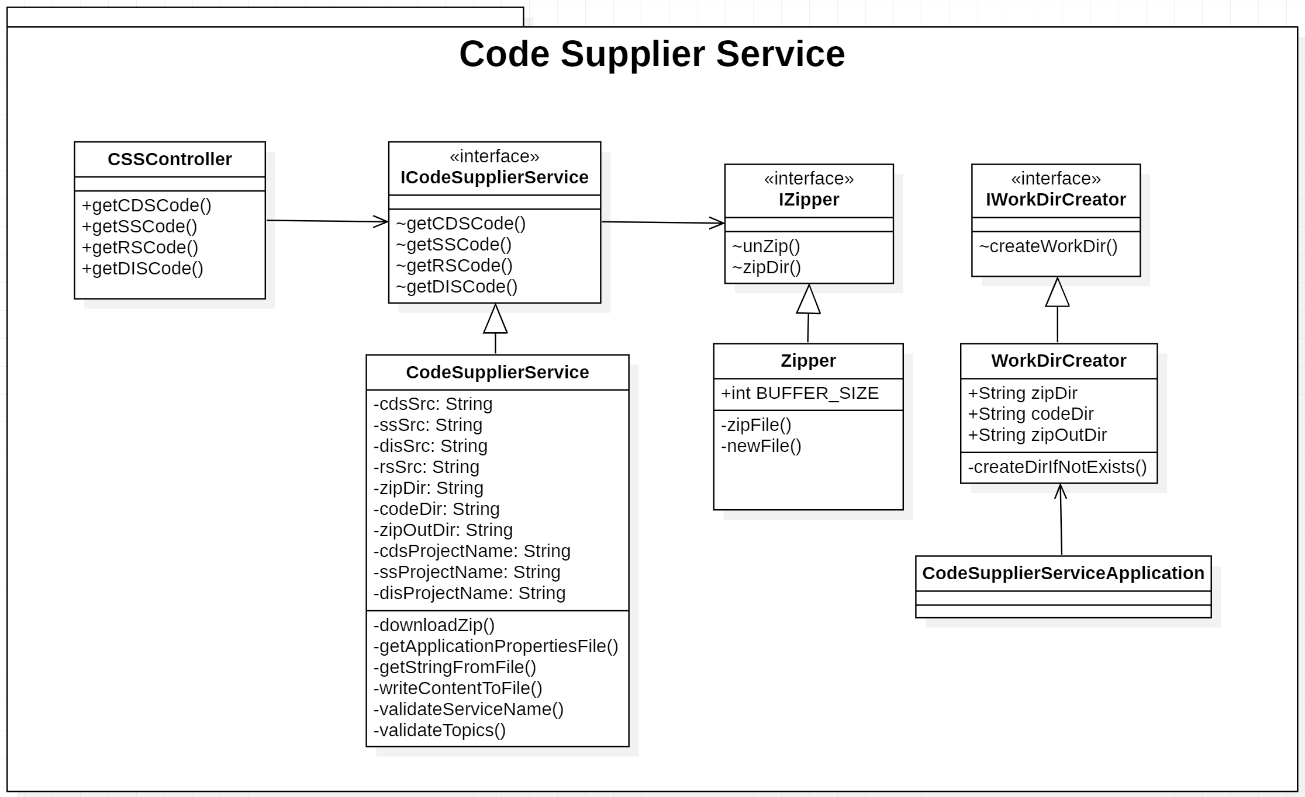
Class Diagram

Slide 9
Change Detector Service Source Code API
Request
Name | Method | Description
/api/v1/sources/cds | GET | Retrieve deployment-ready CDS source codes
Parameter(s)
Name | Data Type | Required/ Optional | Description
topics | String | Required | Value of input topic names

Slide 10
Scoring Service Source Code API
Request
Name | Method | Description
/api/v1/sources/ss | GET | Retrieve deployment-ready SS source codes
Parameter(s)
Name | Data Type | Required/ Optional | Description
topics | String | Required | Value of input topic names

Slide 11
Reporting Service Source Code API
Request
Name | Method | Description
/api/v1/sources/rs | GET | Retrieve deployment-ready RS source codes
Parameter(s)
Name | Data Type | Required/ Optional | Description

Slide 12
Data Input Service Source Code API
Request
Name | Method | Description
/api/v1/sources/dis | GET | Retrieve deployment-ready RS source codes
Parameters
Name | Data Type | Required/ Optional | Description
topics | String | Required | Value of output topic names
interval | String | Required | Value of data publishing interval in millisecond

Slide 13
Demo

Slide 14
THANK-YOU !

