Slide 1

SALAIYUGAPATHI.K
*

Slide 2
MVP REVIEW
INTRODUCTION
SYSTEM SEQUENTIAL DIAGRAM
ENTITTY RELATIONSHIP DIAGRAM
DATABASE CREATION
DESIGNING VIEWS
CREATING AND CONSUMING WEB SERVICES

Slide 3

INTRODUCTION

Slide 4
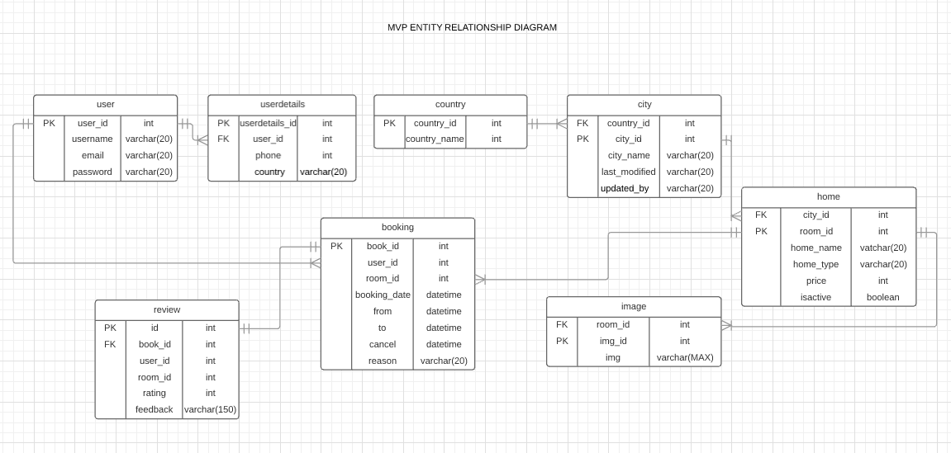
ENTITY RELATIONSHIP DIAGRAM

Slide 5



