Slide 1
EXECUTIVE BRIEF
Fraud Detection & Transaction Risk Scoring
Model performance, risk policy, and production readiness

Slide 2
A rare-event problem demands the right operating metrics
DATA FOUNDATION
Exact duplicates were removed before splitting. Accuracy is de-emphasized in favor of PR-AUC, recall, precision, F1, and alert volume.
284,807
0.17%
473
Raw transactions
Fraud rate after cleaning
Fraud cases after deduplication
2

Slide 3
The pipeline separates learning, policy selection, and operations
LEARN
DECIDE
OPERATE
Train safely
Preprocessing and resampling stay inside the training pipeline.
Select policy
Validation drives model and threshold selection; costs remain configurable.
Prioritize review
Risk scores produce a ranked, human-in-the-loop investigation queue.
3

Slide 4
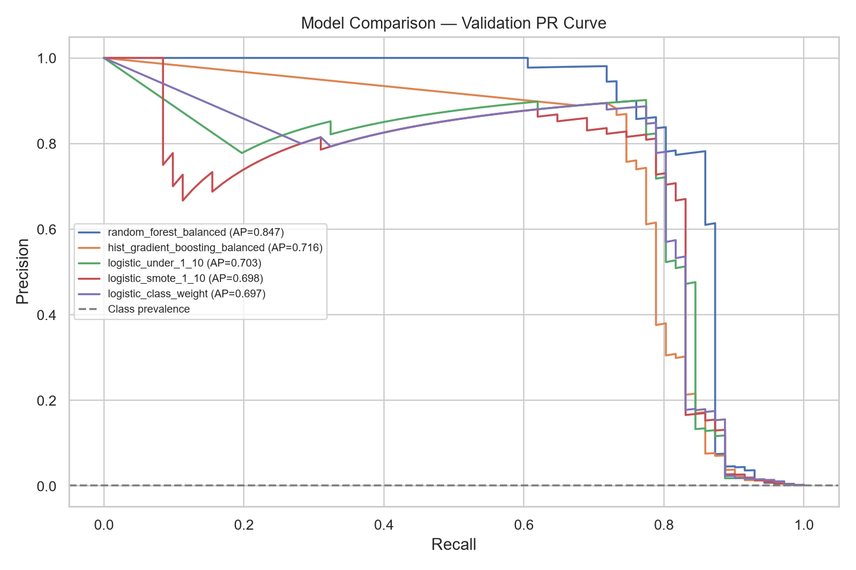
Model performance at a glance
Model search
Class weighting, undersampling, SMOTE, Random Forest, Extra Trees, gradient boosting, XGBoost, LightGBM, CatBoost, and weighted ensembles were compared. Extra Trees produced the best observed holdout F1, while PR curves reveal the precision–recall trade-off hidden by accuracy.
4

Slide 5
The active policy is precise, but it still misses material fraud
ACTIVE EXTRA TREES POLICY
Threshold 0.3783 yields 58 alerts from 42,559 test transactions: 55 true positives, 3 false positives, and 16 false negatives.
94.83%
77.46%
85.27%
Test precision
Test recall
Test F1
5

Slide 6
Risk bands translate model output into review actions
LOW · 0–37.83
Process normally; retain for monitoring and audit sampling.
MEDIUM · 37.83–58.56
Enhanced monitoring and contextual checks.
HIGH · 58.56–79.28
Manual review based on queue capacity.
CRITICAL · 79.28–100
Priority investigation; no automatic decline.
6

Slide 7
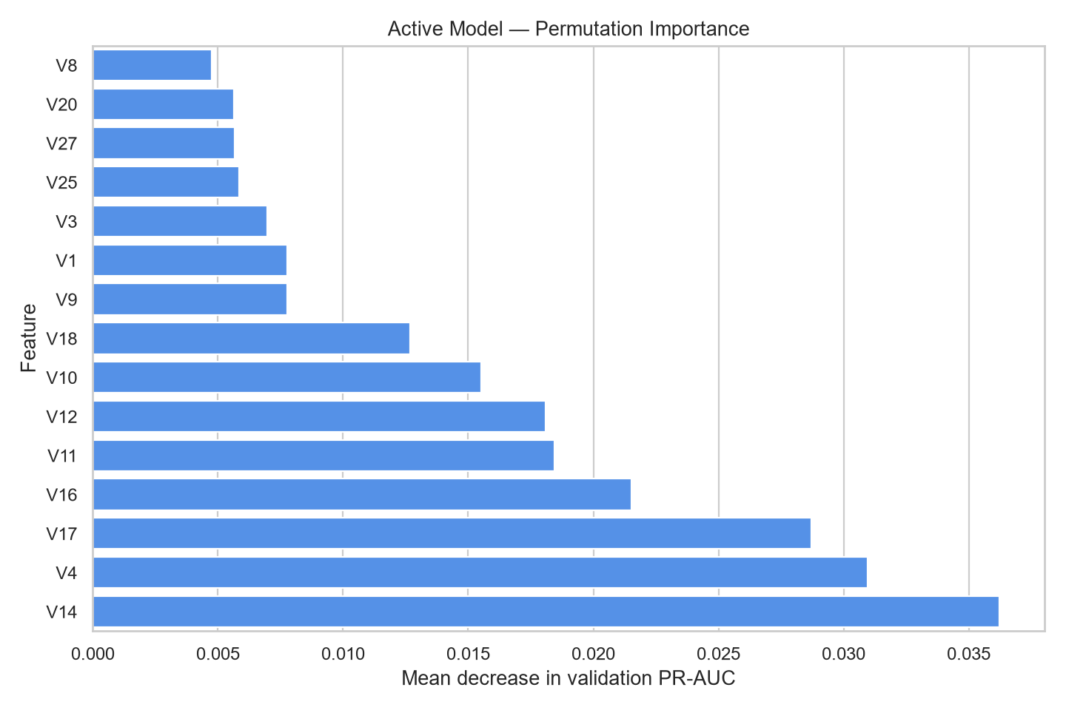
What drives the model score?
Relative importance
Permutation importance ranks V14, V4, V17, V16, V11, V12, and V10 highest. These features support model governance, but anonymous PCA variables cannot provide business-causal explanations.
7

Slide 8
Audit controls improve confidence without overstating performance
Calibration
Sigmoid candidate: test Brier 0.000455; no test F1 uplift.
Pseudo out-of-time
F1 81.72% and PR-AUC 77.77% provide a conservative check.
Provenance
Model ID, SHA-256, split protocol, and threshold are bound together.
Quality gate
14 tests pass, 84% coverage, CI enabled, dashboard smoke-tested.
8

Slide 9
NEXT
Deploy as decision support, not automatic blocking
Future-data validation
Actual cost inputs
Outcome monitoring

