Slide 1
Final Project on Smart Applications in the Master of Software Engineering
Selecting Software Development Team using AI
Supervised by Dr. Wesam Alnabki
Prepared by E. Salam Alkhawwam & E. Amal Al-Khalaf

Slide 2
Project
Idea
Project
Analysis
Similarity and Matching
Team
Selected
Team
Choice Explanation
Analysis + Team + Explanation
Vector DB
(Profiles
Knowledge
Base)
Embedding

Slide 3
Semi-Agentic Architecture
Project Analysis
Agent
Vector DB
(Profiles
Knowledge
Base)
Team
Matching
Agent
Input
Coordinator
Agent
Output
RAG

Slide 4
Python + Fast API + HTML + CSS
Python :
Relies on AI / LLMs / RAG
Rapid Development
Seamless Integration with AI Tools ( LangChain, Hugging Face, and vector databases)
Fast API :
High Performance
Ideal for I/O-bound AI workloads and external model calls.
Strong Data Validation (Type-safe request and response validation using Pydantic)
Developer-Friendly (Minimal boilerplate with clear and readable code)
HTML+CSS :
Lightweight & Fast & Easy to Use
Cross-Browser Compatibility

Slide 5
LLM Orchestration Framework) LangChain(
Flexible LLM Orchestration Framework
Seamless RAG Integration (like Chroma)
Multi-LLM Support
Prompt Management & Experimentation
Agent & Tool Integration
Asynchronous & Scalable
Open-Source & Extensible

Slide 6
Simple Local LLM Runtime
Local LLM Inference Engine ) Ollama(
Open-Source & Free
Fast Development Workflow
Cross-Platform Support
Seamless LangChain Integration & RAG pipelines.
Can be used as a drop-in replacement for OpenAI APIs
Simple Local LLM Runtime (Run LLM locally with a single command)
Zero-Configuration Setup (No Docker, cloud accounts, or complex infrastructure required)
Local-First & Privacy-Friendly (All data and inference stay on the local machine)
Built-in Model Management (Easy download, versioning, and switching between models)

Slide 7
Profile Knowledge Base
Meta Data
ID
Name
Role
Seniority
Years Experience
Availability
Time zone
Languages
Skills
Frameworks
Domains
Tools
Project Types
Summary
Embedding

Slide 8
Query
Meta Data
ID
Name
Role
Seniority
Years Experience
Availability
Time zone
Languages
Skills
Frameworks
Domains
Tools
Project Types
Summary
Embedding

Slide 9
Json
Lightweight and easy to use
No database setup or maintenance required
Human-readable and easy to debug
Flexible schema suitable for evolving data
Ideal for small and static datasets
Fast prototyping and rapid development
Easily integrated with AI pipelines and LLM workflows

Slide 10
Vector DB ( Chroma DB )
Lightweight & Easy to Use & Simple setup
Local-First Design without requiring a separate server
Excellent for Rapid Prototyping & RAG pipelines
Native Integration with LLM Frameworks
Seamless support for LangChain
Persistent Storage
Metadata Filtering Support
Fast semantic search for small to medium-scale datasets
Open-Source & Free
Low Infrastructure Overhead (No need for Docker, Kubernetes, or cloud services)

Slide 11
Embedding Model ( Nomic )
Advantages :
Fast embedding generation
Lightweight & local-friendly
Easy integration with Python & LangChain
Free & open-source
Ideal for small-to-medium projects
Disadvantages :
Lower accuracy than newer models
Limited multilingual support
Not suitable for very large datasets
No built-in fine-tuning support

Slide 12
Embedding Model ( BGE )
Advantages :
High accuracy embeddings
Excellent for semantic search
Handles large datasets efficiently
Multilingual support
Compatible with modern LLM pipelines
Disadvantages :
Requires more computational resources
Slower than lightweight models
Larger model size
Overkill for small-scale projects

Slide 13
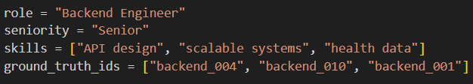
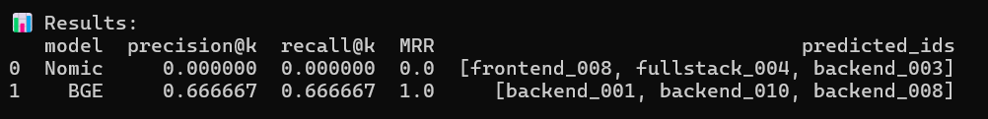
Nomic vs BGE
Evaluation ( precision@k ) - simple 1
Bge-m3

Slide 14
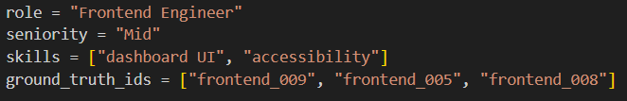
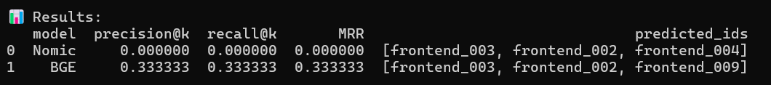
Nomic vs BGE
Evaluation ( precision@k ) - simple 2
Bge-m3

Slide 15
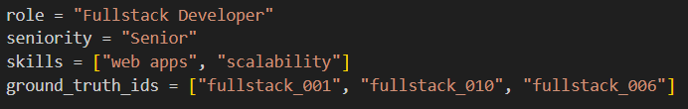
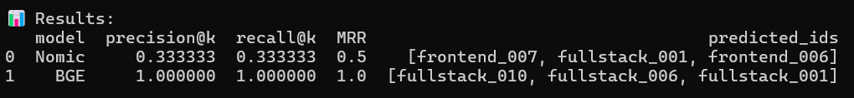
Nomic vs BGE
Evaluation ( precision@k ) - simple 3
Bge-m3

Slide 16
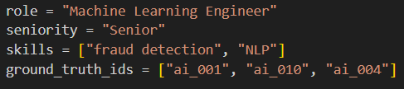
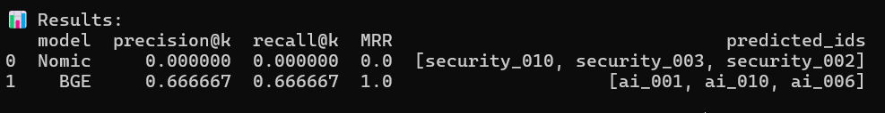
Nomic vs BGE
Evaluation ( precision@k ) - simple 4
Bge-m3

Slide 17
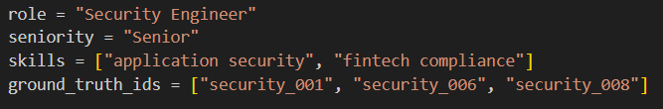
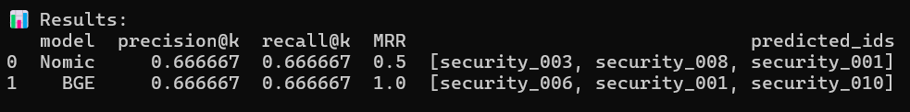
Nomic vs BGE
Evaluation ( precision@k ) - simple 5
Nomic + Bge-m3

Slide 18
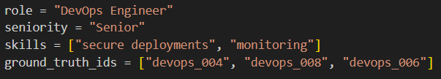
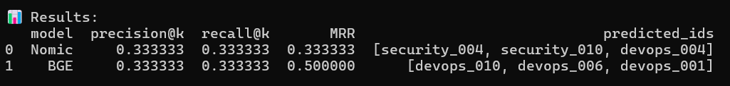
Nomic vs BGE
Evaluation ( precision@k ) - simple 6
Nomic + Bge-m3

Slide 19
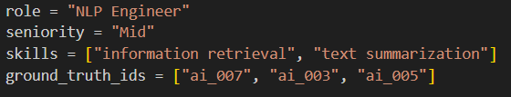
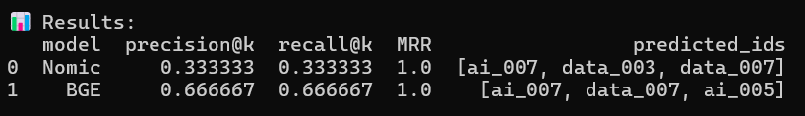
Nomic vs BGE
Evaluation ( precision@k ) - simple 7
Bge-m3

Slide 20
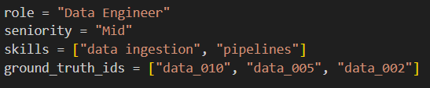
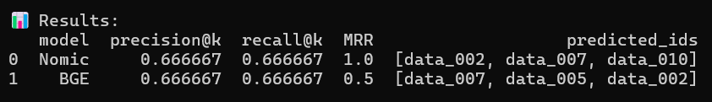
Nomic vs BGE
Evaluation ( precision@k ) - simple 8
Nomic + Bge-m3

Slide 21
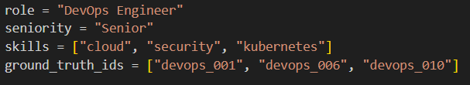
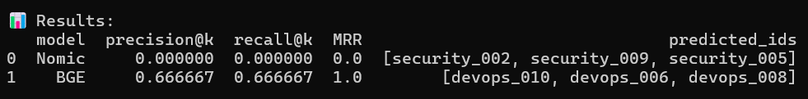
Nomic vs BGE
Evaluation ( precision@k ) - simple 9
Bge-m3

Slide 22
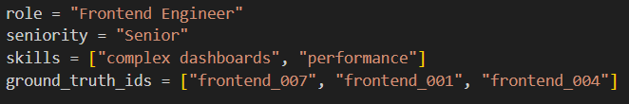
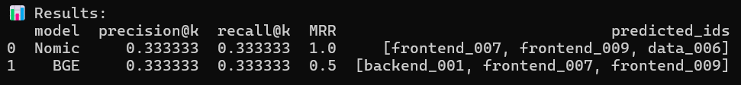
Nomic vs BGE
Evaluation ( precision@k ) - simple 10
Nomic + Bge-m3

Slide 23
Nomic vs BGE
Evaluation ( precision@k ) - 10 simples :
precision@k (10 simples) – nomic : 0.24
precision@k (10 simples) – bge-m3 : 0.55
Bge-m3
BGE model is more accurate than Nomic model

Slide 24
LLM ( llama3-7B )
Advantages :
Open-source and locally usable
Lightweight relative to larger LLaMA models
Excellent general language understanding
Compatible with RAG frameworks (LangChain, ChromaDB)
Disadvantages :
Lower accuracy than larger models in complex tasks
Requires moderate GPU resources
Limited multilingual performance without further training

Slide 25
LLM ( Mistral )
Advantages :
Excellent semantic understanding & text generation
Faster than comparable LLaMA models
Lightweight and local-friendly with quantization
Open-source and integrates well with RAG pipelines
Good multitask performance across general tasks
Disadvantages :
Less fine-tuning support than LLaMA ecosystem
Requires modern GPU for smooth inference
Responses can be less controlled in certain prompts

Slide 26
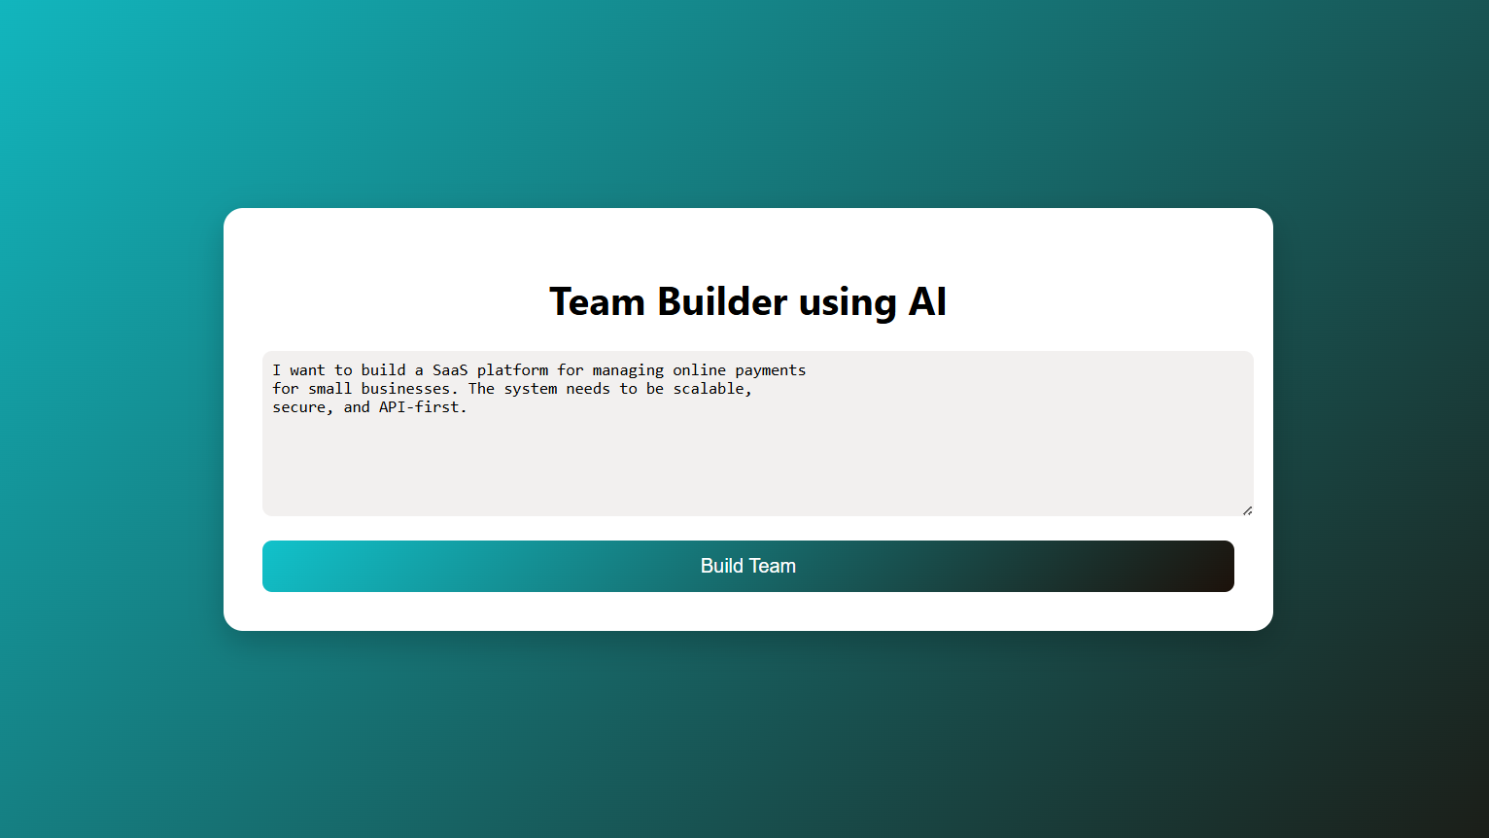
Llama3 LLM : 5 Min
Embedding Model : BGE

Slide 27
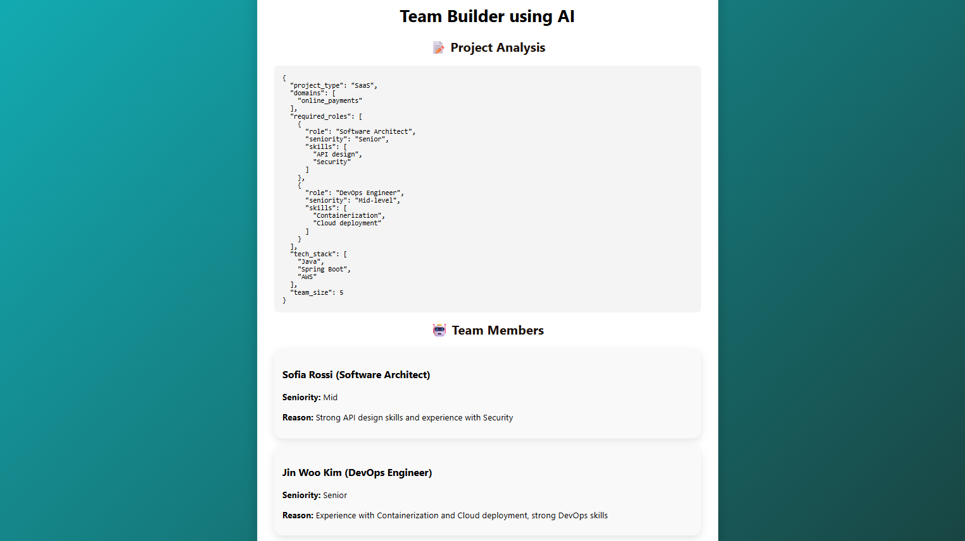

Slide 28
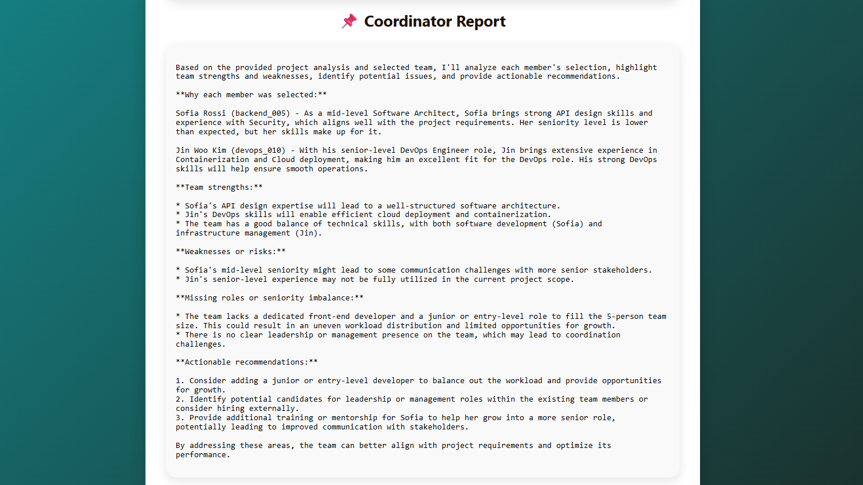

Slide 29
Mistral LLM : 8 Min
Embedding Model : BGE

Slide 30
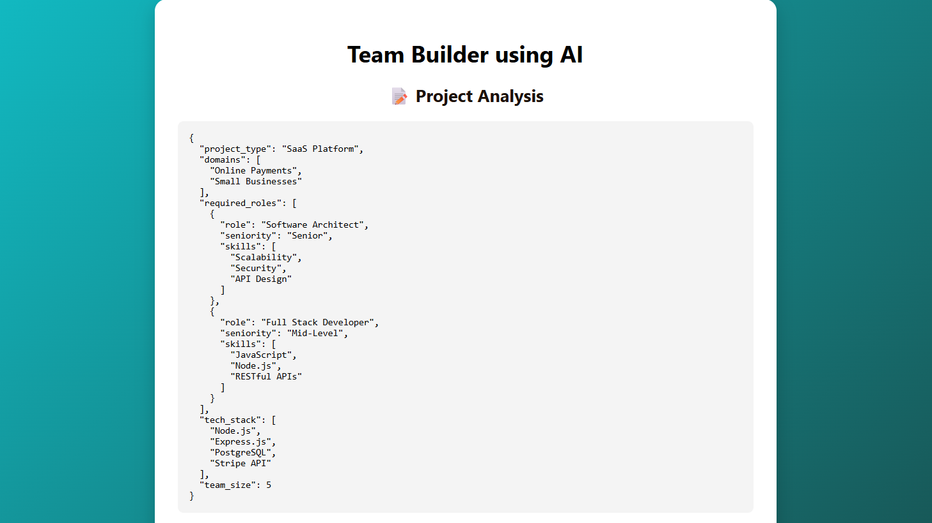

Slide 31
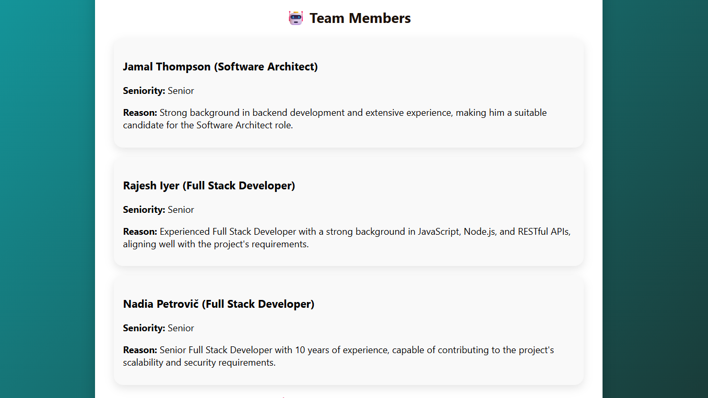

Slide 32
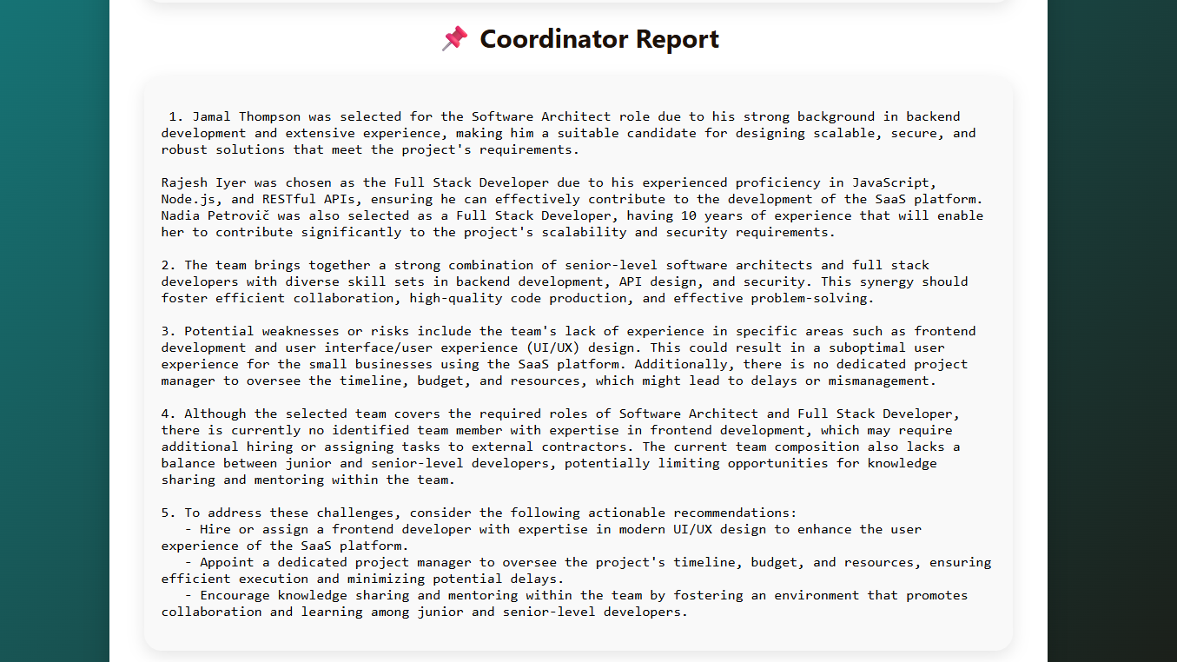

Slide 33
Llama3 LLM : 6 Min
Embedding Model : Nomic

Slide 34
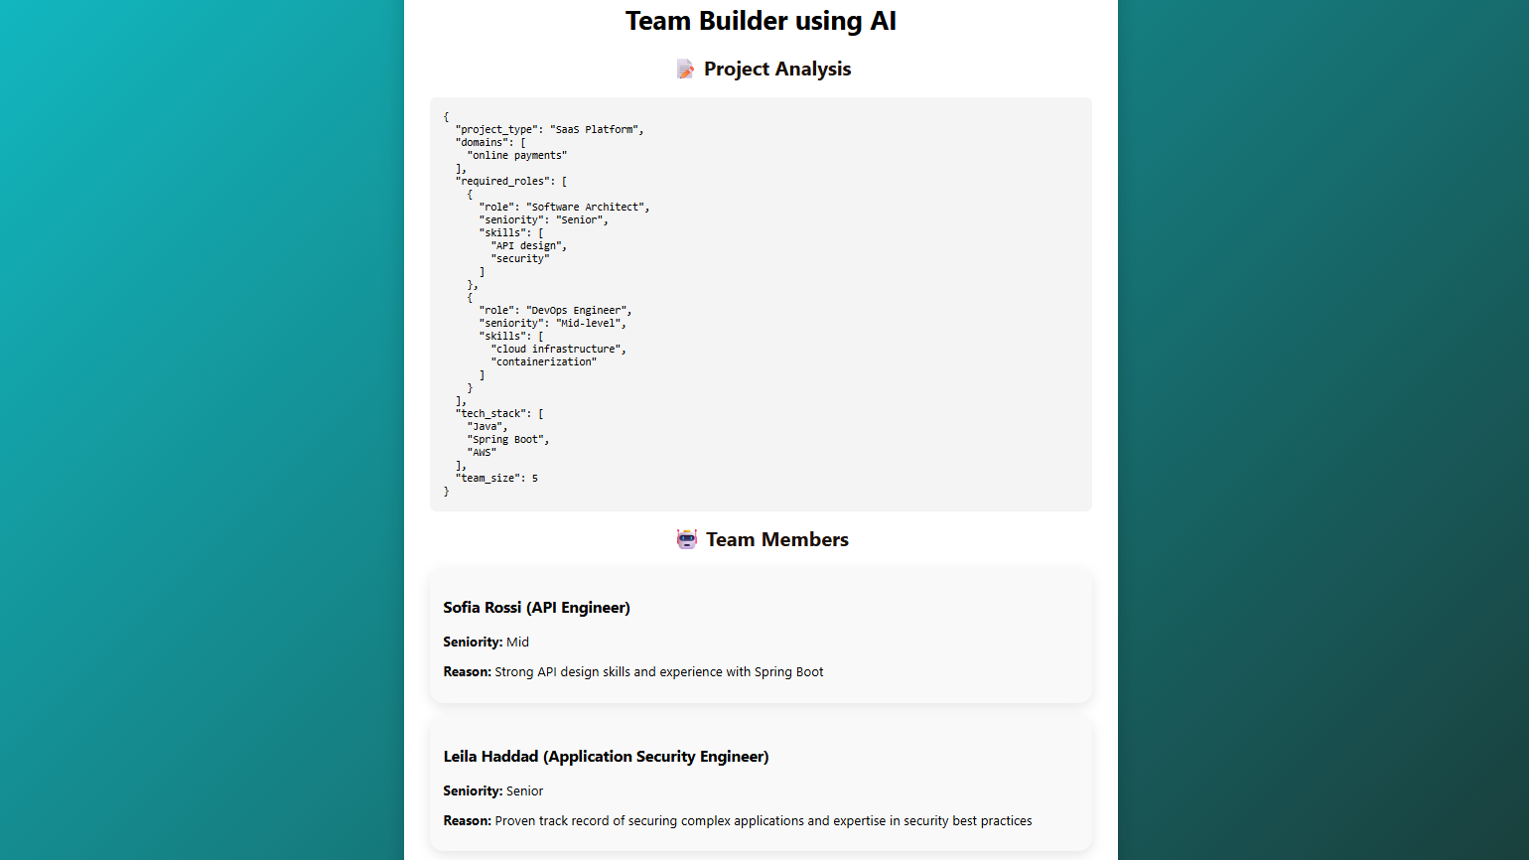

Slide 35
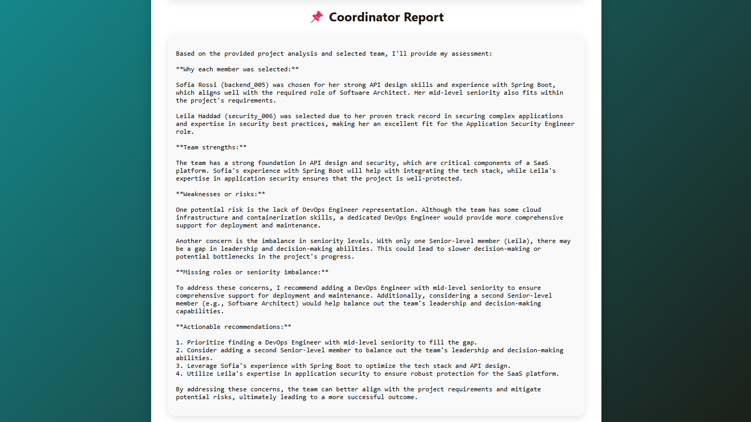

Slide 36
Mistral LLM : 9 Min
Embedding Model : Nomic

Slide 37
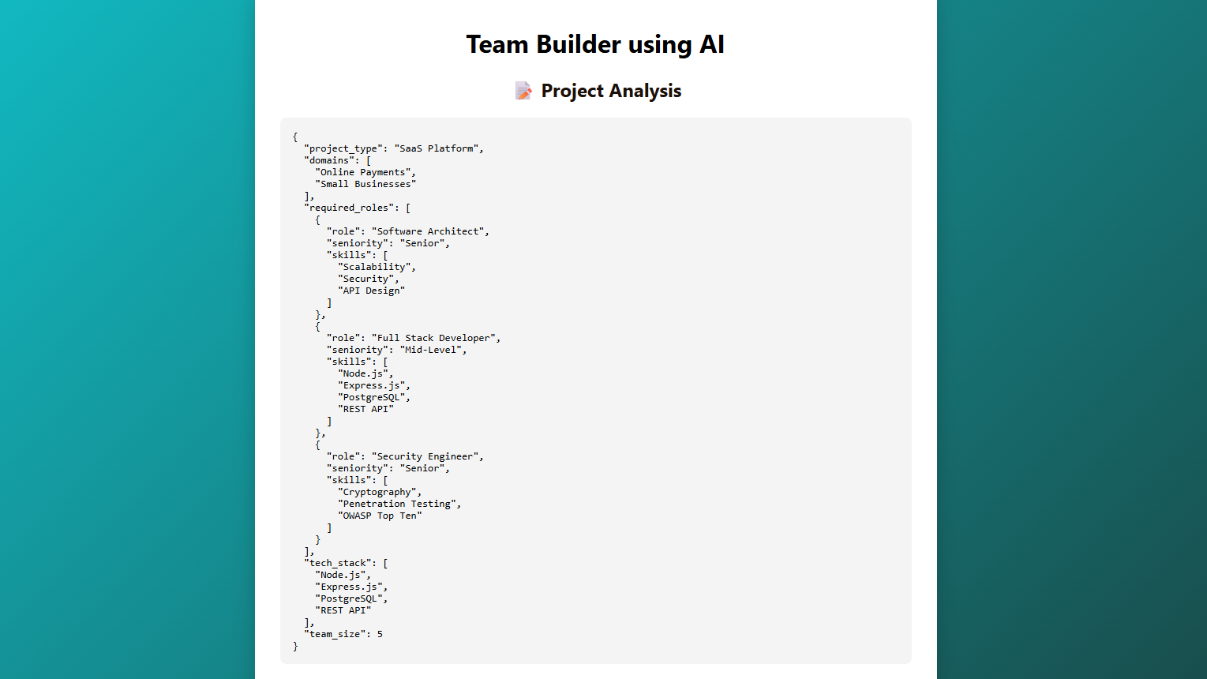

Slide 38
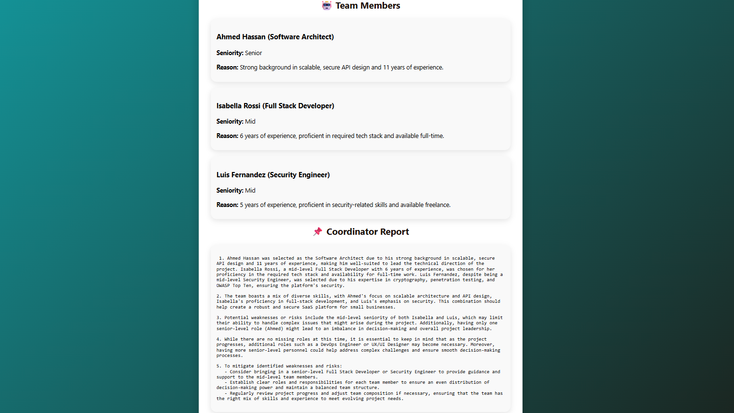

Slide 39
Llama3 vs Mistral
Evaluation :
Mistral is Better than Llama3 in Project Analysis
The style of writing the explanation in the final step is clearly different between Llama3 & Mistral

Slide 40
Future Directions
Filters
Team Matching using Rule Based

