Slide 1


Slide 2

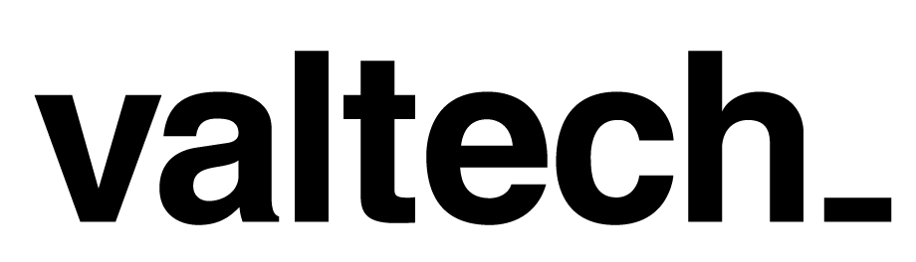

Slide 3

Routing in ASP.NET MVC
ASP.NET routing was initially launched as MVC routing to support clean URL semantics for sites built on ASP.NET MVC.

Slide 4
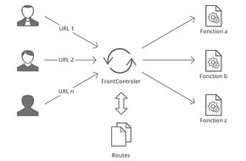
How it usually looks like.

Slide 5
The concept of clean URLs
1. Keep URLs clean: For example instead of
‘hxxp://www.testurl.com/products/Default.aspx?productid=99&view=details’
Have
‘hxxp://www.testurl.com/product/details/99’
2. Keep URLs discoverable by end-users: Having URL parameters baked into routes makes URLs easier to understand and encourages users to play around and discover available functionality.
For example : ‘hxxp://www.testurl.com/product/details/100’
Mean the product details for product id 100.
3. Avoid Database IDs in URL: In the above examples we have used 100, which is a database id and has no meaning for the end user. But if it were to use ‘hxxp://www.testurl.com/product/details/whole-milk’
our users would probably try out
‘hxxp://www.testurl.com/product/details/butter’ on their own.
This make points 1 and 2 even more relevant now.

Slide 6

When your routes look bad...it makes me sad.

Slide 7
Fact is the RouteHandler is first to be executed.
It follows these steps (not evident from the stack trace)
1. Check if route is static file on disk, if so the resource is served directly
2. If it’s not a static route, check if there is a custom route handler, if so it hands off the request to the custom route handler
3. If there are no custom route handlers it hands over to the default MVC Routing handler.

Slide 8
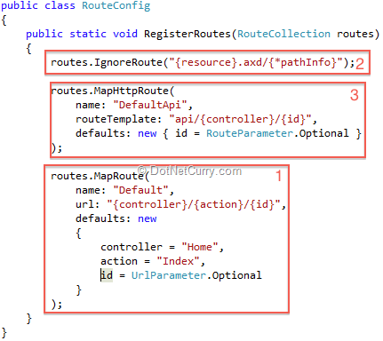
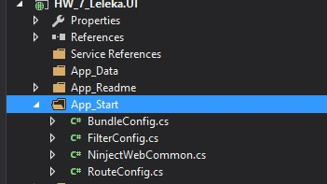
Understanding the default Route declaration
In ASP.NET MVC, by default a couple of routes are defined for you.

Slide 9
Parts...
The Route labeled (1) is named ‘Default’ and it has a url template of type {controller}/{action}/{id}. Note the third parameter, which is an anonymous object with three properties, each of which matches a section in the url template.
The Route labeled (2) is information for MVC Routing to ignore anything that ends with an axd and having additional parameters. The {*pathinfo} is a wildcard for all query params.
Finally the Route Labeled (3) is for WebApi based controllers that derive of ApiController instead of the regular MvcController.

Slide 10
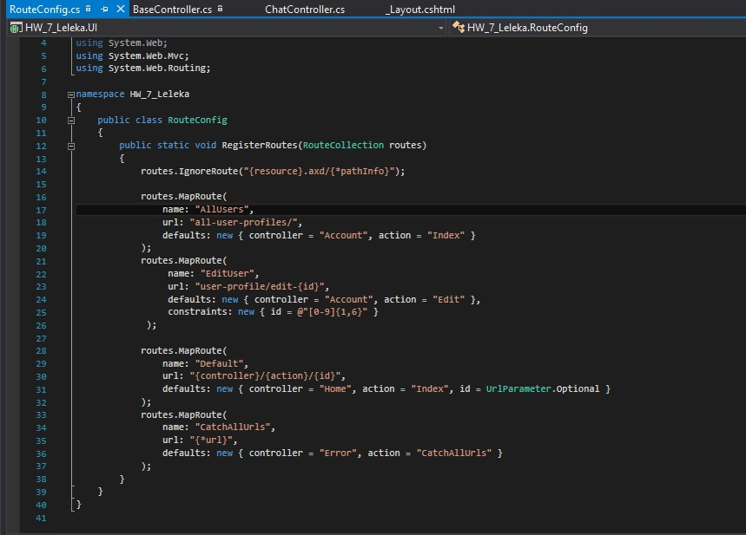

Slide 11
Just for what???
Instead of :

Slide 12

THX

