Slide 1
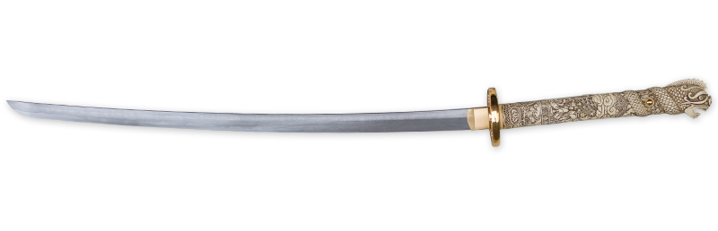

11/2013

Slide 2
Agenda
A brief history…
What is OWIN?
What is Katana?
How this works?
Demo

Slide 3
A brief history…
1996: ASP – Vbscript in page, no SOC.
2002: ASP.Net
Separation between design (aspx) and business code (C#/VB.Net)
Lesser learning curve for WinForms devs.
Stateful event model :-(
Monolithic framework
Tied to .Net framework releases!

Slide 4
A brief history…
2009: ASP .Net MVC
MVC design pattern, SOC!
Out of band, not included in .Net Framework -> independent.
Faster release cycles
Open source!
But still tied to System.Web.dll -> dependencies to IIS :-(

Slide 5
A brief history…
2012: ASP .Net Web Api
“Shift from dynamic, server-generated Web pages to static initial markup with dynamic sections of the page generated from client-side script communicating with backend Web APIs through AJAX requests“
Delivered with Nuget
No dependencies on System.Web.dll -> more modular framework
Custom host! Devs can use a lightweight host for their services.

Slide 6
A brief history…
2013: ASP .Net SignalR
As stated on Wikipedia’s page: “SignalR allows server-side code push content to the connected clients as it happens, in real-time.“
Can be self hosted as well

Slide 7
Why not hosting on IIS?
Use small, lightweight web server
Avoid IIS performance overhead
IIS might not be available…

Slide 8
How?
If you want something being re-hostable on different server implementations, you cannot reference anything from a specific server’s implementation!
Here comes

Slide 9
What is OWIN?
OWIN stands for: The Open Web Interface for .NET
Inspired by Rack in the Ruby community
It creates an abstraction between Web servers and framework components
It’s an open standard
Authored by 2 MS guys: Benjamin Vanderveen and Louis Dejardin

Slide 10
What is Katana?
Katana is « just » Microsoft’s own implementation of OWIN rules!

Slide 11
How this works?
Two core elements
Environment dictionary:
IDictionary<string, object>
“An OWIN-compatible Web server is responsible for populating the environment dictionary with data such as the body streams and header collections for an HTTP request and response. It is then the responsibility of the application or framework components to populate or update the dictionary with additional values and write to the response body stream.”

Slide 12
How this works?
Application delegate:
Func<IDictionary<string, object>, Task>;
“The application delegate an implementation of the Func delegate type where the function accepts the environment dictionary as input and returns a Task.”
The asynchronous design enables the abstraction to be efficient with its handling of computing resources, particularly in more I/O intensive operations.
Because the application delegate is an atomic unit of execution and because the environment dictionary is carried as a parameter on the delegate, OWIN components can be easily chained together to create complex HTTP processing pipelines.

Slide 13
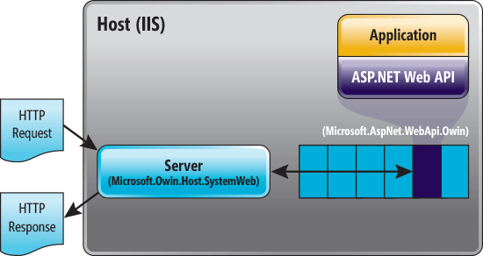
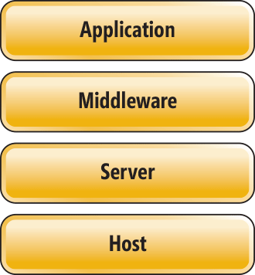
How this works?
Host: The process that runs the application : IIS / Custom
Server: Responsible for binding to a TCP port, constructing the environment dictionary
and processing requests through an OWIN pipeline.
Middleware: The name given to all of the components that handle requests in an
OWIN pipeline: a component that exposes the application delegate.
Application: This is your code!
© MSDN

Slide 14
Who is Owined?
Servers and Hosts | Framework
Katana | Nancy
Nowin | SignalR
 | WebApi
 | FubuMVC
 | Simple.Web
 | DuoVia.Http

Slide 15
DEMO!

Slide 16
Demo
The purpose of the demo is to show how to easy it is to create a simple “Hello World!” in 2 steps:
Running the OWIN pipeline on IIS as part of the ASP .NET request flow
Move to a command-line host and get rid off any IIS dependencies
For those who were not present, here are some screenshots of the demo.

Slide 17
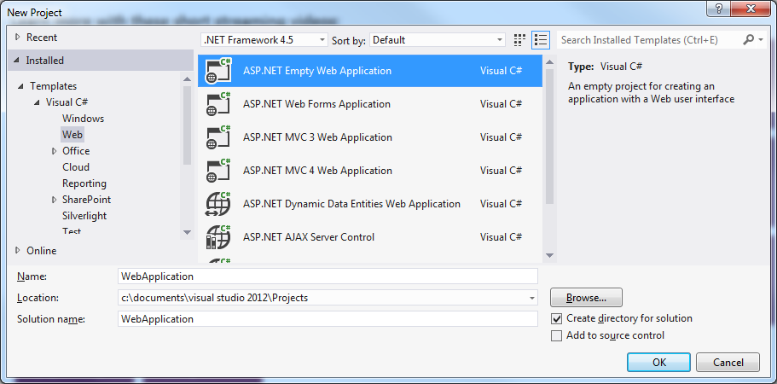
Demo
Create a new “ASP.NET Empty Web Application”

Slide 18
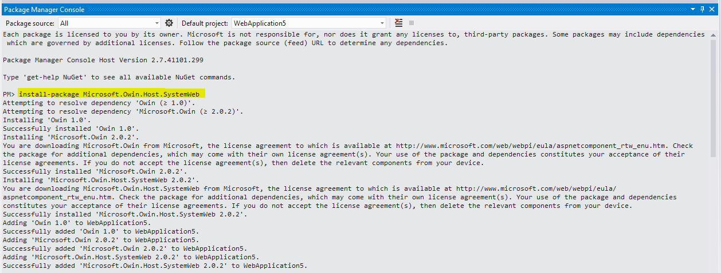
Demo
Install the “Microsoft.Owin.Host.SystemWeb” nuget package (via the Package Manager Console or the Manage Nuget Package window)

Slide 19
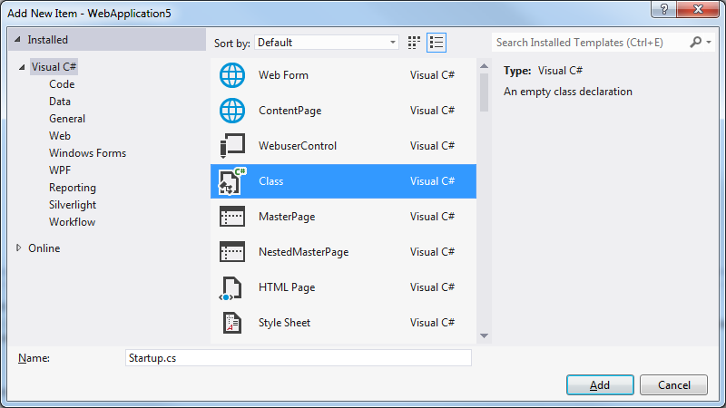
Demo
Add a “Startup” class to your project (convention)

Slide 20
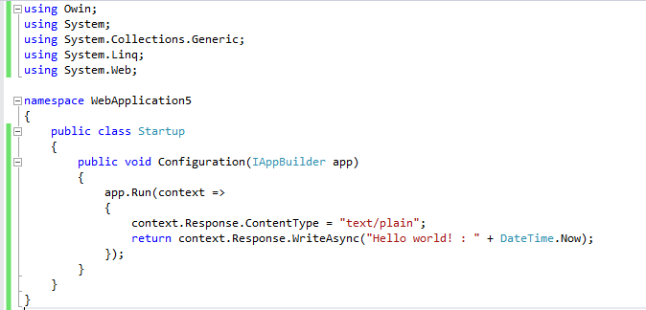
Demo
Add this piece of code to your “Startup.cs” class

Slide 21
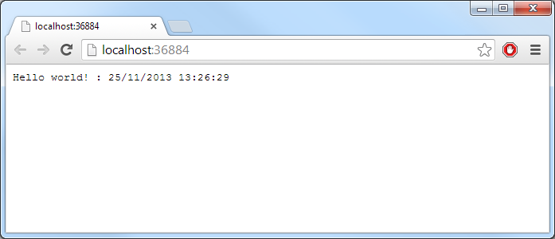
Demo
Press F5!
Step1: Accomplished!

Slide 22
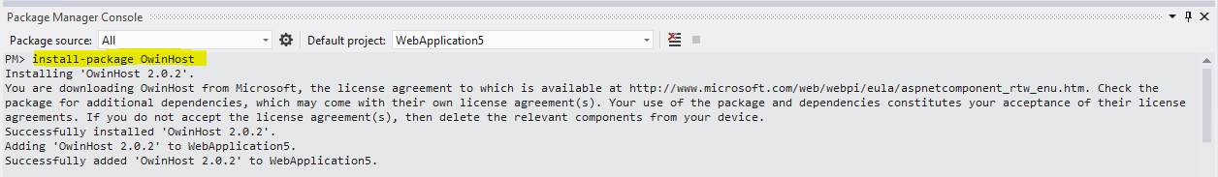
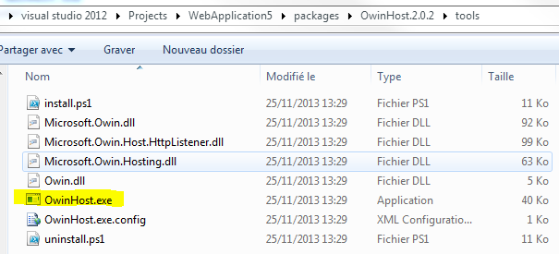
Demo
Step 2: Get rid of IIS ☺
Install the “OwinHost” nuget package (via the Package Manager Console or the Manage Nuget Package window)
It deploys OwinHost.exe
in the “Packages” folder:

Slide 23
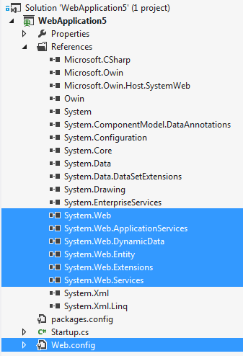
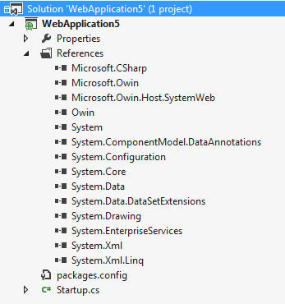
Demo
Remove all your System.Web* references and your Web.config file, from your project:

Slide 24
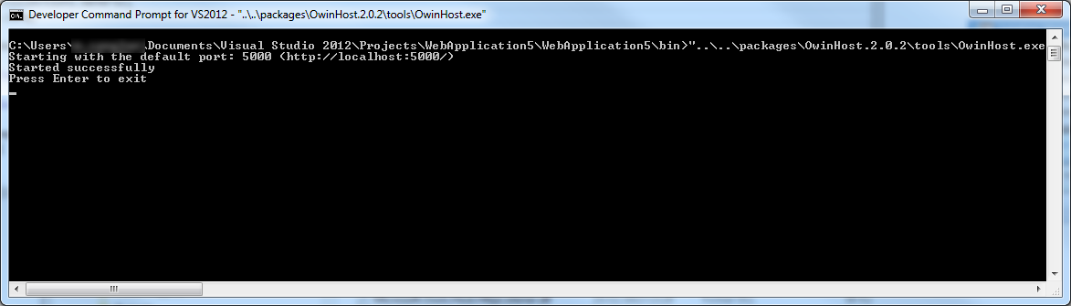
Demo
Remove “using System.Web;” line from your “Startup.cs” class
Rebuild your project
Open a “Developer Command Prompt” window and go to the “\bin” folder of your application. Then run “OwinHost.exe”:

Slide 25
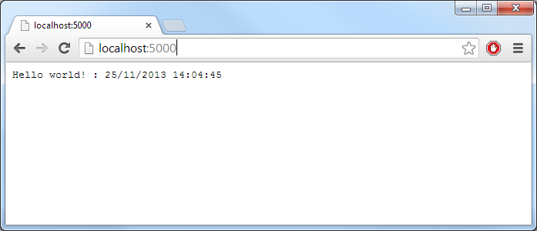
Demo
Open a browser and go to: http://localhost:5000/
Step2: Accomplished!

Slide 26
Questions?

Slide 27
To go further…
Katana Project
Getting Started with the Katana Project
An Overview of Project Katana
Getting started with Owin and Katana
OWIN, Katana and SignalR – Breaking free from your Web Server
Simple Logging Middleware
Visual Studio 2013 Custom Web Servers and OwinHost.exe
Tutorial: SignalR Self-Host
Use OWIN to Self-Host ASP.NET Web API
Host authentication and Web API with OWIN and active vs. passive authentication middleware
Creating a simple REST like service with OWIN – Open Web Server Interface

Slide 28
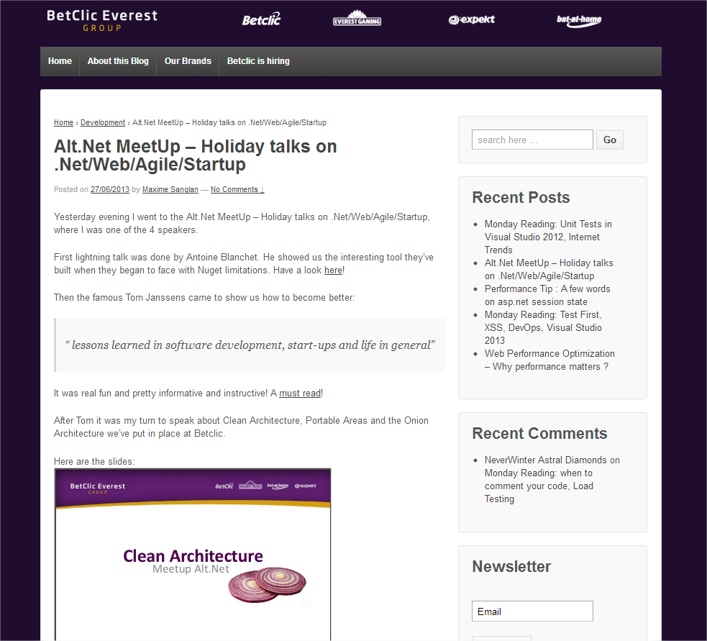
Find out more
On https://techblog.betclicgroup.com/

Slide 29
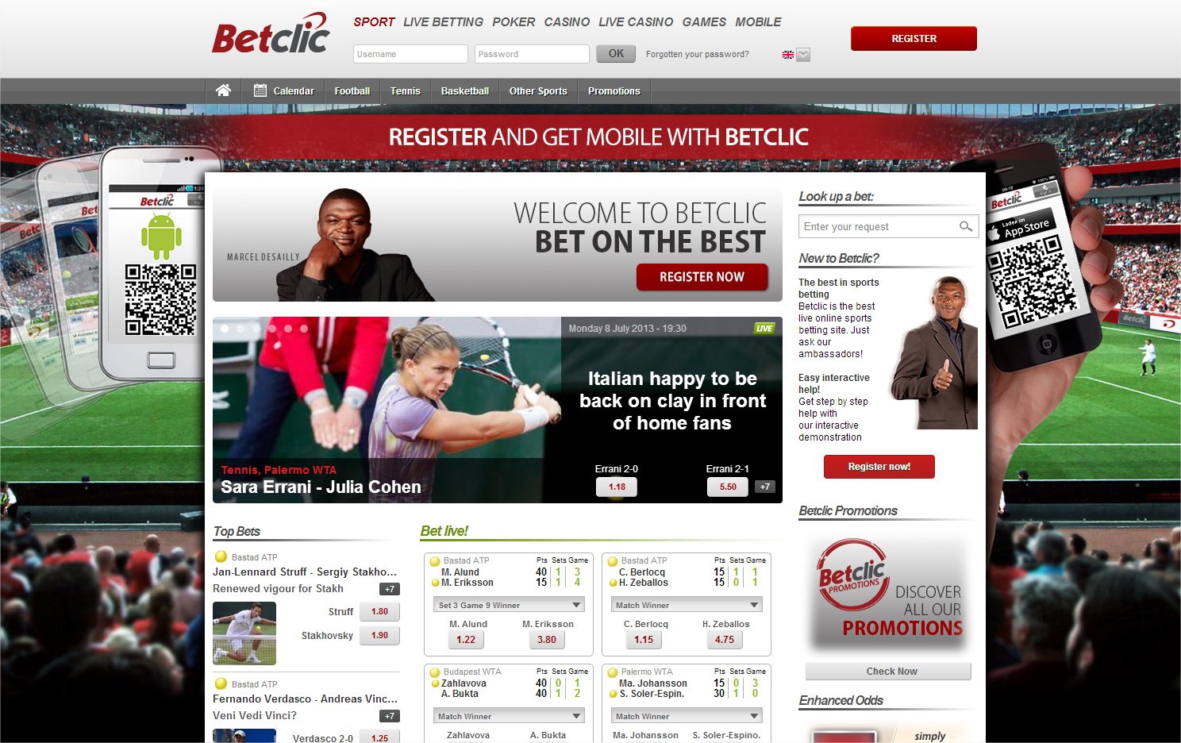



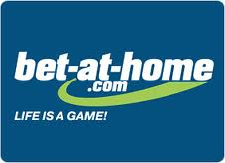
About Betclic
Betclic Everest Group, one of the world leaders in online gaming, has a unique portfolio comprising various complementary international brands: Betclic, Everest Gaming, bet-at-home.com, Expekt…
Active in 100 countries with more than 12 million customers worldwide, the Group is committed to promoting secure and responsible gaming and is a member of several international professional associations including the EGBA (European Gaming and Betting Association) and the ESSA (European Sports Security Association).
Through our brands, Betclic Everest Group places expertise, technological know-how and security at the heart of our strategy to deliver an on-line gaming offer attuned to the passion of our players.

