Slide 1

Note: The data and information in this document is reflective of a hypothetical situation and client. This document is to be used for KPMG Virtual Internship purposes only.
Sprocket Central Pty Ltd
Data analytics approach
[Division Name] – [Salami Opeyemi]

Slide 2
Note: The data and information in this document is reflective of a hypothetical situation and client. This document is to be used for KPMG Virtual Internship purposes only.
Agenda
Introduction
Data Exploration
Model Development
Interpretation

Slide 3
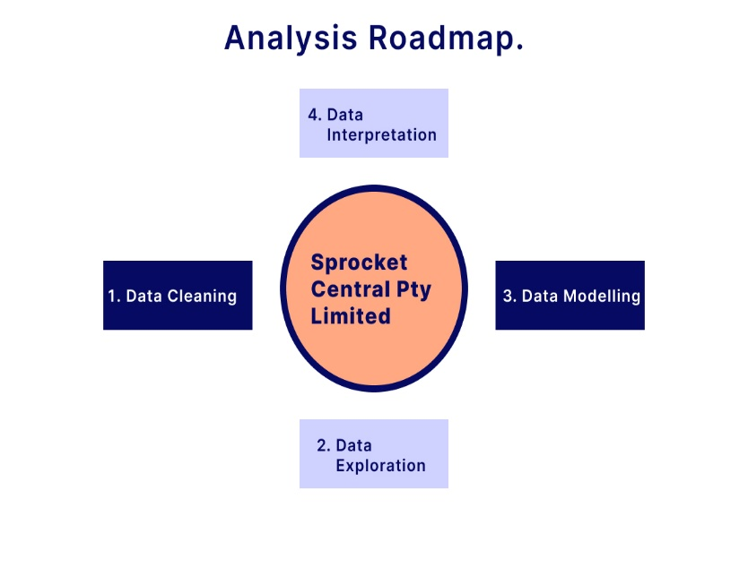
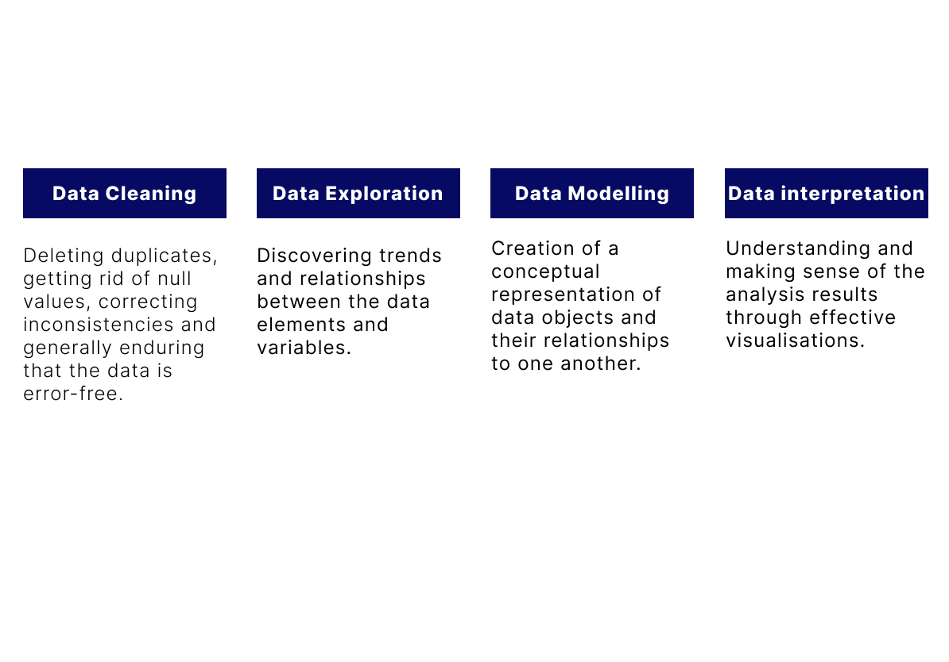
Note: The data and information in this document is reflective of a hypothetical situation and client. This document is to be used for KPMG Virtual Internship purposes only.
Introduction

Slide 4
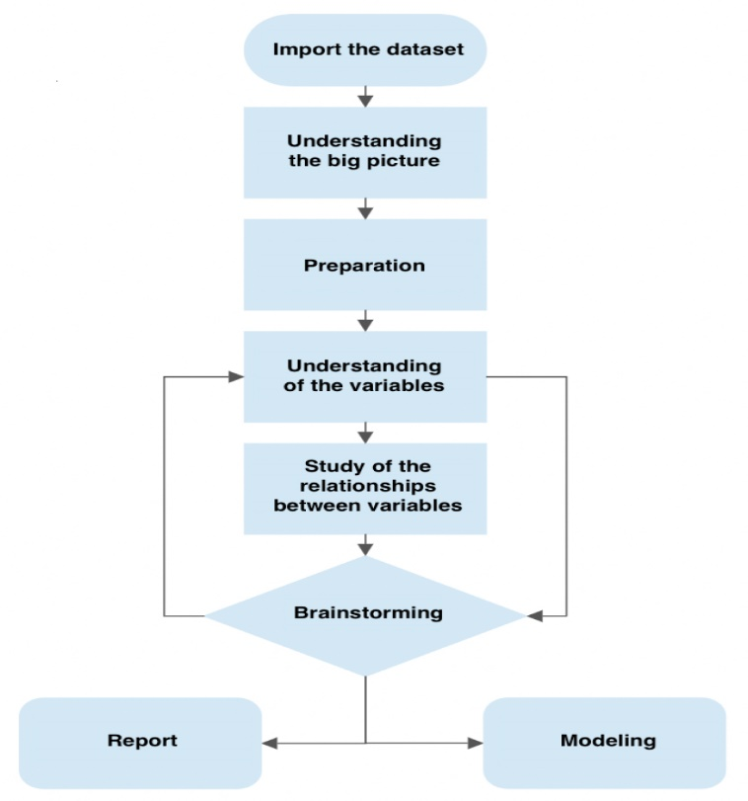
Note: The data and information in this document is reflective of a hypothetical situation and client. This document is to be used for KPMG Virtual Internship purposes only.
Data Exploration
This is the process of exploring the data to discover insights, patterns and relationships between the data elements. It is also known as Exploratory Data Analysis.
Making use of R and SQL, we will make a statistical summary of the data, after which we will proceed to get a profile of it. This is where we identify the outliers.
Analyse the individual variables for a better understanding and to gain insights into their distributions and outliers.
Explore relationships between pairs or multiple variables to identify correlations, dependencies or association.
Generate hypothesis or assumptions about the relationships between the variables.

Slide 5
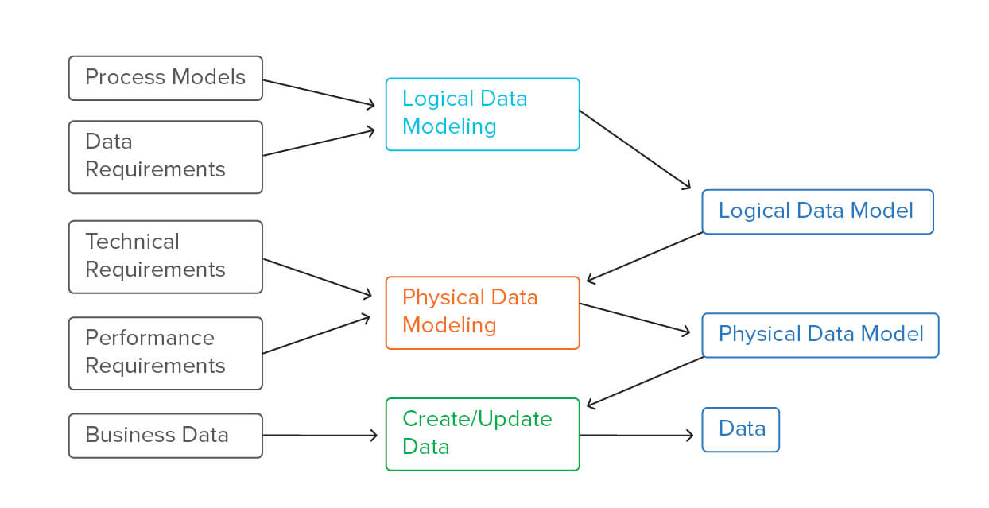
Note: The data and information in this document is reflective of a hypothetical situation and client. This document is to be used for KPMG Virtual Internship purposes only.
Model Development
This is the creation of a conceptual representation that captures the patterns, trends and dependencies within the dataset.
The processes are:
Test the hypothesis and assumptions done in the data exploration.
Establish the relationships between data elements, using Entity-relationship remodelling(EMR) and Unified Modelling Language(UML).
Train the selected model using the training dataset, Optimizing model parameters or coefficients by minimizing a loss function or maximizing a likelihood.
Evaluate the trained model's performance using the validation dataset. Calculate relevant evaluation metrics such as accuracy, precision, recall, F1-score, mean squared error, or others based on the problem type.
Image from Alteryx.com

Slide 6

Note: The data and information in this document is reflective of a hypothetical situation and client. This document is to be used for KPMG Virtual Internship purposes only.
Interpretation
Here, we create effective visualizations, and review the results. We will then come up with recommendations for the marketing team.
The processes are:
define the purpose or the objective of the interpretation.
Selecting the appropriate visualization type that best represents the data and supports the objective.
Determine the visual hierarchy of the visualization and deciding on the layout and arrangement.
Review and testing visualization to ensure it effectively communicates the intended message.
We will be making use of a dashboard to tell an insightful story that will help the marketing team to make good business decisions.

Slide 7
Note: The data and information in this document is reflective of a hypothetical situation and client. This document is to be used for KPMG Virtual Internship purposes only.
Appendix

Slide 8
Appendix

