Slide 1
LAB 2 Black Box Testing (CEG)
Maleeha khalid khan

Slide 2
Steps for making cause effect graph
Step 1: identify cause & effect, give them unique number
Step2: Develop a cause-effect graph.
Step3: Make a Decision Table ( each row shows a test case)
Step4: Convert decision table rules to test cases. Each column of the decision table represents a test case.

Slide 3
Consider Following Example1:
A tourist of age greater than 21 years and having a clean driving record is supplied a rental car. A premium amount is also charged if the tourist is on business, otherwise it is not charged. If the tourist is less than 21 year old, or does not have a clean driving record, the system will display the following message: “Car cannot be supplied”
Draw the cause-effect graph and generate test cases.

Slide 4
Solution 1: Step1:
Solution: The causes are
c1: Age is over 21
c2: Driving record is clean
c3: Tourist is on business and effects are
e1: Supply a rental car without premium charge.
e2: Supply a rental car with premium charge
e3: Car cannot be supplied

Slide 5
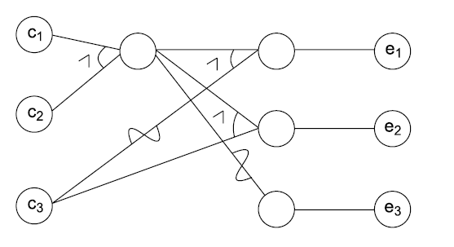
Step2: Draw Cause & Effect Diagram:

Slide 6
How to know how many columns will be made ?
Number of Columns: The number of columns needed is equal to the number of conditions plus one for the effect itself.

Slide 7
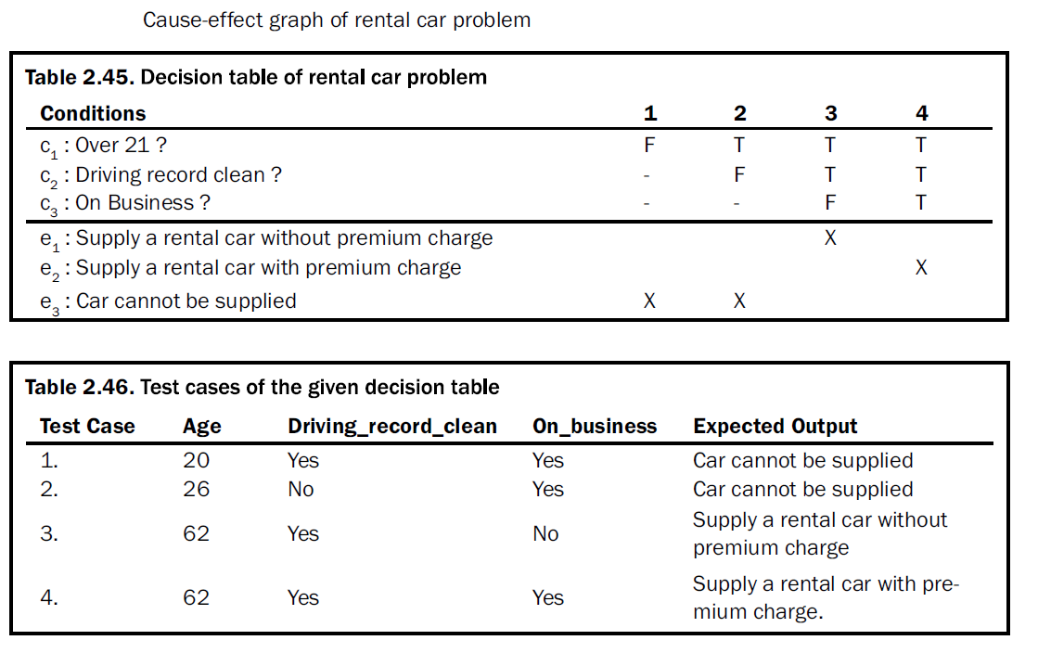
Step 3: Decision Table
Step 4:Test Cases

Slide 8
TASK1: Solve for CEG
In a given network, the sendfile command is used to send a file to a user on a different file server. The sendfile command takes three arguments: the first argument should be an existing file in the sender’s home directory, the second argument should be the name of thereceiver’s file server, and the third argument should be the receiver’s user_id. If all the arguments are correct, then the file is successfully sent; otherwise the sender obtains an error message. The above informal specification is first traced to derive causes and effects. Each one of these causes and effects are given a unique identification number.

Slide 9
Task 2:
Gender can be male and age should be 22 less then P1 is given.
Gender can be male and age should be greater than 22 but less than 58, then P2 is given.
Gender can be male and age should be greater than 58 then P3 is given.
Gender can be female and age is less than 22, or gender is female and age is between 22 but less than 58 should be greater then P4 is given.

Slide 10
Task 3:
Consider Causes (Input conditions):
Username: Valid, Invalid (empty, too long, special characters)
Password: Valid, Invalid (empty, too short, doesn't meet complexity requirements)
Network Connection: On, Off
Two-factor Authentication (2FA): Enabled, Disabled (with valid and invalid codes)
Effects (Outputs):
Login Successful
Login Failed (with specific error messages)
Account Locked

Slide 11
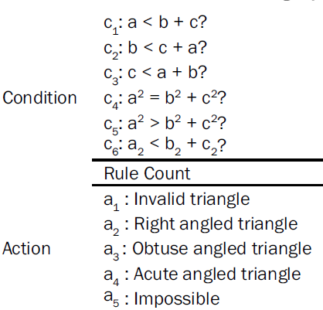
Task 4: Consider The following Example: Make Cause & Effect Graph:
11 Test cases:
c1 : side ‘a’ is less than the sum of sides ‘b’ and ‘c’.
c2 : side ‘b’ is less than the sum of sides ‘a’ and ‘c’.
c3 : side ‘c’ is less than the sum of sides ‘a’ and ‘b’.
c4 : square of side ‘a’ is equal to the sum of squares of sides ‘b’ and ‘c’.
c5 : square of side ‘a’ is greater than the sum of squares of sides ‘b’ and ‘c’.
c6 : square of side ‘a’ is less than the sum of squares of sides ‘b’ and ‘c’.
and effects are
e1 : Invalid Triangle
e2 : Right angle triangle
e3 : Obtuse angled triangle
e4 : Acute angled triangle
e5 : Impossible stage

