Slide 1
Lab # 03 Basic White Box Testing Control Flow Graph (CFG) & Data Flow Testing (DFT)
Maleeha Khalid Khan

Slide 2
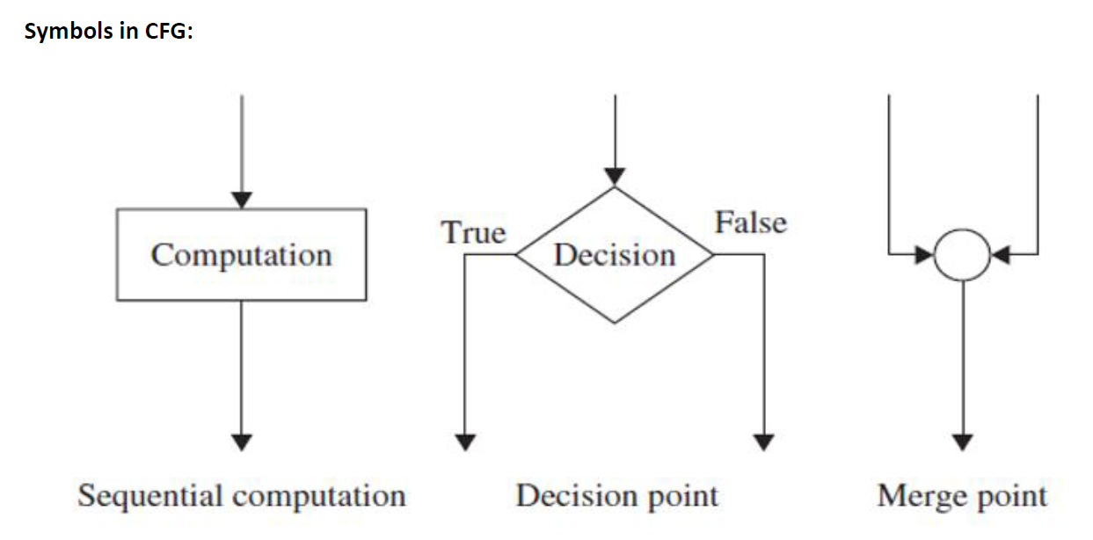
White Box testing Technique/ CFG

Slide 3
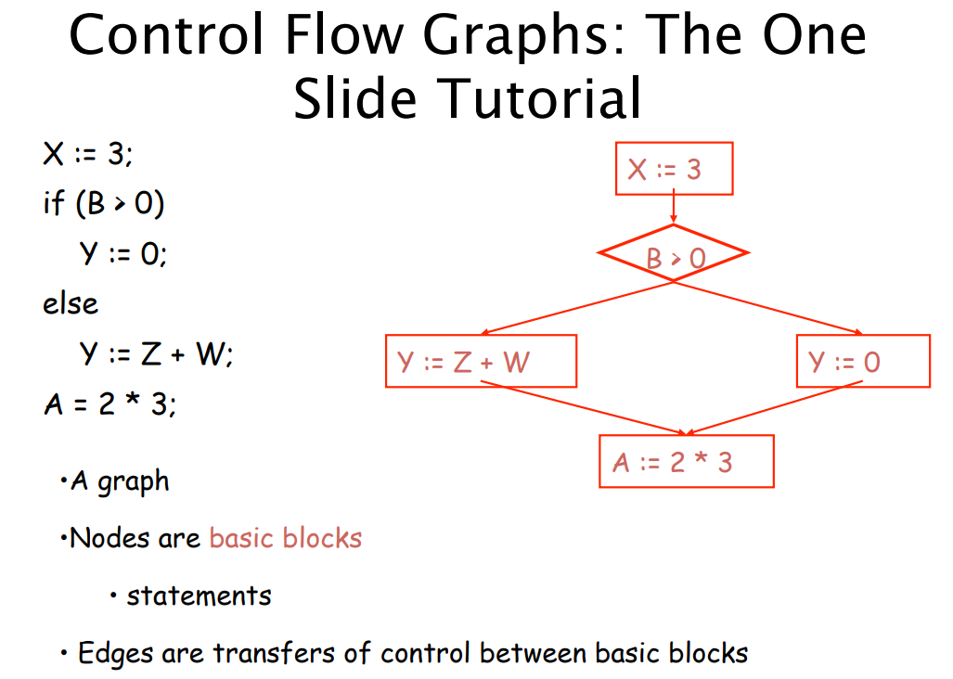

Slide 4
Cyclomatic Complexity
Cyclomatic complexity is a software metric that provides a quantitative measure of the global complexity of a program. When this metric is used in the context of the basis path testing, the value computed for cyclomatic complexity defines the number of independent paths in the basis set of a program.
Three ways to compute cyclomatic complexity:
-The number of regions of the flow graph correspond to the cyclomatic complexity.
-Cyclomatic complexity, V(G), for a flow graph G is defined as V(G) = E - N+2
Another way where E is the number of flow graph edges and N is the number of flow graph nodes.
-Cyclomatic complexity, V(G) = P + 1
where P is the number of predicate nodes contained in the flow graph G.

Slide 5
Example 1
1
node
edge
2
3
4
5
region
6
While if for
7

Slide 6
1
node
No. of regions = 4
(considering the universal region)
No. of edges E = 9
No. of nodes N = 7
No. of predicate nodes = 3
V(G) = 3 + 1 = 4
V(G) = 9 - 7 + 2 = 4
edge
2
3
4
5
region
6
7

Slide 7
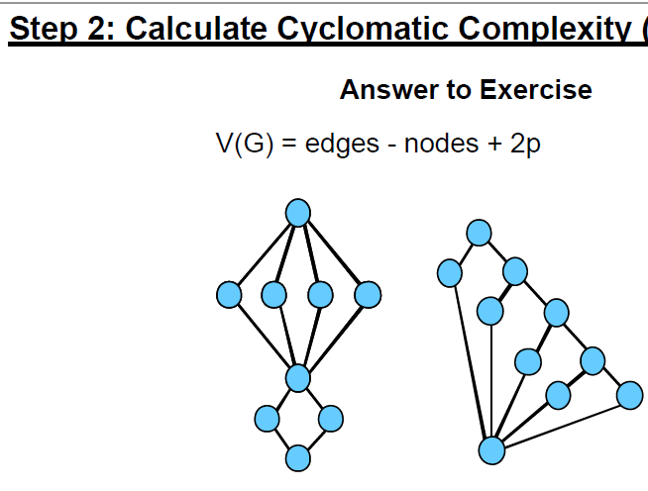
Task 1:

Slide 8
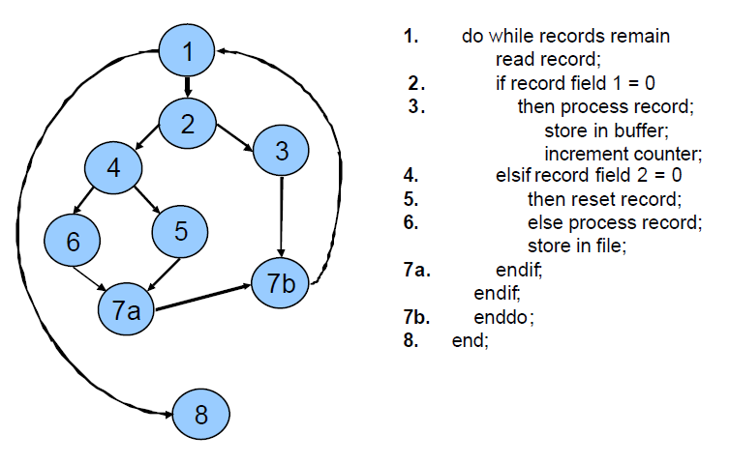
Example 2

Slide 10
Task 2:
Make Control Flow Graph for the following code & identify paths using Cyclomatic complexity, then apply these test cases & analyze the code:
int Numbergame(int a, int b) {
if (a > b) {
while (a >= b) {
a -= 1;
b += 1;
}
} else {
b += a;
}
return b;
}

Slide 11
Task3: Make CFG & Calculate Cyclomatic-complexity
i = 0;
n=4; //N-Number of nodes present in the graph
while (i<n-1)
do j = i + 1;
while (j<n)
do if A[i]<A[j]
then swap(A[i], A[j]);
end
do; j=j+1;
end do;

Slide 12
White-Box Software Testing Methods Basis path testing
Basic path testing (a white-box testing technique):
- First proposed by Tom McCabe.
- Used as a guide for defining a basis set of execution path.
- Guarantee to execute every statement in the program at least one time.
Step 1 : Using the design or code as a foundation, draw a corresponding flow graph.
Step 2: Determine the cyclomatic complexity of the resultant flow graph.
Step 3: Determine a minimum basis set of linearly independent paths.
For example,
path 1: 1-2-4-5-6-7
path 2: 1-2-4-7
path 3: 1-2-3-2-4-5-6-7
path 4: 1-2-4-5-6-5-6-7
Step 4: Prepare test cases that will force execution of each path in the basis set.
Step 5: Run the test cases and check their results

Slide 13
Task 4: Using McCabe technique find basic Paths for following
s:=0;
d:=0;
while (x<y) {
x:=x+3;
y:=y+2;
if (x+y < 100)
s:=s+x+y;
else
d:=d+x-y;
}

Slide 14
Perform Task Take record of steps & Screenshots
Data Reference Error
Data Declaration Error
Control Flow Errors

Slide 15
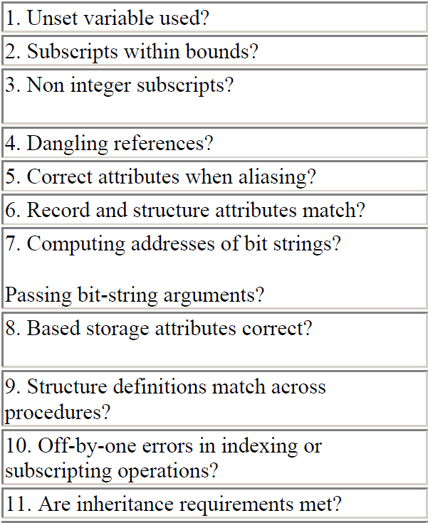
Data Reference Error
Data is referenced to unset or uninitialized reference to a data item (variable, array element, field in a structure), attempt to ‘‘prove’’ informally that the item has a value at that point.
For all array references, is each subscript value within the defined bounds of the corresponding dimension?
For all array references, does each subscript have an integer value?
For all references through pointer or reference variables, is the referenced memory currently allocated? This is known as the ‘‘dangling reference’’ problem. (A dangling reference is a reference to a memory location that has been deallocated or freed)
When a memory area has alias names with differing attributes, does the data value in this area have the correct attributes when referenced via one of these names?

Slide 16
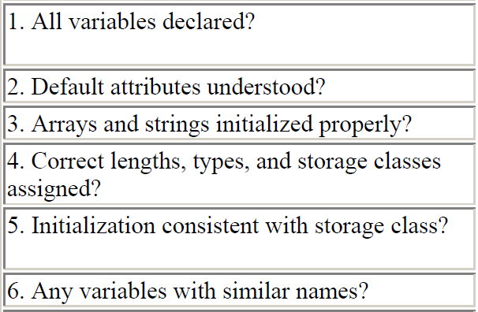
Data Declaration Error
Have all variables been explicitly declared? (variable's type and name should be specified)
If all attributes of a variable are not explicitly stated in the declaration, are the defaults well understood?
Where a variable is initialized in a declarative statement, is it properly initialized?
Is each variable assigned the correct length and data type?
Is the initialization of a variable consistent with its memory type?
Are there any variables with similar names (e.g., VOLT and VOLTS)? This is not necessarily an error, but it should be seen as a warning that the names may have been confused somewhere within the program

Slide 17
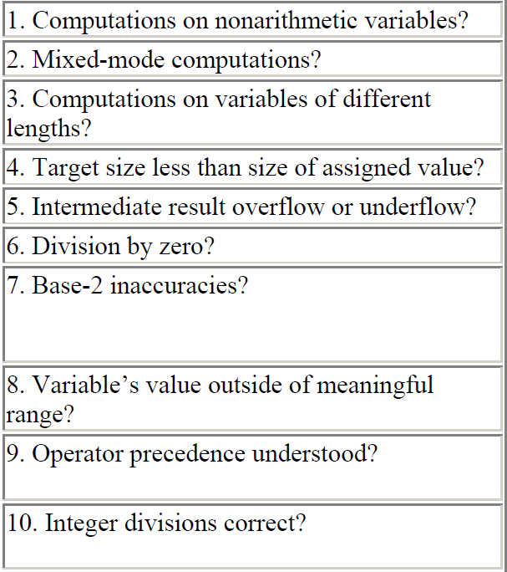
Computation Error
Computational or calculation errors are essentially bad math. The calculations don't result in the expected result.
Adding a floating-point number to an integer.
Adding a long integer to a short integer
If a program encounters a divide-by- zero error, an unhandled exception may occur.

Slide 18
Control flow errors
Control flow errors are the result of loops and other control constructs in the language not behaving as expected. They are usually caused, directly or indirectly, by computational or comparison errors.
while (true)
{ // do something repeatedly }
Control flow errors are the result of loops and other control constructs in the language not behaving as expected. They are usually caused, directly or indirectly, by computational or comparison errors.
while (true)
{ // do something repeatedly }

Slide 19
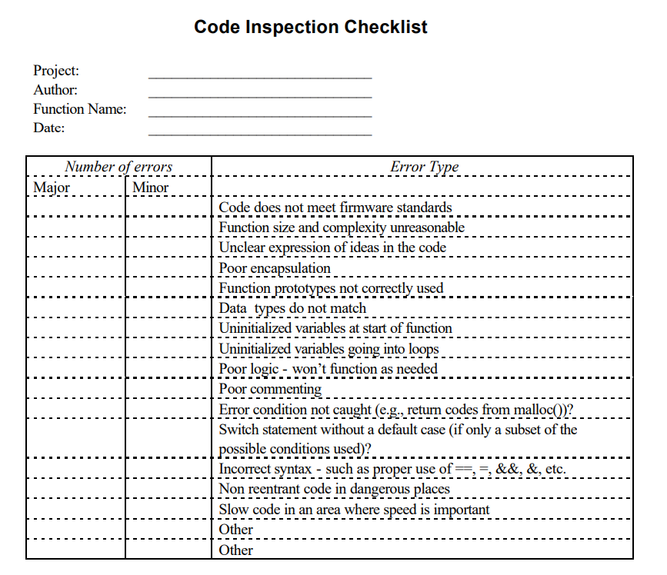
Make a code inspection checklist

Slide 20
Data reference Error Activity:
Q1: Identify what type of error is this? (java code)
public class Main {
public static void main(String[] args) {
String myString;
// Use the reference variable
System.out.println(myString); //
}
}

Slide 21
Identify Error
Example 1:
int[] myArray = {1, 2, 3, 4, 5};
System.out.println(myArray[5]);
Example2:
my_list = [11, 23, 25, 12, 14,17]
list my_list[6]

Slide 22
Identify reference error
int main() {
int x = 10;
int* p1 = &x;
int* p2 = &x;
*p1 = 20;
// The value of x can now also be accessed through p2
std::cout << *p2 << std::endl; // Prints "20"
return 0;
}

Slide 23
Identify Error:
def my_function():
# Declare a variable
my_var = 10
# Print the value of the variable
print(my_var)
my_var = 20
# Print the value of the variable again
print(my_var)
if __name__ == '__main__':
my_function()
Python code

Slide 24
Identify Error:
def calculate_area_of_circle(radius):
"""Calculates the area of a circle.
Args:
radius: The radius of the circle.
Returns:
The area of the circle.
"""
area = radius * radius
return area
# Example usage:
radius = 5
area = calculate_area_of_circle(radius)
print("The area of the circle is", area)

Slide 25
Find error & identify:
public String[] OpenFile() throws IOException {
Map<String, Double> map = new HashMap();
FileReader fr = new FileReader("money.txt");
BufferedReader br = new BufferedReader(fr);
try{
while (br.ready()){
String str = br.readLine();
String[] list = str.split(" ");
System.out.println(list);
}
} catch (IOException e){
System.err.println("Error - IOException!");
}
}

