Slide 1
FDA Drug Adverse Effects Analysis
Domingo Salazar
24 April 2018

Slide 2
Summary
Discussion of the possible questions that would guide the analysis.
Limitations of the data, exploratory data analysis and question(s) selection.
Country analysis based on relative proportions of adverse effects.
Country analysis based on frequencies of adverse effects.
How to make the analysis more robust.

Slide 3
Discussion of the possible questions that would guide the analysis.

Slide 4
Q1: Are different adverse events reported in different countries?
Two ways of approaching this question are explored:
Analysing the relative proportions of the most common adverse events occurring across countries.
Doing something similar to a bio-informatics enrichment analysis, by constructing two-by-two contingency tables for each adverse effect and each country and deciding on which metric we should compared to a chi-square distribution in order to test for significance.
Should we include additional factors like patient sex or age and effect severity in the analysis? I think we need to have a good representation of the population and the effect, so these factors should be included at least during the exploratory data analysis phase.

Slide 5
Q2: What are the different adverse events associated with different disease areas?
Here I would prefer to use the contingency tables approach.
We could perhaps also explore whether the adverse effects are due to primary or secondary pharmacology? This may be tricky due to the limited Mode-of-Action information present in the reports.

Slide 6
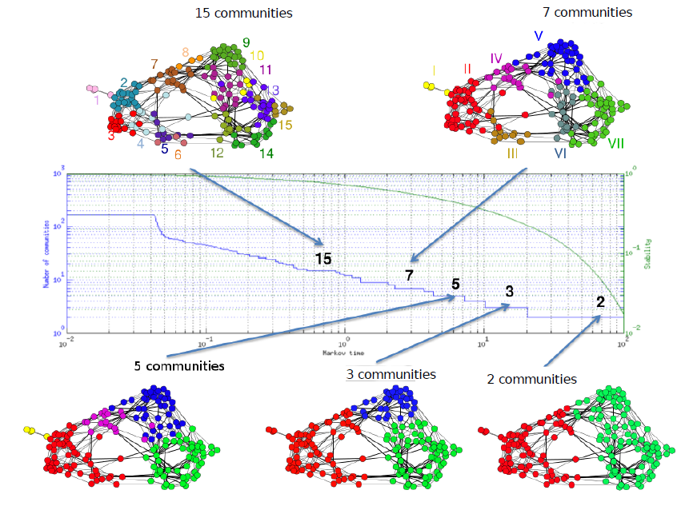
Q3: What drugs tend to be taken together?
This question could perhaps be explored using a network analysis approach similar to what I have been using with my collaborators at Imperial College.
It is based in building a network from a correlations/co-occurrence matrix and identifying clusters in the network at difference levels of granularity.

Slide 7
Other Interesting Questions
What adverse effects co-occurred?
Identifying similar adverse effects and grouping them into “types” could make the previous analysis more robust.
What if two very different adverse effects co-occurred for a certain disease area or drug? This could point to a secondary pharmacology issue.
Changes on adverse effects reported over time?
The FDA mentions ad hoc influences like media reports, etc.
These ad hoc influences, if they happen for a particular country or disease area, could bias the answers to the previous questions.

Slide 8
Limitations of the Data & Exploratory Data Analysis

Slide 9
Data Wrangling
I downloaded approximately 20 GiB of data from the OpenFDA website in the form of json files. I selected from them the desired fields, filtered some errors and concatenated the resulting data frames into a combined CSV file.
The exploratory data analysis was based on this file, of approximately 856 MiB.
This represents only part of the data available for the last 4 quarters. It should be taken only as a (possibly not representative) sample of the data.

Slide 10
Limitations of the Data
Most of the data come from the US. This may present difficulties for Question 1.
A few disease areas/indications are more common than others and there is a large proportion of reports that do not contain this information. This complicates Question 2.
Some active principles are given together in the same medication. This complicates Q3.
Additionally, this complication makes the dose information available in the reports less useful, unless combined with information about the actual product.
When information is missing in the main body of the report, sometimes it is included in the OpenFDA field. Nevertheless, due to time constraints, I restricted myself to the information present in only one source.
Some reports contain errors about patient ages (age > 122 years!). The age field in these cases was set to “not available”.

Slide 11
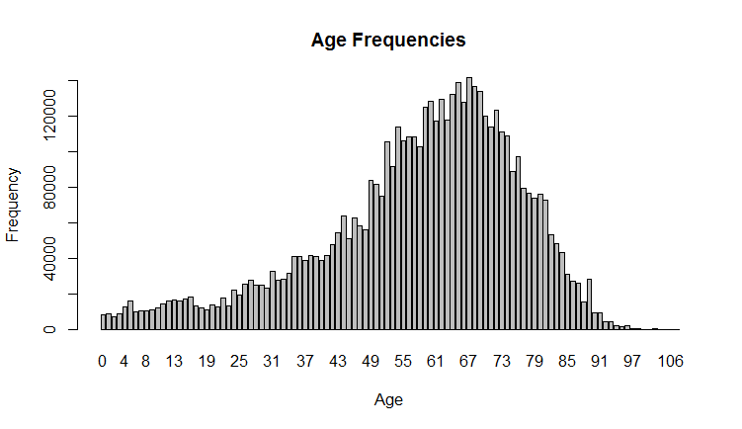
Exploratory Data Analysis (EDA)
For this analysis, I selected the fields: ReportID, Date, Country, patient Age & Sex, disease area (Indication), Substance name and Route.
As it turns out, again due to time constraints, I did not use all this information in the EDA. But when sub-setting countries and adverse effects (see below), I did check that I still had a good representation of sexes and ages.
In fact, I noticed that 60% of the adverse effects were reported on female patients. This could merit further exploration in the context of some recent research about sex differences.
On the other hand, the left-skewness of the Age distribution in this dataset was unsurprising.

Slide 12
Question Selection
I chose to answer Q1, mostly due to time constraints. But I also had time to start exploring relationships between the most prevalence adverse effects.
Q2 would require dealing with the large proportion of missing information about indication and the great diversity of indications and adverse effects.
Q3 would require more data wrangling to extract all the active principles taken by a patient and may be complicated by lack of information about doses.

Slide 13
Country Analysis based on Adverse Effects Relative Proportions

Slide 14
Countries & Adverse Event Selection
After some exploration, I felt that I have enough information to compare the top 21 countries that appeared more often in this dataset. The US is unsurprisingly number 1, with approximately 60% of the data.
It was harder to determined the number of adverse events to select. So I made 4 different cut-off values that produced a selection of the top 11, 21, 28 & 42 most common adverse effects in the dataset.
This allows for situation with more classes (countries) than features (adverse effects), with similar numbers of both and with more features than classes.
Once a certain number of features is selected, a vector is computed for each country representing the proportion of occurrence of each selected feature in the reports from that country that contain one feature in the selected feature set. Proportions of all features in a feature set for each country sum up to 1.
This is a quick and somewhat ad hoc way of trying to compensate for the large differences in the number of reports coming from different countries.

Slide 15
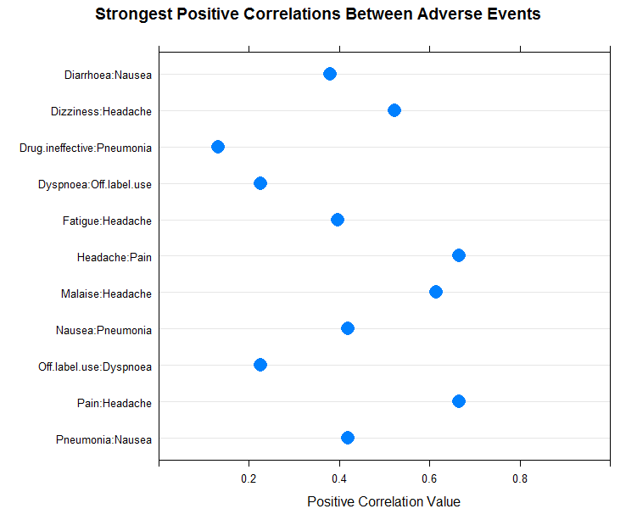
Positive Correlations between Adverse Effects
11 Adverse Effects

Slide 16
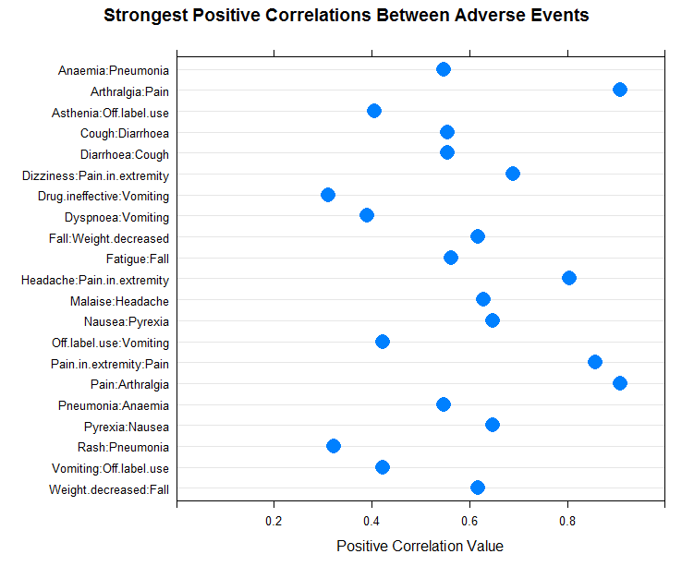
21

Slide 17
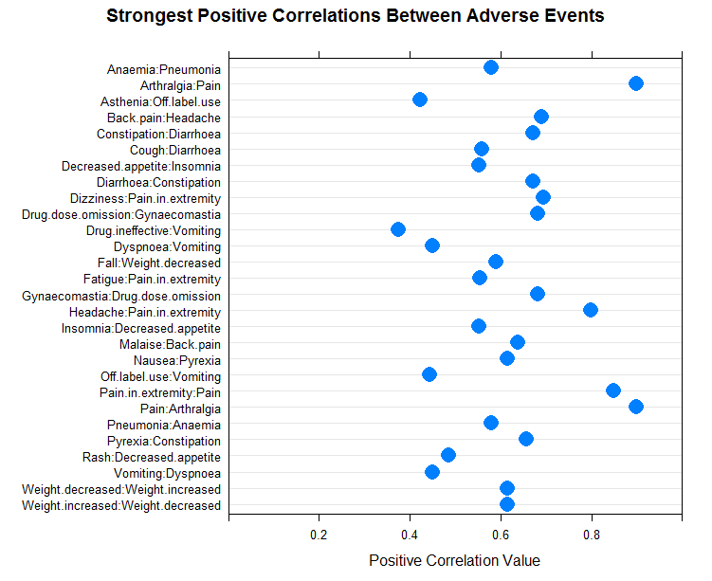
28

Slide 18
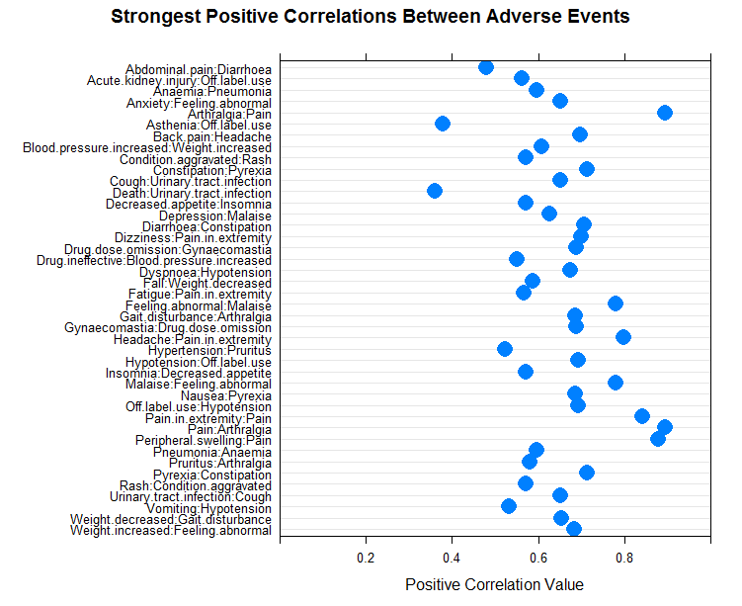
42

Slide 19
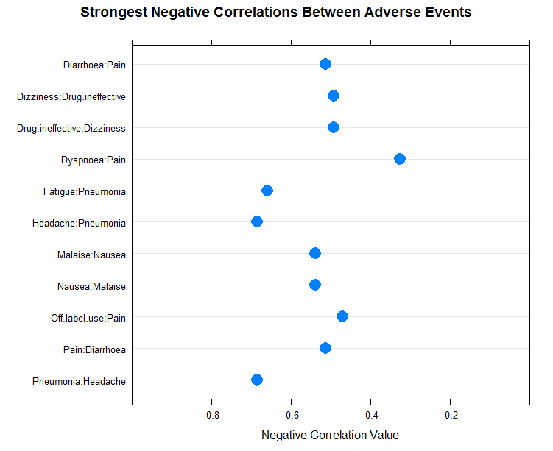
Negative Correlations between Adverse Effects
11 Adverse Effects

Slide 20
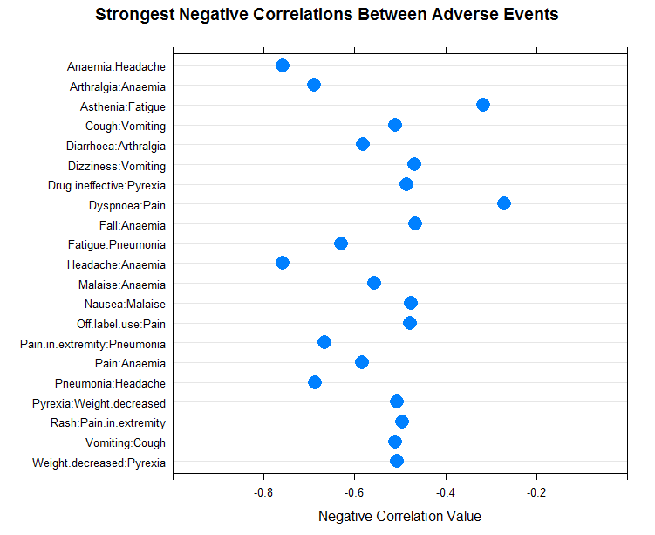
21

Slide 21
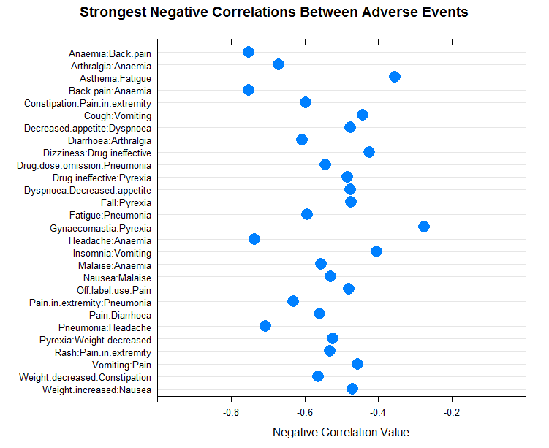
28

Slide 22
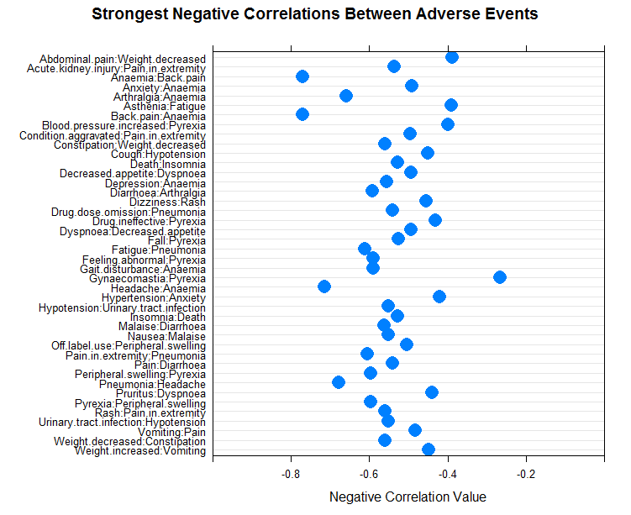
42

Slide 23
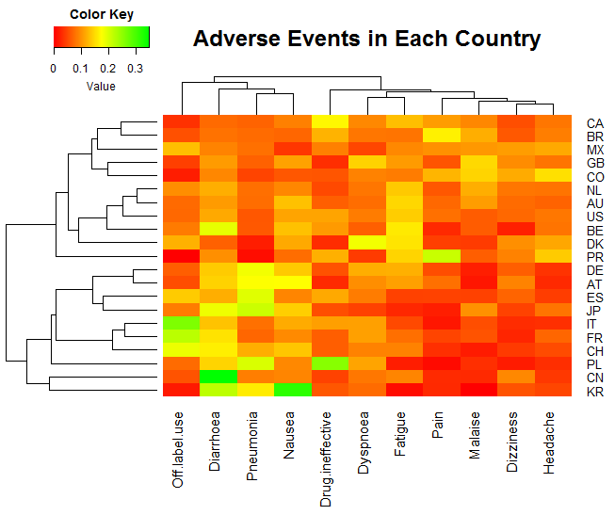
Heat Maps
11 Adverse Effects

Slide 24
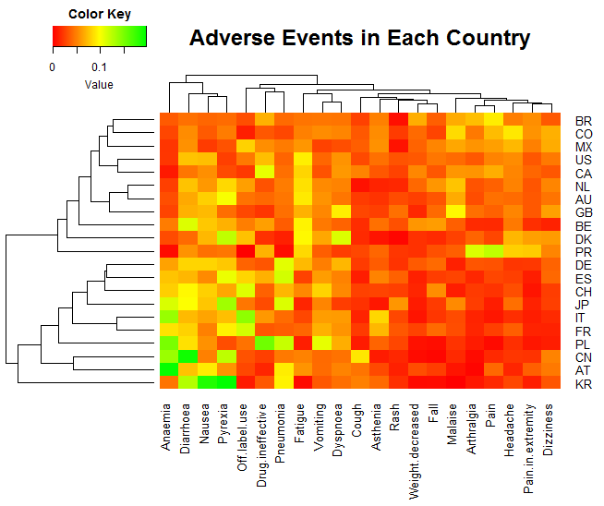
21

Slide 25
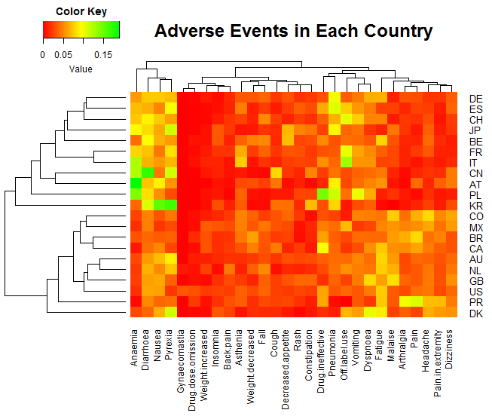
28

Slide 26
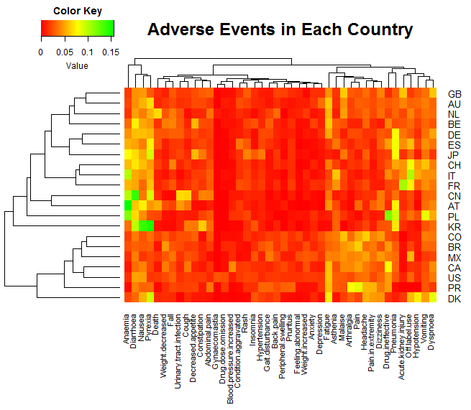
42

Slide 27
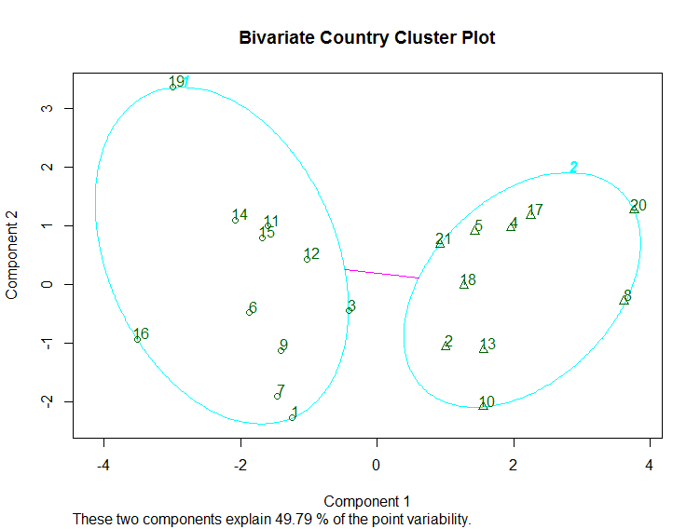
Additional Corroborative Evidence: Mediods Clustering
11 Adverse Effects

Slide 28
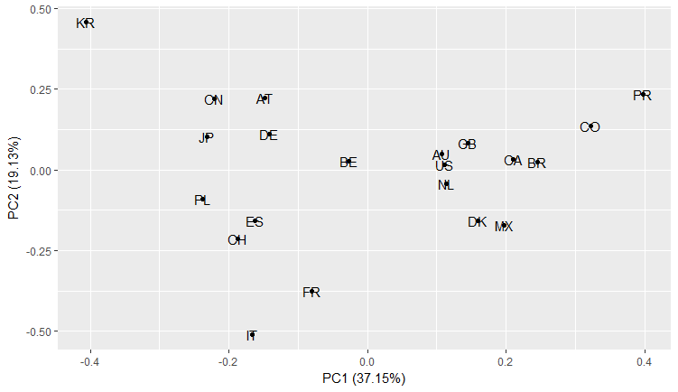
Principal Components Analysis
11

Slide 29
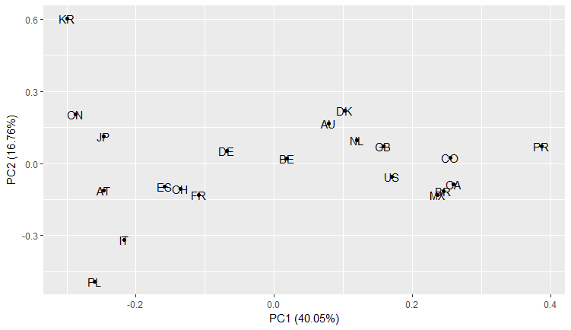
22

Slide 30
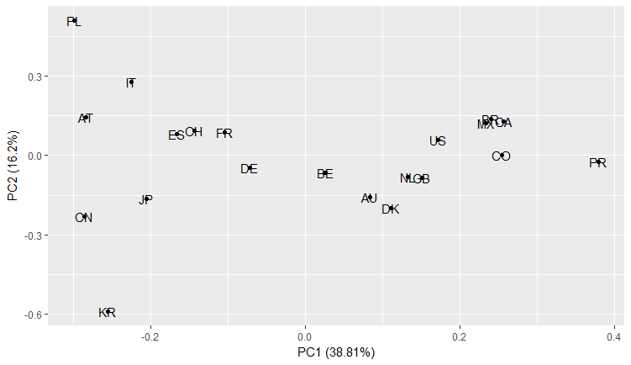
28

Slide 31
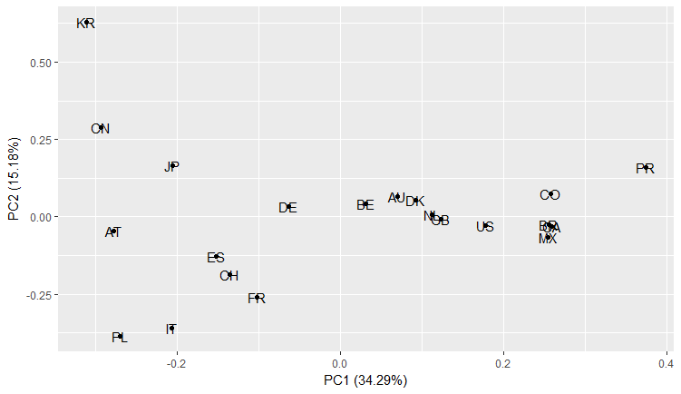
42

Slide 32
Country Analysis based on Relative Frequencies of Adverse Effects

Slide 33
Frequency Analysis
Another way of removing the bias effect due to having very different numbers of reports per country is to construct two-by-two contingency tables for each adverse effect and each country.
Then we need to choose a metric that should be compared to a chi-square distribution in order to test for significance. That is when things become more complicated because we have several possible choices.
Once agreed on one of them, then we can compute p-values to measure the strength of each association, and from there on, the analysis may proceed similarly than what we did for proportions: using hierarchical clustering and building heat maps, etc.

Slide 34
Popular Metrics in the Literature
Adverse Effects (AEs) | Country of Interest | All Other Countries | Total
AE of Interest | n11 | n10 | n11 + n10
All other AEs | n01 | n00 | n01 + n00
Total | n11 + n01 | n10 + n00 | n00+n10+n01+n11
Proportional Reporting Ratios (PRR): n11*(n01 + n00)/n01/(n11 + n10)
Reporting Odd Ratios (ROR): n11*n00/n10/n01
They are also other possibilities. Some of these approaches are based on classical statistics while some are Bayesian. They have not been pursued as part of this exercise.

Slide 35
How to make the Analysis more Robust

Slide 36
Options
The simplest way is to include all the data in the analysis, which was not done on this occasion due to time constraints.
Explore various ways of grouping adverse effects: perhaps by organ, type (cardiovascular, psychological, etc.).
In particular, consider separating procedural issues (“wrong dose administered”) from actual effects.
Add information about severity / outcome.
Create a country reporting index. How many reports per capita come from one country? This may be an additional feature that may help correct biased reporting.
Pursue the contingency tables approach, which can be made more rigorous if the right metric is chosen.

